Slide 1
Bab 3: Benchmarking pada Sistem Komputer
Dr. Ir. Yeffry Handoko Putra, M.T

Slide 2
Benchmark
Definisi Benchmarking: Serial tes dengan metriks dan workload yang telah dirancang sebelumnya
Definisi Benchmark: Workload yang digunakan pada pengukuran Benchmarking, biasanya dirancang untuk memandingkan dua sistem yaitu yang berjenis test workload
Test Workload yang digunakan untuk membandingkan sistem komputer
Addition instruction
Instruction mixes
Kernels
Synthetic programs
Application benchmarks

Slide 3
Addition Instruction (Early day of Computing)
Jenis Workload yang pertama kali digunakan untuk membandingkan dua komputer
Instruksi pada komputer mula-mula masih sedikit
Perbandingan kinerja hanya didasari oleh komputer mana yang bisa mengerjakan instruksi penjumlahan dengan cepat

Slide 4
Instruction Mix (Gabungan Instruksi)
Definisi Instruction Mix: beberapa instruksi yang diberikan pembobotan sesuai dengan jumlah keseringan (frekuensi) pengunaannya dalam sistem komputer.
Faktor pembobotan ini kemudian digunakan untuk waktu rata-rata instruksi
Sehingga jika diberikan waktu tertentu dapat dihitung waktu rata-rata instruksi nya
Yang paling sering digunakan adalah Gibson Mix Gibson Mix (1959, Jack C. Gibson):
Digunakan pada IBM 704
Kecepatan procesor diukur dalam memory cycle time, addition time, average of addition and multiplication time
Gibson Mix mengembanngkan sampai waktu rata-ratadari 13 instruksi

Slide 5
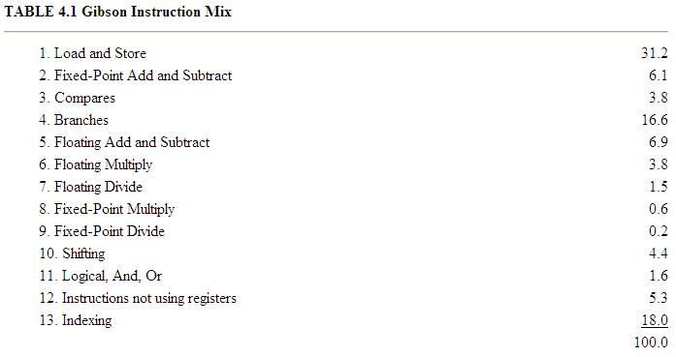
Gibson Instruction Mix
Laju rata-rata procesor kemudian dihitung dari pembobotan dari rata-rata waktu instrusi dari ke-13 instruksi gabungan tersebut

Slide 6
Saat ini Instruction Mix tidak digunakan
Saat ini komputer menyediakan banyak kelas instruksi yang kompleks yang waktu instruksi rata-ratanya tidak berkaitan dengan gabungan instruksi
Intruction Mix hanya merepresentasikan kinerja prosesor saja tidak seluruh sistem komputer
Sistem komputer modern, waktu instruksi tergantung pada:
Addresing modes
cache hit rates
pipeline efficiency,
interference from other devices during processor-memory access cycles
Parameter value. Misal : frequency of zeros as a parameter, the distribution of zero digits in a multiplier, the average number of positions of preshift in floating-point add, and the number of times a conditional branch is taken
Inversi dari waktu rata-rata instruksi : MIPS (Millions of Instructions Per Second) or MFLOPS (Millions of Floating-Point Operations Per Second) rates for the processor

Slide 7
Kernels
Adanya beberapa fasilitas yg membuat waktu instruksi sangat bervariasi, seperti: pipeline, caching, dll
Instruksi diperlakukan sebagai kumpulan instruksi /fungsi bukan sebagai individual yang disebut service
Service tersering (the most frequent function) disebut Kernel. Sering disebut Processing Kernel karena kernel Inisiasi lebih dikonsentrasikan pada kinerja prosesor daripada I/O
Kernel adalah generalisasi dari gabungan instruksi. Beberapa operasi yang memanfaatkan kernel: inversi matriks, Sieve, Puzzle, Tree Searching, Fungsi Ackermann, Sorting
Digunakan untuk membandingkan arsitektur komputer
Namun tetap kinerja Kernel tidak merefleksikan kinerja total sistem karena Peralatan I/O tidak termasuk
Notes:
4.3 KERNELS
The introduction of pipelining, instruction caching, and various address translation mechanisms made computer instruction times highly variable. An individual instruction could no longer be considered in isolation. Instead, it became more appropriate to consider a set of instructions, which constitutes a higher level function, a service provided by the processors. Researchers started making a list of such functions and using the most frequent function as the workload. Such a function is called a kernel. Since most of the initial kernels did not make use of the input/output (I/O) devices and concentrated solely on the processor performance, this class of kernels could be called the processing kernel.
A kernel is a generalization of the instruction mix. The word kernel means nucleus. In some specialized applications, one can identify a set of common operations, for example, matrix inversion. Different processors can then be compared on the basis of their performance on this kernel operation. Some of the commonly used kernels are Sieve, Puzzle, Tree Searching, Ackermann’s Function, Matrix Inversion, and Sorting. However, unlike instruction mixes, most kernels are not based on actual measurements of systems. Rather, they became popular after being used by a number of researchers trying to compare their processor architectures.
Most of the disadvantages of instruction mixes also apply to kernels, although some of the disadvantages related to parameter values, such as frequency of zeros and frequency of branches, no longer apply. The main disadvantage of kernels is that they do not typically make use of I/O devices, and thus, the kernel performance does not reflect the total system performance.

Slide 8
Synthetic Progam
Karena processing kernel tidak digunakan pada I/O devices, maka untuk kinerja I/O dikembangkan lup pelatih (exercieser loop) yang dsebut service call atau I/O request
Melalui Service call dapat dihitung rata-rata CPU time (AVT=Average CPU Time) dan waktu akhir (elapsed time) dari service call.
Exerciser loop ditulis dalam high-level languages (FORTRAN, Pascal)
Exerciser loop pertama disebut synthetic program (Buchloz, 1969) yang berisi i/O request.
Synthetic Program digunakan untuk mengatur jumlah request sekaligus mengukur OS service seperti : process creation, forking, memory allocation
Notes:
4.4 SYNTHETIC PROGRAMS
The processing kernels do not make use of any operating system services or I/O devices. As the applications of computer systems are proliferating, they are no longer used for processing-only applications. Input/output operations have become an important part of the real workloads. Initial attempts to measure I/O performance lead analysts to develop simple exerciser loops that make a specified number of service calls or I/O requests. This allows them to compute the average CPU time and elasped time for each service call. In order to maintain portability to different operating systems, such exercisers are usually written in high-level languages such as FORTRAN or Pascal.
The first exerciser loop was proposed by Buchholz (1969) who called it a synthetic program. A sample exerciser is shown in Figure 4.1. It makes a number of I/O requests. By adjusting the control parameters, one can control the number of times the request is made. Exerciser loops are also used to measure operating system services such as process creation, forking, and memory allocation.
The main advantage of exerciser loops is that they can be quickly developed and given to different vendors. It is not necessary to use real data files, which may contain proprietary information. The programs can be easily modified and ported to different systems. Further, most exercisers have built-in measurement capabilities. Thus, once developed, the measurement process is. automated and can be repeated easily on successive versions of the operating systems to characterize the relative performance gains/losses.

Slide 9
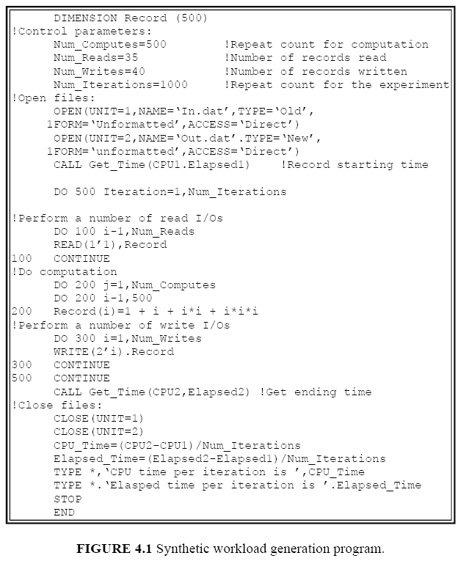
Synthetic Progam
Notes:
4.4 SYNTHETIC PROGRAMS
The processing kernels do not make use of any operating system services or I/O devices. As the applications of computer systems are proliferating, they are no longer used for processing-only applications. Input/output operations have become an important part of the real workloads. Initial attempts to measure I/O performance lead analysts to develop simple exerciser loops that make a specified number of service calls or I/O requests. This allows them to compute the average CPU time and elasped time for each service call. In order to maintain portability to different operating systems, such exercisers are usually written in high-level languages such as FORTRAN or Pascal.
The first exerciser loop was proposed by Buchholz (1969) who called it a synthetic program. A sample exerciser is shown in Figure 4.1. It makes a number of I/O requests. By adjusting the control parameters, one can control the number of times the request is made. Exerciser loops are also used to measure operating system services such as process creation, forking, and memory allocation.
The main advantage of exerciser loops is that they can be quickly developed and given to different vendors. It is not necessary to use real data files, which may contain proprietary information. The programs can be easily modified and ported to different systems. Further, most exercisers have built-in measurement capabilities. Thus, once developed, the measurement process is. automated and can be repeated easily on successive versions of the operating systems to characterize the relative performance gains/losses.

Slide 10
Popular Benchmark
Sieve
Ackermann’s Function
Whetstone
LINPACK
Dhrystone
Lawrence Livermore Loops
Debit-Credit Benchmark
SPEC Benchmark Suite

Slide 11
Sieve
Sieve Kernel digunakan untuk membandingkan microprosesor, PC dan High-level language
Didasari oleh Eratosthenes’s sieve algorithm yang digunakan untuk mencari bilangan prima yang lebih kecil dari bilangan n
Algoritma ini secara manual menuliskan semua bilangan integer dari 1 sampai n lalu menghapus kelipatan dari k untuk k = 2, 3, .., √n
Contoh :
Notes:
The sieve kernel has been used to compare microprocessors, personal computers, and high-level languages. It is based on Eratosthenes’ sieve algorithm and is used to find all prime numbers below a given number n. The algorithm, in its manual form, consists of first writing down all integers from 1 to n and then striking out all multiples of k for k = 2,3,..., √n. For example, to find all prime numbers from 1 to 20, the steps are as follows:

Slide 12
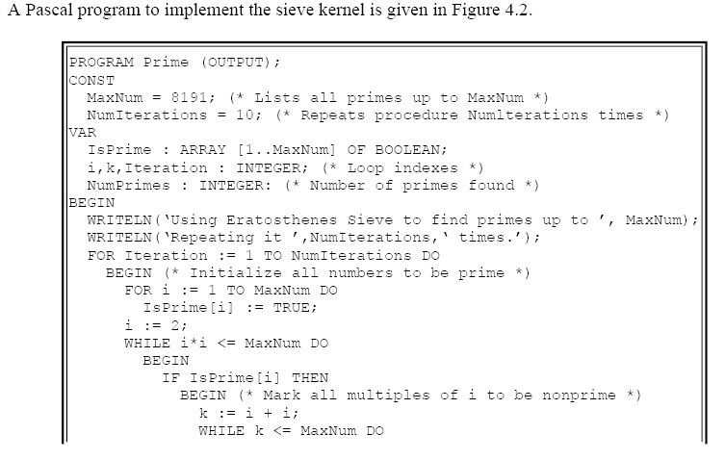
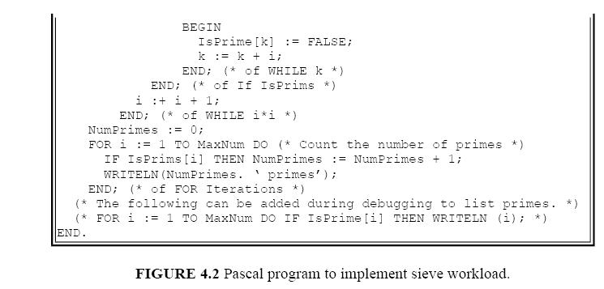

Slide 13
Ackermann’s Function
Kernel ini digunakan untuk menilai efisiensi dari mekanisme pemanggilan prosedur dalam ALGOL-like languages.
Fungsi Ackermann terdiri dari dua parameter dan didefinisikan rekursif. Fungsi Ackermann (3,n) mengevaluasi nilai n dari 1 sampai 6
Nilai dari fungsi Ackermann (3,n) adalah 2^{n+3} – 3. Fungsi ini digunakan untuk memverifikasi benchmark
Kemudian benchmark yang dihasilkan adalah :
The average execution time per call
the number of instructions executed per call
the amount of stack space required for each call
Jumlah pemanggilan rekursif dari Ackermann (3,2) dinyatakan dengan (Wichmann ,1976) :
Notes:
4.6.2 Ackermann’s Function
This kernel has been used to assess the efficiency of the procedure-calling mechanism in ALGOL-like languages. The function has two parameters and is defined recursively. The function Ackermann (3,n) is evaluated for values of n from 1 to 6. The average execution time per call, the number of instructions executed per call, and the amount of stack space required for each call are used to compare various systems.
A listing of the benchmark program in SIMULA is shown in Figure 4.3. The value of the function Ackermann (3,n) is 2^{n+3} – 3. This knowledge is used in the code to verify the implementation of the benchmark. The number of recursive calls in evaluating Ackermann (3,n) has been shown by Wichmann (1976) to be

Slide 14
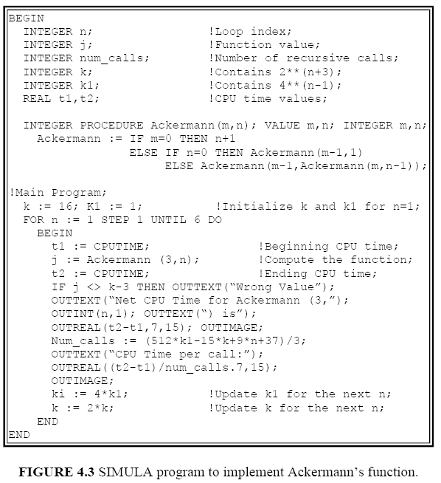
Fungsi Ackermann ditulis dalam SIMULA

Slide 15
Whetstone Benchmark
Synthetic Benchmark untuk mengevaluasi kinerja komputer, mula-mula dikembangkan pada National Physical Lab., UK. 1972 dengan bahasa Algol 60.
Whetstone Benchmark terdiri dari 11 modules
Selain sebagai syntehtic mix, Whetstone digunakan sebagai floating point benchmark pada cache memory. Namun hanya bertujuan pada optimisasi compiler sehingga parameter input I/O tidak mempengaruhi kinerja yang diukur
Kernel Exercises whetstone (processor feature):
Array addressing
Fixed and floating point arithmetic
Subroutine calls
Parameter passing
Whetstone kernel telah diterjemahkan ke FORTRAN, PL/I, dll
Whetstone benchmark diukur dalam KWIPS (kilo Whetstone Instruction per second) juga MWIPS (Million Whestone Instruction per second)
Notes:
4.6.3 Whetstone
Used at the British Central Computer Agency, the Whetstone kernel consists of a set of 11 modules
designed to match observed dynamic frequency of operations used in 949 ALGOL programs. The
kernel exercises such processor features as array addressing, fixed- and floating-point arithmetic,
subroutine calls, and parameter passing. It has been translated from ALGOL to FORTRAN, PL/I,
and other languages. A listing of the workload in ALGOL can be found in Curnow and Wichmann
(1975).
The results of the Whetstone benchmarks are measured in KWIPS (Kilo Whetstone Instructions Per
Second). There are many permutations of the Whetstone benchmark, so it is important to ensure that
comparisons across various systems utilize the same source code and that the internal loop counter is
defined large enough to reduce timing variability.
Despite its synthetic mix of operations, Whetstone is generally considered a floating-point
benchmark and is mostly representative of small engineering/scientific applications that fit into
cache memory.
The modules were designed to minimize the impact of known compiler optimizations. Newer
compiler optimization techniques can significantly affect the execution time of this workload on a
processor. It suffers from other problems of kernels in that there is no I/O and values of input
parameters significantly affect the measured performance.

Slide 16
LINPACK Benchmark
Dikembangkan oleh Jack Dongarra (1983) dari Argonne National Laboratory.
Benchmark LINPACK terdiri dari sejumlah program yang menyelesaikan persamaan linier rumit menggunakan UNPACK subroutine. UNPACK berisi penjumlahan floating point dan perkalian.
Contoh subroutinenya yang menyita waktu (time consumed) adalah BLAS (Basic Linear Algebra Subroutines)
Diukur dalam MFLOPs
Popular for:
100x100 system of equations
1000x1000 system of equations
Represent:
finite element analysis, simulation
calls for high computation speed
graphics processing
Notes:
4.6.4 LINPACK
Developed by Jack Dongarra (1983) of Argonne National Laboratory, this benchmark consists of a number of programs that solve dense systems of linear equations using the UNPACK subroutine package. UNPACK programs can be characterized as having a high percentage of floating-point additions and multiplications. Most of the time is consumed in a set of subroutines called the Basic Linear Algebra Subprograms (BLAS), which are called repeatedly throughout the benchmark.
The LINPACK benchmarks are compared based upon the execution rate as measured in MFLOPS. The most popular variants solve a 100 × 100 system of equations, either in single or double precision, and have become one of the most widely used benchmarks to gauge engineering/scientific applications performance. For example, many finite element, finite difference, simulation, and regression analysis applications exploit LINPACK-like equation solvers.
LINPACK represents mechanical engineering applications on workstations. These applications range from drafting to numerically controlled machines to finite element analysis and call for both high computation speed and good graphics processing

Slide 17
Dhrystone Benchmark
Synthetic computing benchmark yang dikembangkan oleh Reinhold P. Weicker pada Siemens [1984] dengan tujuan merepresentasikan pemrograman integer
Kernel memiliki banyak procedur dan pemanggilan (call procedure) yang percabangannya rendah (low dynamic nesting) dan jumlah instruction per function call yang rendah tetapi waktu komputasi banyak digunakan untuk meng-copy character-string dan membandingkannya
Weicker mengumpulkan meta-data dari broad range of software, kemudian program-program itu dikarakteristikan dalam bentuk umum: procedure call, pointer indirection, assignment, etc.
Dalam bahasa C, Ada and Pascal
Hasil dinyatakan dengan DIPS (Dhrystone Instructions Per Second)
Benchmark ini digunakan untuk mengukur integer performance
Notes:
4.6.5 Dhrystone
Developed in 1984 by Reinhold Weicker at Siemens, this kernel contains many procedure calls and is considered to represent systems programming environments. It is available in three languages: C, Pascal, and Ada. However, the C version is the most commonly used. The results are usually presented in Dhrystone Instructions Per Second (DIPS). The benchmark documentation presents a set of ground rules for building and executing Dhrystone. The benchmark has been updated several times, and it is important to specify the version number when the kernel is used. The kernel allegedly has a rather low dynamic nesting depth of the function calls, a low number of instructions per function call, and a large percentage of time spent in character-string copying and comparing. The benchmark is a popular measure of integer performance; it does not exercise floating-point or I/O processing.
4.6.6 Lawrence Livermore Loops

Slide 18
Lawrence Livermore Loops
Workload terdiri dari 24 pengujian terpisah yang didominasi oleh perhitungan vektor.
Diawali di Lawrence Livermore National Laboratories, kemudian dijalankan pada beberapa sistem dari superkomputer sampai PC
Benchmark yang dihasilkan tidak pernah nilai tunggal karena itu nilai yang diambil berupa maximum, minimum dan tiga mean (Arithmetic, geometric dan harmonic)
Hasilnya dinyatakan dalam MFLOPS (Million of Floating Point Operation per second)
Contoh pada :
Large Scale science application: floating point calculation in single and double precision arithmetic
Large Scale computational fluid dynamic, astrophysic
Monte Carlo Simulation
Notes:
4.6.6 Lawrence Livermore Loops
This workload consists of a set of 24 separate tests dominated by large scientific calculations that are largely vectorizable. They have been abstracted from the applications at Lawrence Livermore National Laboratories (see McMahon 1986) and run widely on systems from supercomputers to personal computers.
The results of this suite of benchmarks are rather complex to interpret because there is no attempt to reduce the results down to a single number. The results, given in MFLOPS (Millions of Floating-Point Operations Per Second), are reported for minimum, maximum, and three means: arithmetic, geometric, and harmonic.
A review of representative, large-scale computational science applications in the physics and chemistry fields reveals that 40 to 60% of the execution time, on average, is spent performing floating-point calculations both in single- and double-precision arithmetic. Large-scale computational fluid dynamics applications, such as those used in airplane design, weather modeling, and astrophysics, benefit from high, single-stream, floating-point performance, such as that provided by vector and RISC-based systems. Similarly, Monte Carlo simulations used in particle physics basic research and in computational chemistry as applied to chemical and drug design benefit from high scalar performance. The Lawrence Livermore FORTRAN kernels, which represent computational kernels extracted from actual applications developed and used in the National Laboratories, have become one de facto standard used to gauge the computational power of systems. As is common among large-scale computational science codes, a number of the kernels are highly resistant to vectorization but do benefit from high single- and double-precision floating-point performance.

Slide 19
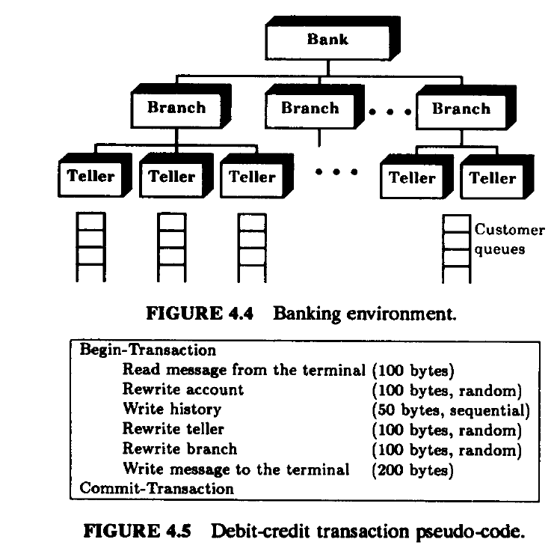
Debit-Credit Benchmark
Berupa benchmark berlevel aplikasi sebagai standar Transaction Prrocessing System sejak 1973 sering diserbut TPC Benchmark
Notes:
4.6.7 Debit-Credit Benchmark
This application-level benchmark has become a de facto standard to compare transaction processing systems. Although several variations of the benchmark have been in use since 1973, it was first recorded in the published literature in an anonymous article by a group of two dozen computer professionals (see Anonymous et al. 1985). The benchmark represents a distributed banking network. As shown in Figure 4.4, a bank usually has several branch offices, each with several tellers. The customers arriving at the branch stand in a queue for the next available teller. Alternately, there may be a separate queue for each teller.
FIGURE 4.4 Banking environment.
The debit-credit benchmark came into being in 1973 when a large retail bank wanted to put its 1000 branches, 10,000 tellers, and 10,000,000 accounts on-line with a peak load of 100 Transactions Per Second (TPS). Smaller systems can be represented by suitably scaling these numbers. Each TPS requires 10 branches, 100 tellers, and 100,000 accounts. For example, systems claiming a performance of 50 TPS should run the benchmark with 500 branches, 5000 tellers, and 5,000,000 accounts.
Different systems are compared on the basis of a price-performance ratio. The performance is measured by throughput in terms of TPS such that 95% of all transactions provide 1 second or less response time. The response time is measured as the time interval between the arrival of the last bit from the communications line and the sending of the first bit to the communications line. The cost includes the total expenses for a 5-year period on purchase, installation, and maintenance of the hardware and software in the machine room. It does not include expenditures for terminals, communications, application development, or operations. A pseudo-code definition of the debit-credit workload is given in Figure 4.5. There are four record types in the database: account, teller, branch, and history. History records are 50 bytes; others are 100 bytes. Each transaction consists of reading a 10byte message from a block mode terminal connected via X.25. The system performs presentation services to map the input for a
Begin-Transaction Read message from the terminal (100 bytes) Rewrite account (100 bytes, random) Write history (50 bytes, sequential) Rewrite teller (100 bytes, random) Rewrite branch (100 bytes, random) Write message to the terminal (200 bytes) Commit-Transaction FIGURE 4.5 Debit-credit transaction pseudo-code.
COBOL program, which in turn uses a database system to debit a bank account, do the standard double-entry bookkeeping, and then reply to the terminal. Fifteen percent of the transactions require access to remote branch databases; others are local.
Due to increased popularity of the transaction processing systems, an effort is underway to define transaction processing benchmarks more precisely. A council of several transaction processing system vendors, users, and consultants, called the Transactions Processing Performance Council (TPC), was formed in August 1988. Its first benchmark, called TPC Benchmark A, is a variant of the debit-credit benchmark (see TPC 1989). In TPC benchmark, the throughput is measured in terms of TPS such that 90% of all transactions provide 2 seconds or less response time.

Slide 20
SPEC Suite 1992, 1995, 2000... (System Performance Evaluation Cooperative)
a nonprofit corporation formed by leading computer vendors to develop a standardized set of benchmarks.
Release 1.0 of the SPEC benchmark suite (SPEC 1990) consist of 10 benchmark submitted by scientists and engineers.
GCC: The time for the GNU C Compiler to convert 19 preprocessed source files into assembly language output is measured. This benchmark is representative of a software engineering environment and measures the compiling efficiency of a system.
Espresso: Espresso is an Electronic Design Automation (EDA) tool that performs heuristic boolean function minimization for Programmable Logic Arrays (PLAs). The elapsed time to run a set of seven input models is measured.
Spice 2g6: Spice, another representative of the EDA environment, is a widely used analog circuit simulation tool. The time to simulate a bipolar circuit is measured.
Doduc: This is a synthetic benchmark that performs a Monte Carlo simulation of certain aspects of a nuclear reactor. Because of its iterative structure and abundance of short branches and compact loops, it tests the cache memory effectiveness.
NASA7: This is a collection of seven floating-point intensive kernels performing matrix operations on double-precision data.
Notes:
4.6.8 SPEC Benchmark Suite
The Systems Performance Evaluation Cooperative (SPEC) is a nonprofit corporation formed by leading computer vendors to develop a standardized set of benchmarks. Release 1.0 of the SPEC benchmark suite (see SPEC 1990) consists of the following 10 benchmarks drawn from various engineering and scientific applications:
1. GCC: The time for the GNU C Compiler to convert 19 preprocessed source files into assembly language output is measured. This benchmark is representative of a software engineering environment and measures the compiling efficiency of a system. 2. Espresso: Espresso is an Electronic Design Automation (EDA) tool that performs heuristic boolean function minimization for Programmable Logic Arrays (PLAs). The elapsed time to run a set of seven input models is measured. 3. Spice 2g6: Spice, another representative of the EDA environment, is a widely used analog circuit simulation tool. The time to simulate a bipolar circuit is measured. 4. Doduc: This is a synthetic benchmark that performs a Monte Carlo simulation of certain aspects of a nuclear reactor. Because of its iterative structure and abundance of short branches and compact loops, it tests the cache memory effectiveness. 5. NASA7: This is a collection of seven floating-point intensive kernels performing matrix operations on double-precision data. 6. LI: The elapsed time to solve the popular 9-queens problem by the LISP interpreter is measured. 7. Eqntom: This benchmark translates a logical representation of a boolean equation to a truth table. 8. Matrix300: This performs various matrix operations using several LINPACK routines on matrices of size 300 × 300. The code uses double-precision floating-point arithmetic and is highly vectorizable. 9. Fpppp: This is a quantum chemistry benchmark that performs two electron integral derivatives using double-precision floating-point FORTRAN. It is difficult to vectorize. 10. Tomcatv: This is a vectorized mesh generation program using double-precision floating-point FORTRAN. Since it is highly vectorizable, substantial speedups have been observed on several shared-memory multiprocessor systems. These benchmarks, which stress primarily the CPU, Floating Point Unit (FPU), and to some extent the memory subsystem, are meant for comparing CPU speeds. Benchmarks to compare I/O and other subsystems may be included in future releases.
The elapsed time to run two copies of a benchmark on each of the N processors of a system (a total of 2N copies) is measured and compared with the time to run two copies of the benchmark on a reference system (which is VAX-11/780 for Release 1.0). For each benchmark, the ratio of the time on the reference system and the system under test is reported as SPECthruput using a notation of #CPU@Ratio. For example, a system with three CPUs taking only 1/15th as long as the reference system on GCC benchmark has a SPECthruput of 3@15. The ratio is a measure of the per processor throughput relative to the reference system. The aggregate throughput for all processors of a multiprocessor system can be obtained by multiplying the ratio by the number of processors. For example, the aggregate throughput for the above system is 45.
The geometric mean (discussed in Section 12.5) of the time ratios for single copies of the 10 benchmarks is used to indicate the overall performance for the suite and is called SPECmark. Again, the notation #CPU@Ratio is used to report the SPECmark.
The TPC and SPEC are the beginning of a new trend in the industry to develop standard benchmarks for comparing all types of computer systems including networks, image processing systems, and databases.
EXERCISES
4.1 Select an area of computer systems (for example, processor design, networks, operating systems, or databases), review articles on performance evaluation in that area, and make a list of benchmarks used in those articles. 4.2 Implement the Sieve workload in a language of your choice, run it on systems available to you, and report the results.

Slide 21
LI: The elapsed time to solve the popular 9-queens problem by the LISP interpreter is measured.
Eqntom: This benchmark translates a logical representation of a boolean equation to a truth table.
Matrix300: This performs various matrix operations using several LINPACK routines on matrices of size 300 × 300. The code uses double-precision floating-point arithmetic and is highly vectorizable.
Fpppp: This is a quantum chemistry benchmark that performs two electron integral derivatives using double-precision floating-point FORTRAN. It is difficult to vectorize.
Tomcatv: This is a vectorized mesh generation program using double-precision floating-point FORTRAN. Since it is highly vectorizable, substantial speedups have been observed on several shared-memory multiprocessor systems.
.
Notes:
These benchmarks, which stress primarily the CPU, Floating Point Unit (FPU), and to some extent the memory subsystem, are meant for comparing CPU speeds. Benchmarks to compare I/O and other subsystems may be included in future releases.
The elapsed time to run two copies of a benchmark on each of the N processors of a system (a total of 2N copies) is measured and compared with the time to run two copies of the benchmark on a reference system (which is VAX-11/780 for Release 1.0). For each benchmark, the ratio of the time on the reference system and the system under test is reported as SPECthruput using a notation of #CPU@Ratio. For example, a system with three CPUs taking only 1/15th as long as the reference system on GCC benchmark has a SPECthruput of 3@15. The ratio is a measure of the per processor throughput relative to the reference system. The aggregate throughput for all processors of a multiprocessor system can be obtained by multiplying the ratio by the number of processors. For example, the aggregate throughput for the above system is 45.
The geometric mean (discussed in Section 12.5) of the time ratios for single copies of the 10 benchmarks is used to indicate the overall performance for the suite and is called SPECmark. Again, the notation #CPU@Ratio is used to report the SPECmark.
The TPC and SPEC are the beginning of a new trend in the industry to develop standard benchmarks for comparing all types of computer systems including networks, image processing systems, and databases.

Slide 22
These benchmarks, which stress primarily the CPU, Floating Point Unit (FPU), and to some extent the memory subsystem, are meant for comparing CPU speeds. Benchmarks to compare I/O and other subsystems may be included in future releases.
The elapsed time to run two copies of a benchmark on each of the N processors of a system (a total of 2N copies) is measured and compared with the time to run two copies of the benchmark on a reference system (which is VAX-11/780 for Release 1.0). For each benchmark, the ratio of the time on the reference system and the system under test is reported as SPECthruput using a notation of #CPU@Ratio.
The TPC and SPEC are the beginning of a new trend in the industry to develop standard benchmarks for comparing all types of computer systems including networks, image processing systems, and databases

Slide 23
Application Benchmarks
Specific applications for:
Banking
Airline reservation
large scientific codes
Includes everything
hardware
input/output
networks
operating system
databases
e.g. debit credit benchmark

