Slide 1
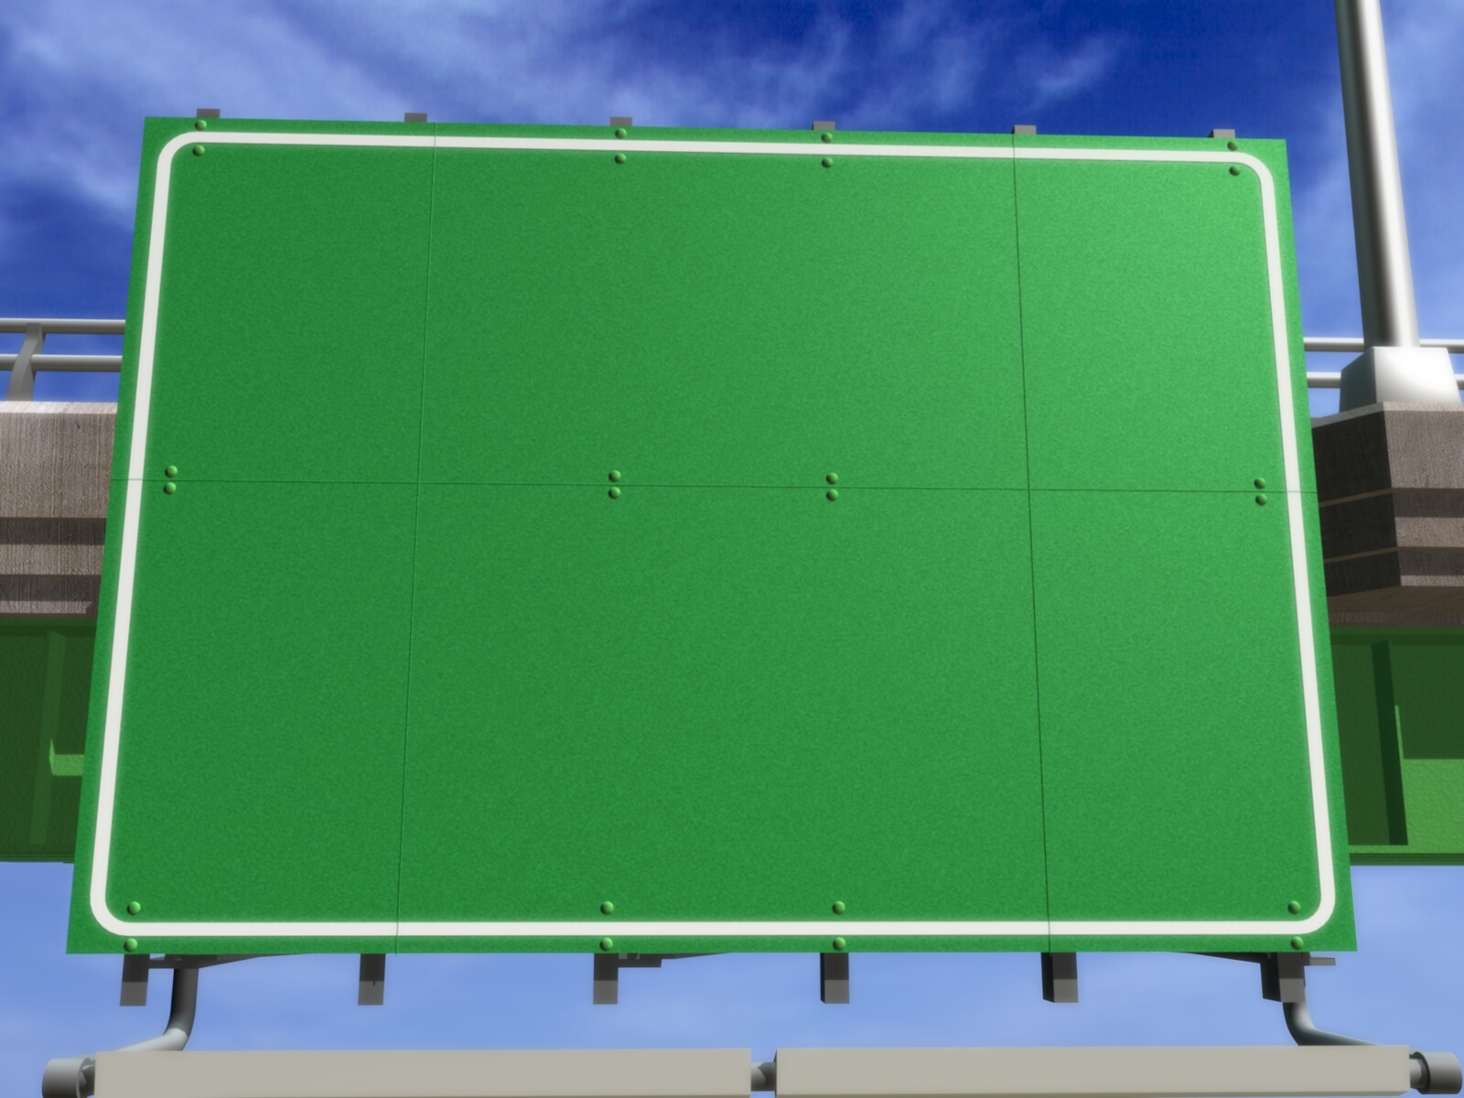
Queue
Adam M.B.

Slide 2
❶❷❸
DEFINITION

Slide 3
Queue
queue is data structure whose its elemen can be added in the last element and taken only from the first element.
Known as FIFO (First In First Out).

Slide 4
Components of Queue
Front is a variable which refers to first position in queue.
Rear is a variable which refers to last position in queue.
Element is component which has data.
MaxQueue is variable that describes maximum number of elements in a queue.

Slide 5
❶❷❸
DECLARATION

Slide 6
Declaration as Array
Kamus:
Const
MaxQueue = value {value is integer number}
Type
NamaQueue = array [1..MaxQueue] of tipedata
Queue : NamaQueue
Front, Rear : integer {pointer of Queue}

Slide 7
Declaration as Array
Kamus:
Const
MaxQueue = 4
Type
ArrayQueue = array [1..MaxQueue] of integer
Queue : ArrayQueue
Front, Rear : integer {pointer of Queue}

Slide 8
Declaration as List
Kamus:
Type
NamaPointer = ↑Queue
Queue = Record
< MedanData : TipeData,
MedanSambungan : NamaPointer >
EndRecord
Front, Rear : NamaPointer {pointer of queue}

Slide 9
Declaration as List
Kamus:
Type
Point = ↑Queue
Queue = Record
< Angka : integer,
Next : Point >
EndRecord
Front, Rear : Point {pointer of queue}

Slide 10
❶❷❸
OPERATION

Slide 11
Operation
Initialization
Empty Operation
Full Operation (array)/One Node Operation (Linked List)
Enqueue
Dequeue

Slide 12
Main Operation
Queue
Enqueue
Dequeue
Add data to element in queue.
Take data from element in queue.

Slide 13
Kinds of Operation
Queue Operation in linear array form
Queue Operation in Linked list form
Queue Operation in circular array form

Slide 14
❶❷❸
QUEUE OPERATION IN ARRAY FORM

Slide 15
Initialization
Operation that give a initial value for front and rear pointer in queue with the following rules:
Give 0 if the first element starts from 1
Give -1 if the first element starts from 0

Slide 16
Empty Operation
Operation that returns true if the rear pointer have 0 or -1 as its value (depend on initialization) or returns false to the contrary.

Slide 17
Full Operation
Operation that returns true if rear has reached maximum array or maximum array -1 (depend on initialization) or returns false if top is not equal to maximum array.

Slide 18
Enqueue
Steps in enqueue operation:
Queue can be added when it’s not full
If queue is empty then front and rear is added by 1. For the contrary, rear is added by 1.
Queue element, which was refered by rear pointer, is filled with new data.

Slide 19
Enqueue
Queue
3
5
8
7
0
1
2
3
4
front
rear
Enqueue(Front,Rear,Queue,3)
Enqueue(Front,Rear,Queue,5)
Enqueue(Front,Rear,Queue,8)
Enqueue(Front,Rear,Queue,7)
Enqueue(Front,Rear,Queue,2)
“Queue is full”

Slide 20
Dequeue
Steps in dequeue operation:
Queue can be dequeue when its elements is not empty.
After first element is taken out from queue then second element in queue will be shifted into first element and so on.
Substract the rear pointer with 1.

Slide 21
Dequeue
3
5
8
Queue
3
7
5
8
7
5
8
7
8
7
7
Item
0
1
2
3
4
front
rear
Dequeue(Front,Rear,Queue,Item)
Dequeue(Front,Rear,Queue,Item)
Dequeue(Front,Rear,Queue,Item)
Dequeue(Front,Rear,Queue,Item)
Dequeue(Front,Rear,Queue,Item)
“Queue is Empty”

Slide 22
❶❷❸
QUEUE OPERATION IN LINKED LIST FORM

Slide 23
Initialization
Prepare queue by giving null value to the front and rear pointer in queue.

Slide 24
Empty Operation
Operation that returns true if the rear pointer is null or returns false to the contrary.

Slide 25
One Node Operation
Operation that returns true if rear and front refer to same node (queue only has one node) or returns false to the contrary.

Slide 26
Enqueue
Steps of enqueue operation in linked list form is similar with back insertion.

Slide 27
Enqueue
Enqueue(Front,Rear,8)
Queue is empty
Front
Rear
baru
8

Slide 28
Enqueue
Enqueue(Front,Rear,3)
Queue isn’t empty
Front
Rear
8
baru
3

Slide 29
Enqueue
Enqueue(Front,Rear,5)
Queue isn’t empty
Front
Rear
8
3
baru
5

Slide 30
Dequeue
Steps of dequeue operation in linked list form is similar with front deletion.

Slide 31
Dequeue
Dequeue(Front,Rear,Item)
{Queue > One node}
Phapus
Front
Rear
8
3
5
Item

Slide 32
Dequeue
Dequeue(Front,Rear,Item)
{Queue > one node}
Phapus
Front
Rear
3
5
Item

Slide 33
Dequeue
Dequeue(Front,Rear,Item)
{Queue = one node}
Front
Rear
Front
Rear
Phapus
5
Item

Slide 34
❶❷❸
QUEUE OPERATION IN CIRCULAR ARRAY FORM

Slide 35
Enqueue
Steps in enqueue operation:
Queue can be added when it’s not full
If queue is empty then front and rear is added by 1. If it isn’t empty then rear is added by 1 but if rear is at maximum queue then rear = 1.
Queue element, which was refered by rear pointer, is filled with new data.

Slide 36
Dequeue
Steps in dequeue operation:
Queue can be dequeue when its elements is not empty.
If it isn’t empty then front is added by 1.
If front is at maximum queue then front = 1.

Slide 37
Enqueue and Dequeue
Queue
8
Enqueue(Front,Rear,Queue,8)
2
3
9
5
7
Enqueue(Front,Rear,Queue,3)
0
1
2
3
4
Enqueue(Front,Rear,Queue,5)
Dequeue(Front,Rear,Queue,item)
Enqueue(Front,Rear,Queue,7)
front
rear
Enqueue(Front,Rear,Queue,2)
Dequeue(Front,Rear,Queue,item)
8
3
Enqueue(Front,Rear,Queue,9)
Item
Enqueue(Front,Rear,Queue,12)
“Queue is full”

Slide 38
Exercise
Do the task 6.46 and 6.48 in page 212 at Data Structures book, seymour.

Slide 39
GRACIAS
THANK YOU
Contact Person:
Adam Mukharil Bachtiar
Informatics Engineering UNIKOM
Jalan Dipati Ukur Nomor. 112-114 Bandung 40132
Email: adfbipotter@gmail.com
Blog: http://adfbipotter.wordpress.com
Copyright © Adam Mukharil Bachtiar 2012

