Slide 1
FILTER
Pertemuan-6
John Adler
KK-Komputasi dan Kecerdasan Buatan
Teknik Komputer
Universitas Komputer Indonesia-UNIKOM

Slide 2
Image processing
1. Spatial filtering
2. Pixel shifting operation
3. Temporal filtering
4. Intensity transformations
5. Window/Level techniques
6. Parametric imaging

Slide 3
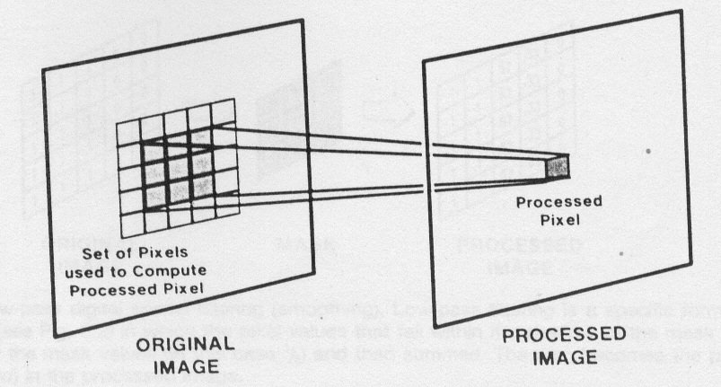
1. Spatial filtering
Spatial filtering is a method of selectively enhancing or diminishing specific spatial frequency components in an image
Diagram of two-dimensional digital spatial filtering

Slide 4
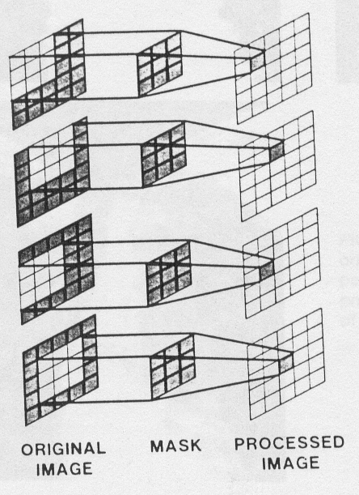
Digital filtering (Convolution)
Each pixel in the processed images is derived from a set of pixels in the original image as determined by the mask.
Methods
Low-pass filtering
High-pass filtering
Median filtering

Slide 5
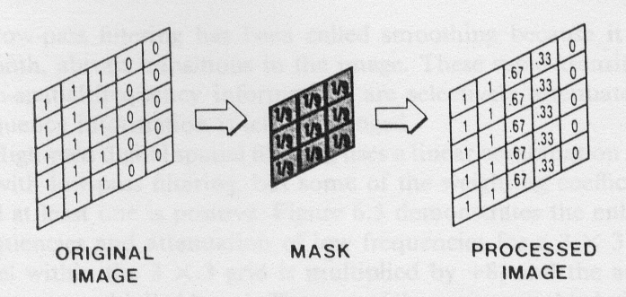
Low-pass digital spatial filtering(Smoothing)

Slide 6
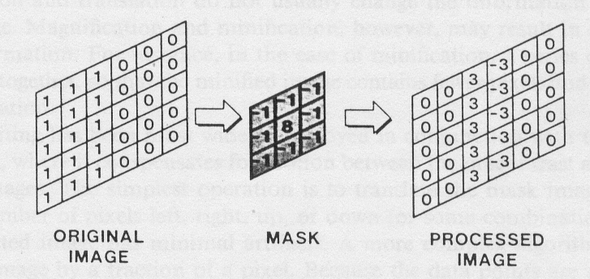
High-pass digital spatial filtering (Edge enhancement)

Slide 7
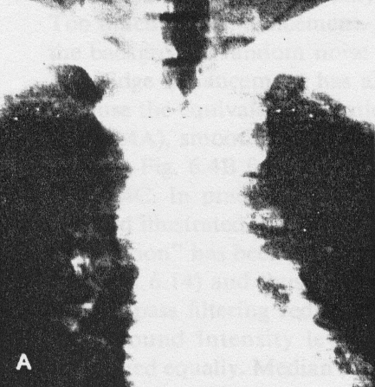
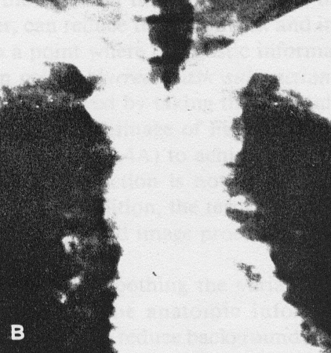
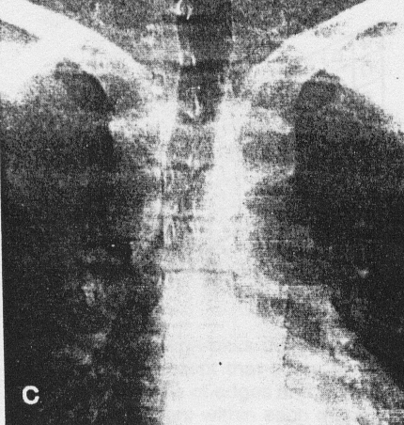
Filtered images
Original
High-pass
(Edge enhancement)
Low-pass
Smoothing

Slide 8
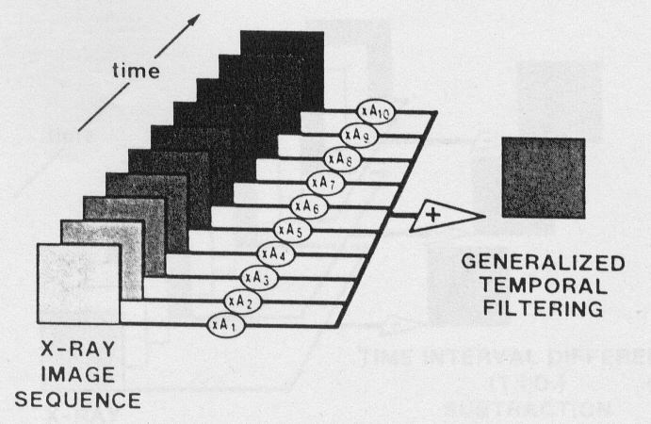
Temporal filtering
1. Time interval difference(TID)
2. Integration
3. Blurred mask temporal subtraction
4. Recursive filtering (real time methods)
Generalized temporal filtering diagram

Slide 9
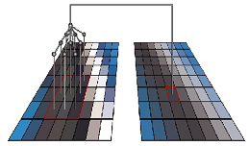

Konvolusi

Slide 10
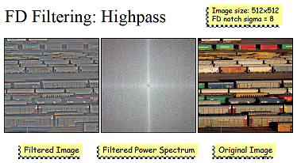
FD Filtering : Highpass

Slide 11
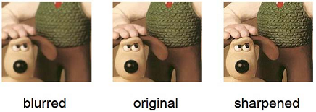
Spasial Filtering

Slide 12
Definition of Terms
3.8 – Spatial Filtering
A filter is an operation performed on digital image data to sharpen, smooth, or enhance some feature, or in some other way modify the image
A distinction can be made between filtering in the spatial versus the frequency domain
Filtering in the frequency domain is performed on image data that is represented in terms of its frequency components
Filtering in the spatial domain is performed on image data in the form of the pixel’s color values.

Slide 13
Convolutions (1)
3.8 – Spatial Filtering
Spatial filtering is done by a mathematical operation called convolution, where each output pixel is computed as a weighted sum of neighboring input pixels
Convolution is based on a matrix of coefficients called a convolution mask
The mask is also sometimes called a filter
The mask dimensions are less than or equal to the dimensions of the image
Let’s call the convolution mask c and the image f
Assume the image is of dimensions M × N and the mask is m × n

Slide 14
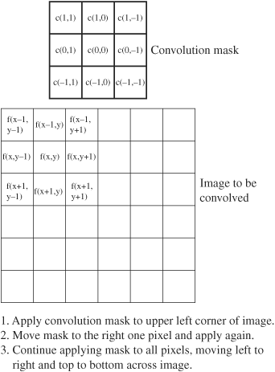
Convolutions (2)
3.8 – Spatial Filtering
The pixel that is to receive a new grayscale value lies at the center of the mask, which implies that the dimensions of the mask must be odd (Figure 3.23)
Assume that pixel f (x, y) is the one to receive the new value
Figure 3.23 Convolution

Slide 15

Convolution – Linear Equation
3.8 – Spatial Filtering
Let f(x, y) be an M × N image and c(v, w) be an m × n mask. Then the equation for a linear convolution is
  where i = (m − 1)/2 and j = (n − 1)/2
  Assume m and n are odd
  This equation is applied to each pixel f(x, y) of an image, for 0 ≤ x ≤ M − 1 and 0 ≤ y ≤ N − 1
  If x − v < 0, x − v ≥ M, y − w < 0, or y − w ≥ N, then f(x, y) is undefined
  These are edge cases, discussed next

Slide 16
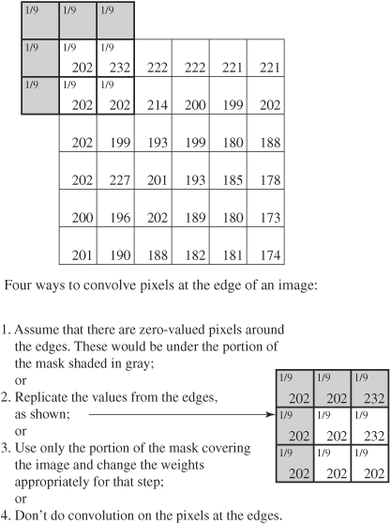
Convolution – Image Edge
3.8 – Spatial Filtering
What happens at the edges of the image
Different ways to handle the edge pixels are summarized in Figure 3.24
Figure 3.24 Handling
edges in convolution

Slide 17
Convolution – Filters
3.8 – Spatial Filtering
Filters are sometimes used for smoothing or blurring an image using an averaging convolution mask
  Blurring can be used as a preprocessing step to “pull objects together” so that the main objects in an image can then be detected and extracted
  It can be helpful in removing image noise
  It can soften jagged edges or remove moiré patterns in an undersampled image
  It can smooth over the blockiness that can be caused by JPEG compression done at a high compression rate
  Smoothing convolutions are sometimes referred to as low-pass filters because their effect is to remove high-frequency
  components of an image

Slide 18
Filters in Digital Image Processing Programs
3.8 – Spatial Filtering
Digital image processing programs like Photoshop and GIMP have an array of filters for you to choose from, for a variety of purposes
  Some are corrective filters for sharpening or correcting colors
  Some are destructive filters for distorting or morphing images
  Some filters create special effects such as simulated brush-strokes, surfaces, and textures
These filters operate by applying convolutions to alter pixel values

Slide 19
Filters in Digital Image Processing Programs - Masks
3.8 – Spatial Filtering
Various convolution masks will affect your images differently
You can apply the predefined filters more effectively, even using them in combination with one another
Customized masks are for creative special effects
One way to design a convolution mask or predict how a predefined mask will work is to apply it to three simple types of image data:
  a block of pixels that contains a sharp edge,
  a block where the center value is different from the rest of
  the values
  a block where all pixel values are the same

Slide 20
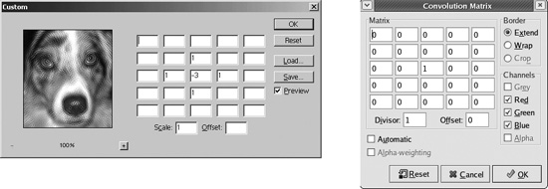
Filters in Digital Image Processing Programs – Custom Filter
3.8 – Spatial Filtering
Figure 3.27 shows the custom mask window
Assume that blank spaces in the mask are 0s
Figure 3.27 Custom filter (from Photoshop and GIMP)

Slide 21


Filters in Digital Image Processing Programs - Equations
3.8 – Spatial Filtering
Since the custom mask varies in its shape and the number of values it contains, and it also involves scaling and offset factors
Therefore equation
is rewritten to
  In order to preserve the brightness balance of an image, = 1
  If > 1, then the center pixel will be become lighter
  If < 1, the center pixel will become darker

Slide 22
Signals and Filtering
Audio recording is 1D signal: amplitude(t)
Image is a 2D signal: color(x,y)
Signals can be continuous or discrete
Raster images are discrete
  In space: sampled in x, y
  In color: quantized in value
Filtering: a mapping from signal to signal

Slide 23
Convolution
Used for filtering, sampling and reconstruction
Convolution in 1D
Chalkboard

Slide 24
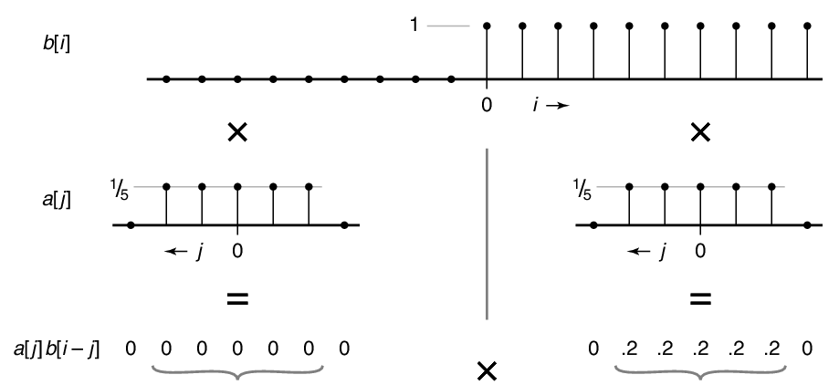
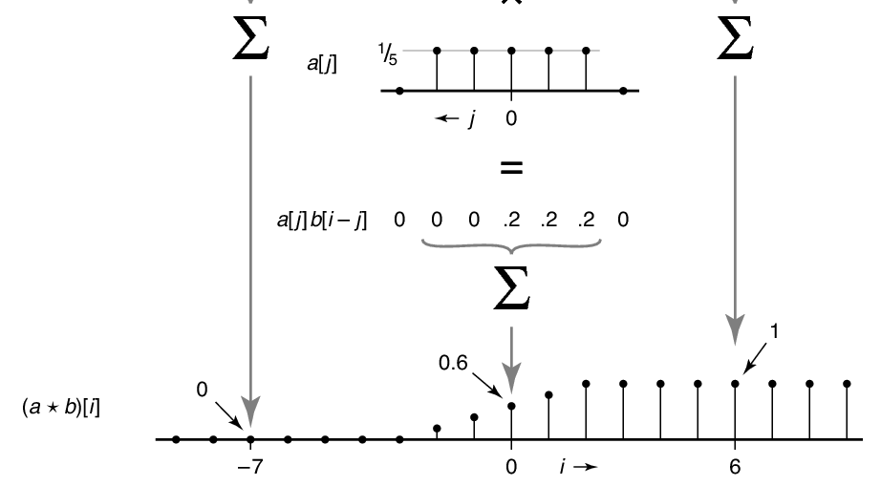
Convolve box and step

Slide 25
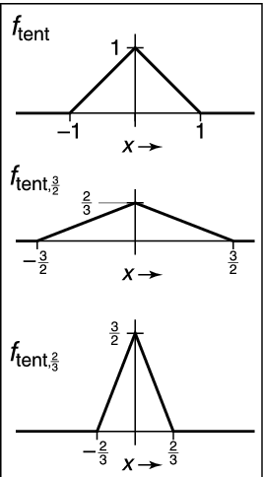
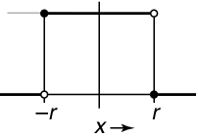
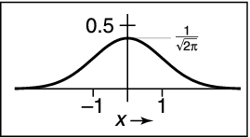
Convolution filters
box
gaussian
tent

Slide 26
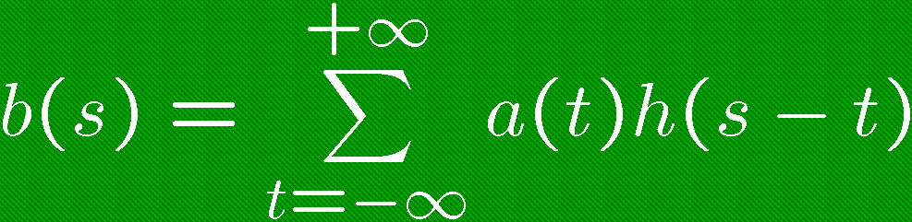
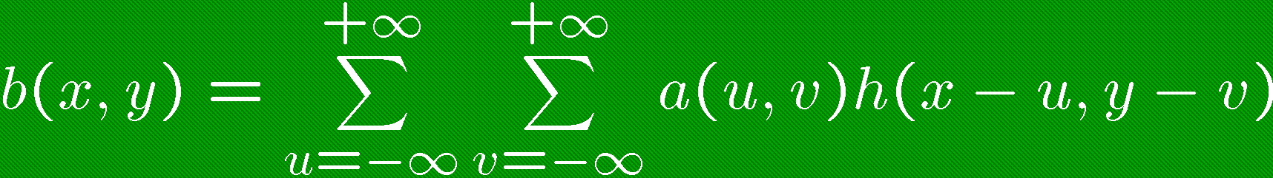
Convolution filters
Convolution in 1D
  a(t) is input signal
  b(s) is output signal
  h(u) is filter
Convolution in 2D

Slide 27
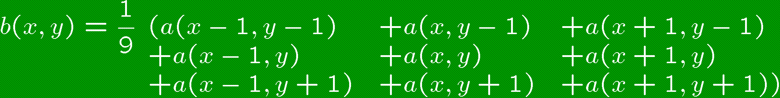
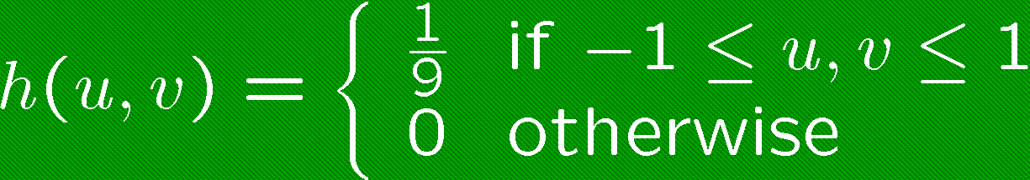
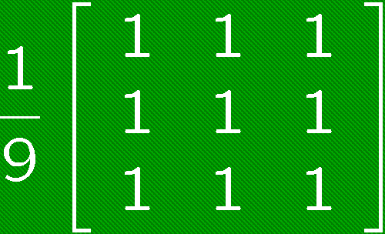
Filters with Finite Support
Filter h(u,v) is 0 except in given region
Represent h in form of a matrix
Example: 3 x 3 blurring filter
As function
In matrix form

Slide 28
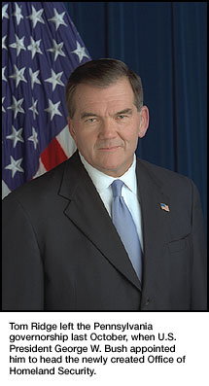


Blurring Filters
A simple blurring effect can be achieved with a 3x3 filter centered around a pixel,
More blurring is achieved with a wider n×n filter:
Original Image
Blur 3x3 mask
Blur 7x7 mask

Slide 29
Image Filtering: Blurring
original, 64x64 pixels
3x3 blur
5x5 blur

Slide 30
Blurring Filters
Average values of surrounding pixels
Can be used for anti-aliasing
What do we do at the edges and corners?
For noise reduction, use median, not average
  Eliminates intensity spikes
  Non-linear filter

Slide 31
LINEAR FILTERING
Low pass filters
Low pass filtering, otherwise known as "smoothing", is employed to remove high spatial frequency noise from a digital image. Noise is often introduced during the analog-to-digital conversion process as a side-effect of the physical conversion of patterns of light energy into electrical patterns

Slide 32
There are several common approaches to removing this noise:
If several copies of an image have been obtained from the source, some static image, then it may be possible to sum the values for each pixel from each image and compute an average. This is not possible, however, if the image is from a moving source or there are other time or size restrictions.

Slide 33
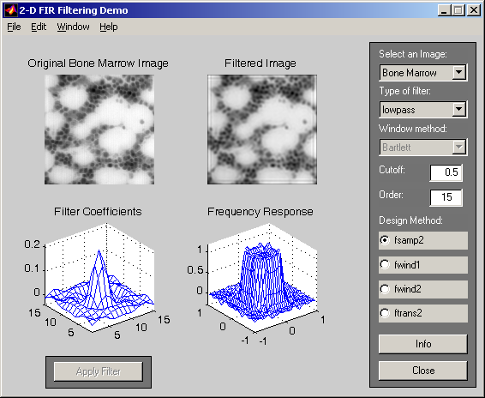

Slide 34
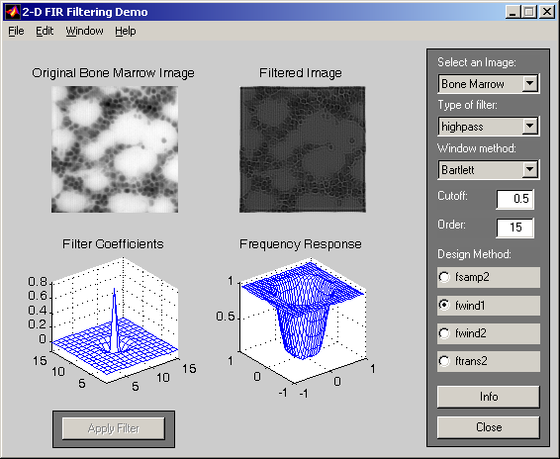

Slide 35


Slide 36
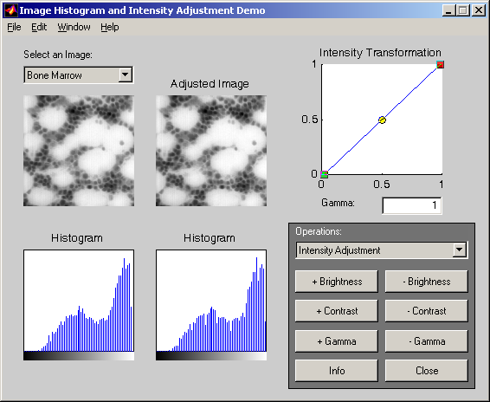
Intensity Histogram / Adjustment

Slide 37
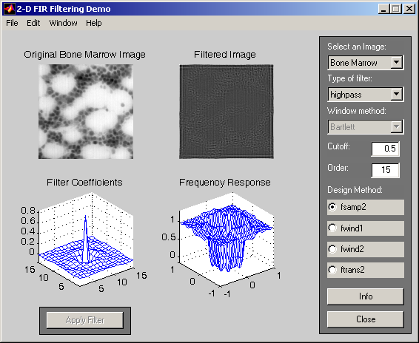
Bone Marrow Image

Slide 38
If such averaging is not possible, or if it is insufficient, some form of low pass spatial filtering may be required. There are two main types:
reconstruction filtering, where an image is restored based on some knowledge of of the type of degradation it has undergone. Filters that do this are often called "optimal filters"

Slide 39
High Pass Filter
A high pass filter is used in digital image processing to remove or suppress the low frequency component, resulting in a sharpened image. High pass filters are often used in conjunction with low pass filters. For example, the image may be smoothed using a low pass filter, then a high pass filter can be applied to sharpen the image, therefore preserving boundary detail.

Slide 40
Referensi
Erkki Rämö, Digital Media, “Image Processing”, Principal Lecturer, Metropolia University of Applied Sciences.
Richard Alan Peters II, EECE/CS 253 -Image Processing, Lecture Notes: Spatial Convolution, Department of Electrical Engineering and Computer Science, Fall Semester 2011, Vanderbilt University School of Engineering

Slide 41
TERIMA KASIH

