Slide 1
WEEK 4 Information Technology for business Project Management
Magister Management
Universitas Komputer Indonesia

Slide 2
LEADERSHIP & PROJECT MANAGEMENT
Source:
Pinto, j.k. 2010, 2ND. ED.; Scwalbe, K. 2007, 5TH. ED. ; q.q. International 2008 ,

Slide 3
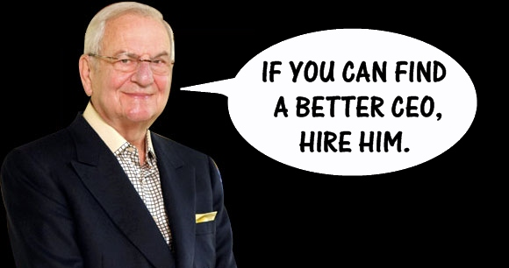
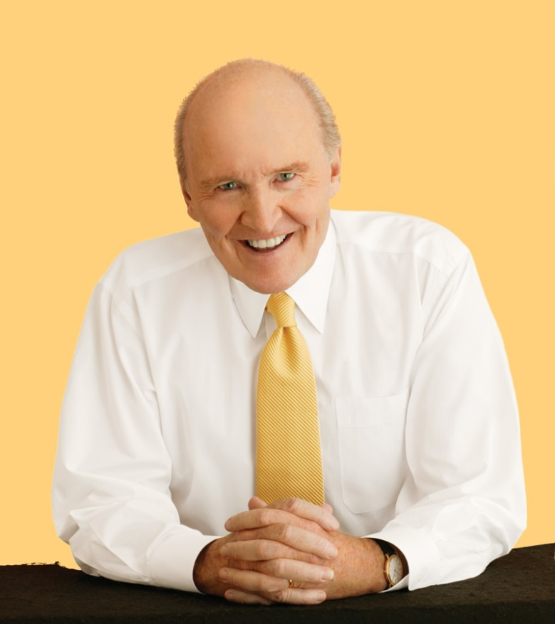
Who is the real leader?

Slide 4
Leaders vs. manager
Leadership is the ability to inspire confidence and support among the people who are needed to achive organizational goals.
Leadership is doing the right thing and management is doing the thing right.

Slide 5
Differences between managers & leaders
Concern | Managers | Leaders
Creation of Purpose | Focus on plans and budgets; create steps, timetables for achieving result, look for resources to support goals | Establish direction, create a vision and the strategies needed to achive it
Developing a Network for Achieving Agenda | Organize and staff; create structure for achieving the plans; delegate responsibility and authority; develop procedures to guide behaviour; create monitoring systems | Align people with the target; communicate direction by word and deed to those whose cooperation is needed; create teams that understand and share the project’s vision
Execution | Control and solve problems; monitor results and apply corrective action | Motivate and inspire; energize people to overcome obstacles and show personal initiative
Outcomes | Produce a degree of predictability and order; seek to maintain status quo | Produce change; challenge the status quo
Focus Timeframe | Efficiency of operations Short-term, avoiding risks, maintaining, and imitating | Effectiveness of outcomes Long-term, taking risks, innovating, and orriginating

Slide 6
Partnership between project Manager & the team
Exchange of Purpose
A right to say no
Joint accountability
Absolute honesty

Slide 7
Roles of project manager
Acquiring Project Resources
Motivating and Building Teams
Having a Vision and Fighting Fires
Communicating

Slide 8
Ten Most important skills & competencies for project manager
1. People skills
2. Leadership
3. Listening
4. Integrity, ethical behavior, consistent
5. Strong at building trust
6. Verbal communication
7. Strong at building teams
8. Conflict resolution, conflict management
9. Critical thinking, problem solving
10. Understands, balances priorities
(Schwalbe, K., 2007)

Slide 9
Characteristics of an effective project manager
Leads by example
Visionary
Technical competent
Decisive
A good communicator
A good motivator
Stands up to top management when necessary
Support team members
Encourages new ideas
(Pinto, K., 2010)

Slide 10
Leadership and emotional intelligence
Five Elements that cracterized Emotional Intelligence:
1. Self-awareness
2. Self-regulation
3. Motivation
4. Empathy
5. Social Skill

Slide 11
Emotional intelligence measurument
DISCovery Methods, Q.Q. International, 2008.
Carter, P., 2010, Soft Competencies, PPM, Jakarta.
Florence Littaeuer, Personality Plus, 1996.
Others relevant tools.

Slide 12
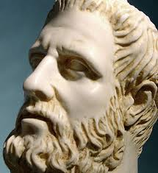
Development of disc
HIPOCRATES, 400 BC
1. Sanguinis
2. Plegmatis
3. Melancholis
4. Cholerics
(Refer to Personality Plus,
Florence Littaeuer)

Slide 13
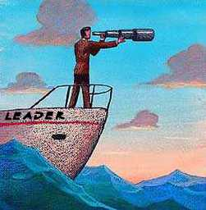
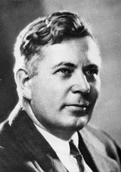
PERSONALITY STYLE
William Moulton Marston, 1928
DISC is personality style assesment tool that measure work behaviour by using 4 factors to determine one’s personality style.

Slide 14
disc
DISC is a psychometric tests determine the individual styles of personality, their strengths, weakness, what motivates them, and, how they behave at work.
The accuracy as high as 83% to 95% and validity 89% with standard deviation 0.065
Introduced by William Moulton Marston, 1928

Slide 15
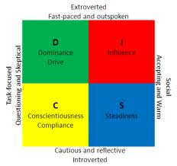
DISC

Slide 16
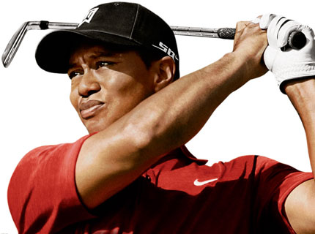
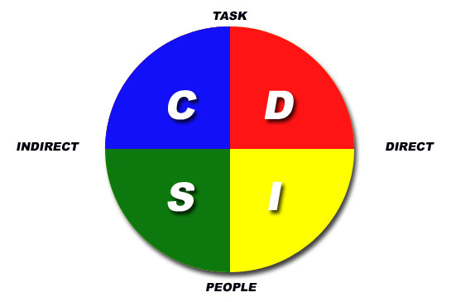
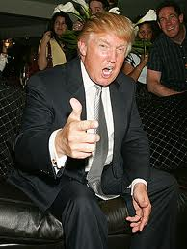
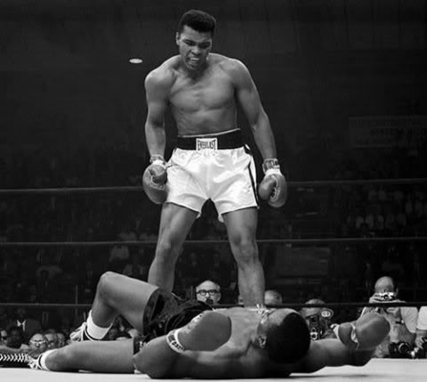
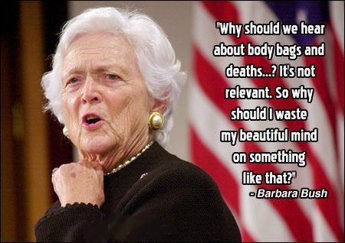
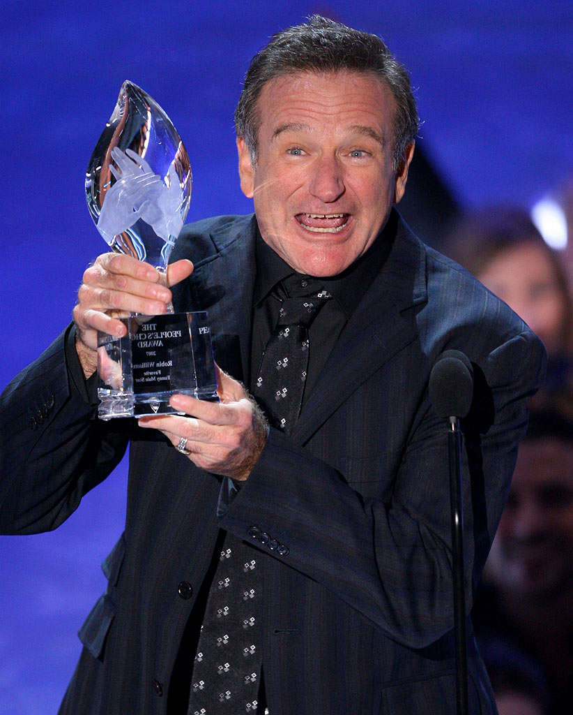
disc

Slide 17
Dominant behaviour style
Focus : Power
Keyword (Hi) : Decisive, Driving, Competitive, Forcefull, Direct, Self starter, Assertive.
(Low) : Indecisive, Non-demanding
Communicating style: Tell
Managerial Style: Autocratic
Motivators : Tangible goals
Fears : Failure, Being taken advantage of
Question : What are we doing?
Power : Force of character

Slide 18
Influencer’s behaviour style
Focus : self
Keyword (Hi) : Influential, verbal, friendly, persuasive, communicative, positive.
(Lo) : Serious, Probing, Suspecious.
Communicating style: sell
Managerial style : Democratic
Motivator : Social recognition, popularization
Fears : Rejection
Question : who else is doing this?
Power : Personality

Slide 19
Stable behaviour style
Focus : Social
Keyword (Hi) : Stable, dependable, amiable, good listener, deliberate, persistent.
(Low) : Alert, Active, Eager, Demonstrative, Restless.
Communicating style: Listen
Managerial style : Procedural
Motivators : Job Contract & Group inclusion
Fears : Insecurity
Question : How are we doing this?
Power : Experience

Slide 20
Compliance’s behaviour style
Focus : Policy
Keyword (Hi) : Carefull, Complient, Precise, Logical, Perfectionist, Systematic, Accurate.
(Low) : Persistent, Stubborn, Independent, Strong Wild.
Communicating style: Write
Managerial style : Rigid
Motivators : Job specs and Rules
Fears : Critics
Question : Why are we doing this?
Power : Know-how

Slide 21
TERIMA KASIH

