Slide 1
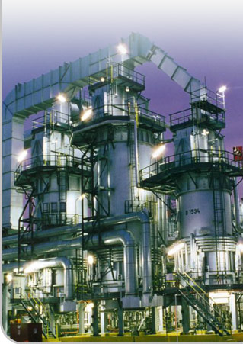
STRATEGIC MANAGEMENT DR. HERMAN S. MBA
Business strategy
Magister Management Program
Universitas Komputer Indonesia

Slide 2
Referensi
T.L. Wheelen and J.W. Hunger, Strategic Management and Business Policy, 13th Ed., Pearson Education Ltd., 2010.
Louis, S., et.al., Even Elephant Can Dance, GML Consulting, 2012.

Slide 4
SITUATIONAL ANALYSIS: SWOT Analysis
Mc. Kinsey Survey 2007 0f 2700 executives
GML Survey 2010-2011 0f 175 executives in Indonesia

Slide 5
Management Tools: GML Survey 2010-2011

Slide 6
SWOT
A widely used framework for organizing and using data and information gained from situation analysis
Encompasses both internal and external environments
One of the most effective tools in the analysis of environmental data and information

Slide 7
SWOT description
A SWOT analysis generates information that is helpful in matching an organization’s or a group’s goals, programs, and capacities to the social environment in which they operate
It is an instrument within strategic planning
When combined with a dialogue, it is a participatory process

Slide 8
SWOT
Factors affecting an organization can usually be classified as:
Internal factors
Strengths (S)
Weaknesses (W)
External factors
Opportunities (O)
Threats (T)
Strengths
Weaknesses
Opportunities
Threats

Slide 9
SWOT: internal factors
Strengths
Positive tangible and intangible attributes, internal to an organization. They are within the organization’s control
Weaknesses
Factors that are within an organization’s control that detract from its ability to attain the core goal. In which areas might the organization improve?

Slide 10
SWOT: external factors
Opportunities
External attractive factors that represent the reason for an organization to exist and develop. What opportunities exist in the environment which will propel the organization?
Identify them by their “time frames”
Threats
External factors, beyond an organization’s control, which could place the organization’s mission or operation at risk. The organization may benefit by having contingency plans to address them should they occur
Classify them by their “seriousness” and “probability of occurrence”

Slide 11
For the external factors
Seriousness of Impact
Low
High
Minimum resources if any
Must plan for
High
Probability of occurrence
Maintain flexibility in plan
Low
Forget it
Notes:
This matrix is mostly self explanatory, we just have to remember if we know that if we have factors that have low seriousness of impact and high probability of occurrence then should not focus to hard on them and therefore we put minimum resources if any on them.

Slide 12
Major benefits of SWOT analyses
Simplicity
Flexibility
Integration and synthesis
Collaboration
Lower costs

Slide 13
TOWS Matrix
INRTERNAL FACTORS (IFAS) EXTERNAL FACTORS (EFAS) | Strength (S) List 5-10 Internal Strength here | Weaknesses (W) List 5-10 internal weaknesses here
Opportunities (O) List 5-10 opportunities here | SO Strategies Generate strategies here that use strength to take advance of opportunities | WO Strategies Generate strategies here that take advance of opportunities by overcoming weaknesses
Threats List 5-10 external threats here | ST Strategies Generate strategies here that use strength to avoid threats | WT Strategies Generate strategies here that minimize weaknesses and avoid threats

Slide 14
Criticism of SWOT Analysis
It generates lengthy lists
It uses no weights to reflect priorities
It uses ambiguous words and phrases
The same factor can be placed in two categories
There is no obligations to verify opinions with data or analysis
There is no logical link to strategy implementation

Slide 15
STRATEGIC FACTORS ANALISYS SUMMARY (SFAS)
SFAS matrix summarizes an organization’s strategic factors by combining the external factors from the EFAS Table with the internal factors from the IFAS Table.

Slide 16
SFAS Matrix Steps
In column 1 (Strategic Factor), list the most important EFAS and IFAS.
In column 2 (Weight), assign weights for all of the internal and external strategic factors.
In column 3 (Rating), assign a rating of how the company’s management is responding to each of the strategic factors.
In column 4 (Weighted Score), multiply weight & rating.
In column 5 (Duration), indicate short term, intermediate, and long term.
In column 6 (Comments), repeat or revise your comments.

Slide 17
SFAS MATRIX EXAMPLE
Internal Strategic Factor | Weight | Rating | Weighted Score | Comment
Strength
S1 Quality Maytag Culture | .15 | 5.0 | .75 | Quality key success
S2 Experience Top Management | .05 | 4.2 | .21 | Know appliances
S3 Vertical Integration | .10 | 3.9 | .39 | Dedicated factories
S4 Employee Relations | .05 | 3.0 | .15 | Good, but detiorat
S5 Hoover’s Internation Relation | .15 | 2.8 | .42 | Hoover name
Weaknesses
W1 Process Oriented R&D | .05 | 2.2 | .11 | Slow on new prod
W2 Distribution Channels | .05 | 2.0 | .10 | Superstore trend
W3 Financial Position | .15 | 2.0 | .30 | High debt load
W4 Global Positioning | .20 | 2.1 | .42 | Hoover weak outsi
W5 Manufacturing Facilities | .05 | 4.0 | .20 | Investing now
Total Scores | 1 |  | 3.05

Slide 18
SFAS MATRIX EXAMPLE
External Strategic Factor | Weight | Rating | Weighted Score | Comment
Opportunities
O1 Economic Integration in Euro | .20 | 4.1 | .82 | Acquisition
O2 Demographics favor quality | .20 | 5.0 | .50 | Maytaq quality
O3 Economic Developmet of Asia | .05 | 1.0 | .05 | Low Maytag presence
O4 Opening of Eastern Europe | .05 | 2.0 | .10 | Will take time
O5 Trend t “Superstore” | .10 | 1.8 | .18 | Maytag weak in this
Threats
Increasing government regulation | .10 | 4.3 | .43 | Well positioned
Strong US competition | .10 | 4.0 | .40 | Well positioned
T3 Whirpool & Eletrolux strong globa | .15 | 3.0 | .45 | Hoover weak global
T4 New product advances | .05 | 1.2 | .06 | Qustionable
T5 Japanese appliance company | .10 | 1.6 | .16 | Only Asian precense
Total Scores | 1 |  | 3.15

Slide 19
SFAS MATRIX EXAMPLE
Strategic Factor (Select the most important opportunities /threats from EFAS and strength /weakness from IFAS | Weight | Rating | Weighted Score | Short Term | Intermediate | Long Term
S1 Quality Maytag culture | .10 | 5.0 | .50 |  | X
S5 Hoover international orientation | .10 | 2.8 | .28 | X | X
W3 Financial position | .10 | 2.0 | .20 | X | X
W4 Global positioning | .15 | 2.2 | .33 |  | X | X
O1 Economic integration | .10 | 4.1 | .41 |  |  | X
O2 Demographics favor quality | .10 | 5.0 | .50 |  | X
O5 Trend to super stores | .10 | 1.8 | .18 | X
T3 Whirlpool and Electrolux | .15 | 3.0 | .45 | X
T5 Japanese appliance companies | .10 | 1.6 | .16 |  |  | X
Total Scores | 1 |  | 3.01

Slide 20
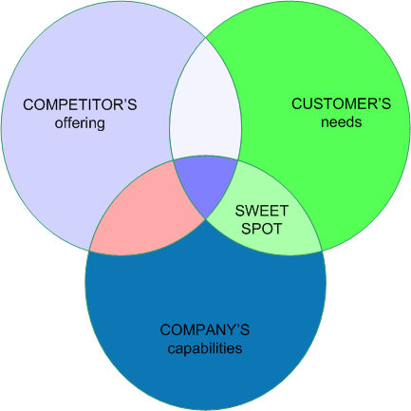
NICHE MARKET

Slide 21
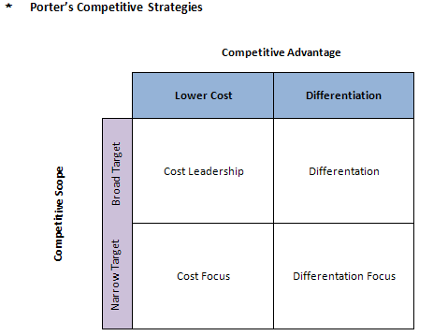
PORTER’S COMPETITIVE STRATEGY

Slide 22
COMPETITIVE STRATEGY
OFFENSIVE TACTICS
- Frontal assault
- Flanking maneuver
- Bypass attack
- Guerilla warfare
DEFENSIFE TACTICS
- Raise the structural barrier
- Increase expected retaliation
- Lower the inducement for attack

Slide 23
COOPERATIVE STRATEGIES
Collusion
Strategic Alliance
- Mutual service consortia
- Joint venture
- Licensing arrangements
- Value-Chain partnership

