Slide 1
Relationship Marketing dan CRM
Pertemuan 7

Slide 2
CRM Programs Can Potentially Improve
Front Office – Operational CRM
Sales System
Marketing System
Customer Service System
Collaborative CRM
Data werehouse
Data Mining
Back Office – Analytical CRM
Sumber : Payne, A., 2005, Hand Book of CRM : Achieving Excellence in Customer Management, Oxfore : Buterworth-Heinemann.

Slide 3
What does CRM involve?
CRM involves the following :
Organisations must become customer focused
Organisations must be prepared to adapt so that it take customer needs into account and delivers them
Market research must be undertaken to assess customer needs and satisfaction

Slide 4
Face-to-face CRM
CRM can also be carried out in face-to-face interactions without the use of technology
Staff members often remember the names and favourite services/products of regular customers and use this information to create a personalised service for them.
For example, in a hospital library you will know the name of nurses that come in often and probably remember the area that they work in.
However, face-to-face CRM could prove less useful when organisations have a large number of customers as it would be more difficult to remember details about each of them.

Slide 5
The Five Key Drivers of the Lifetime Value of a Customer
Cost of Targeting;
Cost of Acquisition;
Service and Usage Revenue;
Cost of service; and
Duration of relationship.
Customer Relationship Management is about making every customer as valuable as possible over the lifetime of the relationship

Slide 6
Pertanyaan
Sebutkan para perusahaan yang termasuk para pemain utama dalam menyediakan aplikasi CRM dan jelaskan produk CRM dari masing – masing perusahaan tersebut

Slide 7
RELATIONSHIP MARKETING DAN CRM

Slide 8
The Shift from Transaction-Based Marketing to Relationship Marketing
Transaction-based marketing
  Buyer and Seller exchanges characterized by limited communications and little or no ongoing relationship between the parties
Relationship marketing
  Development and maintenance of long-term, cost-effective relationships with individual customers, suppliers, employees, and other partners for mutual benefit

Slide 9
Customer relationship management
  The combination of strategies and tools that drive relationship programs, re-orientating the entire organization to a concentrated focus on satisfying customers

Slide 10
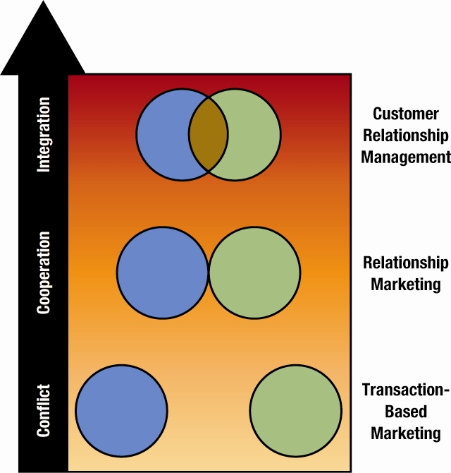
  Forms of Buyer-Seller Interactions on a Continuum from Conflict to Cooperation

Slide 11
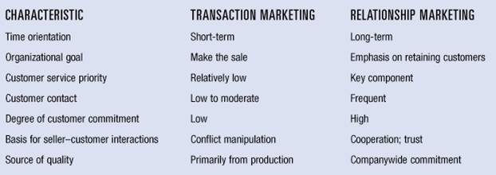
  Comparing Transaction-Based Marketing and Relationship Marketing Strategies

Slide 12
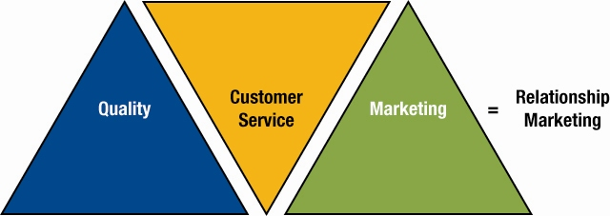
Figure 10.2
  Integrating Quality and Customer Service with Other Marketing Mix Elements to Create and Maintain a Relationship Marketing Focus

Slide 13

Making a Promise to Customers
  The small print promises that Gore-Tex outwear is “Guaranteed to Keep You Dry”

Slide 14
Internal marketing
  Managerial actions that help all members of the organization understand and accept their respective roles in implementing a marketing strategy
    Employee satisfaction

Slide 15
The Relationship Marketing Continuum
First Level: Focus on Price
Second Level: Social Interactions
Third Level: Interdependent Partnerships

Slide 16
Three Levels of Relationship Marketing
Characteristic | Level 1 | Level 2 | Level 3
Primary bond | Financial | Social | Structural
Degree of customization | Low | Medium | Medium to high
Potential for sustained competitive advantage | Low | Moderate | High
Examples | American Airlines’ AAdvantage program | Harley-Davidson’s Harley Owners Group (HOG) | Federal Express’ PowerShip program

Slide 17
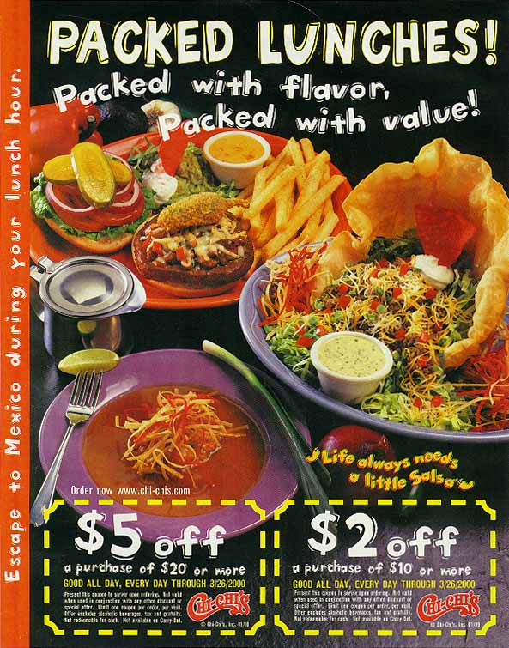
Chi-Chi’s
  Using Financial Incentives Characterizes the First Level of Relationship Marketing

Slide 18
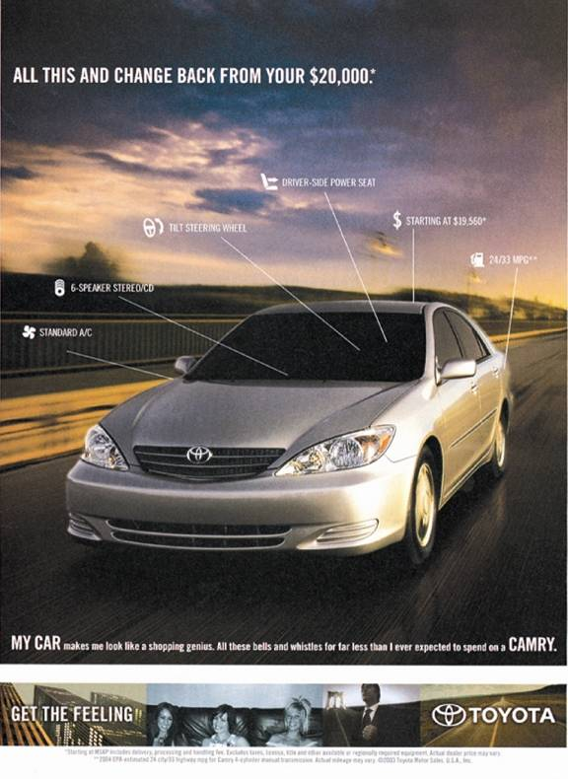
  The First Level of Relationship Marketing

Slide 19

Developing a Social Relationship With Customers
  American Airlines’ custom published magazine communicates with its customers

Slide 20
Second Level
Social Interactions
Dry Cleaner chats with customers
Art Gallery host receptions - “Thursday Night” in Portland
Auto Service Department – calls after a repair
Your business – “Special Customer Night”, take to dinner, send birthday, holiday cards
[Need to develop a data base]
What else can you think of?

Slide 21
Third Level
Interdependent Partnership
Supplier manages the customer’s inventories
Supplier owns the customer’s inventories
Food Broker supplies sales specialists [CROSSMARK/Cadbury Adams]
Manufacturers have customer advisory boards that help develop products and marketing programs

Slide 22
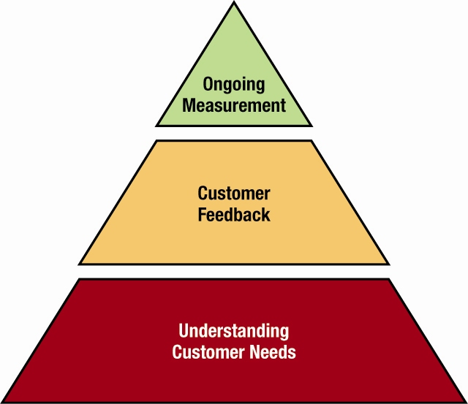
Enhancing Customer Satisfaction
Three Steps to Measure Customer Satisfaction

Slide 23
Building Buyer-Seller Relationships
Many customers are seeking ways to simplify their lives, and relationships provide a way to do this
Customers find comfort with brands that have become familiar through their ongoing relationships with companies
Such relationships often lead to more efficient decision-making my customers and higher levels of customer satisfaction

Slide 24
How Marketers Keep Customers
  Retaining customers as far more profitable than losing them
  Customers typically generate more profits for firm with each additional year of the relationship
  It has been noted that a 5 percent gain in customer retention can lead to an 80 percent increase in profits
    Frequency marketing – Mileage Plus
    Affinity marketing – sponsor’s name on credit cards, non-profit contributors get restaurant discounts

Slide 25

Frequency marketing:
  Marriott Rewards

Slide 26
Database marketing
  Benefits include:
    Selecting the best customers
    Calculating the lifetime value of their business
    Creating a meaningful dialogue that builds genuine loyalty
  Interactive television
  Application service providers (ASPs) – Software to collect, manipulate and analyze consumer/B to B data

Slide 27
One-to-One marketing – customized to build long-term customer relationships
  Grassroots marketing – use of non-mainstream channels like unique events [new dishwasher soap introduction in laundromats for Hispanic/Latino consumers]
  Viral marketing [analogous to the spread of a pathological or computer virus] –
    refers to the idea that people will pass on and share interesting and entertaining content.
    Uses pre-existing social networks to produce increases in brand awareness
    Can be word-of-mouth, enhanced online

Slide 28
Customer Relationship Management
The combination of strategies and tools that drive relationship programs, reorientating the entire organization to a concentrated focus on satisfying customers
  Managing Virtual Relationships [Online to consumers and/or business customers]
  Retrieving Lost Customers [determine who, why, and how to retrieve]

Slide 29
Buyer-Seller Relationships in
Business-to-Business Markets
Business-to-business marketing involves an organization’s purchase of goods and services to support company operations or the production of other products
Buyer-seller relationships between companies involve working together to provide advantages that benefit both parties
Advantages might include the lower prices, quicker delivery, improved quality and reliability, customized product features, and more favorable financing terms

Slide 30
Choosing Business Partners
  Partnership: an affiliation of two or more companies to assist each other in the achievement of common goals
Types of Partnerships
  Buyer partnership – buyer has unique needs that must be met
  Seller partnerships – seller develops long-term relationships
  Internal partnerships – within the company itself
  Lateral partnerships – with other compatible companies, “co-branding”

Slide 31
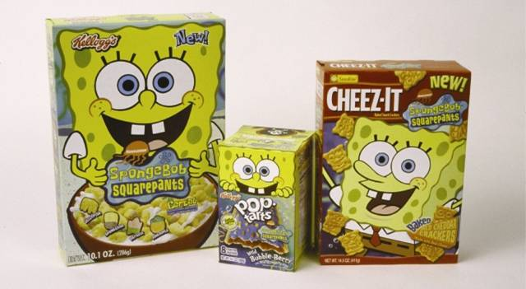
Cobranding and Comarketing
  A Co-marketing Effort Involving SpongeBob Squarepants

Slide 32
Improving Buyer-Seller Relationships in Business-to-Business Markets
National Account Selling
Business-to-Business Databases [Sales Discovery System]
Electronic Data Interchange
  Quick-response merchandising
Vendor-Managed Inventory (VMI)
  Collaborative planning, forecasting, and replenishment
Managing the Supply Chain

Slide 33
Business-to-Business Alliances
  Resources and Skills That Partners Contribute to Strategic Alliances
 |  | Skills
Patents Product lines Brand equity Reputation - For product quality - For customer service - For product innovation Image - Company wide - Business unit - Product line/brand Knowledge of product-market | Customer base Marketing resources - Marketing infrastructure Sales force size Established relationship with: - Suppliers - Marketing intermediaries - End-use customers Manufacturing resources - Location - Size, scale economies, scope economies, excess capacity, newness of plant and equipment Information technology and systems | Marketing Skills - Innovation and product development - Positioning and segmentation - Advertising and sales promotion Manufacturing Skills - Miniaturization - Low-cost manufacturing - Flexible manufacturing Planning and implementation skills R&D skills Organizational expertise, producer learning, and experience effects
Resources

Slide 34
Evaluating Customer Relationship Programs
Lifetime value of customer: the revenues and intangible benefits that a customer brings to the seller over an average lifetime, less the amount of money which must be spent to acquire, market to, and service the customer
Assessing
Costs &
Benefits
Measure-
ment &
Evaluation
Structuring
Relationships

Slide 35
Additional techniques used to evaluate relationship programs include:
  Tracking rebate requests, coupon redemptions, credit-card purchases, and product registrations
  Monitoring complaints and returned products and analyzing why customers leave
  Reviewing reply cards, common forms, and surveys
  Monitoring "click-through" behavior on Websites to identify why they stay or leave

Slide 36
Hopefuls Gird for Gridiron
Little-Known Firms Bet on Maximum Super Bowl Impact
Buying Super Bowl ads has helped catapult companies like online brokerage E*Trade Financial, Internet job board Monster.com and video site Hulu into the public eye. That's why several little-known advertisers—including mobile pay-TV firm Flo TV, information provider KGB and vacation rental service HomeAway.com—are forking over millions of dollars to appear on this year's Big Game broadcast.
Flo TV, which will be pitching a pocket-size device for watching TV on the go, has enlisted CBS Sports commentators James Brown and Jim Nantz in one of its spots, which features a man unable to watch the game because he is stuck shopping for bras with his wife.
KGB, which answers consumer questions via text message for 99 cents a apiece, is still deciding which ad it will run. One possibility shows actors William Baldwin and Stephen Baldwin jumping out of a plane, while another features two women trying to find a clown to appear at their kids' birthdays. The mom who doesn't use KGB ends up with a not-so-lovable clown.
HomeAway's spot features Chevy Chase and the rest of the Griswold family from "National Lampoon's Vacation."

Slide 37
Real People, Real Choices
Reebok (Que Gaskins)
How to capture the pulse of youth culture in the long run?
  Option 1: mimic Nike’s moves with Michael Jordan
  Option 2: build on Reebok’s success with Iverson, while separating the brand from other performance sneaker brands like Nike
  Option 3: maintain the Iverson emphasis and increase efforts to build credibility as a shoe for soccer and track

Slide 38
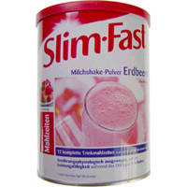

Target Marketing Strategy: Selecting and Entering a Market
Market fragmentation: The creation of many consumer groups due to the diversity of their needs and wants.
Target marketing strategy: dividing the total market into different segments based on customer characteristics, selecting one or more segments, and developing products to meet those segments’ needs.

Slide 39
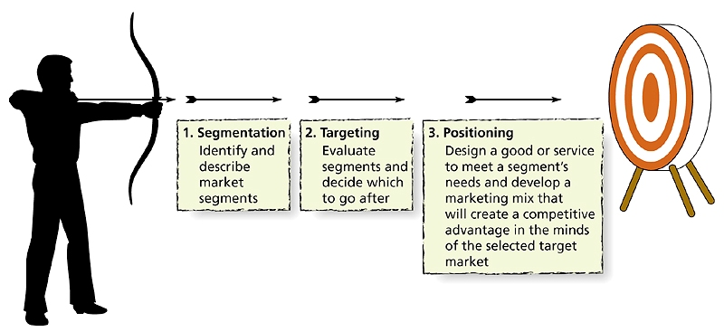
Figure 7.1: Steps in the Target Marketing Process

Slide 40
Step 1: Segmentation
The process of dividing a larger market into smaller pieces based on one or more meaningful shared characteristics
Segmentation variables: dimensions that divide the total market into fairly homogeneous groups, each with different needs and preferences

Slide 41
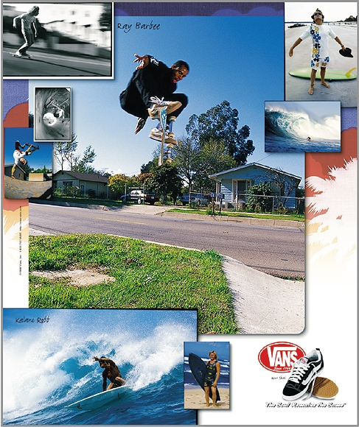
Segmenting Consumer Markets
Segmentation variables can slice up the market
  Demographic, psychological, and behavioral differences

Slide 42
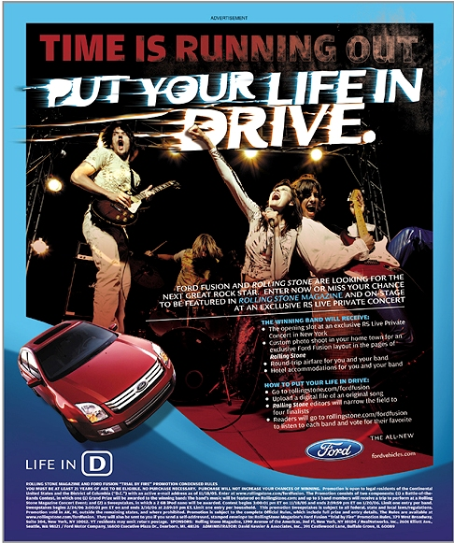
Segmenting by Demographics
Age: Generational Marketing
Children
Teens/tweens
Generation Y: born between 1977 and 1994
Generation X: born between 1965 and 1976
Baby boomers: born between 1946 and 1964
Older consumers

Slide 43
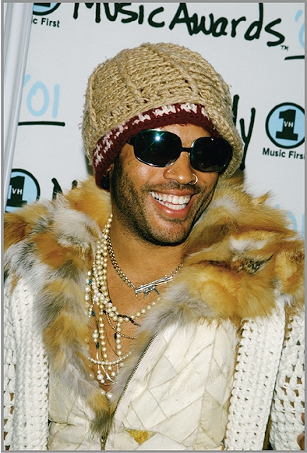
Segmenting by Demographics Gender
Many products appeal to one sex or the other
Metrosexual: a man who is heterosexual, sensitive, educated, and an urban dweller in touch with his feminine side

Slide 44

Segmenting by Demographics (cont’d)
Family Structure
Income
Social Class
Race and Ethnicity
  African Americans
  Asian Americans
  Hispanic Americans
VOSS WATER
MINORITEAM ON ADULT SWIM

Slide 45
Segmenting by Geography
Geodemography: combines geography with demographics
Geocoding: Customizes Web advertising so people who log on in different places see ad banners for local businesses
CLARITAS.COM

Slide 46
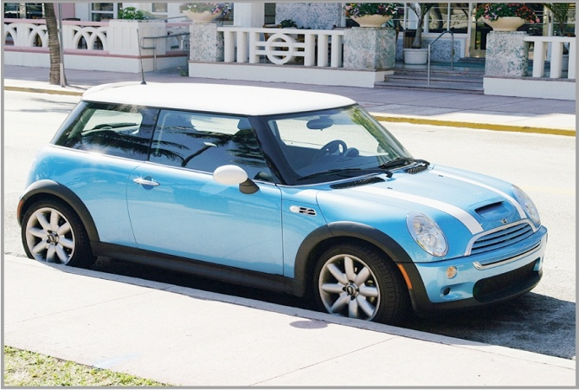
Segmenting by Psychographics
Psychographics: The use of psychological, sociological and anthropological factors to construct market segments.
AIOs: Psychographics segments consumers in terms of shared activities, interests, and opinions.

Slide 47
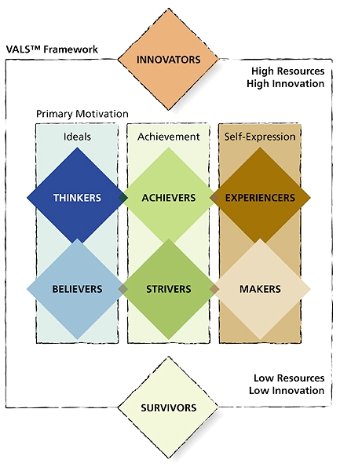
Figure 7.2: VALS

Slide 48
Segmenting by Behavior
Segments consumers based on how they act toward, feel about, or use a product
80/20 rule: 20 percent of purchasers account for 80 percent of a product’s sales
Heavy, medium, and light users and nonusers of a product
Usage occasions
AMAZON.COM

Slide 49
Segmenting Business-to-Business Markets
By organizational demographics
By production technology used
By whether customer is a user/nonuser of product
By North American Industry Classification System (NAICS)

Slide 50
Step 2: Targeting
Marketers evaluate the attractiveness of each potential segment and decide in which they will invest resources to try to turn them into customers
Target market: customer group(s) selected

Slide 51
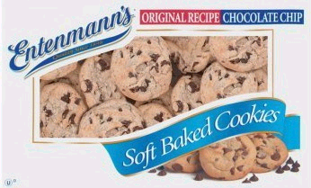
Evaluation of Market Segments
A viable target segment should:
  Have members with similar product needs/wants
  Be measurable in size and purchasing power
  Be large enough to be profitable
  Be reachable by marketing communications
  Have needs the marketer can adequately serve

Slide 52
Developing Segment Profiles
Need to develop a profile or description of the “typical” customer in a segment.
Segment profile might include demographics, location, lifestyle, and product-usage frequency.

Slide 53
Choosing a Targeting Strategy
Undifferentiated targeting: appealing to a broad spectrum of people
Differentiated targeting: developing one or more products for each of several customer groups
Concentrated targeting: offering one or more products to a single segment

Slide 54
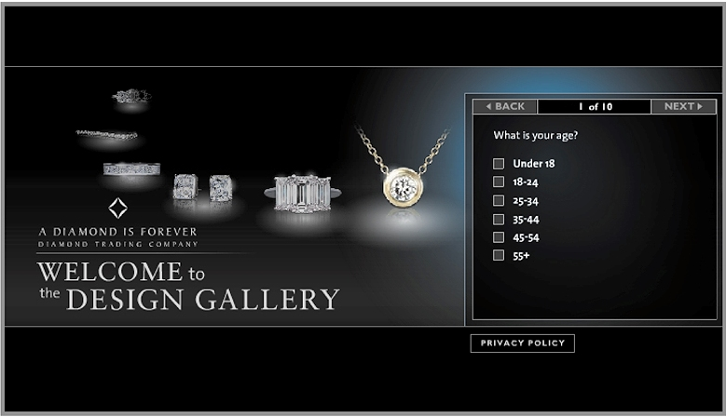
Choosing a Targeting Strategy (cont’d)
Custom marketing: tailoring specific products to individual customers
Mass customization: modifying a basic good or service to meet the needs of an individual

Slide 55
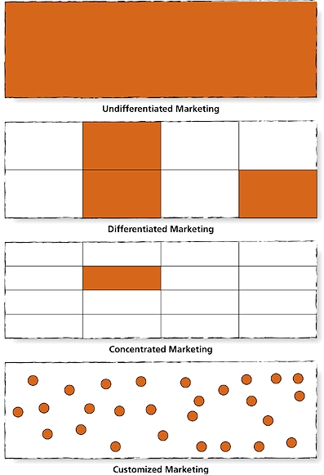
Figure 7.3: Choosing a Target Marketing Strategy

Slide 56

Step 3: Positioning
Developing a marketing strategy aimed at influencing how a particular market segment perceives a good/service in comparison to the competition

Slide 57

Steps in Developing a
Positioning Strategy
Analyze competitors’ positions.
Offer a good/service with competitive advantage.
Match elements of the marketing mix to the selected segment.
Evaluate target market’s responses and modify strategies if needed.

Slide 58
Positioning (cont’d)
Repositioning: redoing a product’s position to respond to marketplace changes.
Retro brand: a once-popular brand that has been revived to experience a popularity comeback, often by riding a wave of nostalgia.

Slide 59
The Brand Personality
A distinctive image that captures the brand’s character and benefits
Perceptual map: a picture of where products/brands are “located” in consumers’ minds

Slide 60
Ideal Points
Customer perceptions
Aggregation of individuals
    Distributions around points
Different shapes
    Optimal points, vectors
Segment variations
Evolutionary progression
    Nice to have => Must have

Slide 61
Preference Models
Ideal points (individuals)
Clusters (segments)
Proximity (preference)

Slide 62
In general ...
Most of a brand’s sales will come from the segments with the closest ideal points
Most of a segment’s sales (share) will go to the brands closest to its ideal point

Slide 63
Targeting Strategies
Direct hit …
single product ‘right on’
Bracketing
multiple products ‘surround’
“Tweeners”
single product ‘splitting the difference’
to induce a new segmentation

Slide 64
Beer Market
Perceptual Mapping
Regular
Popular with Men
Full Bodied
Heavy
Old Milwaukee
Budweiser
Beck’s
Meister Brau
Special Occasions
Heineken
Miller
Blue Collar
Dining Out
Premium
Good Value
Coors
Budget
Stroh’s
Premium
Michelob
Coors Light
Popular with Women
Miller Lite
Pale Color
On a Budget
Old
Milwaukee Light
Light
Light
Less Filling
Notes:
17

Slide 65
Customer Relationship Management (CRM)
Sees marketing as a process of building long-term relationships with customers to keep them satisfied and coming back.
CRM facilitates one-to-one marketing.

Slide 66
Four Steps in One-to-One Marketing
Identify customers; know them in as much detail as possible.
Differentiate customers by their needs and value to the company.
Interact with customers; find ways to improve the interaction.
Customize some aspect of the products you offer each customer.

Slide 67
CRM: A New Perspective on an
Old Problem
CRM systems use computers, software, databases, and the Internet to capture information at each touch point between customers and companies, to allow better customer care.
CRM proposes that customers are relationship partners, with each partner learning from the other every time they interact.

Slide 68
Characteristics of CRM
Share of customer (vs. share of market)
Lifetime value of the customer
Customer equity
Focus on high-value customers

Slide 69
Real People, Real Choices
Reebok (Que Gaskins)
Que chose option 2: build on Reebok’s success with Iverson, while separating the brand from other performance sneaker brands like Nike
  Reebok created a new category called Rbk that fuses sports with youth lifestyle and entertainment

Slide 70
Pertanyaan
Pilihlah dan jelaskan iklan dari perusahaan yang berbasis di Indonesia yang menunjukkan
  Ketiga level dari Relationship Marketing
  Segmentasi Pasar
  Cobranding

