Slide 1
UML
(Unified Modeling Language)

Slide 2
UML is used to model (i.e., represent) the system being built. Taken in total, the UML model that you build will represent, to a certain level of fidelity, the real system that will be constructed. However, it is impossible to capture all the subtle details of a complex software system in just one large diagram. The UML has numerous types of diagrams, each providing a certain view of your system.
One must understand both the structure and the function of the objects involved. One must understand the taxonomic structure of the class objects, the inheritance mechanisms used, the individual behaviors of objects, and the dynamic behavior of the system as a whole. The problem is somewhat analogous to that of viewing a sports event such as tennis or a football game. Many different camera angles are required to provide an understanding of the action taking place. Each camera reveals particular aspects of the action that could not be conveyed by one camera alone” .

Slide 3
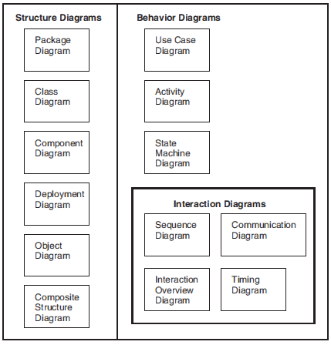
UML Diagrams

Slide 4
Conceptual, Logical and Physical Models
The models of your system may present various levels of detail as your system development progresses and matures over time. The conceptual model captures the system in terms of the domain entities that exist (or will exist) and their association with other such entities of your system. The conceptual level of modeling is performed using the terminology of your business domain and should be technology-agnostic. The logical view of a system takes the concepts created in the conceptual model and establishes the existence and meaning of the key abstractions and mechanisms that will determine the system’s architecture and overall design. The physical model of a system describes the concrete software and hardware composition of the system’s implementation. Obviously, the physical model is technology-specific.

