Slide 1
Chapter 6
Supply Chain Management & ERP

Slide 2
Learning Objectives
Understand the concept of the supply chain, its importance and management.
Describe the problems of managing the supply chain and some innovative solutions.
Trace the evolution of software that supports activities along the supply chain.
Understand the relationships among enterprise resources planning (ERP), supply chain management (SCM), and e-Commerce.
Describe order fulfillment problems and solutions in e-Commerce and how EC solves other supply chain problems.

Slide 3
Case: How Dell Reengineered its Supply Chain
Problem:
Dell pioneered the mail order approach to selling PCs
In 1993, Compaq cuts prices to drive Dell out of the market. Dell experiences $65 million in losses.
Solution:
Dell implements the following re-engineering strategies:
mass customization
just-in-time marketing
electronic orders & shipments
e-collaboration with major buyers
reduction in testing period
monitoring of productivity & returns on investments

Slide 4
Case: How Dell Reengineered its Supply Chain (cont.)
Results:
In 2001, Dell made over $4 million in computer web sales/ day.
Becomes leader in Customer Relationship Management (CRM)
Online tracking of orders & shipments
Viewer approved configurations and pricing
Customized home pages for clients.
Use of Intelligent Agents in production process.
Increased communication with suppliers.
By 1999, Dell becomes the number two PC seller and is a leader in management & profitability.

Slide 5
Lessons from the Case
By introducing a new business model , one can change the manner in which business is done.
To implement this model on a large scale, one needs to build superb supply chain management.
Another major success factor in Dell’s plans was the improvements made in its logistics system along the entire supply chain.
Improved communications and customer service, which are part of Dell’s CRM program, are the cornerstones of its success.
Dell was using c-Commerce with its business partners.

Slide 6
Supply Chain & Value Chain Definitions
SUPPLY CHAIN
flow of materials, information, payments, and services from raw material suppliers, through factories and warehouses, to the end customers.
DEMAND CHAIN
the process of taking orders.
SUPPLY CHAIN MANAGEMENT (SCM)
to plan, organize, and coordinate all the supply chain’s activities.

Slide 7
Benefits of SCM
Reduces uncertainty & risks in the supply chain.
This positively affects inventory levels, cycle time, business processes & customer service.
Contributes to overall increase in profitability & competitive advantage.

Slide 8
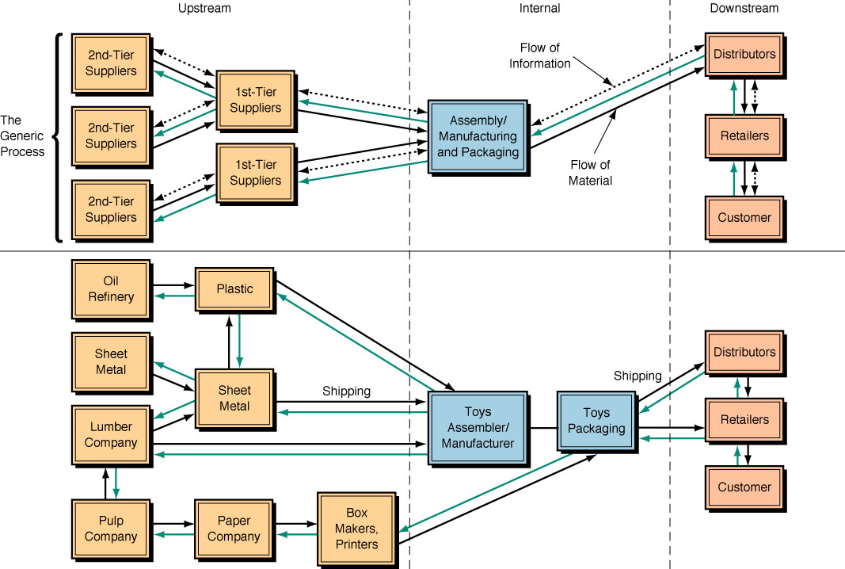
Components of Supply Chain

Slide 9
Components of Supply Chains
Upstream Supply Chain
Organization’s first tier suppliers & their suppliers.
Internal Supply Chain
Processes used by an organization to transform their inputs to outputs.
Downstream Supply Chain
Processes involved in delivering the product to the final customers.

Slide 10
The Supply Chain
Involves the life of a product from ‘dirt to dust’.
Involves movement of tangible & intangible inputs.
Can come in all shapes and sizes and may be fairly complex.
Can be bi-directional and involve the return of products (reverse logistics)
The flow of goods, services, information & financial resources must be followed with an increase in value.

Slide 11
Supply Chain Problems
Problems with the Supply Chain have caused armies to lose wars & companies to go out of business, for example…
In WWII, Germany encountered problems supplying troops in Russia, which contributed to their collapse.
In 1999 ToysRUS
had problems
supplying to
holiday shoppers
& lost business.

Slide 12
Sources of Supply Chain Problems
UNCERTAINTY
In demand forecast
In delivery times &
production delays
POOR COORDINATION
With Internal units and
business partners
Ineffective customer
service
High inventory costs, loss of revenue & extra cost for expediting services.

Slide 13
The Bull Whip Effect
The most persistent SCM problem.
Erratic shifts in orders up & down the supply chain.
Distributor orders fluctuate because of poor demand forecast, price fluctuation, order batching & rationing with supply chain.
Example: Porter & Gamble’s distortion in SCM for manufacturing of disposable diapers.
Avoidable with proper interorganizational EC.
EDI, Extranets & Groupware technology

Slide 14
Solutions to Supply Chain Problems
Vertical Integration
Purchasing & managing the supply source.
Building Inventories
“Insurance” against supply chain shortages.
Main problem: It is difficult to correctly determine inventory level for each product & part. This can be costly.

Slide 15
CASE: How Littlewoods Improved its SCM
Problem:
Littlewoods Large British clothing retailer with 136 stores in the UK & Ireland.
Overstocking problems in the supply chain management.
Solution:
Introduced web-based performance reporting system.
Enabled merchandising personnel to make more accurate stock, sales and supplier decisions.
Results:
In 1997, Littlewoods saves $1.2 million as a direct result of its strategic price merchandizing.

Slide 16
Other Solutions to SCM Problems
During peak times, outsource rather than do-it-yourself.
“Buy” rather than “make” production inputs when appropriate.
Configure optimal shipping plans.
Create strategic partnerships with suppliers.
Use the just-in-time approach to purchasing.
Reduce the lead time for buying and selling.
Use fewer suppliers.
Improve supplier-buyer relationships.
Manufacture only after orders are in.
Achieve accurate demand by working closely with suppliers.

Slide 17
Two Tools for Reducing Supply Chain Problems
Supply Chain Teams
“Teams of tightly integrated business that work together and serve the customers”
Measurements & Metrics
Use of IT for measuring areas in need of improvement. For example;
Delivery on time
Quality at unloading area
Cost performance
Lead time for procurement

Slide 18
COMPUTERIZED SYSTEMS & S.C.M.
PHASE 1: 1950s - 60s, the first software programs to support the supply chain arrive.
PHASE 2: Development of the Material Requirement Protocol (MRP).
PHASE 3: Enhanced MRP known as Material Resource Planning become available.
PHASE 4: Enterprise Resource Planning (ERP) integrates transaction processing activities.
PHASE 5: Extended ERP/SCM software.

Slide 19
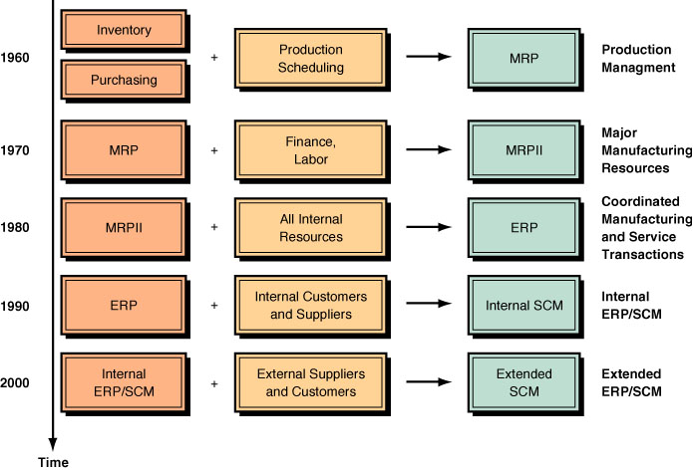
COMPUTERIZED SYSTEMS & S.C.M.

Slide 20
Benefits of Systems Integration Source: Sandoe & Saharia (2001)
TANGIBLE BENEFITS
Inventory reduction
Personnel reduction
Productivity improvement
Order management improvement
Financial-close cycle improvements
IT cost reduction
Procurement cost reduction
Revenue/profit increases, etc.
INTANGIBLE BENEFITS
Information visibility
New/improved processes
Customer responsiveness
Standardization
Flexibility
Globalization and business performance

Slide 21
Value Chain Integration
“The process by which multiple enterprises within a shared market channel collaboratively plan, implement, and manage (electronically as well as physically) the flow of goods, services, and information along the entire chain in a manner that increases customer-perceived value.“

Slide 22
Integrating the Supply Chain & Value Chain
A Supply Chain transforms into an integrated Value Chain when it…..
Extends the chain all the way from sub-suppliers to customers.
Integrates the back-office operations with those of the front office.
Becomes highly customer-centric, focusing on demand generation and customer service.
Is proactively designed by chain members to compete as an “extended enterprise”.
Seeks to optimize the value added by information and utility-enhancing services.

Slide 23
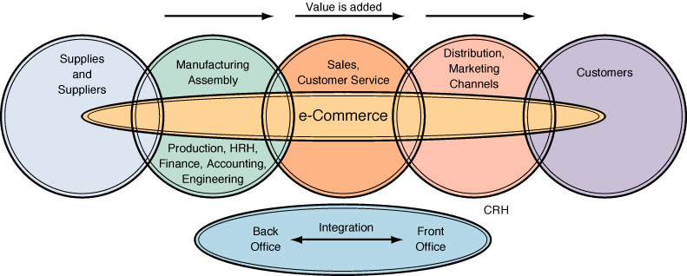
Value Chain Integration

Slide 24
Case: Warner-Lambert’s Integrated Supply Chain
Problem:
WL requires assistance with demand forecast of products.
Solution:
They use Manugistic Inc.’s Demand Planning Information System to analyze their manufacturing, distribution and sales data.
The system is able to anticipate seasonal impact or a production line problem.
Results:
WL increases its ‘shelf fill’ rate from 87% to 98%, earning them $8 million/year in additional sales.

Slide 25
Enterprise Resource Planning
ERP = Process of planning & managing all resources & their use in the entire enterprise.
Leading ERP software producers
SAP, Oracle, J.D. Edwards, Computer Associates, People Soft
MAIN OBJECTIVE of ERP
⬇
to integrate all departments & functions across a company onto a single computer system.

Slide 26
Functions of ERP
Provides a single interface for managing routine manufacturing activities.
Facilitates customer interaction & manages relationships with suppliers & vendors.
Forces discipline & organization around business.
Supports administrative activities.

Slide 27
Post- ERP: 2nd Generation ERP
By the late 1990s, the major benefits of ERPs had been fully exploited.
There was a need for planning systems oriented towards decision-making.
Emergence of SCM systems that complement ERP systems.
Provide intelligent decision support capabilities.
Overlay existing system & pull data from every step of the supply chain.

Slide 28
How is SCM Integration Achieved?
FIRST APPROACH
Work with different software products from different vendors (i.e. one for ERP & one for SCM).
SECOND APPROACH
ERP vendors add decision support and business intelligence capabilities.
Creation of 2nd generation ERP.

Slide 29
3 Ways to Provide Supply Chain Intelligence
Use an enhanced ERP package that includes business intelligence capabilities
Integrate the ERP with business intelligence software from a specialized vendor such as Brio, Cognus, or Comshare.
Create a “best of breed” system by using components from several vendors that will provide the required capabilities.

Slide 30
Componentization
Breaking large ERP systems into individual components that work together.
Makes it easier for ERP vendors to enhance their solutions and for customers to upgrade their software.
Helps vendors extend the core ERP system with supply chain, sales force automation solutions, and customer relationship management (CRM).

Slide 31
ERP Implementation To avoid failures, the following factors should be considered;
The customer’s expectations.
The ERP product capabilities, and gaps.
The level of change the customer has to go through to make the system fit.
The level of commitment within the customer organization to see the project through.
The customer’s organization and culture.
The risks presented by politics within the customer organization.
The consultant’s capabilities, responsibilities and role (if applicable).

Slide 32
Application Service Providers & ERP Outsourcing
“ASP alternative” = A popular option today for businesses that want ERP functions but lease applications rather than building systems.
Application Service Provider (ASP) is a software vendor that offers to lease ERP-based applications to other businesses.
The ASP concept is especially useful in ERP projects, which are expensive to install and take a long time to implement, and for which staffing is a major problem.

Slide 33
Global Supply Chains
Some of the issues involved in global supply chains;
legal issues, customs fees and taxes
language and cultural differences
fast changes in currency exchange rates
political instabilities.
Global Supply Chains = Supply chains that involve suppliers and/or customers in other countries.

Slide 34
CASE: LEGO Struggles with Global Issues
Problem:
In a rush to get its innovative product to market, Lego did not first solve all necessary issues, for example;
The need for a supportive distribution & service system.
Merging the offline and online operations
Existing warehouses were not optimized to handle distribution to individual customers
How to handle returns around the globe.
Invoicing must comply with the regulations of many countries.
Results:
Lego closed the Web site for business. It took almost a year to solve all global trade-related issues.

Slide 35
How EC contributes to SCM
Digitizes products such as software, which expedites the flow of materials.
Replaces all paper documents with electronic documents.
Replaces faxes, phone & telegrams with electronic messaging system.
Enhances collaboration & information sharing.
Change the nature and structure of the supply chain from linear to a hub.
Results in shorter supply chain and minimum inventories.
Facilitates customer service.
Introduces efficiencies in buying & selling through the creation of e-marketplaces.

Slide 36
Buying & Selling along the Supply Chain
A major role of EC is to facilitate buying and selling along the supply chain. The major activities are;
UPSTREAM
INTERNAL SCM
DOWNSTREAM
COMBINED UPSTREAM / DOWNSTREAM

Slide 37
Integration of EC with ERP
Since most middle-sized and large companies already have an ERP system, and since EC needs to interface with ERP, it makes sense to interconnect the two.
By extending the existing ERP system to support e-commerce, organizations not only leverage their investment in the ERP solution, but also speed up the development of EC applications.
The problem is that the ERP software is very complex and inflexible (difficult to change), so it is difficult to achieve easy, smooth, and effective integration.

Slide 38
Order Fulfillment in EC
When a company sells direct to customers it is involved in the following activities:
Quickly find the products to be shipped, and pack them.
Arrange for the packages to be delivered quickly to the customer’s door.
Collect the money, either in advance, in COD, or by individual bill.
Handle the return of unwanted or defective products.
Many companies find it very difficult to fulfill these activities effectively & efficiently. This reveals that they have problems in their own supply chains.

Slide 39
Online Order Fulfillment & Logistics
While order fulfillment is a part of the back-office operations, it is strongly related to front-office operations.
Recently, e-Tailors have faced continuous problems in order fulfillment, especially during the holiday season.
For example, Amazon.com had to add physical warehouses in order to expedite deliveries and reduce order fulfillment costs.
EC is based on the concept of “pull” operations, which begin with an order, frequently a customized one.
In the “pull” case it is more difficult to forecast demand.
Furthermore, in a B2C pull model, the goods need be delivered to the customer’s door.

Slide 40
Innovative Solutions to Supply Chain Problems
Galleryfurniture.com
Uses dozens of cameras, (Webcam) to demonstrate its product inventory on the Web. This is an alternative to paper or electronic catalogs.
Garden.com Developed proprietary software that allows it to collaborate with its 70 suppliers efficiently and effectively.
Mail Boxes Etc. & Return.com Developed a logistics system that determines whether a customer is entitled to a return & refund.
.
Rightfreight.com Manages a marketplace that helps companies with goods to find "forwarders" -- the intermediary that prepare goods for shipping.

Slide 41
Automated Warehouses
Traditional warehouses are built to deliver large quantities to a small number of stores and plants. But in B2C EC, companies need to send small quantities to large number of individuals.
Large-volume EC fulfillment requires special automated warehouses.
This may include robots and other devices that expedite the pick up of products.
Most B2C is shipped via outsourcers.
Fingerhut handles the logistics of mail orders (including online orders) for Wal-Mart, Macys, and many others.

Slide 42
Options for Dealing with Returns
Return an item to the place where it was purchased.
This only works when there is a small amount of returns.
Returns are shipped to an independent unit and handled separately inside the company.
May be more efficient, but the buyer is still unhappy.
Allow the customer to physically drop the returned items at collection stations.
Such as convenience stores or Mail Boxes, Etc.
Completely outsource returns.
Several outsourcers, including UPS provide such services.

Slide 43
MANAGERIAL ISSUES
Ethical issues. Conducting a supply chain management project may result in the need to lay off, retrain, or transfer employees. Other ethical issues may involve sharing of personal information and computer programs.
How much to integrate? While companies should consider extreme integration projects, including ERP, SCM, and electronic commerce, they should recognize that integrating sometimes results in failure.
Role of IT. Almost all major SCM projects use IT. However, it is important to remember that technology plays a supportive role to organizational and managerial issues.

