Slide 1
Supply Chain Management

Slide 2
Supply Chain
All facilities, functions, activities, associated with flow and transformation of goods and services from raw materials to customer, as well as the associated information flows
An integrated group of processes to “source,” “make,” and “deliver” products

Slide 3
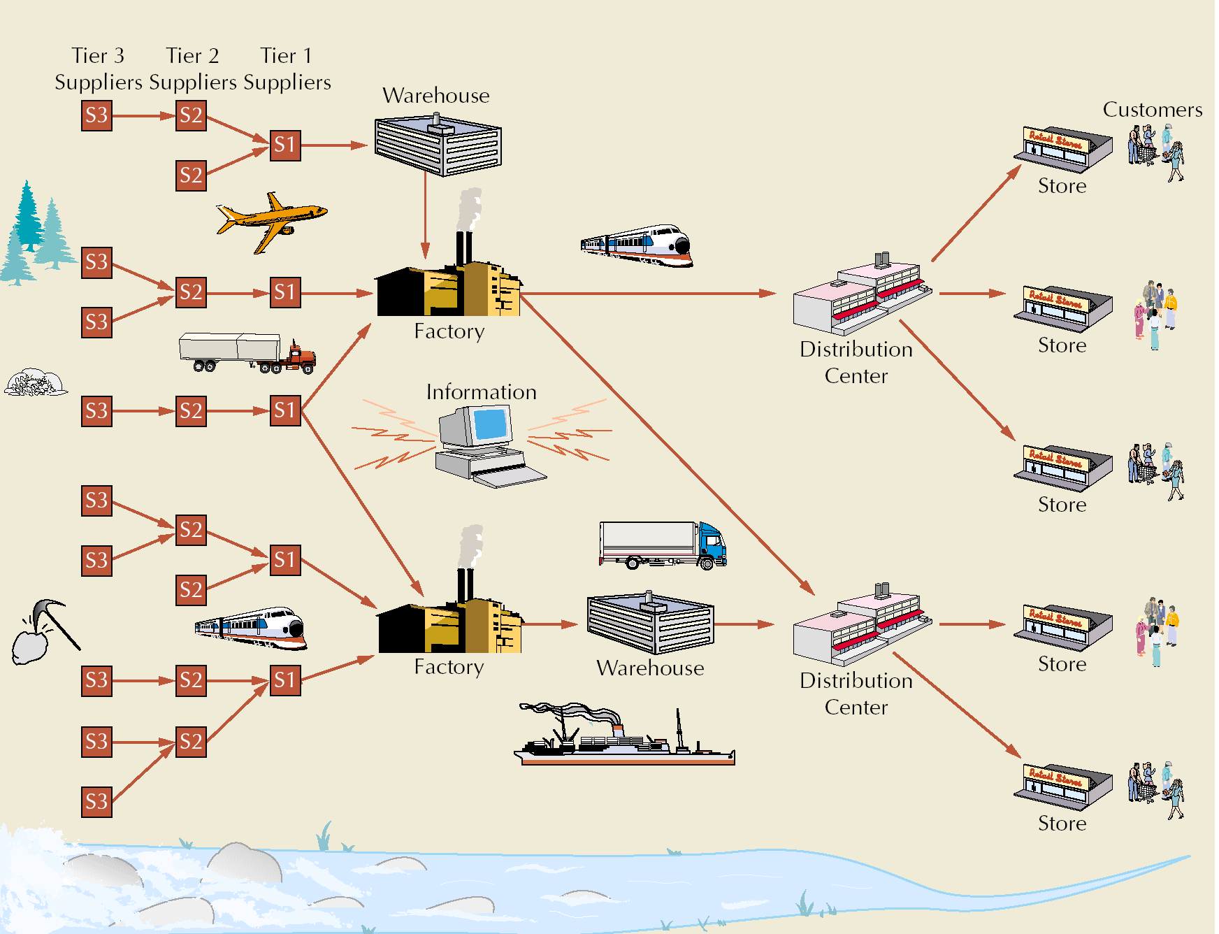
Supply Chain Illustration

Slide 4
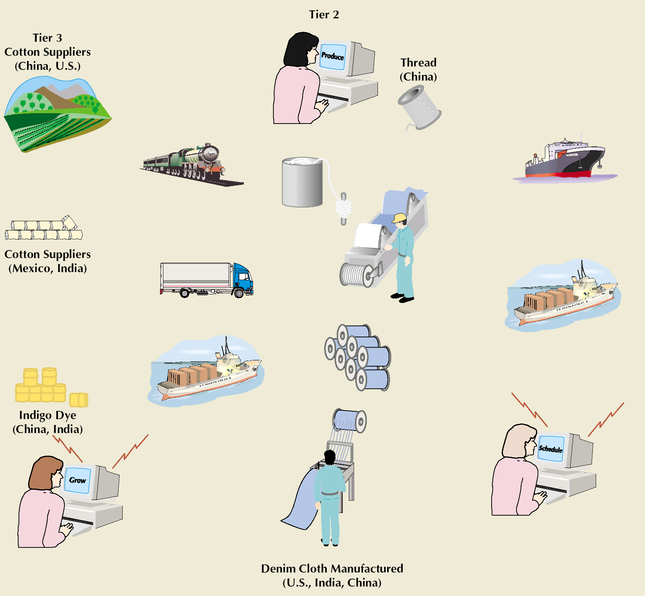
Supply Chain for Denim Jeans

Slide 5
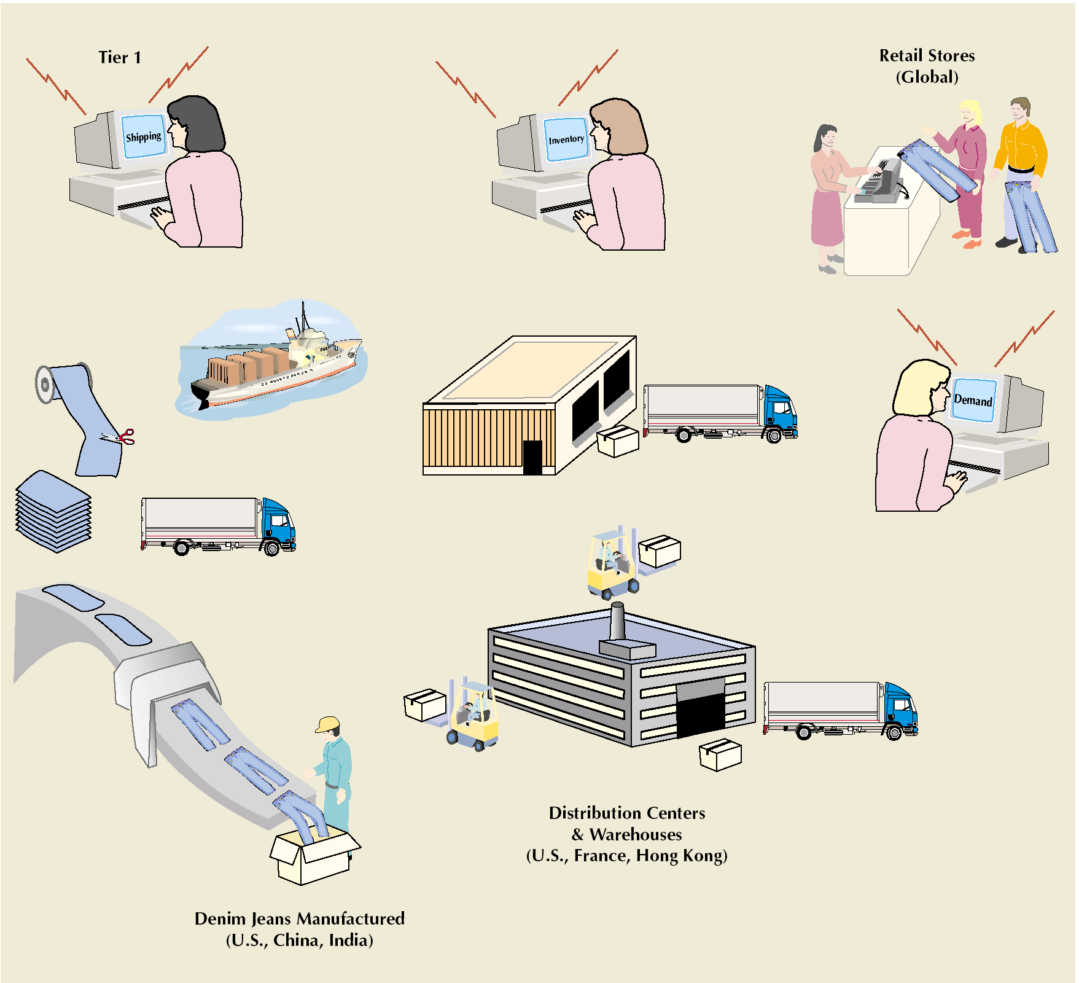
Supply Chain for Denim Jeans (cont.)

Slide 6
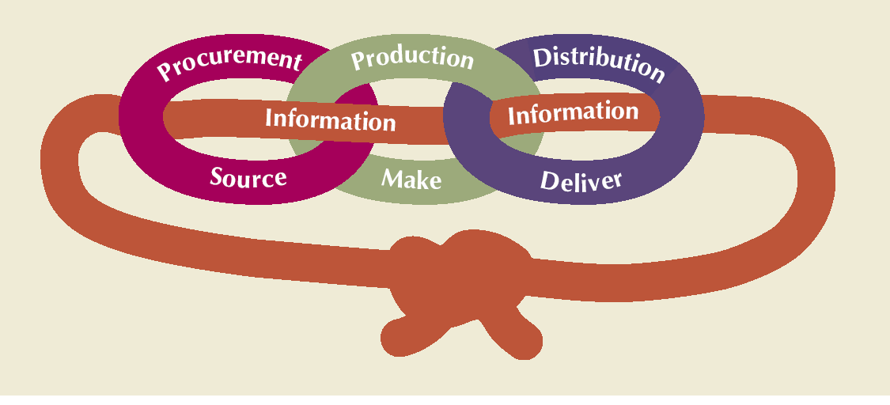
Supply Chain Processes

Slide 7
Supply Chain for Service Providers
More difficult than manufacturing
Does not focus on the flow of physical goods
Focuses on human resources and support services
More compact and less extended

Slide 8
Value vs. Supply Chain
Value chain
  every step from raw materials to the eventual end user
  ultimate goal is delivery of maximum value to the end user
Supply chain
  activities that get raw materials and subassemblies into manufacturing operation
Terms are used interchangeably

Slide 9
Supply Chain Management (SCM)
Managing flow of information through supply chain in order to attain the level of synchronization that will make it more responsive to customer needs while lowering costs
Keys to effective SCM
  information
  communication
  cooperation
  trust

Slide 10
Supply Chain Uncertainty
One goal in SCM:
  respond to uncertainty in customer demand without creating costly excess inventory
Negative effects of uncertainty
  lateness
  incomplete orders
Inventory
  insurance against supply chain uncertainty
Factors that contribute to uncertainty
  inaccurate demand forecasting
  long variable lead times
  late deliveries
  incomplete shipments
  product changes batch ordering
  price fluctuations and discounts
  inflated orders

Slide 11
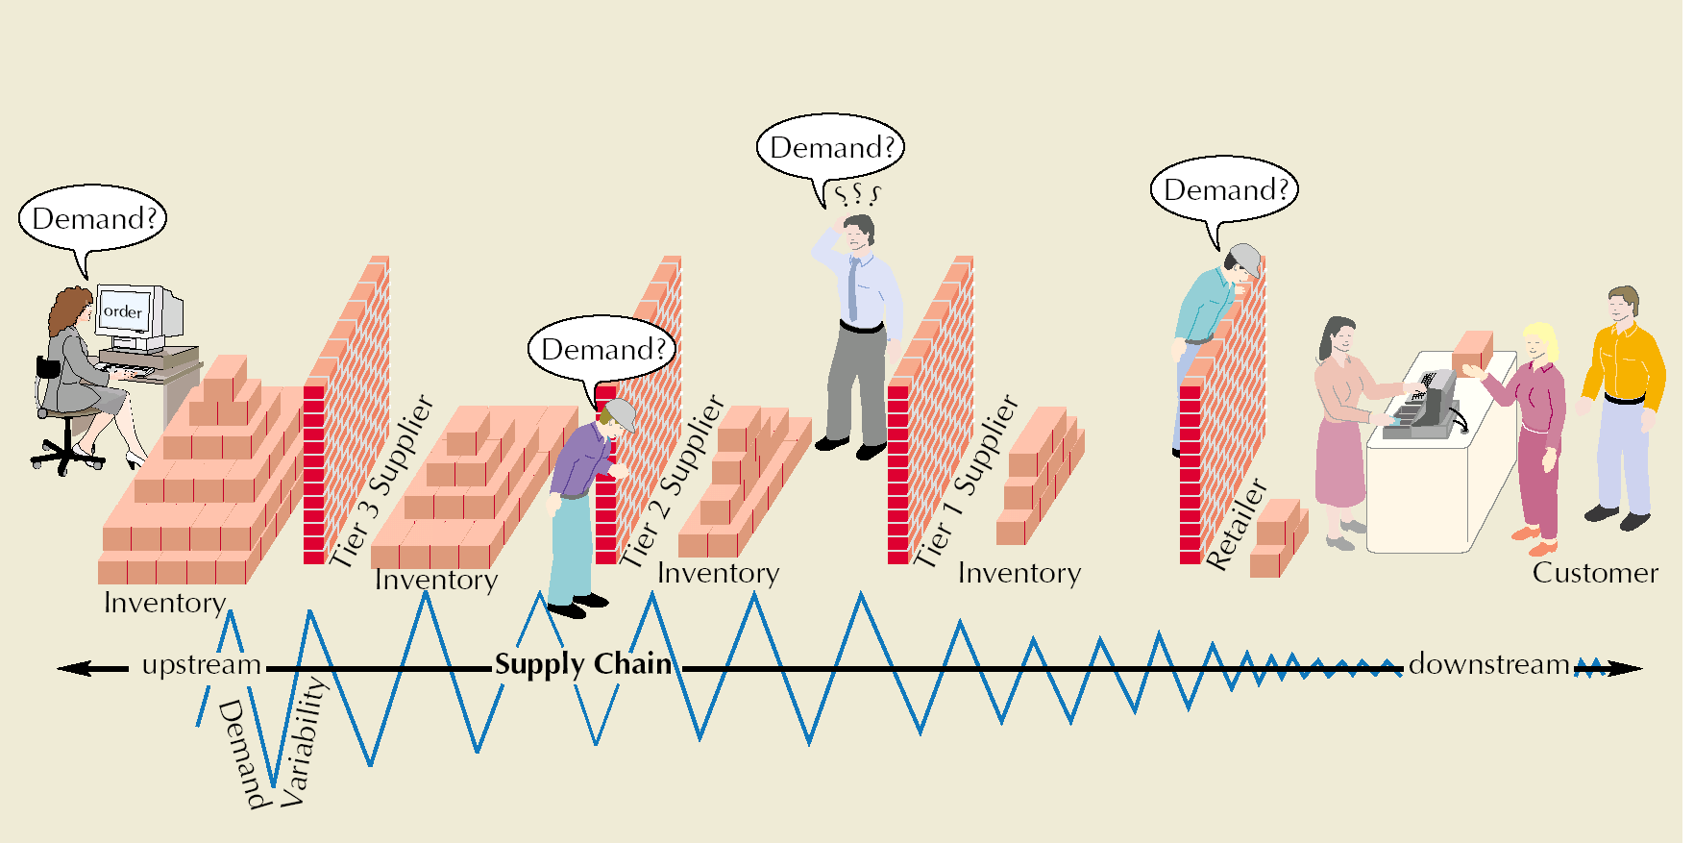
Bullwhip Effect
Occurs when slight demand variability is magnified as information moves back upstream

Slide 12
Information Technology: A Supply Chain Enabler
Information links all aspects of supply chain
E-business
  replacement of physical business processes with electronic ones
Electronic data interchange (EDI)
  a computer-to-computer exchange of business documents
Bar code and point-of-sale
  data creates an instantaneous computer record of a sale
Radio frequency identification (RFID)
  technology can send product data from an item to a reader via radio waves
Internet
  allows companies to communicate with suppliers, customers, shippers and other businesses around the world, instantaneously

Slide 13
E-business and Supply Chain
Cost savings and price reductions
Reduction or elimination of the role of intermediaries
Shortening supply chain response and transaction times
Gaining a wider presence and increased visibility for companies
Greater choices and more information for customers

Slide 14
E-business and Supply Chain (cont.)
Improved service as a result of instant accessibility to services
Collection and analysis of voluminous amounts of customer data and preferences
Creation of virtual companies
Leveling playing field for small companies
Gaining global access to markets, suppliers, and distribution channels

Slide 15
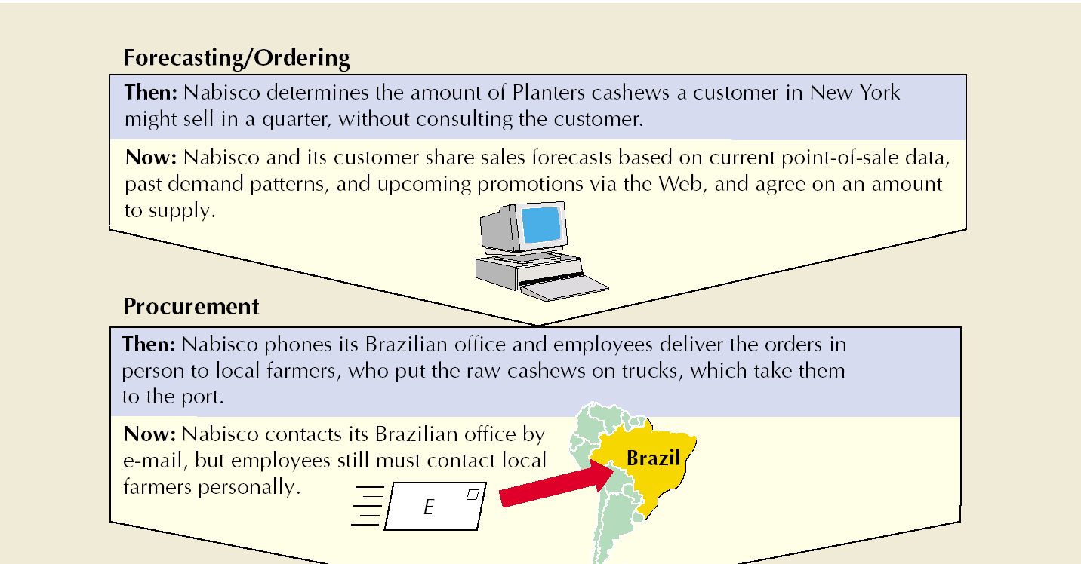
Supply Chain Evolution at Nabisco
Source: F. Keenan, “Logistics Gets a Little Respect,” Business Week (November 20, 2000), pp. 112–115.

Slide 16
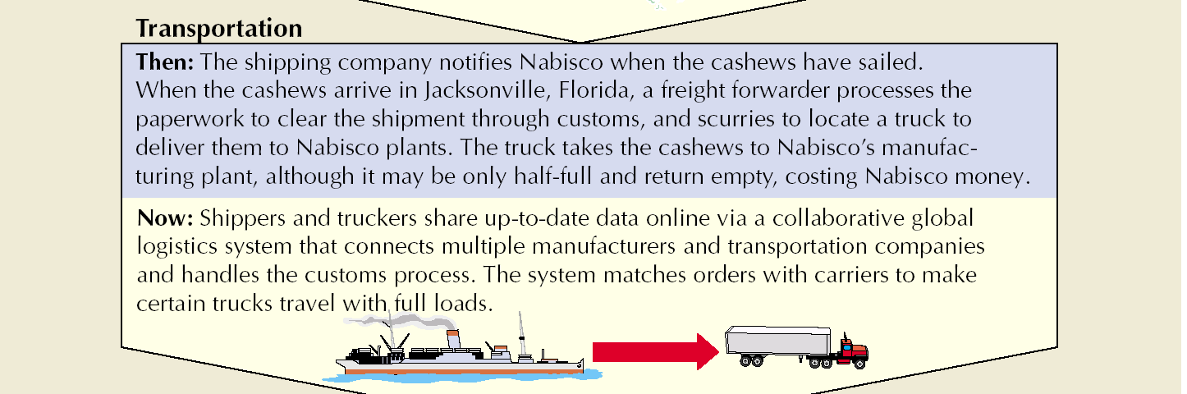
Supply Chain Evolution at Nabisco (cont.)
Source: F. Keenan, “Logistics Gets a Little Respect,” Business Week (November 20, 2000), pp. 112–115.

Slide 17
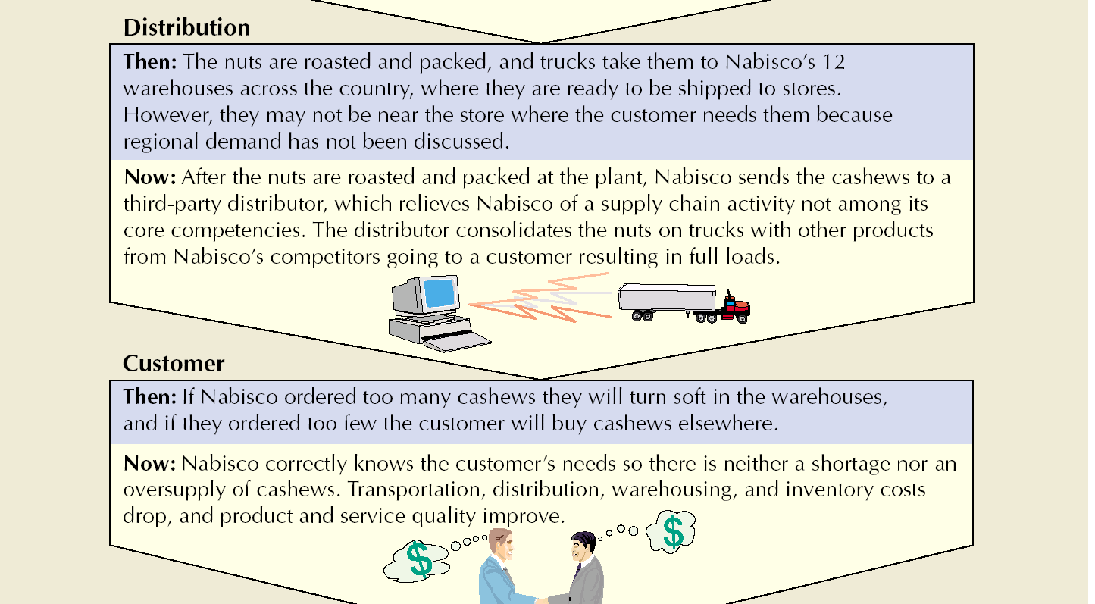
Supply Chain Evolution at Nabisco (cont.)
Source: F. Keenan, “Logistics Gets a Little Respect,” Business Week (November 20, 2000), pp. 112–115.

Slide 18
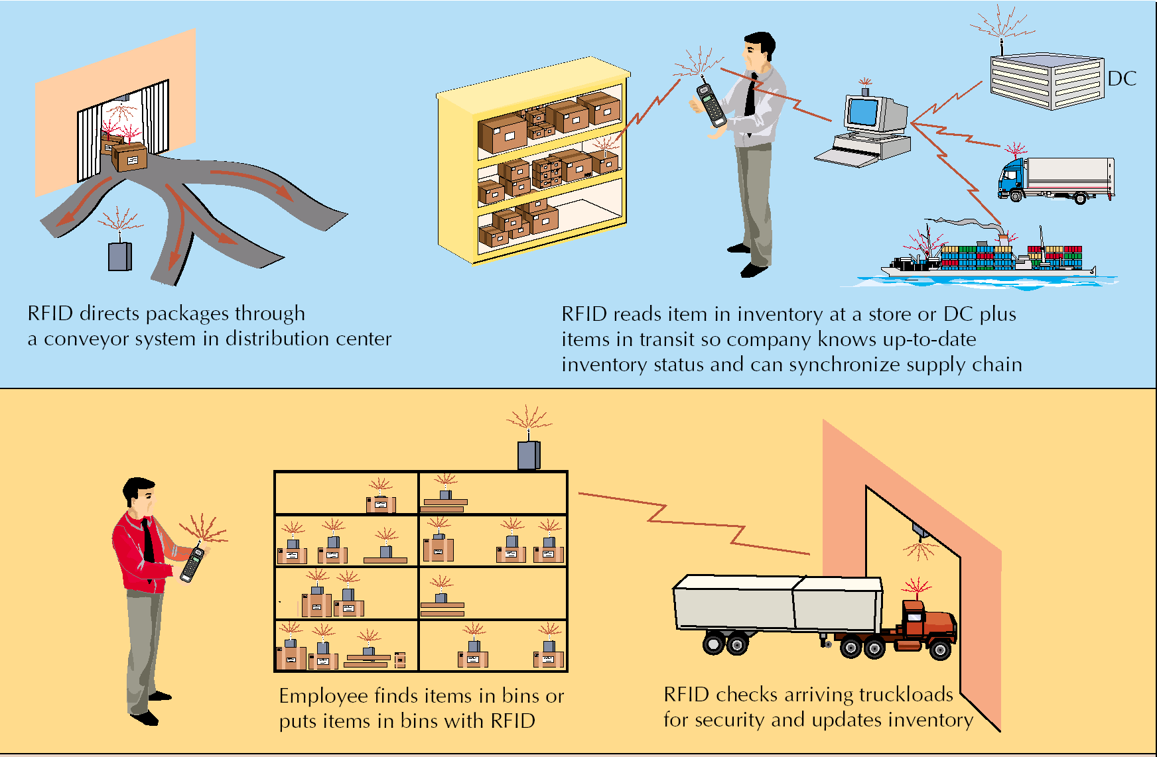
RFID Capabilities

Slide 19
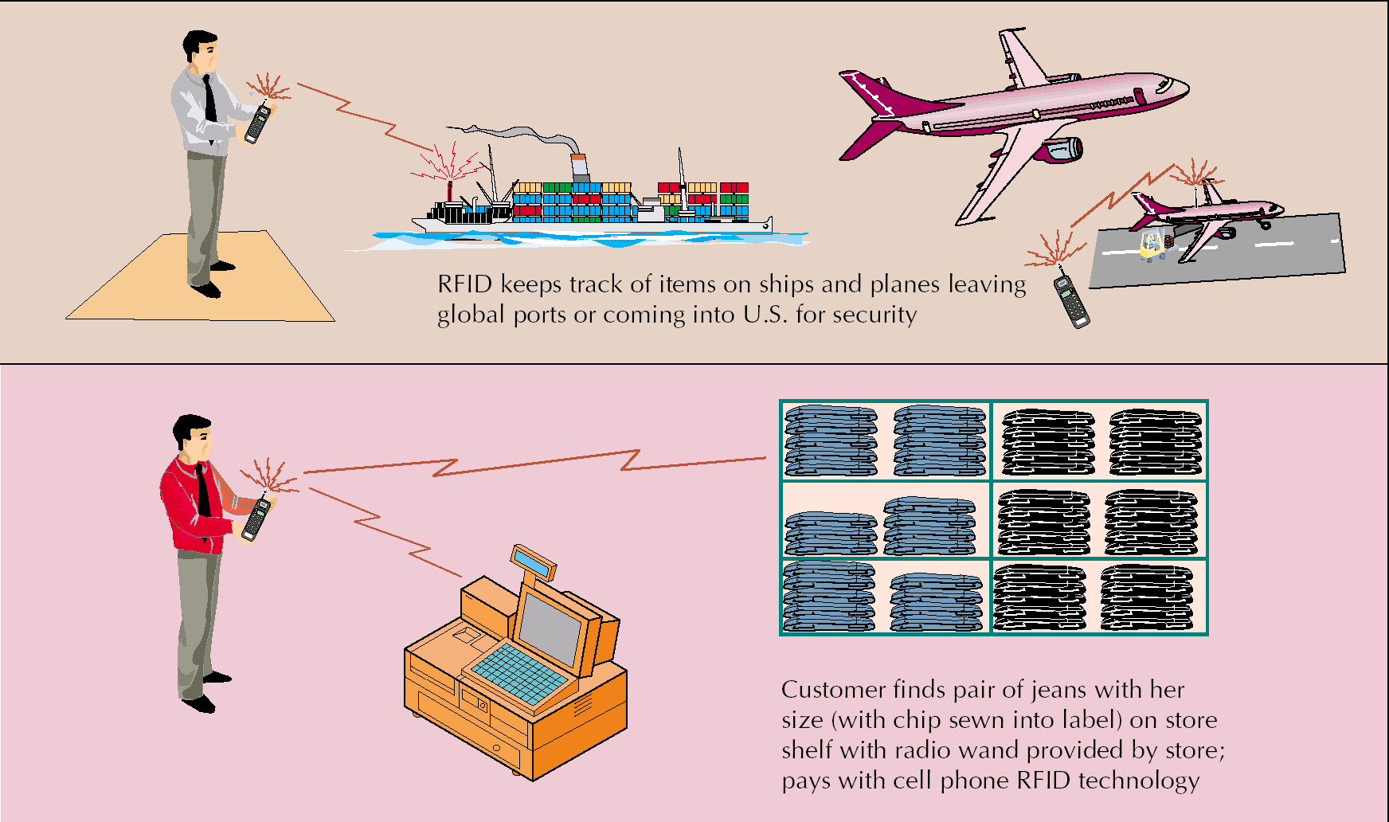
RFID Capabilities (cont.)

Slide 20
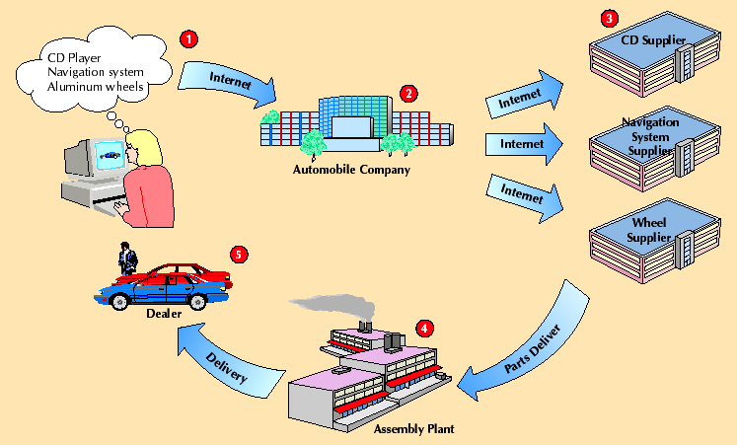
Build-to-order cars over the Internet

Slide 21
E-automotive Supply Chain
Supply Chain
Processes
Automotive
Past
E-Automotive
Customer sales
Production
Distribution
Customer relationship
Push—sell from inventory stock
Goal of even and stable production
Mass approach
Dealer-owned
Pull—build-to-order
Focus on customer demand, respond with supply chain flexibility
Fast, reliable, and customized to get cars to specific customer location
Shared by dealers and manufacturers

Slide 22
E-automotive Supply Chain (cont.)
Supply Chain
Processes
Automotive
Past
E-Automotive
Managing uncertainty
Procurement
Product design
Large car inventory at dealers
Batch-oriented; dealers order based on allocations
Complex products don’t match customer needs
Small inventories with shared information and strategically placed parts inventories
Orders made in real time based on available-to-promise information
Simplified products based on better information about what customers want

Slide 23
Supply Chain Integration
Information sharing among supply chain members
  Reduced bullwhip effect
  Early problem detection
  Faster response
  Builds trust and confidence
Collaborative planning, forecasting, replenishment, and design
  Reduced bullwhip effect
  Lower Costs (material, logistics, operating, etc.)
  Higher capacity utilization
  Improved customer service levels

Slide 24
Supply Chain Integration (cont.)
Coordinated workflow, production and operations, procurement
  Production efficiencies
  Fast response
  Improved service
  Quicker to market
Adopt new business models and technologies
  Penetration of new markets
  Creation of new products
  Improved efficiency
  Mass customization

Slide 25
Collaborative Planning, Forecasting, and Replenishment
Process for two or more companies in a supply chain to synchronize their demand forecasts into a single plan to meet customer demand
Parties electronically exchange
  past sales trends
  point-of-sale data
  on-hand inventory
  scheduled promotions
  forecasts

Slide 26
Suppliers
Procurement
  purchase of goods and services from suppliers
On-demand (direct response) delivery
  requires supplier to deliver goods when demanded by customer
Continuous replenishment
  supplying orders in a short period of time according to a predetermined schedule
Cross-enterprise teams coordinate processes between company and supplier

Slide 27
Outsourcing
Sourcing
  selection of suppliers
Outsourcing
  purchase of goods and services from an outside supplier
Core competencies
  what a company does best
Single sourcing
  a company purchases goods and services from only a few (or one) suppliers

Slide 28
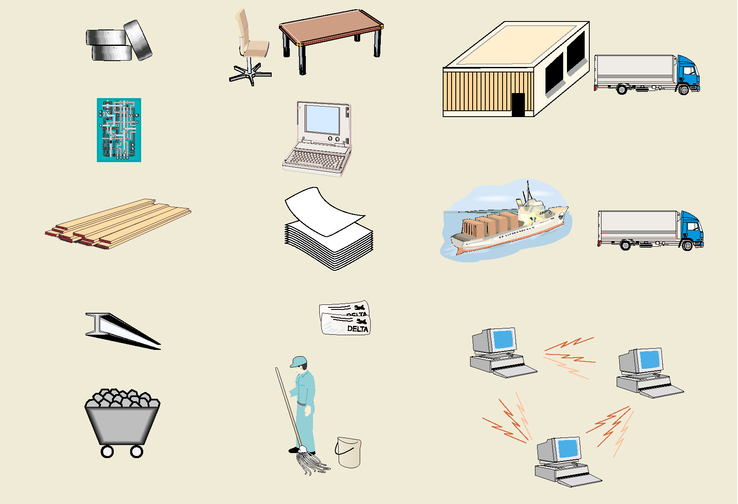
Original Equipment Manufacturer
(OEM)
Maintenance
Repair and
Operation (MPO)
Corporate
Services

