Slide 1
State Machine Diagrams

Slide 2
State machines are well known in industries that use real-time processing. State machine diagrams are used to design and understand time-critical systems, in which the consequences of improper timing are severe. Medical devices, financial trading systems, satellite command and control systems, and weapon systems are typical examples where state machine diagrams can play an important role in understanding how systems behave in reaction to key events.
A state machine diagram expresses behavior as a progression through a series of states, triggered by events, and the related actions that may occur. Such state machines are also known as behavioral state machines. State machine diagrams are typically used to describe the behavior of individual objects. However, they can also be used to describe the behavior of larger elements of any system.

Slide 3
State machine diagrams are cousins to activity diagrams. However, state machine diagrams focus on the states and transitions between those states versus the flow of activities. Not every class has significant event-ordered behavior, so we supply state machine diagrams only for those classes that exhibit such behavior. We may also provide state machine diagrams that show the event-ordered behavior of the system as a whole. During analysis, we may use state machine diagrams to indicate the dynamic behavior of the system. During design, we use state machine diagrams to capture the dynamic behavior of individual classes or of collaborations of classes.
The two essential elements of a state machine diagram are states and state transitions.

Slide 4

Essentials: Initial, Final, and Simple States
At any given point in time, the state of an object encompasses all of its (usually static) properties, together with the current (usually dynamic) values of each of these properties. By properties, we mean the totality of the object’s attributes and relationships with other objects. We can generalize the concept of an individual object’s state to apply to the object’s class because all instances of the same class live in the same state space, which encompasses an indefinite yet finite number of possible (although not always desirable or expected) states.
When an object is in a given state, it can do the following:
  Execute an activity
  Wait for an event
  Fulfill a condition
  Do some or all

Slide 5

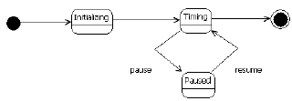
Essentials: Transitions and Events
The movements between states are called transitions. On a state machine diagram, transitions are shown by directed arrows between states. Each state transition connects two states.
While transitions often show how an object moves between states, they may also be recursive, showing an exit from and reentry into the same state. The UML elements described thus far constitute the essential elements of all state transition diagrams. Collectively, they provide a notation sufficient to describe simple, flat, finite state machines, suitable for applications with a limited number of states.

Slide 6
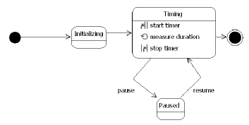
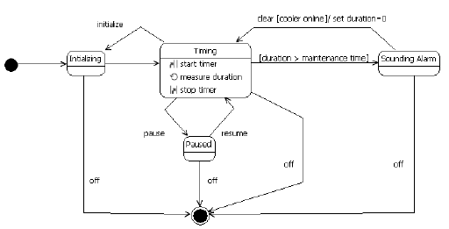

Slide 7
A state-machine diagram is a picture that describes the different statuses (states) of an object and the events and conditions that cause an object to pass from one state to another. The diagram describes the life of a single object over a period of time—one that may span several system use cases. 1 For example, a state-machine diagram might show the different statuses of an insurance claim (Received, Validated, Under Adjustment, Adjusted, Paid, Not Paid, and so on).

Slide 8
In this diagram, a box with rounded corners indicates a state, with a label giving its name. An arrow indicates a transition to another state – the label on the arrow indicates the trigger that causes the transition. A black circle with an arrow coming out of it points to an initial state – a state into which an object can be born. An arrow pointing to a ringed black circle indicates that the source is a ﬁnal state – a state where an object can end its life.

Slide 9
State: “A state models a situation during which some (usually implicit) invariant condition holds. The invariant may represent a static situation such as an object waiting for some external event to occur. However, it can also model dynamic conditions such as the process of performing some behavior (i.e., the model element under consideration enters the state when the behavior commences and leaves it as soon as the behavior is completed).”
A state is a status that an object may have. The object may be in a dormant (static) state, which it exits once an event it is waiting for finally occurs; an example is the state Waiting for Receipt of Proposal, which ends once a proposal has been received. Alternatively, an object may be in an active state, which it exits once activities associated with the state have been completed; an example is the state Under Adjudication, which ends once adjudication activities have been completed.

Slide 10
State machine: “State machines can be used to express the behavior of part of a system. Behavior is modeled as a traversal of a graph of state nodes interconnected by one or more joined transition arcs that are triggered by the dispatching of series of (event) occurrences. During this traversal, the state machine executes a series of activities associated with various elements of the state machine.”
A state machine is a model of the statuses through which an object passes; the model describes the events and conditions that cause it to move from state to state and the activities associated with each state. The model may be depicted as a state-machine diagram.
A transition is a change of state.

Slide 11
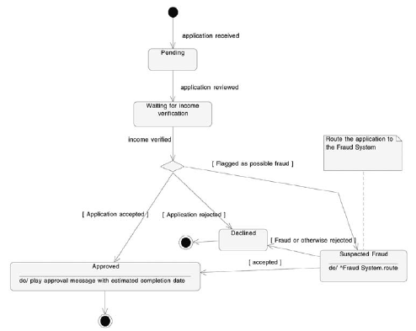

Slide 12
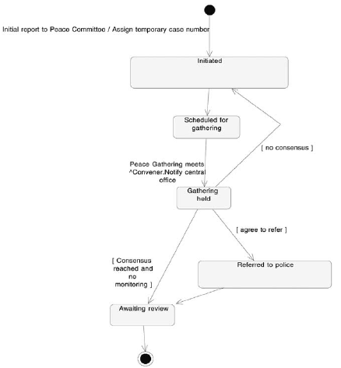

Slide 13
Elements
Initial pseudostate : This is shown as a dot on the diagram. It is the start point for the object. The UML classifies this, as well as some other modInitial pseudostate eling elements, as pseudostates rather than states. Pseudostates mark points that transitions may leave from or go to, but they do not represent actual states of the object.
Final state : This appears as a bulls-eye. It represents the final state of the object. The final state may be named, and there may be more than one final state for an object. There are a number of restrictions on how you can use the final state : It may not have any outgoing transitions, and you cannot associate specific ehaviors, such as entry, exit, or ongoing activities.
Wait state : The object isn’t doing anything important; it is simply waiting for an event to happen or a condition to become true.
Ongoing state : The object is performing some ongoing process and stays in this state until some event interrupts the process. For example, a system to manage the work of health inspectors has an inspector state Monitoring Compliance that ends only when management instructs the inspector to discontinue.
Finite state : The object is performing some work that has a definite end. Once the work is over, the object passes out of the state.

Slide 14
Transition : A change of state, indicated with an arrow.
Event : A trigger that fires—or forces—a transition. To document an event, simply write the event name beside the transition symbol.
Transition activity : A quick, uninterruptible activity that happens whenever the transition occurs. To document an activity, precede the activity name with a slash, as in /Assign Temporary Case Number.
Send event : A message that is sent to another object whenever the transition occurs. To document a send event, identify the target (the object receiving the request) and the event (or message) that is sent as follows: ^Target.Event. Transition. If you find the notation of a send event cumbersome, or if the diagram is to be presented to business stakeholders, don’t use this feature. Document it as a regular event and clarify who performs the job with a note if necessary.
Guard : A condition that must be true for the transition to occur. A guard is somewhat like an event in that both determine whether a transition may occur.

Slide 15
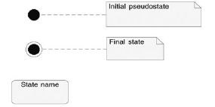

Slide 16
Concurent State
If, according to one criterion, an object can be in one of a set of states and, according to another criterion, can be in another state at the same time, use concurrent states to model the object.
An object is in concurrent states when it is considered to be in more than one state at the

