Slide 1
Scope of Information System
Last Week Lecture Note
Data : raw facts that describe the characteristic of an event
Information : data converted into a meaningful and useful context
Business Intelligent. E.g. Customer Relationship Management
Knowledge . E.g. Knowledge Management System

Slide 2

Virtual Shop by TESCO.COM
Gatwick, Airport, UK. November 2011

Slide 3

Virtual Shop by Me

Slide 4
Overview IS and ISM
Dr.Ir. Yeffry Handoko Putra
Ref. [shim] chap 1& 2
UNIVERSITAS KOMPUTER INDONESIA

Slide 5
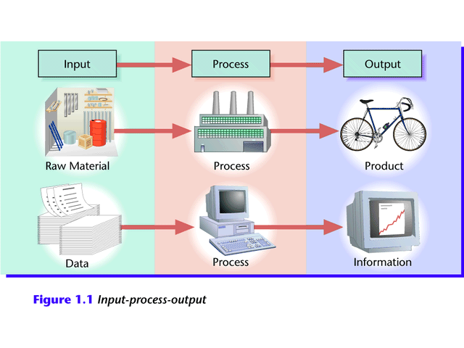
Information Process Cycle
Figure 1.1 Input-process-output

Slide 6
Elemen IS dan MSI
Computer Hardware
  PC/Notebook (Client)
  Server (mainframe)
  Data Communication
Computer Software
  Operating System
  Application
Enterprise
  Organisation
  Human capital and IT Demand
  Decision support system
  POAC
  Evaluation
  Information resource
  (in house operatio, outsourcing)
Notes:
Realtime information for decision support system
POCC Planning Organizing Coordinating and Controlling

Slide 7
Activity support by Information
Activity
Organization
Control
IS Governance
IS Management
Decision
rights
Business Processes
Data
Formal
Reporting
relationships
Planning
IS Strategy
People,
Information and
Technology
Informal
networks
Performance measurement
And
evaluation
IS Audit
Incentives
and rewards
Knowledge
Management
Values
Culture

Slide 8
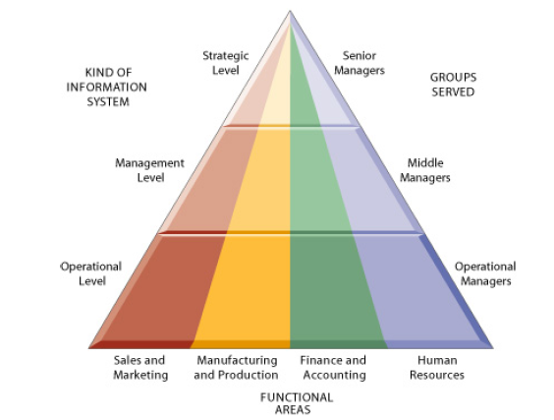
FOUR MAJOR TYPE OF INFORMATION SYSTEM IN MANAGERIAL LEVEL
Systems are built to serve these different organizational
interests (Anthony, 1965)
Ref: [Laudon] Chap 2

Slide 9
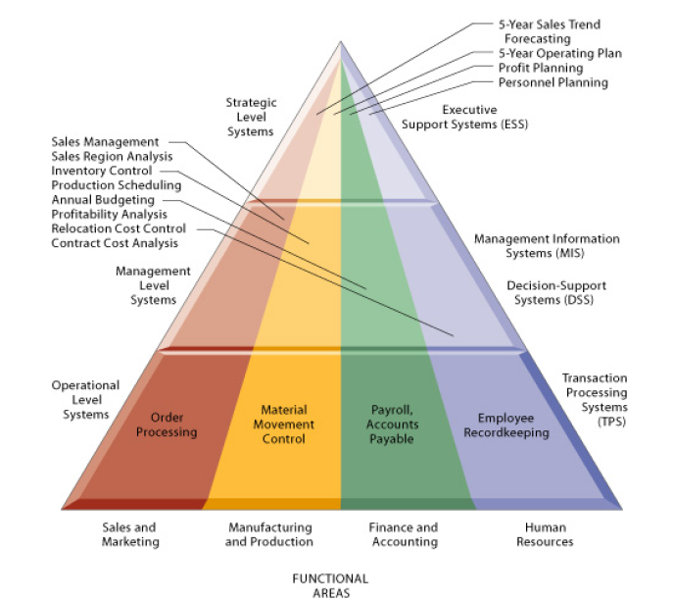
FOUR MAJOR TYPE OF INFORMATION SYSTEM IN MANAGERIAL LEVEL
Ref: [Laudon] Chap 2

Slide 10
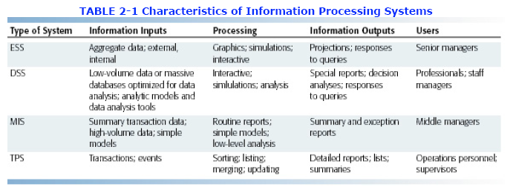
FOUR MAJOR TYPE OF INFORMATION SYSTEM IN MANAGERIAL LEVEL
Ref: [Laudon] Chap 2

Slide 11
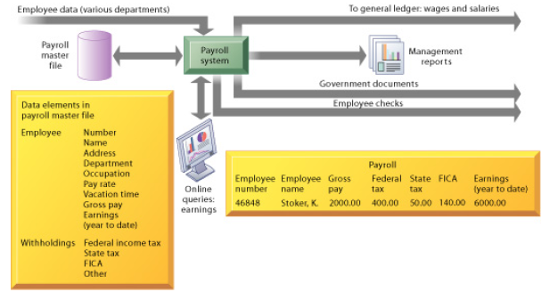
Example: Payroll TPS

Slide 12
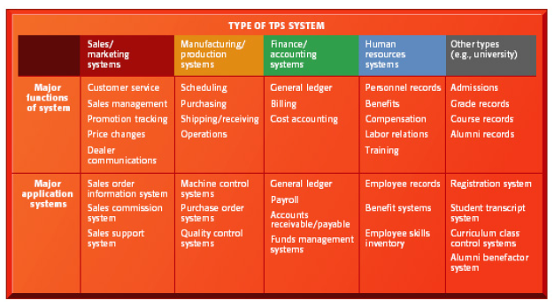
OTHER TPS

Slide 13
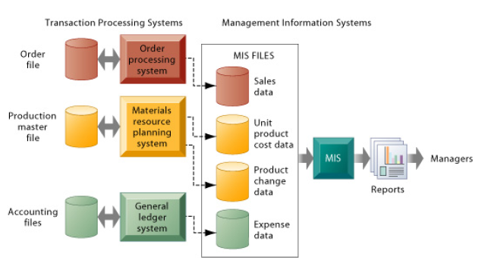
How Management Information System do Data from TPS?

Slide 14
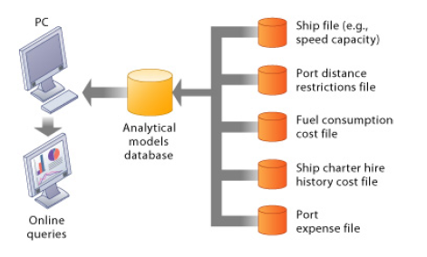
Decision Support System

Slide 15
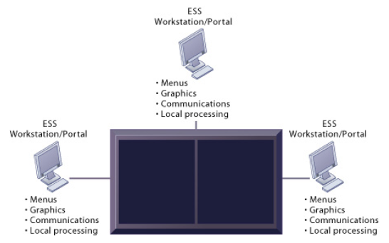

Slide 16
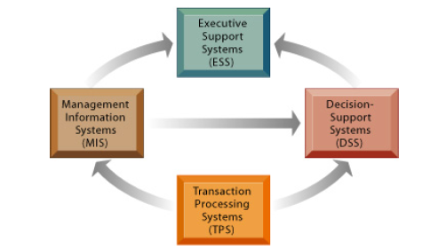


Slide 17

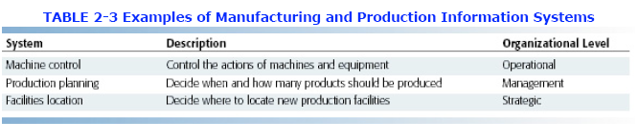
Others System
Manufacturing and Production System

Slide 18
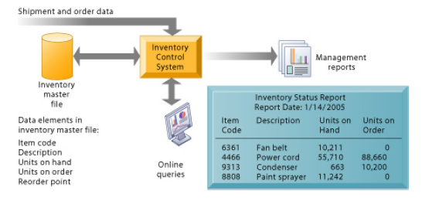

Others System

Slide 19
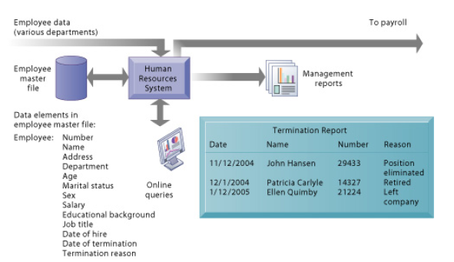
Others System

Slide 20
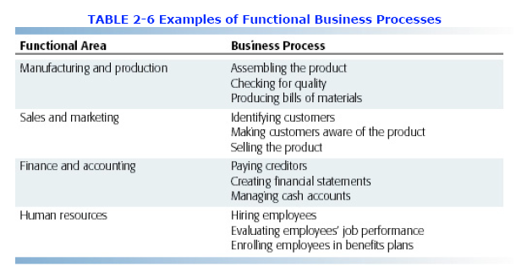
Integrating Function and Business Process

Slide 21
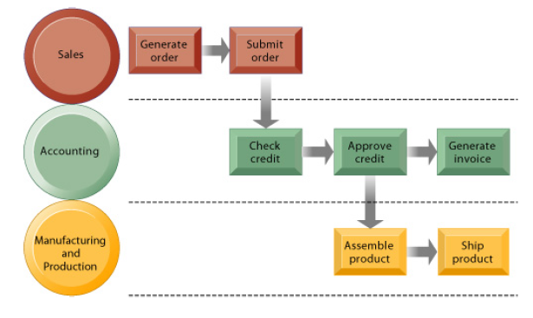
IT Help Cross Functional Business Process

Slide 22
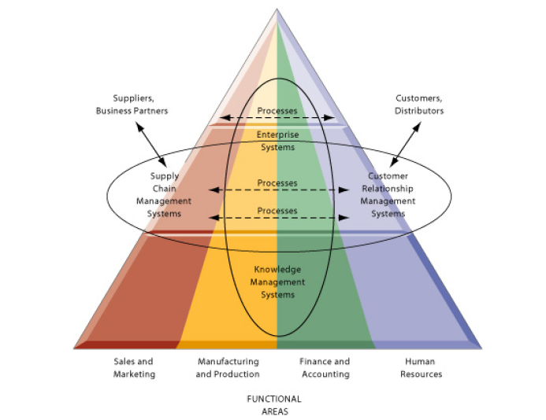
ENTERPRISE-WIDE PROCESS INTEGRATION

Slide 23
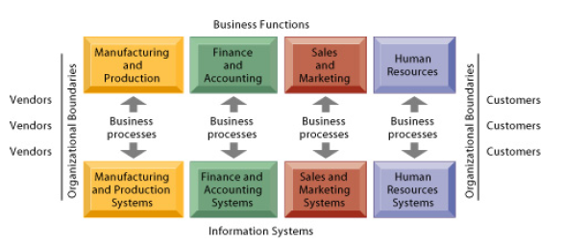
TRADITIONAL VIEW OF SYSTEM

Slide 24
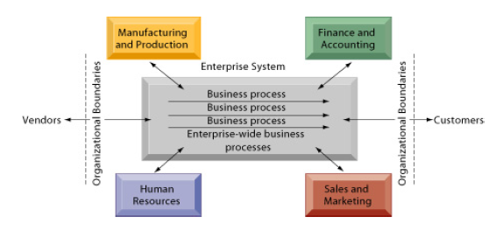
BECOMING ENTERPRISE SYSTEM

Slide 25
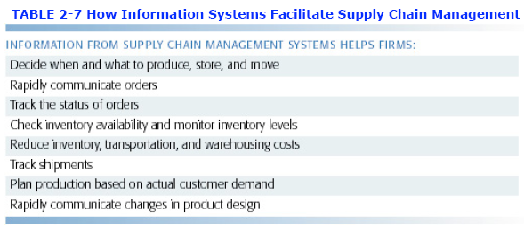
OVERVIEW SUPPLAY CHAIN MANAGEMENT SYSTEM (SCM)

Slide 26
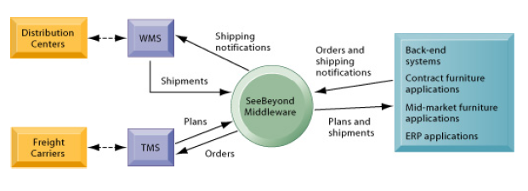

OVERVIEW SUPPLAY CHAIN MANAGEMENT SYSTEM (SCM)

Slide 27
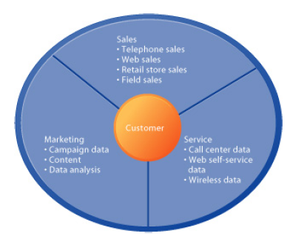

OVERVIEW CUSTOMER RELATIONSHIP MANAGEMENT (CRM)

Slide 28
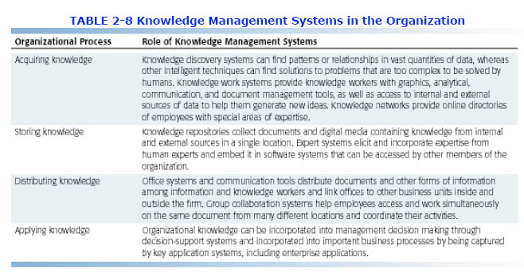
OVERVIEW KNOWLEDGE MANAGEMENT SYSTEM

Slide 29
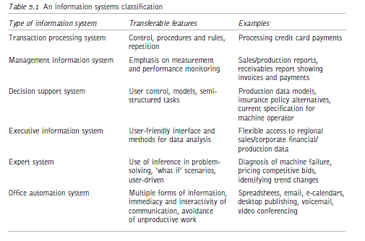

Slide 30
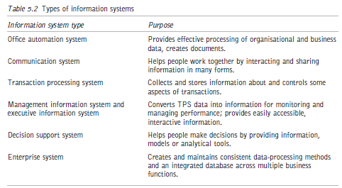

Slide 31
IS Classification in Organisation
Transaction Processing System (TPS)
Management Reporting System (MRS)
Executive Information System and support (EISS)
Decision Support System (DSS)
Office Information System (OIS)
Notes:
☺ Jelaskan pengertian semua ini dengan kata-kata
☺ Kapan sistem2 ini digunakan lihat [shim] chap 1
WHEN TO USE TRANSACTION PROCESSING SYSTEMS
Transaction information systems are designed to process the day-to-day transactions
of an organization so that many labor-intensive business transactions can be replaced
by automated processes. Theses transactions have characteristics of large numbers
and routine processes. Each process has a very simple data transaction, and the
transaction processing system (TPS) is expected to process each one in a very short
period of time. Examples are supermarket/grocery checkout (billing systems) or
bank transaction processes.
When computers were first used for processing business applications, TPS was
the primary system implemented to replace the manual system. Typically, a successful
TPS can improve transaction efficiency, customer service, and reduce transaction
costs. The first TPS was a batch system. A TPS in batch processing implies that all
transactions are collected first and processed later. The disadvantage of batch processing
is that information cannot be updated immediately. A TPS with on-line
processing updates information when the transaction is entered. In a business where
immediate update is required, an on-line TPS is necessary. On-line TPS requires
higher fees for operation than batch TPS. Today, most TPS use on-line processing
to achieve better customer satisfaction and current information.
WHEN TO USE MANAGEMENT REPORTING
(INFORMATION) SYSTEMS
After TPS had been implemented, some organizations realized that the results produced
by TPS are not satisfiable for higher-level decision making and that the
computer’s capability to perform rapid calculations and logical functions could be
used to produce meaningful information for management. As the result, management
reporting systems (MRSs) began to be develop so that managerial reports and
summarized data could be produced. Theses reports helped managers perform their
duties and provided middle management with statistical or summarized data for
tactical-level decision making. In general, MRS is usually used with TPS. TPS processes daily transactions,
updates inventory, and keeps customer information while MRS uses the data from
TPS to produce daily total sales, inventory ordering lists, and customer lists with
different criteria. The output from MRS provides middle management with printed
reports and inquiry capabilities to help maintain operations and management control
of the enterprise. The concept of management reporting systems evolved as managers
realized that computer processing could be used for more than just day-to-day
transaction processing; it could also be used to produce meaningful information for
management.
Frequently, an MRS is integrated with a TPS, and the input source of MRS is
usually the result of TPS. For example, a sales transaction can be processed by using
a TPS to record the sales total and customer’s information. An MRS can further
process these data to generate reports on average sales daily or fast moving items.
WHEN TO USE DECISION SUPPORT SYSTEMS
Decision support systems (DSSs) are designed to help managers reach a decision
by summarizing or comparing data from different resources. They are suitable for
semi-structured and unstructured problems. Decision support systems often include
query languages, statistical analysis capabilities, spreadsheets, and graphics to help
decision makers evaluate their decisions. DSSs are a type of MIS expressly developed
to support the decision-making process. DSSs facilitate a dialogue between the user,
who is considering alternative problem solutions, and the system, with its built-in
models and access able database. A typical DSS process involves retrieving a model
from the model base and allocating proper data from the database.
With a model, users can ask if-then questions by changing one or several
variables as the input, and the combination of data and model generates the recommendations
from a DSS. The database is managed by a data base management
system (DBMS), whereas a model base is managed by a model base management
system (MBMS). Some DSSs allow users to create models for better evaluation. For
example, the vice president of marketing may want to know the net effect on
company profit if the advertising budget decreases. TPSs and MRSs usually do not
provide this type of information.
WHEN TO USE OFFICE INFORMATION SYSTEMS
Office information systems (OISs) are designed to support office tasks with information
technology. Voice mail, multimedia system, electronic mail, video conferencing,
file transfer, and even group decisions can be achieved by office information
systems. The final goal for an OIS is to have an office environment where no paper
need be used
(paperless environment)
.
WHEN TO USE EXECUTIVE INFORMATION SYSTEMS
An executive information system (EIS) is designed to generate information that is
abstract enough to present the whole company operation in a simplified version to satisfy senior management. Characteristically, senior managers employ a great variety
of informal sources of information, so computerized information systems are
able to provide only limited assistance. However, the CEO, senior and executive
vice presidents, and the board of directors also need to track the performance of
their company and of its various units, assess the business environment, and develop
strategic directions for the company’s future.
In particular, these executives need a great diversity of external information to
compare their company’s performance to that of its competition and to investigate
the general trends of the economies in the many countries where the company may
be doing business. EIS is therefore designed to address the information needs for
senior management who may not be familiar working with computer systems. An
EIS also provides features that make it easier for executives to use. An EIS provides
a graphical user interface that can be mouse or touch screen oriented. EIS relies
heavily on graphic presentation of both the menu options and data.

Slide 32
MIS Schematic
Marketing
management
information
system
Manufacturing
management
Information
system
Common
databases
Financial
management
Information
system
Order
management
information
system
TPS

Slide 33
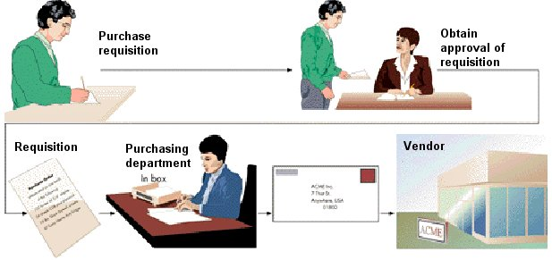
Purchase Order - Traditional

Slide 34

Purchase Order – E-commerce

Slide 35
Manajemen Report
Schedule Report
On demand Report
Exception Report
Predictive Report
Summary Report
Notes:
Baca Curry chap 5 berikan penjelasan dari komponen manajemen report
Scheduled reports
These are generated at regular intervals, such as daily, weekly or monthly and are widely distributed
to users. Monthly sales figures and product range information, for example, would
require regular reporting. They often contain large volumes of
information, only some of which is immediately relevant or useful. As machine readability
increases in usage and accessibility, there will be a corresponding decrease in the need for scheduled
reports, as users will be able to access directly and very specifically the particular
information they require at the time. One must bear in mind, however, that some managers will
always prefer hard copy of reports, unless speed is crucial.
On-demand reports
Such reports as these are unscheduled and produced on request. A requirement for a report
of this type might arise when responding to a need for information about a particular customer’s
complaint. These reports fulfil irregular needs for information and can nowadays be
produced very speedily. In the past, unanticipated demands for information were problematic
and fraught with delay.
Exception reports
Management by exception entails an immediate focus on situations that are out of control.
Activities progressing according to plan do not need managerial attention. Exception reports
are part of the control function in an organisation, signalling the need for corrective action,
such as outstanding late deliveries from suppliers and overdue accounts. Error reporting, such
as the sudden rise in scrap being produced from a particular process, would constitute the
content of an exception report.
Predictive reports
Predicting the future is difficult at the best of times, but techniques such as time series analysis,
correlation and regression and simulation exercises can be most valuable. Such reporting
effectively fulfils the need for sensitivity, or ‘what if ’ analysis, and is very important for
planning. Reports analysing potential profit increase or decrease with an increase in sales
volume or increase in fixed or variable costs would be a typical business example of sensitivity
analysis. Since predictive reports frequently rely on historical data, such data must
be readily accessible and the data sources valid or the predictive models and reports produced
will be of little value to management.
Summary reports
These reports summarise information from a variety of sources. They range from executive
summaries or projects undertaken, to summary reports on specific operational issues, such as
productivity rates and monitoring of special processes. Summary reports are exchanged
between the various organisational levels, and play a crucial role in the communication process

Slide 36
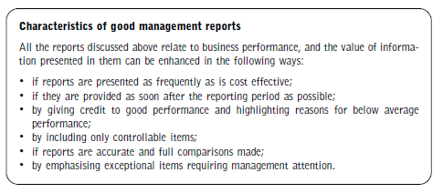

Slide 37
Sumber Informasi
In house operation
Outsourcing

Slide 38
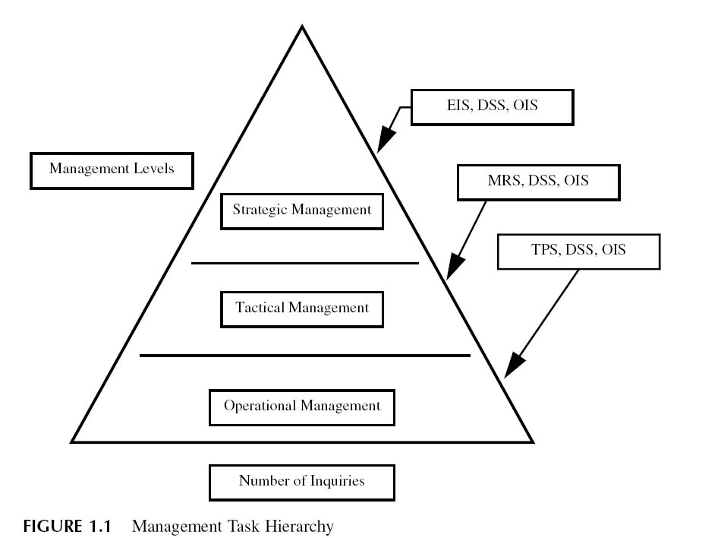
Managerial Task Hierarchy
Notes:
First level.
Strategic management is the highest level of management. This level contains fewer decision makers but controls much power over the whole organization. Therefore, EIS becomes the most appropriate information
system available at this level.
•
Second level.
Tactical management is the middle level of management. Managers in this level very often use MRS for summarized information and to generate management reports for decision making.
•
Third level.
Operational is the lowest level of management. Foremen and supervisors are in this level. TPS with large routine transaction processing capability is usually used for this management level.

Slide 39
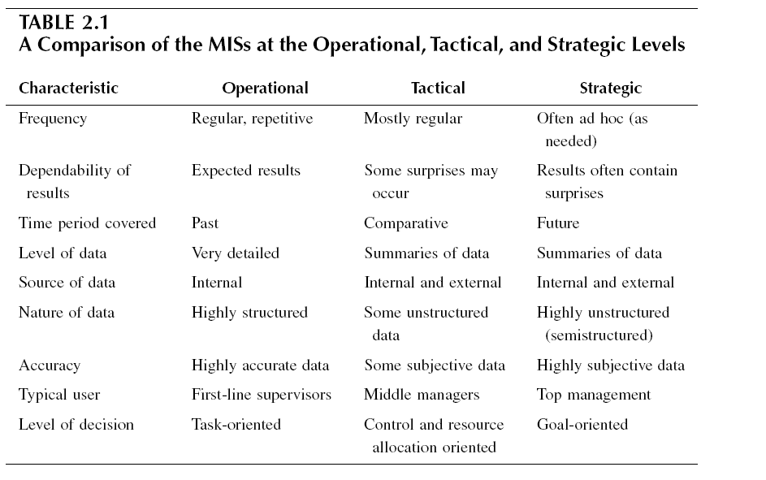
Level of Management: What kind of Decision are made
Notes:
Each level of management can be differentiated by the types of decisions made,
the time frame considered in the decisions, and the types of report information
needed to make decisions (see Table 2.1).

Slide 40
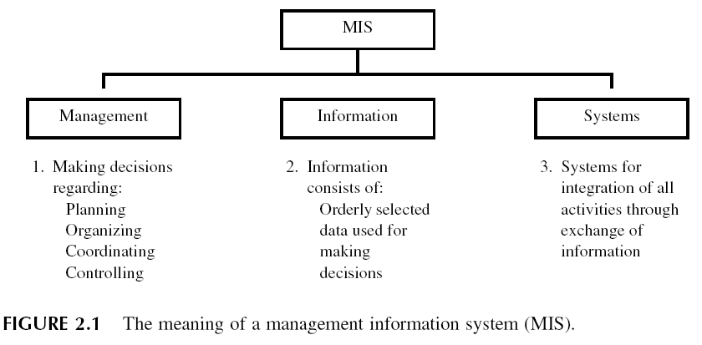
MSI dan Decision Making Model
Notes:
☺ Jelaskan pengertian POCC dari buku [shim] chap 2
They plan by setting
strategies and goals and selecting the best course of action to achieve the plan. They organize the tasks necessary for the operational plan, set these tasks up into homogeneous groups, and assign authority delegation. They control the performance of the work by setting performance standards and avoiding deviations from standard.
Because decision making is such a fundamental prerequisite to each of the foregoing processes, the job of an MIS becomes that of facilitating decisions necessary for planning, organizing, and controlling the work and the functions of the business

Slide 41
Klasifikasi MSI berdasarkan output
MSI that generate report
MSI that answer ‘what-if’ kind of question asked by management
MSI that support Decision Making (Decision Support System)
Notes:
1. MISS THAT GENERATE REPORTS
These reports can be income statements, balance sheets, cash flow reports, accounts receivable statements, inventory status reports, production efficiency reports, or any report on the status of a situation of interest to the decision maker. The reports can be historical or refer to the current status of the situation.
2. MISS THAT ANSWER “WHAT-IF” KINDS OF QUESTIONS ASKED BY MANAGEMENT
These information systems take the information stored in the data base and reply to questions asked by management. These questions are in the form of “what would happen if this or that happened?” The information system thus uses its stored information, its comparison and calculation capabilities, and a set of programs
especially written for this situation to provide management with the consequences
of an action they are considering. It works like this. The vice-president for human resources of an airline wonders
what pilot recruiting levels would be necessary if the company changed its retirement
age from 65 to 62. The vice president uses a “what-if” information system approach to answer the
question. The computer indicates that monthly recruiting levels would have to be increased from 110 to 185 pilots to meet these two conditions. The vice president realizes that is not feasible and now “asks” the system the “what-if” question with the retirement age changed to 63. The reply is now 142 pilots per month recruited.
This appears to be an attainable recruiting target. Some “what-if” systems print out entire financial statements reflecting the financial consequences of actions that are being contemplated. Figure 2.2 depicts a “what-if” scheme.
“What-if” management information systems combine models (to be discussed later), software that enables the decision maker to make various inputs to those models and receive the outputs, and report-generating capability. These are generally run on a real-time system, which can be online and which can also run on a timesharing
basis. In Figure 2.2, we have illustrated a “what-if” MIS.
3. MISS THAT SUPPORT DECISION MAKING (DECISION SUPPORT SYSTEMS)
These advanced systems attempt to integrate the decision maker, the data base, and the models being used. A decision support system (DSS) requires a very comprehensive data base plus the ability to manage that data base, to provide outputs tothe decision maker, and to update whatever permanent models are stored in the
system. It requires extensive hardware and software. Two features distinguish DSS from other information systems: (1) they actually make a recommended decision instead of merely supplying additional information to the decision maker, and (2) they “build in” the decision maker as an integral part of the system (the software
accommodates the person as part of the decision process). Figure 2.3 illustrates a
DSS management information system

Slide 42
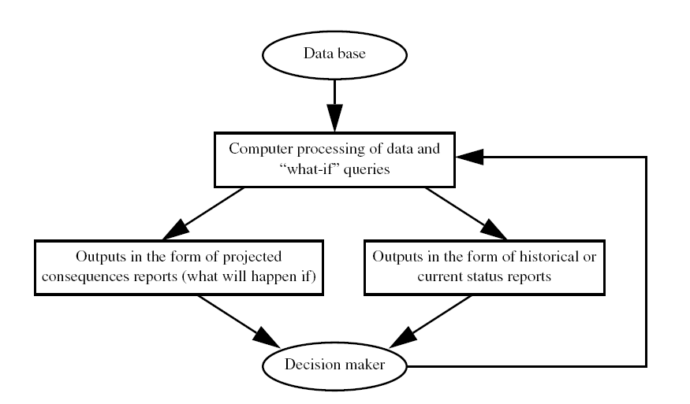

Slide 43
Level Managemen
Lower Management (Supervisory/Operational)
Middle Management (Tactical)
  Deal with semistructured decision
Top Management (Strategy)
  Title: CEO, COO, CFO, CIO
Notes:
Dari buku shim chap 2 jelaskan semuanya
The largest level of management, lower (operational) management, deals mostly
with decisions that cover a relatively narrow time frame. Lower management, also
Called supervisory management, actualizes the plans of middle management and
controls daily operations—the day-to-day activities that keep the organization humming.
Examples of a lower-level manager are the warehouse manager in charge of
inventory restocking and the materials manager responsible for seeing that all necessary
materials are on hand in manufacturing to meet production needs.
Most decisions at this level require easily defined information about current
status and activities within the basic business functions—for example, the information
needed to decide whether to restock inventory. This information is generally
given in detail reports that contain specific information about routine activities. These
reports are structured, so their form can usually be predetermined. Daily business
operations data is readily available, and its processing can be easily computerized.
Managers at this level typically make structured decisions. A structured decision is
a predictable decision that can be made by following a well defined set of predetermined,
routine procedures. For example, a clothing store floor manager’s decision
to accept your credit card to pay for some new clothes is a structured decision based
on several well defined criteria: Does the customer have satisfactory identification?
2. Is the card current or expired?
3. Is the card number 011 on the store’s list of stolen or lost cards?
4. Is the amount of purchase under the cardholder’s credit limit?
Middle level
The middle level of management deals with decisions that cover a somewhat broader
range of time and involve more experience. Some common titles of middle managers
are plant manager, division manager, sales manager, branch manager, and director
of personnel. The information that middle managers need involves review, summarization,
and analysis of historical data to help plan and control operations and implement
policy that has been formulated by upper management. This information is usually
given to middle managers in two forms: (1) summary reports, which show totals
and trends— for example, total sales by office, by product, by salesperson, and total
overall sales—and (2) exception reports, which show out-of-the-ordinary data—for
example, inventory reports that list only those items that number fewer than 10 in
stock. These reports may be regularly scheduled (periodic reports), requested on a
case-by-case basis (on-demand reports), or generated only when certain conditions
exist (event-initiated reports).
Periodic reports are produced at predetermined times: daily, weekly, monthly,
quarterly, or annually. These reports commonly include payroll reports, inventory
status reports, sales reports, income statements, and balance sheets. On-demand
reports are usually requested by a manager when information is needed for a particular
problem. For example, if a customer wants to establish a large charge account,
a manager might request a special report on the customer’s payment and order
history. Event-initiated reports usually clear with a change in conditions that requires
immediate attention, such as an out-of-stock report or a report on an equipment
breakdown.
Managers at the middle level of management are often referred to as
Tactical decision makers who generally deal with semistructured decisions. A
Semistructured decision is a decision that includes some structure procedures and some procedures
that do not follow a predetermined set of procedures. In most cases, a semistructured
decision is complex, requiring detailed analysis and extensive computations. Examples
of semistructured decisions include deciding how many units of a specific product should be kept in inventory, whether to purchase a larger computer system, from what source to purchase personal computers, and whether to purchase a multiuser minicomputer system. At least some of the information requirements at this
level can be met through computer-based data processing.
TOP Level
The top level of management deals with decisions that are the broadest in scope and
cover the widest time frame. Typical titles of managers at this level are chief
executive officer (CEO), chief operating officer (COO), chief financial officer (CFO), treasurer, controller, chief information officer (CIO), executive vice president, and senior partner. Top managers include only a few powerful people who are in charge of the four basic functions of a business—marketing, accounting and finance, production,
and research and development. Decisions made at this level are unpredictable,
long-range, and related to the future, not just past and/or current activities.
Therefore, they demand the most experience and judgment.
A company’s MIS must be able to supply information to top management as
needed in periodic reports, event-initiated reports, and on-demand reports. The
information must show how all the company’s operations and departments are related
to and affected by one another. The major decisions made at this level tend to be
directed toward (1) strategic planning—for example, how growth should be financed
and which new markets should be tackled first; (2) allocation of resources, such as
deciding whether to build or lease office space and whether to spend more money
on advertising or the hiring of new staff members; and (3) policy formulation, such
as determining the company’s policy on hiring minorities and providing employee
incentives. Managers at this level are often called strategic decision makers. Examples
of unstructured decisions include deciding five-year goals for the company, evaluating future financial resources, and deciding how to react to the actions of competitors.
At the higher levels of management, much of the data required to make decisions
come from outside the organization (for example, financial information about other
competitors). Table 2.2 shows the decision areas that the three levels of management
would deal with in (a) a consumer product business and (b) a bank.

Slide 44
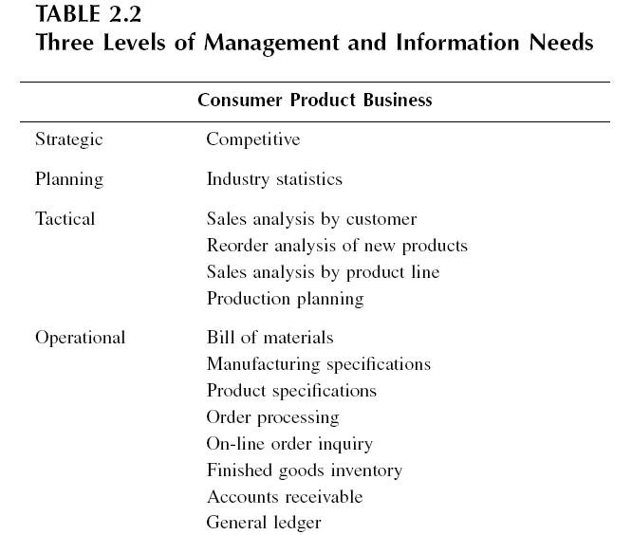

Slide 45
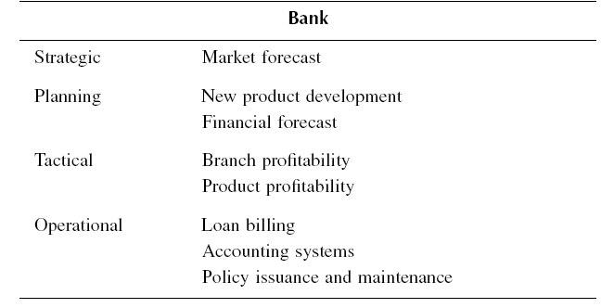

Slide 46
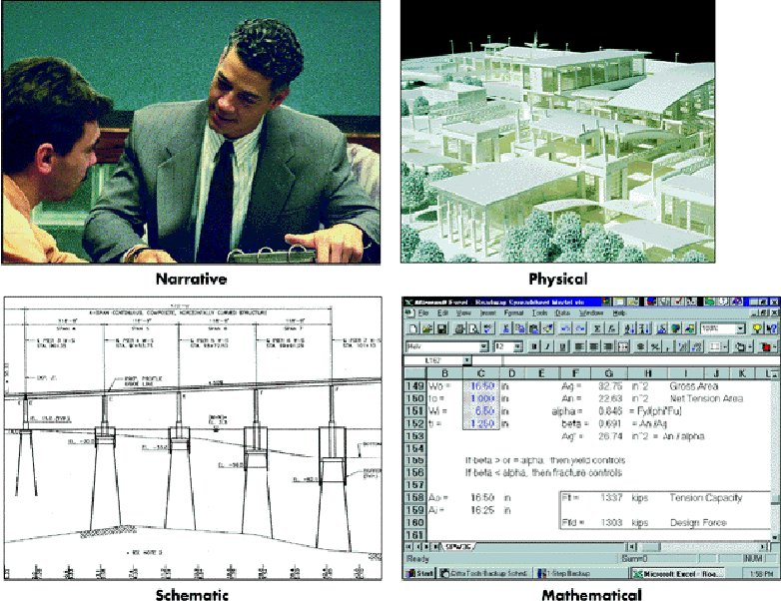
Pemodelan MSI
Notes:
NARRATIVE MODELS
A narrative model is either written or oral. The narrative represents a topic or subject.
In an organization, reports, documents, and conversations concerning a system are
all important narratives. Examples include a salesperson verbally describing a product’s
competition to a sales manager, and a written report describing the function
of a new piece of manufacturing equipment.
PHYSICAL MODELS
The fashion model is an example of a physical model, as are dolls and model
airplanes. Many physical models are computer designed or constructed. An aerospace
engineer may develop a physical model of a shuttle to gain important information
about how a large-scale shuttle might perform in space. A marketing department
may develop a prototype of a new product.
GRAPHICAL MODELS
A graphical model is a pictorial representation of reality. Lines, charts, figures,
diagrams, illustrations, and pictures are all types of graphical models. These are
used often in developing computer programs.
Flowcharts show how computer programs are to be developed. A graph that shows budget and financial projections and a break-even chart are good examples of graphic models. The break-even chart
depicts the point at which sales revenues and costs are equal, as shown in Figure 2.4. M
ATHEMATICAL MODELS
A mathematical model is an quantitative representation of reality. These models are
most popular for decision making in all areas of business. Any mathematical formula
or equation is a model that can be used for simulation or “what-if” analysis purposes.
Once properly constructed, management can experiment with them just as physical
scientists do with a controlled experiment in their laboratory. In a sense, mathematical
models are the managers’ laboratory. For example, the break-even formula used
to compute the break-even point in Figure 2.4 is simply

Slide 47
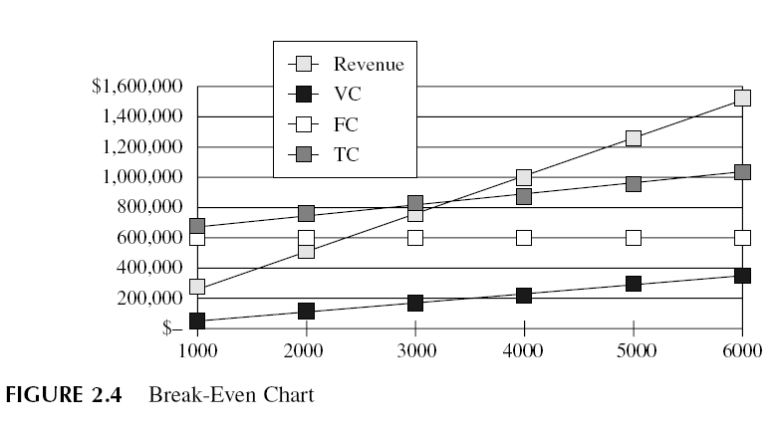
Graphical Model

Slide 48

Mathematical Model
Break event point:
  X_{b} = break-even point,
  P = price or average revenue per unit,
  V = unit variable cost, and
  FC = total fixed costs

Slide 49
Model Management Software
Financial Model
  Cash flow
  Internal rate and return
  Investment analysis
Statistical Model
  Summary statistic
  Trend projection
  Hypothesis testing
  Software: SPPS (Statistical Packages for Social Scientist), SAS (Statistical Anaylisis System), minitab
Notes:
The purpose of the model base in a MIS is to give decision makers access to a
variety of models and to assist them in the decision-making process. The model
base can include model management software (MMS) that coordinates the use of
models in a MIS. Depending on the needs of the decision maker, one or more of
these models can be used.
FINANCIAL MODELS
Financial models provide cash flow, internal rate of return, and other investment
analysis. Spreadsheet programs such as Excel® are often used for this purpose. In
addition, more sophisticated financial planning and modeling programs, such as
Comshare’s Interactive Financial Planning System (IFPS), can be employed. Some
organizations develop customized financial models to handle the unique situations and problems faced by the organization. However, as spreadsheet packages continue
to increase in power, the need for sophisticated financial modeling packages may
decrease.
STATISTICAL MODELS
Statistical models can provide summary statistics, trend projections, hypothesis
testing, and more. Many software packages, including Statistical Packages for Social
Scientists (SPSS), Statistical Analysis System (SAS), and MINITAB, provide outstanding
statistical analysis for organizations of all sizes. These statistical programs
can calculate means, variances, and correlation coefficients; perform regression
analysis; do hypotheses testing; etc. Many packages also have graphics output
capability.
The following illustrates the use of SPSS for Windows for regression analysis
and the sample output.

Slide 50
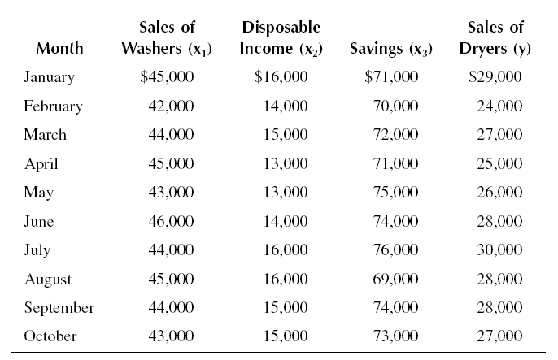
Contoh Statistical Model
Cypress Consumer Products Corporation wishes to develop a forecasting model for its dryer sales by using multiple regression analysis. The marketing department prepared the following sample data.

Slide 51
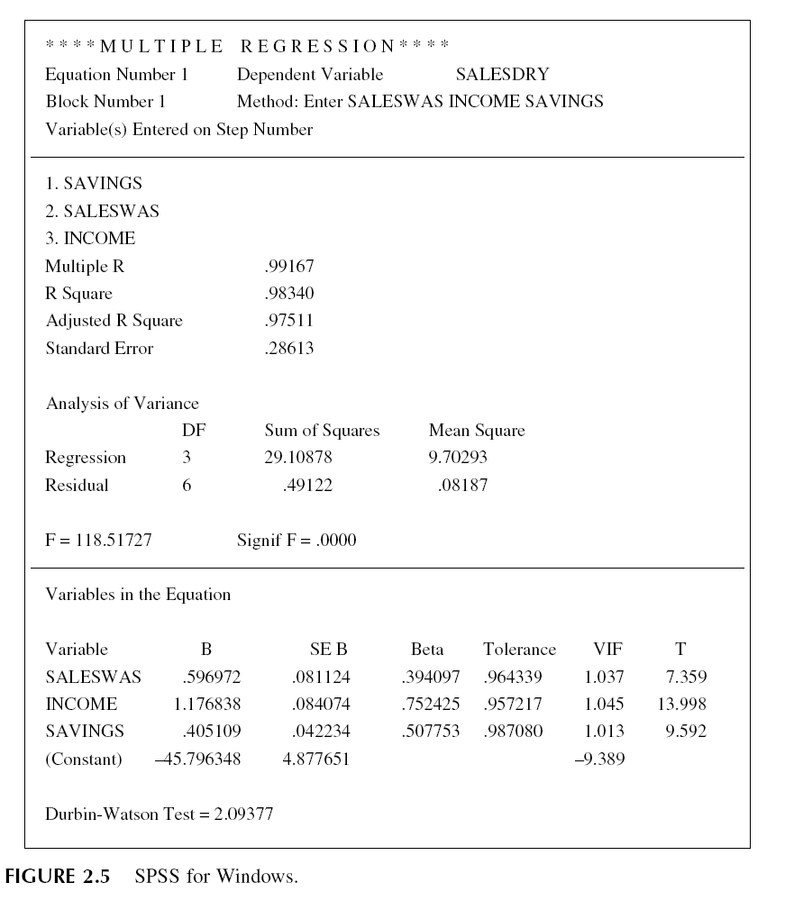

Slide 52
Optimization Model
  Techniques for establishing complex sets of mathematical equations and inequalities that represent objectives and constraints
  Sering disebut riset operasi, linier programming
  Contoh Aplikasi:
    Selecting least-cost mix of ingredients for manufactured products
    Developing an optimal budget
    Determining an optimal investment portfolio (or asset allocation)
    Allocating an advertising budget to a variety of media
    Scheduling jobs to machines
    Determining a least-cost shipping pattern
    Scheduling flights
    Gasoline blending
    Optimal manpower allocation
    Selecting the best warehouse location to minimize shipping costs
Notes:
Sering disebut Riset Operasi, linear programming
The termoptimization models refers to techniques for establishing complex sets of
mathematical equations and inequalities that represent objectives and constraints.
These models are “prescriptive” in that they try to provide the best possible solution
to the problem at hand. They include mathematical programming such as linear
programming (LP) and goal programming (GP) models.
Linear programming (LP) is a mathematical technique designed to determine
an optimal decision (or an optimal plan) chosen from a large number of possible
decisions. The optimal decision is the one that meets the specified objective of the
company, subject to various restrictions or constraints. It concerns itself with the
problem of allocating scarce resources among competing activities in an optimal
manner. The optimal decision yields the highest profit, contribution margin (CM),
or revenue, or the lowest cost. A linear programming model consists of two important
ingredients:
1. Objective function. The company must define the specific objective to be
achieved.
2. Constraints. Constraints are in the form of restrictions on availability of
resources or meeting minimum requirements. As the name linear pro-gramming indicates, both the objective function and constraints must be
in linear form.

Slide 53
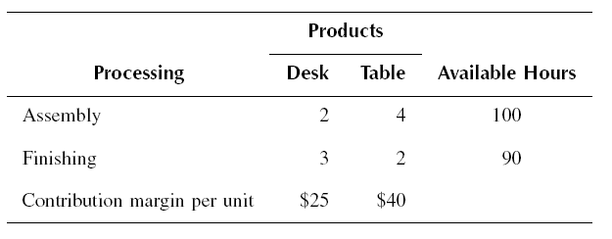
Contoh Linear Programming
The JKS Furniture Manufacturing Company produces two products: desks and tables. Both products require time in two processing departments, the Assembly Department and the Finishing Department. Data on the two products are as follows: The company wants to find the most profitable mix of these two products

Slide 54
Step 1
Define the decision variables as follows:
A = Number of units of desk to be produced
B = Number of units of table to be produced
Step 2
The objective function to maximize total contribution margin (CM) is expressed as
Total CM = 25A + 40B
Then, formulate the constraints as inequalities.
2A + 4B ≤ 100 (assembly constraint)
3A + 2B ≤ 90 (finishing constraint)
In addition, implicit in any LP formulation are the constraints that restrict A and B
to be nonnegative, i.e.,
A, B ≥ 0
Our LP model is:
Maximize: Total CM = 25A + 40B
Subject to: 2A + 4B ≤ 100
3A + 2B ≤ 90
A, B ≥ 0

Slide 55
Decision analysis model with uncertainty
Decision Analysis Model with uncertainty:
Diatasi dengan
  Expected value
  Standard deviasi
  Coeficient of variation
Decision Matrix
Decision Tree
Notes:
☺ Tuliskan kembali contoh2 dari Ketiganya pada buku shim chap 2

Slide 56
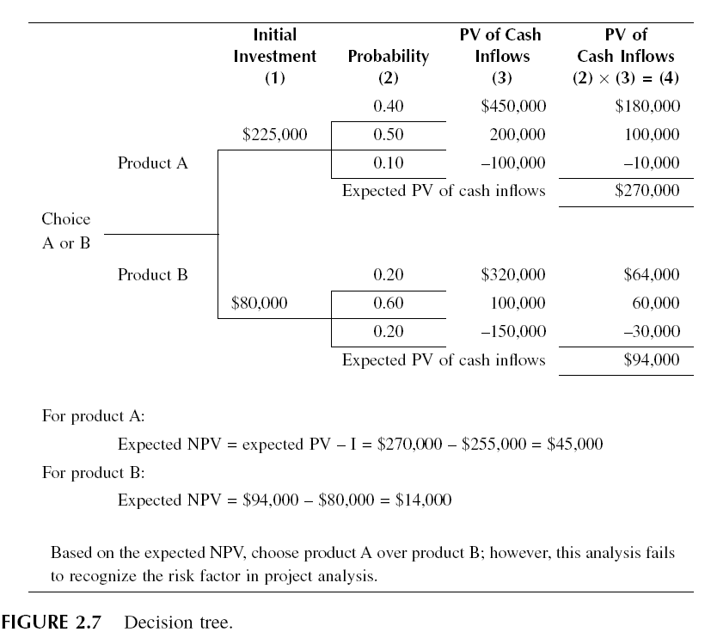

Slide 57
Project Planning and Management Models
PERT (Program Evaluatioan and Review Technique) untuk planning, schedulling, costing coordinating , complex controlling misal dipakai pada:
  Formulation of a master budget
  Construction of buildings
  Installation of computers
  Scheduling the closing of books
  Assembly of a machine
  Research and development activities
  Questions to be answered by PERT include
  • When will the project be finished?
  • What is the probability that the project will be completed by any given
  time?
Notes:
Project planning and management models are used to navigate and coordinate large
projects, and to discover critical paths that could delay or jeopardize an entire project
if they are not completed in a timely and cost-effective fashion. Some of these
programs can determine the best way to speed up a project by effectively using
additional resources, including cash, labor, and equipment. Project management
allows decision makers to keep tight control over projects of all sizes and types.
Program evaluation and review technique (PERT) is a useful management tool
for planning, scheduling, costing, coordinating, and controlling complex projects
such as

