Slide 1
Chap 7: Using BSC as strategic management (Robert s. Kaplan and david p. norton)
Dr. Ir. Yeffry Handoko Putra, M.T

Slide 2
The Idea in Brief
Performance in three key nonfinancial area:
A company’s relationship with its customers
Its key internal process
Its learning and growth

Slide 3
The Idea in Practice
Translating the vision
Communication and linking
Business Planning
Feedback and learning

Slide 4
Translating Vision and Strategy: Four Perspectives

Slide 5
Managing Strategy

Slide 6
How one Company built a Strategic Management System

Slide 7
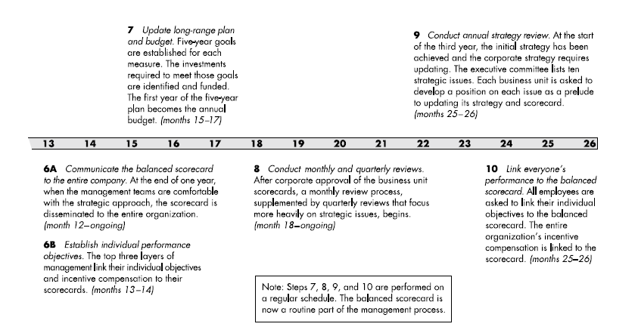
How one Company built a Strategic Management System

Slide 8
Around Balanced Scorecard

Slide 9
The Personal Scorecard

Slide 10
How one company linked Measures

Slide 11
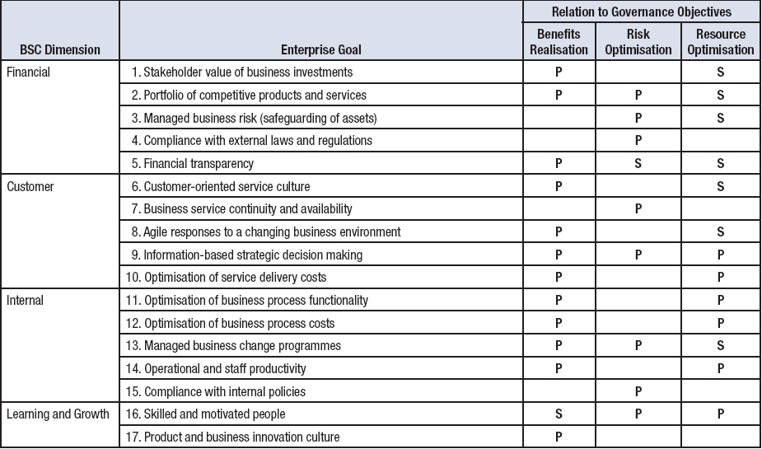
Stakeholder Value and Business Objectives (cont.)
Source: COBIT® 5, figure 5. © 2012 ISACA® All rights reserved.

