Slide 1
Chap 5 :Information System and Organization Change [Curry] chap 7
Dr. Ir. Yeffry Handoko Putra, M.T
Head Department
Magister of Information System
Universitas Komputer Indonesia

Slide 2
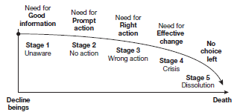
Born, change and die

Slide 3
Change in Organization
Structure and Culture
People
Process
Support process
Business Network Process
Management Process
Notes:
Structure and culture
In the previous chapter organisational structure
and culture were extensively discussed with
regard to information systems. The concept of
organisational ‘fit’ is very important and must
be determined by strategic objectives if the
company is to make successful progress in the
right business direction. An organisation may
be changed in a number of ways in terms of its
structure:
• It needs to have an appropriate shape and
physical design, which may involve changing
the extent to which it is centralised/decentralised
and the hierarchical levels, in terms
of layers of management.
• It has to be in the right location. This may
involve the creation of subsidiaries or independent
business units in remote areas.
• It has to have the right type of ownership. It
may benefit from privatisation or nationalisation.
A privately owned company may
need to become a public limited one.
Culture has to fit with structure. An atmosphere
of informality, trust and absence of strict
control works better in an organisation with a
professional, motivated, innovative workforce.
What is more, if radical performance improvement
requires collaboration, teamwork and
empowerment, strong departmental or functional
loyalties may become an obstacle. If the
focus is on customer and supplier relationships,
a culture of stringent cost control will create
conflicts. Organisational culture is most import-ant when implementing technological innovations,
which may impact the very nature of
work being done by imposing new behavioural
requirements on users (Cabrera et al., 2001).
Aligning technology and culture is not an easy
task and organisational effectiveness is a function
of how well the social and technical systems
are designed with respect to one another
People
The balance within the workforce may need
altering and redundancies may be necessary as
a result. The skills-base may be inadequate and
training of various types and at various levels of
the organisation may be needed, particularly if
new technology is to be introduced. The core
workforce may have to shrink to reduce overhead
costs and make way for contracting out to
independent agencies or specialised consultancies.
Location of workers has become increasingly
flexible as a result of new communication
technologies, resulting in teleworking and flexible
hours of working. More in the way of
networking may improve the quality of working
life by allowing people to work from home and
eliminating the need to face rush-hour traffic
each day to travel into heavily populated
metropolitan areas.
Processes
Business processes have internal or external
customers and cross-organisational boundaries.
Their change is discussed in some detail
throughout this chapter in business process
re-engineering. At this point it suffices to say that
there are different business processes that may
require change (see also Chapter 2, Figure 2.14).
These are (Murdick and Munson, 1986):
Core processes, which are central to the functioning
of the business and relate directly to external
customers.
They are usually the primary
activities in the organisational value chain, e.g.
sales, operations.
Support processes have internal customers and
provide support for the core processes. They are
usually the secondary activities in the organisational
value chain, e.g. administration, finance.
Business network processes, which often extend
beyond the organisational boundary to suppliers,
customers and other stakeholders, e.g. outbound
logistics.
Management processes, which are those used by an
organisation to plan, organise and control
resources and then make decisions, e.g. senior
management review.
Technology
Information technology supports and facilitates
change in a number of ways, such as ERP, which
serve to integrate internal operations, and CRM,
which serve to integrate the organisation and its
customers, with the aim of increasing value for
both. Two particular aspects of technology
worth noting at this point are the following:
1 The potential of telecommunications technology
to increase the scope of organisational
and inter-organisational coordination
and reduce the costs of that coordination.
2 The potential of shared information systems
and databases to provide relevant information
in a timely way to those who need it.

Slide 4
Reason for organisational Change
Internal reason
Resources have to be adequate and distributed
Technology may be introduced into the organisation
People within an organisation are themselves a stimulus for internal change
Priorities may need to be changed
Problems of different types arise within organisations and these are often powerful motivators of change
Notes:
Internal reasons for change
Organisations can be structured and restructured
in different ways according to the decision-
making and political processes within their
own boundaries. As there is a reciprocal relationship
between structure and strategy, a
major task for senior managers is to determine
the most appropriate organisational form for
various situations.
If organisational effectiveness is to be improved
to ensure future survival, goals need to
be the right ones and need to be met. Resources
have to be adequate and have to be distributed
in the right way across the organisation.
Managers and staff may be inadequately trained,
demotivated and dissatisfied and lack cohesion.
Lines of communication and information flows
may be unsatisfactory or inappropriate. There
may be contradictions and conflicts within and
between the different elements of the organisation,
such as strategic objectives, critical success
factors, management style, degree of centralisation
and information flows and networks.
Resources have to be adequate and have to be
appropriately distributed across the organisation.
Resources may decrease or increase and
need to be reallocated, restricted or concentrated
in certain business priority areas as part
of a change process.
Technology may be introduced into the organisation.
It may be an extension to what was
already there or may be completely new. In
either case, changes within the organisation will
be triggered.
People within an organisation are themselves a
stimulus for internal change. Redundancies
require redeployment of tasks and responsibilities
and skills shortages require training and
staff development to be updated.
Priorities may need to be changed if, for example,
organisational targets are not being
achieved. Priority activities relate to critical
success factors and organisational goals. The
necessity to readjust internal priorities is a powerful
force for change which will affect internal
control mechanisms.
Problems of different types arise within organisations
and these are often powerful motivators
of change. Wastage costs may be seriously
affecting profits, and information flows may be
inadequate, resulting in inefficiencies and poor
communication. Increasing customer dissatisfaction
requires attention as does an unprofitable
product range. Marks & Spencer have
had to reconfigure their product range quite
drastically on more than one occasion to realign
the organisation with market demand.
The internal forces of change centre on the
notion of ‘fit’. Culture and structure must dovetail
with management tasks and behaviour to
produce a cohesive, integrated, cooperative
whole. Mismatching elements, internal inefficiency
and ineffectiveness will transgress the
organisational boundary, creating negative
external perceptions among customers, suppliers
and stakeholders in general.
Internal change may start from a new business
vision, translated into aims and objectives
to ensure future success. An example is given in
Figure 7.2.

Slide 5
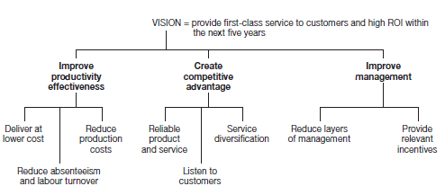
It is good to change vission?

Slide 6
Reason for organisational Change
External reason
Culture
Demographic
Legislation
Political Climate
Economy
Technology Advance
Competition and increasing customer demands
Inter-organisational relationships create powerful synergies
Public Opinion
Notes:
External reasons for change
The external environment accounts for a great
deal of organisational change, change which is
imposed and which is more difficult, if not impossible, to control. There may also be
sequential changes that arise as a result of previous
reasons for change.
The culture in different countries affects local
operation of companies. Multinationals have to
be aware of the necessity to take an entirely
different business approach when establishing
subsidiaries in the USA, Japan, China and
Europe. Culture impacts significantly on local
business behaviour/protocol and on strategies
for the future.
Demographic trends are predictors of market
opportunities which bring about change. The
need to cater for an increasing ageing population
is one factor and the location of organisations
in growing or declining metropolitan areas
is another. The greater sophistication of the
requirements of the young upwardly mobile
population has created opportunities for organisations
to occupy select market niches.
Legislation in force is a powerful motivator for
change. Organisations are having to tackle
dramatic changes of various kinds in response
to health and safety requirements and the
Environmental Protection and Disability
Discrimination Acts.
The political climate brings about the legislation
affecting organisations, and political pressures
will reduce or boost investment in different
industry sectors. Reduction in public spending
and increasing privatisation are both examples
of powerful external forces of change.
The economy will shape the ways organisations
operate in terms of confidence in times of boom
and rationalisation in periods of recession.
Interest rates and currency exchange fluctuations
will dramatically alter organisational business
policies.
Technological advances have created numerous
opportunities for organisations which can capitalise
on their use, but pose threats for those who
lag behind, especially if the particular industry
sector is heavily dependent on up-to-date technology,
such as in the financial services sector.
Competition and increasing customer demands
have generated very powerful forces of change.
Customers are taking charge and their requirements
must be met if organisations wish to stay
in business in the longer term. Competition has
intensified to the extent where companies must
work both harder and smarter to stay ahead of
the game.
Inter-organisational relationships create powerful
synergies, particularly with the help of new communication
technologies. Developing these relationships
is an increasingly important factor in
doing business in the longer term. Opportunities
are presented to those who can respond well to
the challenge, but necessary changes may give
rise to increasing organisational complexity,
unless well handled.
Public opinion will shape and prompt change,
often with respect to issues of the day. For
example, a perceived fall in educational standards
provoked the introduction of the National
Curriculum in the UK. Long working hours of
junior doctors and the shortage of hospital beds
have motivated public opinion to instigate
change in the UK health care sector. The
increasing importance of environmental issues
has also provoked corporate responses to maintain
favourable public perceptions.

Slide 7
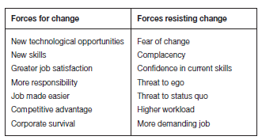
Forces Again Change

Slide 8
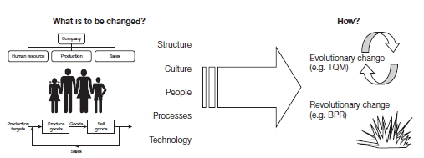
What and how of organisational change
Notes:
Evolutionary change
Evolutionary change, as its name suggests,
refers to a change process that evolves over
time, gradually rather than dramatically or radically.
It may take the form of a series of projects
carried out by task teams, followed by
absorption of new work processes into everyday
working life over a period of time.
An example of this type of change is total
quality management, which is a process of continuous
improvement over a number of years.
The underlying principle is that a thousand process are of greater value than one single
quantum leap. The aim is to make total quality
part of every activity in the organisation and to
enlist commitment to getting things done right
first time and taking on responsibility for one’s
own quality of work. Commitment is not something
that can be gained quickly, nor does the
habit of building quality into activities and tasks
become ingrained over night! Change of this
kind takes time and demands sustained effort to
reach a successful outcome.
The impetus for evolutionary change, such as
TQM, may be the need for greater efficiency
and effectiveness, the desire for better productivity
or the wish to change the corporate culture.
Staff morale and motivation may need to be
improved and absenteeism and labour turnover
reduced. Changing corporate culture is neither
quick nor easy. Service organisations, which
have worked at it over time, have however seen
considerable benefits, particularly in terms of
more effective service delivery, enhanced customer
satisfaction levels and good staff relations.
Figure 7.5 provides a useful model for the various
activities embraced by TQM. Some or all of
them may be undertaken at different time intervals
and in varying order of priority.
Revolutionary change
Unlike evolutionary change, revolutionary
change is dramatic and intends to be achievable
within a relatively restricted time interval. The impetus for this type of change is often more
imperative and frequently triggered by external
forces that cannot be controlled, such as sharp
competition and new legislation. Organisational
response needs to be immediate and corporate
survival may be in jeopardy if radical change is
not undertaken. Table 7.1 contrasts some elements
of continuous improvement and business
process re-engineering (BPR), which is an
example of revolutionary change.

Slide 9
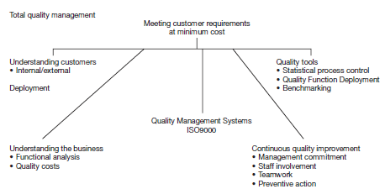

Slide 10
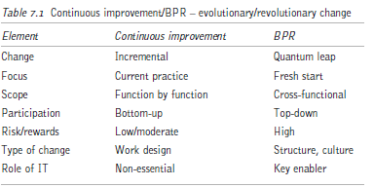
Contiunous Improvement (Kaizan) dan BPR
Notes:
Business process re-engineering
There is some debate as to whether BPR
involves evolutionary or revolutionary change.
Arguably the Japanese have only ever engaged
in continuous incremental change rather than
anything dramatic or radical. ‘Kaizan’ refers to
many small steps along a journey to improvement
and has been incorporated into the TQM
concept and philosophy adopted by Western
companies. The reality is that continuous
improvement has been sustained over time by
the Japanese, who have effectively redesigned
their organisations to stay ahead of the field;
their Western competitors, however, need to
embark on something more drastic to catch up.
Gradualist initiatives may be insufficient for
contemporary survival and radical change is
now deemed the only route to realising the huge
potential of computers and telecommunications
to succeed in business. The Midland Bank, for
example, having decided that their existing
organisational design was inadequate for the
purpose of offering good home-banking services,
created First Direct. This radical redesign
of the business entailed an independent entity
able to articulate a vision and objectives specifically
to tackle the way forward.
While definitions of BPR may vary, it typically
has four critical characteristics:
1 It attempts to achieve dramatic improvements
in performance.
2 It involves radical departure from existing
practices.
3 It is usually enabled by information technology.
4 It is a deliberate and planned endeavour
(Alter, 2002; Hammer, 1990; Venkatraman,
1991).
These four elements of BPR can be illustrated
in the box on p. 210.
BPR involves a critical analysis and radical
redesign of work-flows and business processes in
order to improve performance dramatically
where it matters most. Both the physical and informational aspects of business processes
need to be considered, with particular regard
to the information-processing activities. Reengineering
has provided a means for organisations
to delineate their structure as they
become more adaptable to the task environment
(Dibrell and Miller, 2002). Huff (1992)
sees the basic concept behind re-engineering as
the reorganisation of tasks using IT to automate
processes, while Hammer (1990) regards reengineering
as involving a change of mindset,
challenging old assumptions and shedding the
rules leading to organisational underperformance.
Hammer and Champy (1993) suggested
that an organisation should focus on larger
objectives by embracing technology and recognised
that IT plays a critical role. IT staff act as
catalysts in the re-engineering process, providing
input as to how to use IT most effectively.
The assumption is that BPR improves
competitive capability by combining radical
operational changes, i.e. doing things more efficiently,
with new strategies, i.e. more effective
approaches. The aim of BPR is to transform the
organisational resources of materials, labour
and data into value-added outputs of products,
services and information that are important to
both internal and external customers. A process
orientation replaces a functional orientation,
whereby the current value and potential
improvement of each business process are highlighted
for consideration.

Slide 11
7 stages to BPR Success
confirm business vision and customer values
identify aims for each process
evaluate effectiveness of existing processes
set new performance standards and targets
redesign the business processes
implement the redesigned processes
evaluate process performance and refine processes
Notes:
BPR challenges established ways of operating
and doing business. Managers must rethink
objectives and activities; determine key business
processes from the customers’ viewpoint and
then model new approaches to meet their needs.
Specific aims may be cost reduction, quicker
response, improved productivity or flexibility.
Many processes may need to be redesigned from
scratch, while others may need merely fine tuning.
Processes that add no or insufficient value
need to be eliminated. Outdated processes need
to make way for innovative ones and multidisciplinary
task teams may be needed to
breach functional barriers. Undertaking BPR
involves potential risks and cannot be casually
approached if it is to succeed. The seven stages
to BPR success are detailed below:

Slide 12
3 common reason for BPR failure
lack of senior management commitment
poor communication among those involved in BPR
poor implementation of the redesigned processes
Notes:
Three of the most common reasons for BPR
failure are the following:
1 lack of senior management commitment
2 poor communication among those involved
in BPR
3 poor implementation of the redesigned
processes
These problems relate largely to inadequate
understanding and poor management of organisational
change. Both technological and human
change have to be managed simultaneously:
structures and policies have to fit with technological
change and staff have to accept organisational
change. Fear, anxiety and additional job
responsibilities can all create problems, while the
increasing use of IS/IT may arouse suspicions of
staff monitoring and even workforce reductions.
The preceding boxed example illustrates a failed
BPR project. Table 7.2 illustrates these potential
problems in a bit more detail.
It is clear from the table that problems
come from a combination of organisational,
technological and project management sources.
Organisational change is complex and that

Slide 13
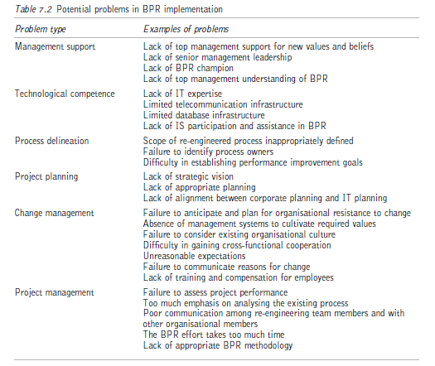

Slide 14
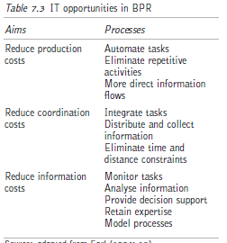
Notes:
IT as a key element
What is important is the understanding and
harnessing of IS/IT so that business processes
can be redesigned in ways that would otherwise
have not been feasible. Bearing in mind the
potential for integrating IS and databases and
for networking, Table 7.3 summarises the IT
opportunities in terms of reducing costs.
The potential of IT for business change is
achieved by viewing IT as an enabler of process
innovation. Certain activities help identify key
change enablers, which must then be analysed
in terms of feasibility and constraints imposed

Slide 15
The Impact of IT on process innovation
Notes:
by existing technology, activities such as the
following:
• identify potential technological and human
opportunities for process innovation;
• identify potential technological and human
constraints;
• seek out opportunities with respect to specific
processes;
• identify which constraints are acceptable.
Opportunities and constraints must be identified,
along with their relevance to the process
under consideration. Cost/benefit analysis and
planning have to be undertaken and decisions
must be made as to which constraints are
acceptable and which need to be overcome.
The notion of IT as an enabler may well be
more accurately represented as IS/IT helping
to implement a process rather than enabling it.
Suffice to say, IT can offer organisations considerable
advantages in terms of providing innovative
ways to improve existing processes and
better design new processes. IT and other
process change enablers all need to be considered
as valuable tools for shaping processes,
though it must be remembered that such tools
can have a positive or negative effect on
processes. IT may provide opportunities for
and impose constraints on process design.
The potential impact of IT on process
change has been summarised by Davenport
(1993) under nine categories (see Table 7.4).
The automational benefit of IT lies in its ability
to eliminate human labour and produce a more
structured process. The use of robotics in manufacturing
and automated call distributors in
telephone-intensive services are examples of this
benefit. The informational impact of IT captures
process performance information, which can
then be analysed and used as the basis for
making decisions (see also the analytical impact
of IT). Computer-based tools are used extensively
in a variety of chemical processes to optimise
resource and energy consumption, while
credit card companies benefit from rapid authorisation
of large numbers of credit card purchases,
thereby reducing corporate risk and
maintaining customer confidence.
Sequential benefit is provided when processes
can be carried out simultaneously or in parallel,
thereby reducing process cycle times. It is often
possible to design in parallel, components that previously had to be designed in sequence. The
design and development cycle for the Kodak
35mm camera was dramatically reduced as a
result.
Tracking often implies bar-coding of items
and scanning at different stages of the logistics
and distribution chain. Federal Express have
always tracked and monitored all their letters
and parcels throughout the delivery process, so
that a customer who has not received an item
of mail can at least know where it is in the
system.
Geographical benefits of IT enable processes to
be connected globally. Worldwide electronic
mail and teleconferencing enable more rapid
availability and exchange of information, as
well as cooperative decision-making.
The integrative impact of IT helps improve
process performance where tasks are scattered
across jobs and functions, making process
management very difficult. Whole processes,
such as patient care management and insurance
policy underwriting can be managed better by
using relational databases. Knowledge and
experience of individuals is frequently lost
unless formally captured and readily available.
The intellectual impact of IT can be seen
in excellent service organisations, such as
American Express Travel Related Services and
British Airways, where extensive databases were
built with customer service procedures and customer
requirements easily accessible to staff.
Finally, disintermediation serves to ‘cut out the
middle man’. Intermediaries may slow down
processes or make them less efficient in terms of
passing on information quickly and effectively.
Electronic trading of stocks and shares, for
example, has not only cut lead times dramatically
but has also saved a great deal of money.

Slide 16
Five levels of IT-enabled business transformation Source: adapted from Venkatraman (1994)
High
Business Scope redefinition
Business network redesign
Revolutionary levels
Degree of business transformation
Business process redesign
International integration
Evolutionary levels
Localised use
Low
Low
Notes:
Venkatraman (1994) maintains that the role
of IT in organisations has evolved from a focus
on efficiency (automation) to a focus on creating
and maintaining flexible business networks,
alliances and partnerships (see also Chapter 5
for inter-organisational IS and Chapter 8 for IS
and competitive advantage). In his five-level
framework, localised use and internal integration
correspond to the lowest level at which IT
impacts upon business functions. Business
network redesign and business scope redefinition
involve reconfiguring the scope and tasks of
the business network that delivers the products
and services (see Figure 7.6). It must, however,
be remembered that, while higher levels of
business transformation may bring greater
benefits, they also entail risk and a higher degree
of changes in organisational routines, such as
logical structuring and lines of reporting. Each
organisation needs to decide which level of
transformation fits with potential costs and
required effort to implement the necessary
changes.
The five-level model of IT-induced reconfiguration
charts the increasing use made of IT
and provides a means of assessing current and
future potential positions of organisations. The
range and value of potential benefits are predicted
to increase from each level to the next
but only if accompanied by a greater degree of
change in the way the business is operated
(Brown, 1994).

Slide 17
The recursive relationship between IS/IT and BPR Source: adapted from Davenport and Short (1990)
How can IT Support Business processes?
IT Capabilities
BPR
How can business processes be transformed by IT?
Notes:
It is important to recognise that IT-enabled
transformation is more likely to succeed when
everyone involved accepts that IT is not a
magic bullet (Markus and Benjamin, 1997).
Good ideas and good designs together are not
enough and change management involves listening,
understanding and giving people a
chance to learn. Change management activity
must be undertaken as an integral part of initiating,
designing and building technologyenabled
change. It is also essential to merge
technological and process innovations in order
to transform organisations, processes and relationships
(Clark and Stoddard, 1996).
It is important to understand the recursive
relationship between IT and BPR. Thinking
about IT should stimulate thinking about BPR.
IT needs consideration of how it supports new
or redesigned business processes. Conversely,
business processes and process improvements
need consideration in terms of the capabilities
IT can provide. This relationship is illustrated
in Figure 7.7.
BPR and IT are not one and the same, nor
are they inseparable. Re-engineering of business
processes should take place before introducing
technology. Applications of IT may well be crucial
to those redesigned processes but IS/IT
architectures constructed to serve the organisation
in the past may impose constraints on BPR.
IS/IT infrastructure contributes to successful
implementation of BPR, and organisations having
developed a higher level of IS/IT infrastructure
capability have been able to implement
extensive changes to their business processes
over relatively short time-frames (Broadbent et
al., 1999). This extends further to the mutually
supportive nature of BPR and information
architecture. A stable information architecture
can support existing as well as improved business
processes and reciprocally BPR provides a highprofile
justification for the information architecture
endeavour (Kettinger et al., 1996).
BPR contains the three core elements of
processes, IT and transformation, where IT
is a key enabler rather than a necessity. IT can
surmount time and distance constraints,
contributing considerably to increased responsiveness
and flexibility. Communication technologies
increase the extent of collaboration,
while shared information resources, such as
relational databases, increase the extent of
direct involvement by managers and users. BPR
aims to optimise IT use and align more closely
different IS to the value added or support
processes they service.

