Slide 1
Secondary Storage Device
Pengantar Ilmu Komputer

Slide 2
Intro
Semiconductor memories are not sufficient to provide the whole storage capacity required in computers. The major limitation in using semiconductor memories is the cost per bit of the stored information. So to fulfill the large storage requirements of computers, magnetic disks, optical disks are generally used.

Slide 3
Storage level
Semiconductor
Memory
Primary
Storage
Direct
Access
Magnetic
Disks
Floppy Disk
Hard Disk, RAID
Access Speed Increases
Storage Capacity Decreases
Cost per Bit Increases
Magnetic Tape
Sequential
Access
Secondary Storage
Optical Disks
CD-ROM, CD-R
CD-RW
DVD
Direct
Access

Slide 4
External Memory types
EXTERNAL MEMORY
SASD
MICRO DISK
DASD
MINI DISK
MAGNETIC DISK
PUNCH CARD
REMOVABLE DISK
( DISK PACK )
HARD CARD
PAPER TAPE
HARD DISK
FIXED DISK
(WINCHESTER DISK)
MAGNETIC TAPE
TAPE STRIP CATRIDGE
REEL TO REEL
DISK
CARTRIDGE
OPTICAL DISK
CARTRIDGE TAPE
MAGNETIC DRUM
CASSETTE
MAGNETIC BUBBLE MEMORY

Slide 5
External Memory types
SASD (Serial/Sequential Access Storage Devices)
data storage devices that read their data in sequence
Ex : Punch card, Paper tape, magnetic tape

Slide 6
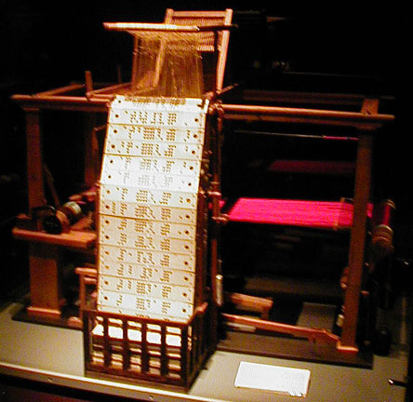
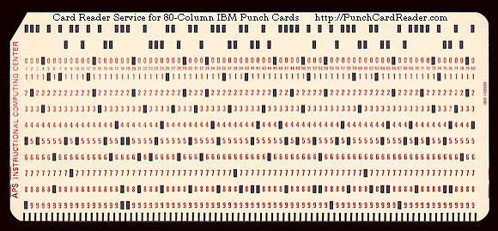
Punch Card

Slide 7
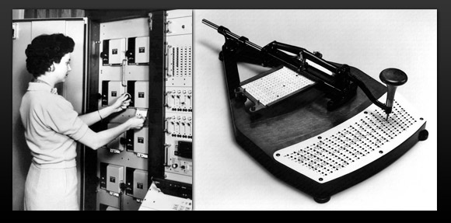
Punch Card
Punch Card Reader Punch Card writer

Slide 8
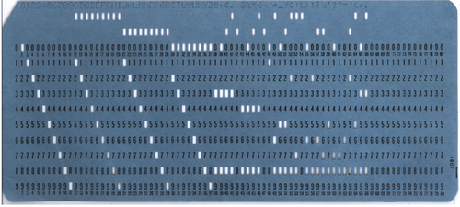
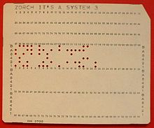
Punch Card
96 columns punch card 80 columns punch card

Slide 9
Punch Card
A punched card, punch card, IBM card, or Hollerith card is a piece of stiff paper that contains digital information represented by the presence or absence of holes in predefined positions.
Develop by Herman Hollerith. Cards collection called as deck. If deck consist of same type data it will form a file.
Data recorded with a punch card tools and read by computer with a card reader.

Slide 10
Punch Card
Types of punch card :
80 columns (standard card/hollerith card)
consist of max 80 char and using hollerith code
96 columns
consist of 96 columns and using SBCDIC (standard Binary Coded Decimal Interchange)

Slide 11
Paper Tape
perforated paper tape is a form of data storage, consisting of a long strip of paper in which holes are punched to store data. Now effectively obsolete, it was widely used during much of the twentieth century for teleprinter communication, for input to computers of the 1950s and 1960s, and later as a storage medium for minicomputers and CNC machine tools.

Slide 12
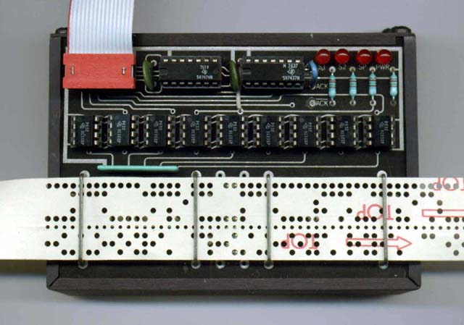
Paper Tape

Slide 13
Magnetic Tape
Magnetic tape is a medium for magnetic recording, made of a thin magnetizable coating on a long, narrow strip of plastic film. It was developed in Germany, based on magnetic wire recording. Devices that record and play back audio and video using magnetic tape are tape recorders and video tape recorders. A device that stores computer data on magnetic tape is a tape drive (tape unit, streamer).

Slide 14
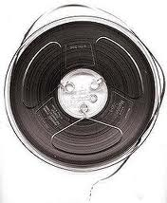
Magnetic Tape

Slide 15
Reel to Reel tape
Reel-to-reel, open reel tape recording is the form of magnetic tape audio recording in which the recording medium is held on a reel, rather than being securely contained within a cassette.
In use, the supply reel or feed reel containing the tape is mounted on a spindle; the end of the tape is manually pulled out of the reel, threaded through mechanical guides and a tape head assembly, and attached by friction to the hub of a second, initially empty takeup reel. The arrangement is similar to that used for motion picture film

Slide 16
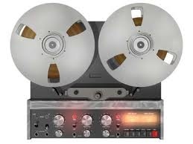
Reel to Reel Tape

Slide 17
External Memory types
DASD (Direct Access Storage Devices)
A type of storage device, such as a magnetic disk, in which bits of data are stored at precise locations, enabling the computer to retrieve information directly without having to scan a series of records.
ex : Magnetic Disk

Slide 18
Magnetic Disk
Magnetic storage uses different patterns of magnetization in a magnetizable material to store data and is a form of non-volatile memory. The information is accessed using one or more read/write heads

Slide 19
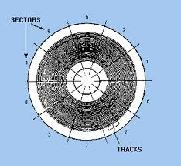
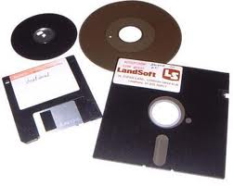
Magnetic Disk

Slide 20
Hard Disk
ATA (IDE Drive)
IDE (Integrated Drive Electronics) is a standard electronic interface used between a computer motherboard's data paths or bus and the computer's disk storage devices. The IDE interface is based on the IBM PC Industry Standard Architecture (ISA) 16-bit bus standard, but it is also used in computers that use other bus standards. Most computers sold today use an enhanced version of IDE called Enhanced Integrated Drive Electronics (EIDE). In today's computers, the IDE controller is often built into the motherboard.
SATA
Serial ATA (SATA or Serial AT Attachment) is a computer bus interface for connecting host bus adapters to mass storage devices such as hard disk drives and optical drives. Serial ATA was designed to replace the older parallel ATA (PATA) standard (often called by the old name IDE), offering several advantages over the older interface: reduced cable size and cost (7 conductors instead of 40), native hot swapping, faster data transfer through higher signaling rates, and more efficient transfer through an (optional) I/O queuing protocol.

Slide 21
SCSI (Small Computer System Interface)
Small Computer System Interface (SCSI) is a set of standards for physically connecting and transferring data between computers and peripheral devices. The SCSI standards define commands, protocols, and electrical and optical interfaces. SCSI is most commonly used for hard disks and tape drives, but it can connect a wide range of other devices, including scanners and CD drives, although not all controllers can handle all devices.

Slide 22
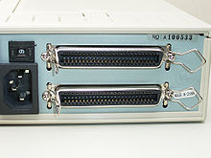
SCSI Connectors

Slide 23
Hard Card
Hardcard is the genericized trademark for a hard disk drive, disk controller, and host adapter on an expansion card for a personal computer.
Typically a hard disk drive (HDD) installs into a drive bay; cables connect the drive to a host adapter and power source. If the personal computer lacks an available bus on a compatible host adapter, then one may have to install an adapter into an expansion slot. The Hardcard supplies its own host adapter, and doesn't require an empty drive bay.

Slide 24
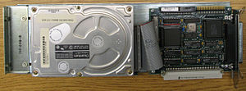
Hard Card

Slide 25
Optical Disk
optical disc (OD) is a flat, usually circular disc which encodes binary data (bits) in the form of pits (binary value of 0 or off, due to lack of reflection when read) and lands (binary value of 1 or on, due to a reflection when read) on a special material (often aluminium) on one of its flat surfaces. The encoding material sits atop a thicker substrate (usually polycarbonate) which makes up the bulk of the disc and forms a dust defocusing layer.
The encoding pattern follows a continuous, spiral path covering the entire disc surface and extending from the innermost track to the outermost track. The data is stored on the disc with a laser or stamping machine, and can be accessed when the data path is illuminated with a laser diode in an optical disc drive which spins the disc at speeds of about 200 to 4000 RPM or more, depending on the drive type, disc format, and the distance of the read head from the center of the disc (inner tracks are read at a faster disc speed

Slide 26
Laser Disk
LaserDisc (LD) is a home video format and the first commercial optical disc storage medium. Initially licensed, sold, and marketed as MCA DiscoVision (also known as simply "DiscoVision") in North America in 1978, the technology was previously referred to internally as Optical Videodisc System, Reflective Optical Videodisc, Laser Optical Videodisc, and Disco-Vision (with a dash), with the first players referring to the format as "Video Long Play". Later, Pioneer Electronics purchased the majority stake in the format and marketed it as both LaserVision (format name) and LaserDisc (brand name) in 1980, with some releases unofficially referring to the medium as "Laser Videodisc".

Slide 27
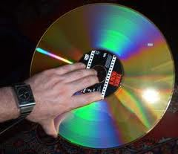
Laser Disk

Slide 28
Compact Disk (CD)
The Compact Disc, or CD for short, is an optical disc used to store digital data. It was originally developed to store and play back sound recordings only, but the format was later adapted for storage of data (CD-ROM), write-once audio and data storage (CD-R), rewritable media (CD-RW), Video Compact Discs (VCD), Super Video Compact Discs (SVCD), PhotoCD, PictureCD, CD-i, and Enhanced CD. Audio CDs and audio CD players have been commercially available since October 1982.

Slide 29
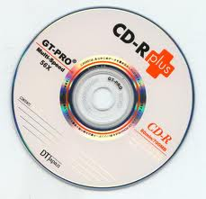
Compact Disk (CD)

Slide 30
DVD
DVD is an optical disc storage format, invented and developed by Philips, Sony, Toshiba, and Panasonic in 1995. DVDs offer higher storage capacity than Compact Discs while having the same dimensions.
Pre-recorded DVDs are mass-produced using molding machines that physically stamp data onto the DVD. Such discs are known as DVD-ROM, because data can only be read and not written nor erased. Blank recordable DVD discs (DVD-R and DVD+R) can be recorded once using a DVD recorder and then function as a DVD-ROM. Rewritable DVDs (DVD-RW, DVD+RW, and DVD-RAM) can be recorded and erased multiple times.

Slide 31
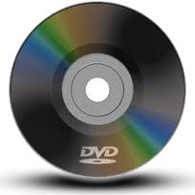
DVD

Slide 32
Blue ray disc
Blu-ray Disc (BD) is an optical disc storage medium designed to supersede the DVD format. The plastic disc is 120 mm in diameter and 1.2 mm thick, the same size as DVDs and CDs. Conventional (pre-BD-XL) Blu-ray Discs contain 25 GB per layer, with dual layer discs (50 GB) being the industry standard for feature-length video discs. Triple layer discs (100 GB) and quadruple layers (128 GB) are available for BD-XL re-writer drives. The name Blu-ray Disc refers to the blue laser used to read the disc, which allows information to be stored at a greater density than is possible with the longer-wavelength red laser used for DVDs

Slide 33
Blue ray disc

Slide 34
Universal Media Disc (UMD)
The Universal Media Disc (UMD) is an optical disc medium developed by Sony for use on their PlayStation Portable handheld gaming and multimedia platform. It can hold up to 1.8 gigabytes of data and is capable of housing video games, feature-length films, and music. UMD is the trademark of Sony Computer Entertainment Inc. for their optical disk cartridge (ODC)

Slide 35
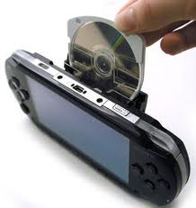
Universal Media Disc (UMD)

Slide 36
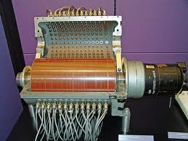
Magnetic Drum
Drum memory is an obsolete magnetic data storage device. It was invented by Gustav Tauschek in 1932 in Austria and was widely used in the 1950s and into the 1960s as computer memory

Slide 37
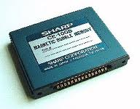
Magnetic Bubble Memory
Bubble memory is a type of non-volatile computer memory that uses a thin film of a magnetic material to hold small magnetized areas, known as bubbles or domains, each storing one bit of data. Bubble memory started out as a promising technology in the 1970s

Slide 38
Questions
Find how to know processor, RAM and computer specification at windows XP at you computer
Floppy drive didn’t used for present PC. For your opinion, what device will not used anymore.
If human gen size = 800 million byte and how many human can store in a 120 Gb harddisk!

