Slide 1
IS Organization
Lesson 3

Slide 3
Introduction
Management of IT has changed drastically in the past 50 years
Early days = manage the technology:
Get it to work
Keep it running
Reduce cost of doing business
Then = manage the information resources
Support (management) decision making
Delivering information when and where it was needed
Now = IT is pervasive and is a mandatory link between enterprises

Slide 4
Introduction cont.
Responsibilities of the head of IS now go far beyond operating highly efficient ‘production programming shops’
These executives are now part of top management and help form the goals of the enterprise in partnership with the CEO, CFO and other members of top management

Slide 5
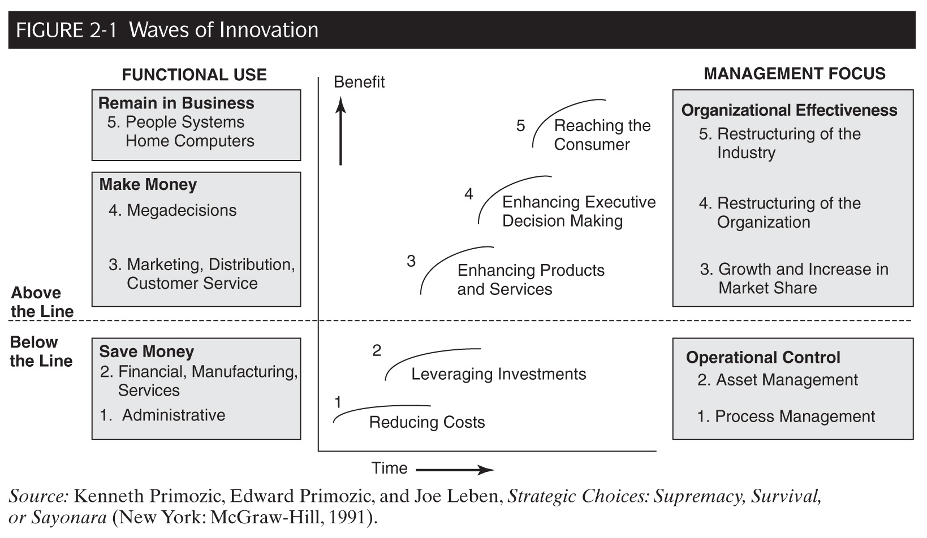
Where Is the IS Organization Headed?
Escalating Benefits of IT

Slide 6
Waves of Innovation - Below the line (Saving $)
Wave 1: Reducing costs
Began in the ’60s
Focused on increasing the productivity of individuals and business areas by e.g. automating manual processes
Wave 2: Leveraging Investments
Began in the ’70s
Concentrated on more effective use of corporate assets
Systems justified on ROI, cash flow etc.

Slide 7
Waves of Innovation - Above the line (Making $)
Wave 3: Enhancing Products & Services
Began in the ’80s
Attention shifted to using IT to produce revenue by gaining strategic advantage or creating entirely new businesses
Wave 4: Enhancing Executive Decision Making
Began in the late ’80s
Changed fundamental structure of organizations
Created real-time business management systems
Waves 1 & 2 = could be done at ‘any time’ (and are still being done!)
Waves 3 & 4 = must be implemented once an industry leader has set a precedent
Companies that don’t do = cease to be competitive

Slide 8
Waves of Innovation - Above the line (Making $) cont.
Wave 5: Reaching the Consumer
Began in the ’90s
Uses IT to communicate directly with consumers leading to new:
Marketing
Distribution, and
Service strategies
Changes the rules of competition
Management must be involved in guiding IT use once you ‘cross the line’
Management must steer the company in the new (evolved) business environment
Not the ‘techies’

Slide 9
The SABRE system (American Airlines)
Case example: ‘Waves of Innovation’
Waves 1 and 2
SABRE built to reduce costs of making airline seat reservations
Wave 3
System expanded so it could be used directly by travel agents
Wave 4
System expanded to include hotels and rental cars through alliances with these suppliers

Slide 10
The SABRE system (American Airlines)
Case example: ‘Waves of Innovation’ cont.
Wave 5
American extended their reach to the consumer:
Introduced EAASY SABRE that enabled consumers direct access from their PCs
AAdvantage – frequent flyer program
Enhanced their Wave 5 connections to consumers via the Web (and mobiles?)
Targeted its most profitable customers = Frequent Flyers
Marketing strategy including ‘distressed inventory’ (the unsold seats)
Note: this example also illustrates that as the benefits of IT increase, the importance of executive guidance also increases

Slide 11
Traditional Functions Are Being Nibbled Away
IT has become an essential piece of business strategy
Not keeping up in IT may even mean going out of business
The job has become too large for one group
While the growing importance of IT is causing the IS Department’s work to expand into new areas of responsibility, management is realizing that the traditional and more operational portions of the job do not have to be performed by the IS department
Particularly ‘centralized’

Slide 12
Traditional Functions Are Being Nibbled Away cont.
The traditional set of responsibilities for IS has included:
Managing operations of data centers, remote systems, and networks
Managing corporate data
Performing systems analysis and design, and constructing new systems
Systems planning
Identifying opportunities for new systems

Slide 13
Traditional Functions Are Being Nibbled Away (Figure 2-2)
The traditional functions still need to be performed but the following trends are moving their performance out of the IS department and into other parts of the organization or to other enterprises:
Distributed systems
Software applications migrating to user areas
Ever more knowledgeable users have taken on increased IS responsibilities
Better application packages
Less need for ‘armies’ of programmers, analysts etc.
Outsourcing

Slide 14
New Roles are Emerging
(Another way to look at it:) IS is not a single monolithic organization, but rather a cluster of four functions (Fig. 2-3):
Run operations
Develop systems
Develop architecture
Identify business requirements

Slide 16
LifeScan
Case example: The ‘Federal’ Model
Johnson and Johnson subsidiary
New CIO = agenda to align the department with the business
Focussed on execution and measurement to gain credibility with the business units
Strong project management and not allow scope creep
Emphasis on staff with these skills
Uses Johnson and Johnson Group ‘stuff’ combined with local (LifeScan) ‘culture’
Centralization of policies, procedures etc.
Local implementation with all projects business led
Moves ownership of systems to the business people

Slide 17
The CIO’s Responsibilities
In line with the evolution of IS departments, the emphasis of the top job has changed
86 = Infrastructure
89 = helping formulate corporate policy
92 = IT as a catalyst for revamping the way enterprises worked
98 = revamp business operations using IT continued with the Internet (customers +)
02 = the ‘technical member’ of top management
04 = a cost and risk based approach Vs. “let’s get into e-commerce fast…”
Today the cost emphasis remains
Outsourcing continues to grow (amid controversy)
CIOs are expected to do much more with not much more $$
Also = under pressure:
To implement protective measures
New financial reporting e.g. Sarbanes Oxley
Keep the IT innovations coming!!

Slide 18
CIO Responsibilities — History

Slide 19
CIO Responsibilities — History cont.
The Mainframe Era
Predominated 1960s – early ’80s
Role of DP / IS Manager = operational manager of a specialist function
Distributed Era
End of ’70s as PCs became commonplace
LANS and WANS linking computers
Took on 4 more roles:
Organizational Designer
Technology Advisor
Technology Architect
Informed Buyer

Slide 20
CIO Responsibilities — History cont.
The Web Era
Started in the mid-1990s for some
Arose from the emergence of the Internet, and esp. the Web as a business tool
Era is still in its ‘infancy’ but add to the CIO’s ‘job’ the role of business visionary
Relationship between CEO and CIO vary along a wide spectrum

Slide 21
Four Aspects of the CIO role
Leading: Creating a vision by understanding the business
Governing: Establishing an IS Governance structure
Investing: Shaping the IT portfolio
Managing: Fostering change

Slide 22
Leading: Creating a Vision by Understanding the Business

Slide 23
1. Leading: Creating a Vision by Understanding the Business
There are seven approaches CIOs are using to understand the business and its environment:
Encourage project teams to study the marketplace
Concentrate on lines of business
Sponsor weekly briefings
Attend industry meetings with line executives
Read industry publications
Hold informal listening sessions
Become a “partner” with a line executive

Slide 24
THE ‘KEY’
UNDERSTAND THE BUSINESS
TALK TO PEOPLE

Slide 25
BP
Case example: Leading - Vision
Main activities = exploration and production of crude oil and natural gas
The Business is in the Business Units
150 business units in 100 countries
Each have their own balance sheet and performance contract
HQ must convince the business units of the wisdom of BP-wide practices
Overarching this distribution of power is a set of group-wide policies based on shared core values

Slide 26
BP
Case example: Leading – Vision cont.
Digital Business (DB) Underpins Transformation
1999 = rare companywide mandate for a common operating environment (COE)
Early 2000 = formed Digital Business
Moved IT out of the beleaguered role of technology provider into a strategy-creation role
Delivered overarching strategy, enterprise infrastructure and projects and standards while supporting differentiated service offerings driven by the business streams
DB Strategy and Chief of Staff
DB Chief Technology Office
DB Projects
DB Operations

Slide 27
BP
Case example: Leading – Vision cont.
Living on the Web
Moving processes and systems to the Web and simplifying both at the same time
Socializing Technical Directions
Socialize the idea of a new common good to the point where people accept it
Technical choices are now made through business-based networks of experts
Going Forward: Foster Learning and Focus on Explanation
Major challenge = fostering learning
Real leverage comes from the new value a new system opens up
Bright people have been attracted to DB because it is involved in the most important conversion: where BP is going digitally

Slide 28
Aetna Life and Casualty
Case example: ‘Champions’
Financial services company (employee benefit and pension programs)
Much of their IT work is decentralised, therefore the ‘Corporate Admn. Department’ focuses on 3 functions they call:
Plan
Build
Run

Slide 29
Aetna Life and Casualty
Case example: ‘Champions’ cont.
They seek out ‘Business Champions’ who think a technology might solve their business problem(s)
Extensive use of:
Pilot Projects
Steering Committees
Challenges; especially making a future technology credible to people today has been one hurdle

Slide 30
2. Governing: Establishing an IS Governance Structure
The term ‘Governance’ has become prominent in all areas of business including IT.
IT Governance
“The assignment of decision rights and the accountability framework to encourage desirable behavior in the use of IT”
Governance differs from management in that
Governance is about deciding who makes decisions whereas
Management is about making decisions once decision rights have been assigned
Numerous business scandals (U.S. – Enron, Global Crossing etc.; Australia – HIH) have prompted the increased interest in this area

Slide 31
2. Governing: Establishing an IS Governance Structure cont.
‘Governance’ has become more important in the IS world because IT expenditures have become so large and diverse that management has had to find a way to bring order to all the decision making
Centralizing all IT decisions is not a solution
All business units and local employees need a voice in the decisions to tailor their business to the local culture and customers
Striking such a balance is a major IS emphasis

Slide 32
Duke Energy International Case example: IS Governance
US HQ but operates all over, esp. Latin America – manages a diverse portfolio of natural gas and electric supply, delivery, and trading businesses
Product and service innovation combined with speed and flexibility are key drivers
IT Governance is based on Principles and Relationships
8 Principles in managing Information Management (IM):
Agree on the reason for being
Have a vision for IM
Put a clear organizational design in place
Implement successful IT governance
Implement demand management
Design useful reporting information flows
Manage business-IM value relationships
Implement global collaborative networks

Slide 33
Duke Energy International Case example: IS Governance cont.
Regional CIOs follow these guidelines:
I will involve others if the consequences of my actions affect others
I will not involve others if it just affects me
I will inform others when the consequences of my actions will be of benefit to others
Aims to foster relationships with the business which:
Increase nimbleness
Help identify opportunities (save costs)
Lead to innovation

Slide 34
3. Investing: Shaping the IT Portfolio
IT investments are large and important to company success
How to make such investments is getting increased attention
Business executives can no longer “blame CIOs” for poor IT investments
CIOs can only implement good systems
They are not responsible for changing business practices to take advantage of those systems
= the job of line executives!

Slide 35
3. Investing: Shaping the IT Portfolio – A Strategic View of Making IT Investments
Intense competition in ‘non-regulated’ industries forced executives in these to innovate
By investing in IT
By improving their business processes, and
By offering new products and services
These innovations, in turn, increased productivity
Virtuous circle (Figure 2-10)
Competition leads to innovation, which leads to productivity increases

Slide 37
3. Investing: Shaping the IT Portfolio – A Strategic View of Making IT Investments cont.
Sequencing and timing IT investments
Companies that reaped the highest productivity generally sequenced their IT investments so that new ones built on existing ones
Timing is also important
‘Rush in’ only when it advances company goals, builds on strengths and cannot be easily replicated by competitors
‘Everybody is doing it’ = not a good reason

Slide 38
4. Managing: Establishing Credibility and Fostering Change
CIOs are in the change business
Information systems bring about change
BUT – before a CIO and the IS organization will be heard as a voice for change, the must be viewed as being successful and reliable
To foster change, a CIO must establish and then maintain the credibility of the IS organization

Slide 39
4. Managing: Establishing Credibility
The first job of IS management is to get the “today” operation in shape
Until that task is accomplished, CIOs will have little credibility with other top management
Managing “today” includes:
Computer operations
Technical support (including networks)
The help desk, and
Maintenance and enhancement of existing systems
Delivery oriented with a high level of service
Some = outsource parts
Once you have “today” working well – they will listen to you “tomorrow”

Slide 40
4. Managing: Fostering Change
‘Techies’ presume a technically elegant system is a successful one
Not so. Many technically sound systems have turned into implementation failures because the people side of the system was not handled correctly
IT is all about managing change
New systems require changing how work is done
Focusing on the technical aspects is only ‘half’ the job. The other job is change management

Slide 41
4. Managing: Fostering Change cont.
People resist change, especially technological change
May react in several ways:
Deny, distort or delude
ODR (and others) methodology:
Sponsor
Change agent
Target

Slide 42
4. Managing: Fostering Change cont.
Working across Organizational Lines
CIOs now find that systems they implement affect people outside their firm
Supply side = fewer suppliers but deeper relationships
Customer side = need buy-in to building / using inter-business systems

Slide 43
ALSO
UNDERSTAND THE BUSINESS
TALK TO PEOPLE

Slide 44
Question
Give example of innovations waves of inovation of IT for an organizations
Explain early IS job and today IS job.
Explain how to implement seven approaches that used by CIOs to understand the business and its environment.
What is the importance of IT Governance
How to make right decision to invest in IT
Give your explanation how to maintain credibility of IS organizations to support changes

