Slide 1


Project Management
DR. HERMAN S. MBA
Project Management
DR. HERMAN S. MBA
Magister DESAIN
Universitas Komputer Indonesia
Magister Desain
Universitas Komputer Indonesia

Slide 2

REFERENCE
Larson, E.W., Gray, C.F., 2014. Project Management: The Managerial Process, 6th Ed., Mc. Graw Hill.
Pinto, J.K., 2010. Project Management: Achieving Competitive Advantage, 2nd Ed., Pearson.
Microsoft Project 2007/2010/2013
Win QSB2
Primavera 6.0 Suretrack

Slide 3


Slide 4
A project is “a temporary endeavor undertaken to create a unique product, service, or result” (PMBOK® Guide, Third Edition, 2004, p. 5)

Slide 5

ELEMENTS OF PROJECTS
Complex, one-time processses
Limited by budget, schedule, and resources
Developed to resolve a clear goal or set of goals
Customer focused

Slide 6
Current Drivers of Project Management
Compression of the Product Life Cycle
Knowledge explosion
Triple Bottom line (planet, people, profit)
Corporate Downsizing
Increased Costumer Focused
Small Project, Represent Big Problem

Slide 7
GENERAL PROJECT CHARACTERISTICS
Project are ad hoc endeavours with a clear life cycle
Projects are building blocks in the design and excecution of organizational strategies.
Project are responsible for the newest and most improved products, services, and organizational processes
Project provide a philosophy and strategy for the management of change

Slide 8
GENERAL PROJECT CHARACTERISTICS
(Continued)
Project management entails crossing functional and organizational boundaries.
The traditional management function of planning, organizing, motivation, directing, and control apply to project management
The principal outcomes of a project are satisfaction of costumer requirement with the constraints of technical, cost, and schedule objectives
Project are terminated upon successfull completion of performance objectives

Slide 9
Differences Between Process & Project Management
Process | Project
Repeat process or product | New Process or Product
Several Objectives | One objective
Ongoing | One shot – limited life
People are homogenous | More heterogenous
Well-established system in place to integrate efforts | System must be created to integrate effort
Greater certainty of performance, cost, schedule | Greater uncertainty of performance, cost, schedule
Part of line organization | Outside of line organization
Bastion of established practice | Violates established practice
Supports status quo | Upsets status quo

Slide 10
Project Size
Project Size Criteria - G.J. Ritz :
Size ($ Million)
Manhours (Thousand)
Small (1 - 10)
24 - 240
Medium (11 - 75)
240 – 1.200
Big (80 - 200)
1.200 – 3.000
Super (250 - 600)
3.000 – 6.000
Mega (1.000 – 3.000)
10.000 – 24.000

Slide 11
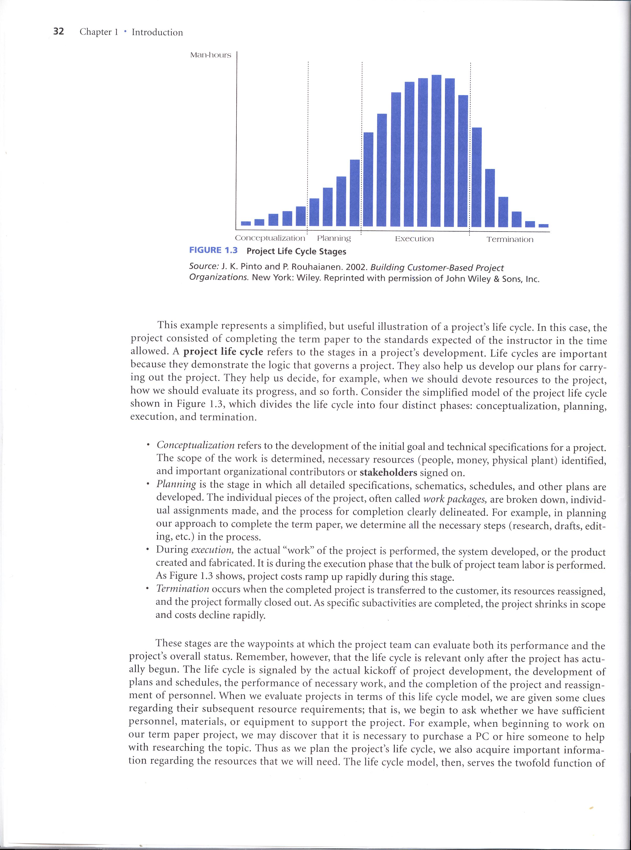
PROJECT LIFE CYCLE

Slide 12
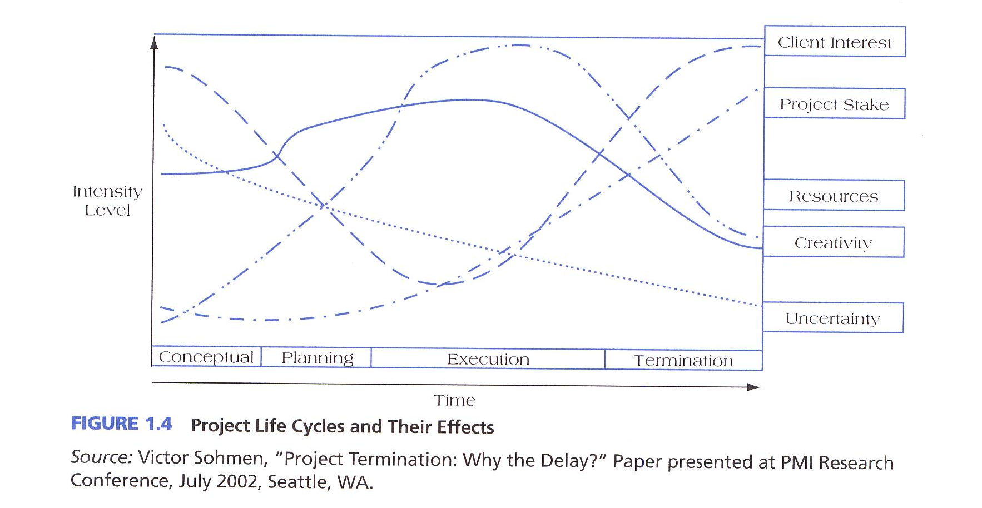
Project Life Cycles and Their Effects

Slide 13

DETERMINANT OF PROJECT SUCCESS
The Triple Constraint

Slide 14
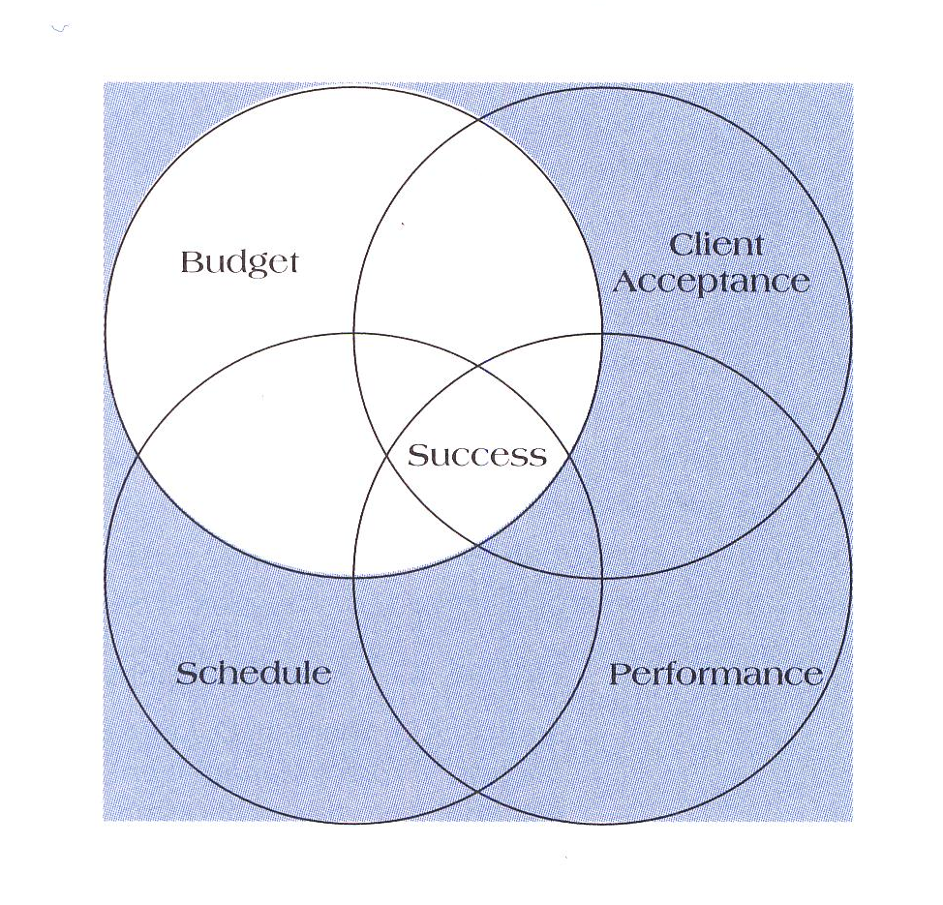
DETERMINANT OF PROJECT SUCCESS
The Quadruple Constraint

Slide 15
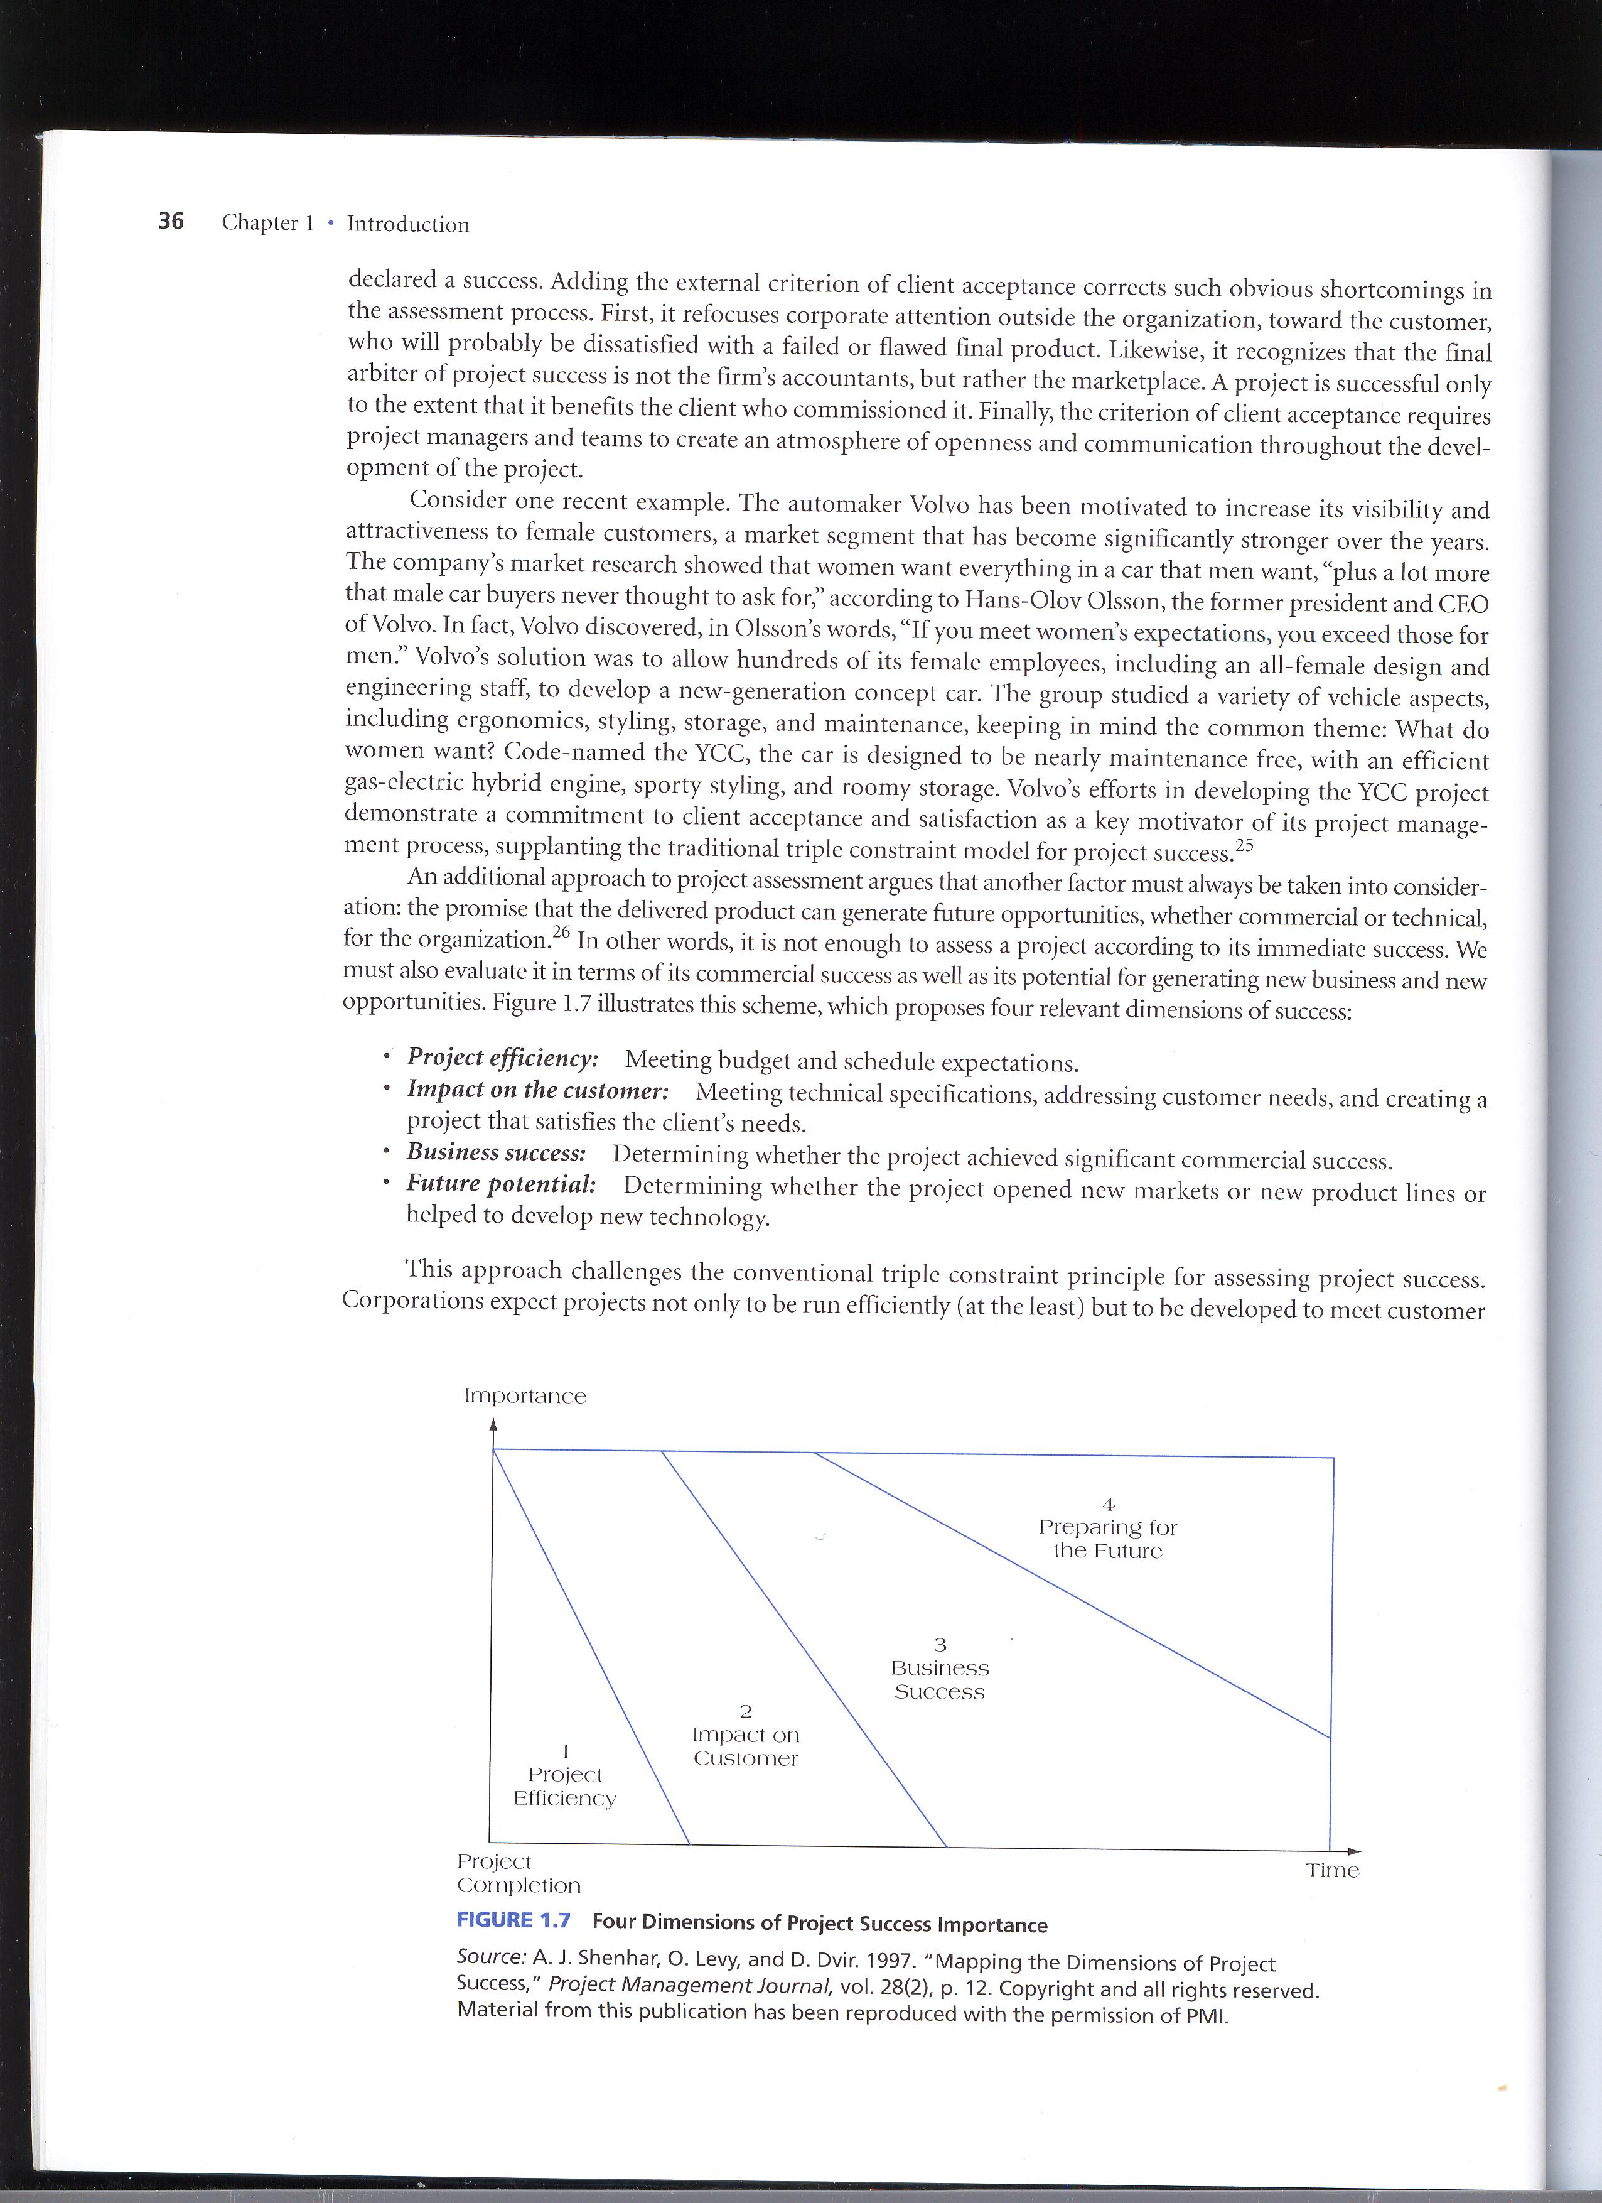
Four Dimensions of Project Success Importance

Slide 16
What Help Project Succeed
1. Executive support
2. User involvement
3. Experienced project manager
4. Clear business objectives
5. Minimized scope
6. Standard software infrastructure
7. Firm basic requirements
8. Formal methodology
9. Reliable estimates
10. Other criteria, such as small milestones, proper planning, competent staff, and ownership
*The Standish Group, “Extreme CHAOS,” (2001).

Slide 17

WHAT IS PROJECT MANAGEMENT ?
Project management is “the application of knowledge, skills, tools and techniques to project activities to meet project requirements” (PMBOK® Guide, Third Edition, 2004, p. 8)

Slide 18

PROJECT MANAGER
Project managers strive to meet the triple / quadruple constraint by balancing project scope, time, and cost goals

Slide 19
PROJECT MANAGER RESPONSIBILITIES
Selecting a team
Developing project objectives and a plan for execution
Performing risk management activities
Cost estimating and budgeting
Scheduling
Managing resources

Slide 20
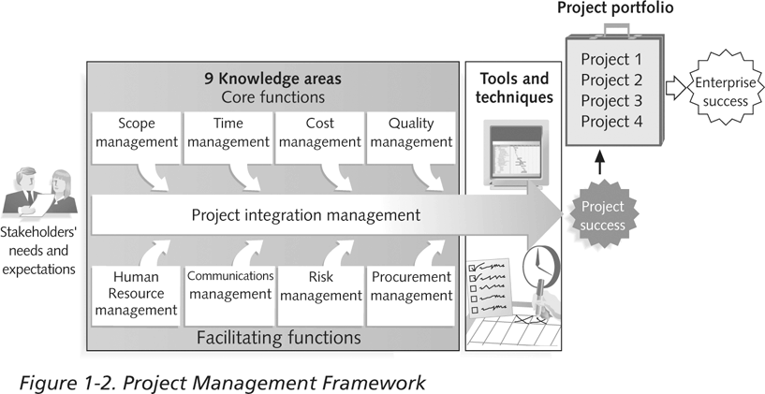
PROJECT MANAGEMENT FRAMEWORK

Slide 21
Sugested Skills for Project Manager
Project managers need a wide variety of skills
They should:
  Be comfortable with change
  Understand the organizations they work in and with
  Be able to lead teams to accomplish project goals

Slide 22
Important Skills and Competencies for Project Manager
1. People skills
2. Leadership
3. Listening
4. Integrity, ethical behavior, consistent
5. Strong at building trust
6. Verbal communication
7. Strong at building teams
8. Conflict resolution, conflict management
9. Critical thinking, problem solving
10. Understands, balances priorities

Slide 23
Importance of Leadership Skills
Effective project managers provide leadership by example
A leader focuses on long-term goals and big-picture objectives while inspiring people to reach those goals
A manager deals with the day-to-day details of meeting specific goals
Project managers often take on the role of both leader and manager

Slide 24
Program
Program: group of related projects managed in a coordinated way to obtain benefits and control not available from managing them individually (PMBOK® Guide, Third Edition, 2004, p. 16)
Program managers oversee programs and often act as bosses for project managers

Slide 25
Project VS Program
PROGRAM
PROYEK D
PROYEK A
PROYEK B
PROYEK C

Slide 26
Project Management Maturity
Project management maturity model are used to allow organization to benchmark the best practices of successfull project management firms

Slide 27
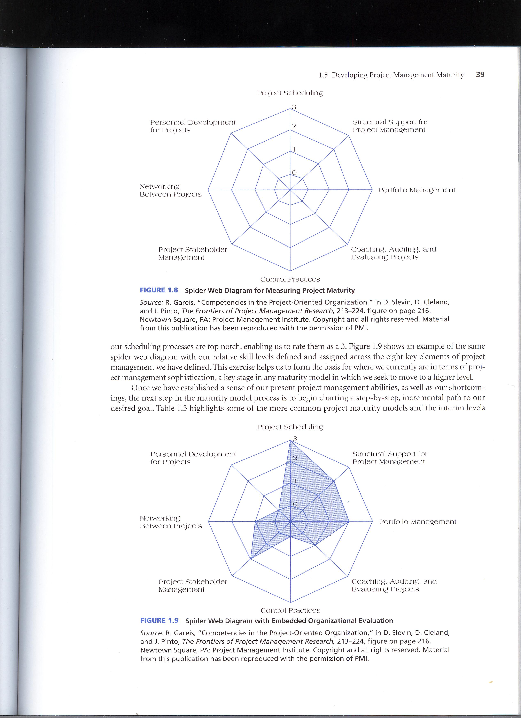
Project Management Maturity (Spider Web Diagram)
Ring Level | Meaning
0 | Not defined or poor
1 | Defined but sub standard
2 | Standardized
3 | Industry leader or cutting edge

Slide 28

TERIMA KASIH

