Slide 1

SCOPE MANAGEMENT
Project Management
Magister aDesain
Universitas Komputer Indonesia
Source:
Larson & gray, 2014
Pinto, j.k. 2010, 2ND. ED.

Slide 2
Project scope
is everything about a project – work content as well as expected outcomes. Project scope consist of naming all activities to be performed, the resources consumed, and the end product that result, including quality standard. Scope includes a project goals, constraints, limitations.

Slide 3
SCOPE MANAGEMENT
is the function of controlling a project in terms of its goals and objectives through the processes of conceptual development, full definition, execution, and termination.
It’s a dream until you write it down. Then it’s goal
We can control only what we have planned

Slide 4
Defining the project
Defining the project scope
1. Project objective
2. Deliverables
3. Milestones
4. Technical requirements
5. Limits & Exclusions
6. Reviews with customer
Establishing project priorities
Creating the breakdown structure
Integrating the WBS with the Organization
Coding the WBS

Slide 5
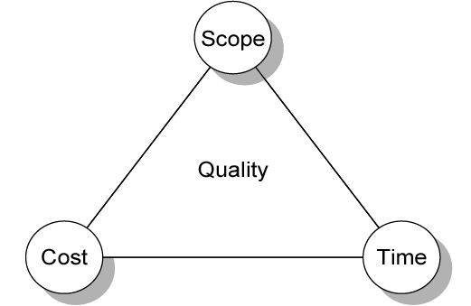
Establishing project priorities

Slide 6
Establishing project priorities
Cost
Profit Potential
Time To Market
Development Risk
Others

Slide 7
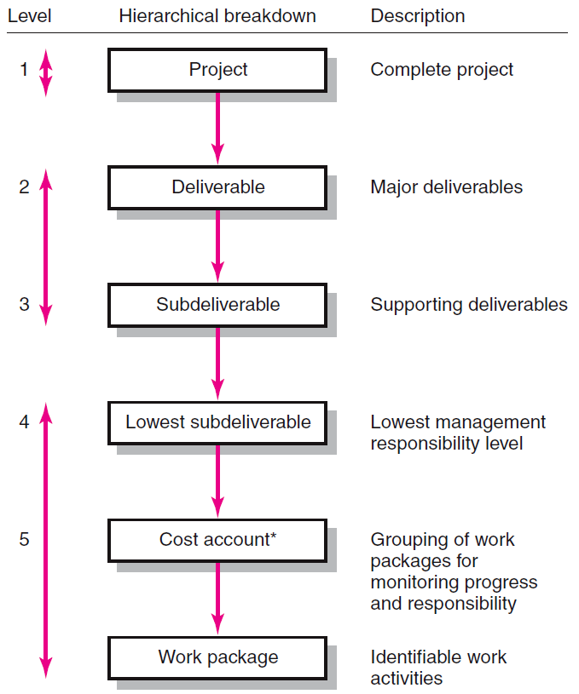
Hierarchical breakdown of the wbs

Slide 8
Wbs example
Level 1 →
Level 2 →
Level 3 →

Slide 9
Integrating wbs & obs (Example)
PROJECT OFFICE
RESP DEPT
B. Smithers
CIVIL
STRUCTURAL
ELECTICAL
PLUMBING
RESP DEPT
RESP DEPT
RESP DEPT
RESP DEPT
R. Kelly
P. Tate
J. Sims
R. Lee
CONCRETE
CARPENTRY
WIRING
WATER/SEWER
PERF DEPT 6010
PERF DEPT 5010
PERF DEPT 4010
PERF DEPT 3010
M. Manning
R. Sites
S. Johnson
K. Wells
MASONRY
ROOFING
HOOKUP/TIE-IN
GAS
PERF DEPT 6020
PERF DEPT 5020
PERF DEPT 4020
PERF DEPT 3020
T. Greams
Y. Taylor
P. Ottis
R. Oriely
TEST
DRYWALL
PERF DEPT 6030
PERF DEPT 5030
K. Neumann
D. Smith

Slide 10
Coding the wbs for information (EXAMPLE)

Slide 11
Coding the wbs for information (EXAMPLE)
Housing Corporation
1.1 New Home Construction
1.1.1 Concrete
1.1.1.1 Pour Foundation
1.1.1.2 Install Patio
1.1.1.3 Pour Stairway
1.1.2 Framing
1.1.2.1 Frame Exterior Walls
1.1.2.2 Frame Interior Walls
1.1.2.3 Install Roofing Trusses
1.1.3 Plumbing
1.1.3.1 Install Water Lines
1.1.3.2 Install Gas Lines
1.1.3.3 Install B/K Fixtures
1.1.4 Electrical
1.1.4.1 Install Wiring
1.1.4.2 Install Outlets/Switches
1.1.4.3 Install Fixtures
1.1.5 Interior
1.1.5.1 Install Drywall
1.1.5.2 Install Carpets
1.1.5.3 Install Painting
1.1.6 Roofing
1.1.6.1 Install Felt
1.1.6.2 Install Shingles
1.1.6.3 Install Vents

Slide 12


