Slide 1
Matrices

Slide 2
Definition
A matrix is a rectangular array of numbers arranged in m horizontal rows and n vertical columns :
is a mxn matrix (m rows, n columns), where the entry in the i^{th} row and j^{th} column is a_{ij} . We often write A=[a_{ij}].

Slide 3
Let
Then A is 2x3 with a₁₂= 2 and a₂₃= 6
Let
Then we knows that : a = 1, b =2, c = 3, d = 4, e = 5, and f = 6

Slide 4
Two m x n matrices A=[a_{ij}] and B=[b_{ij}] are said to
be equal if a_{ij}= b_{ij},
If
Then A = B if and only if x = -3, y = 0, and z = 6

Slide 5
Types of Matrices
Triangular matrices
A matrix like this one, with all-zero entries below the top-left-to-lower-right diagonal ("the diagonal") is called "upper triangular".
Diagonal Matrices
A matrix with non-zero entries only on the diagonal is called "diagonal“

Slide 6
Identity Matrices
A diagonal matrix whose non-zero entries are all 1's is called an "identity" matrix

Slide 7
Singular Matrices :
determinants = 0
Non Singular Matrices :
determinants ≠ 0

Slide 8
Transpose Matrices :

Slide 9
Matrix Addition
.
We need to add the pairs of entries, and then simplify for the final answer :

Slide 10
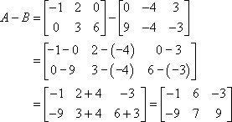
Matrix Subtraction
Given the following matrices, find A – B and A – C, or explain why you can not.
A and B are the same size, each being 2 × 3 matrices, so I can subtract, working entry-wise :

Slide 11
However, A and C are not the same size, since A is 2 × 3 and C is 2 × 2. So this subtraction is not defined.

Slide 12
Scalar and Matrix Multiplication
There are two types of multiplication for matrices: scalar multiplication and matrix multiplication.
Scalar multiplication is easy. You just take a regular number (called a "scalar") and multiply it on every entry in the matrix.
Let

Slide 13
Scalar Multiplication
For the following matrix A, find 2A and –1A.
To do the first scalar multiplication to find 2A, We just multiply a 2 on every entry in the matrix :

Slide 14
Matrix Multiplication
Find CD and DC, if they exist, given that C and D are the following matrices :
C is a 3×2 matrix and D is a 2×4 matrix, so first I'll look at the dimension product for CD :

Slide 15
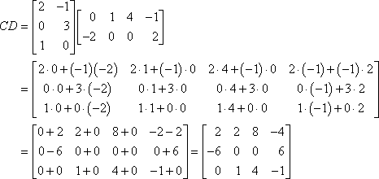
So the product CD is defined (that is, We can do the multiplication); Here's the multiplication:

Slide 16
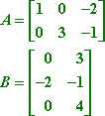
Given the following matrices, find the product BA.

Slide 17
Determinants
If you have a square matrix, its determinant is written by taking the same grid of numbers and putting them inside absolute-value bars instead of square brackets :
M_{2x2} :
Ma_{3x3} :
= a.e.i + b.f.g + c.d.h – b.d.i – a.f.h – c.e.g

Slide 18
Inverse
If you are given a matrix equation like AX = C, where you are given A and C and are told to figure out X, you would like to "divide off" the matrix A.
But you can't do division with matrices. On the other hand, what if you could find the inverse of A,
The inverse of A, written as "A^{–1}" and pronounced "A inverse", would allow you to cancel off the A from the matrix equation and then solve for X.

Slide 19
We know that : A x A⁻¹ = A⁻¹ x A = I
, Assume that :

Slide 20
AX = C A^{–1}AX = A^{–1}C IX = A^{–1}C X = A^{–1}C
Note : Multiplying by the identity matrix I doesn't change anything, just like multiplying a number by 1 doesn't change anything.

Slide 21
Let A, B and C are matrices, then
A + B = B + A
AB ≠ BA
AI = IA = A
AA⁻¹ = A⁻¹A = I
A + (B + C) = (A + B) + C
A (BC) = (AB) C
A (B + C) = AB + AC

Slide 22
Homework
Suppose we know that :
1. Define :
a) A+B b) A – B - C c) AB
2. Prove that :
a) (AB)C = A(BC)
b) IBA = BA

