Slide 1
Bab 2

Slide 2
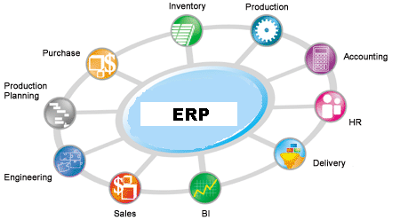

Slide 3
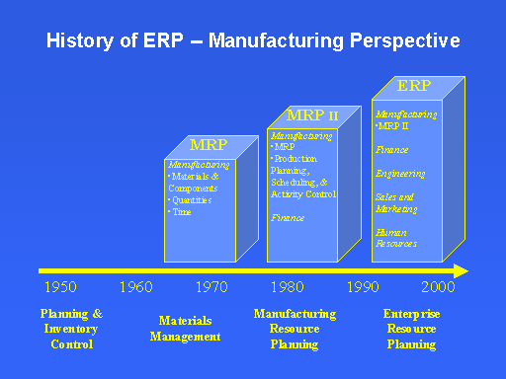

Slide 4
1960’s - Systems Just for Inventory Control
1970’s - MRP – Material Requirement Planning (Inventory with material planning & procurement)
1980’s - MRP II – Manufacturing Resources Planning (Extended MRP to shop floor & distribution Management.)
Mid 1990’s - ERP – Enterprise Resource Planning (Covering all the activities of an Enterprise)
2000 onwards – ERP II – Collaborative Commerce (Extending ERP to external business entities)

Slide 5
Vendors of ERP

Slide 6
SAP - Systems Applications Products in Data Processing
29% market share - Honda, IBM, Bank of Canada, P & G
BAAN - Dutch - 5% - Russell Stover Candy, Mercedez Benz, Boeing, Nortel
Peoplesoft - California - 6% - NBA, Adidas, Anderson Consulting, Hilton Hotels, NYNEX
Oracle - California - 10% - USPS, CBS, Nike, Kodak, Toronto Dominion Bank
J.D. Edwards - Colorado - 7% - Harley Davidson, Saab Automobile, BellSouth Cellular Corporation, Holiday Inns, Fox Television Stations

Slide 7
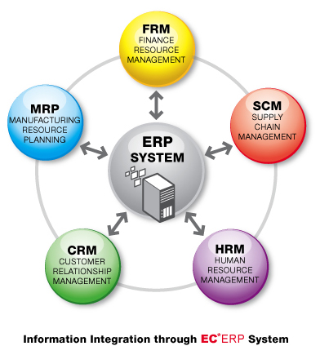

Slide 8
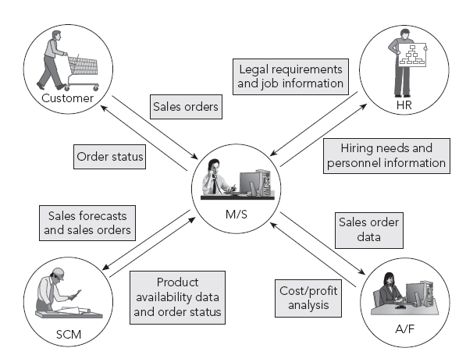
Hubungan Interdepedensi
Marketing and Sales

Slide 9
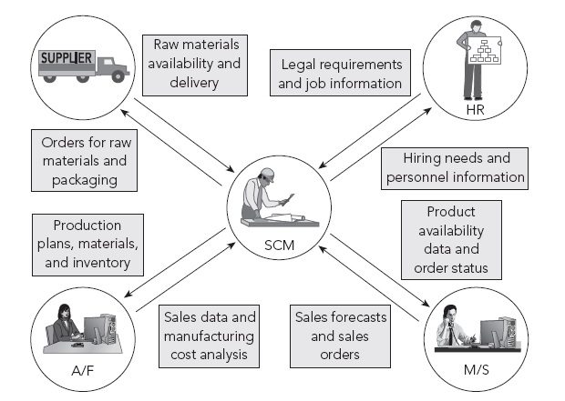
Hubungan Interdepedensi
Supply Chain Management

Slide 10
Hubungan Interdepedensi
Supply Chain Management

Slide 11
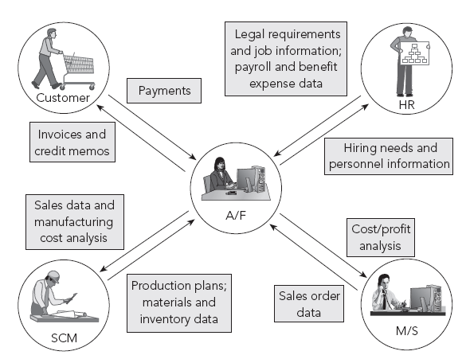
Hubungan Interdepedensi
Accounting and Finance

Slide 12
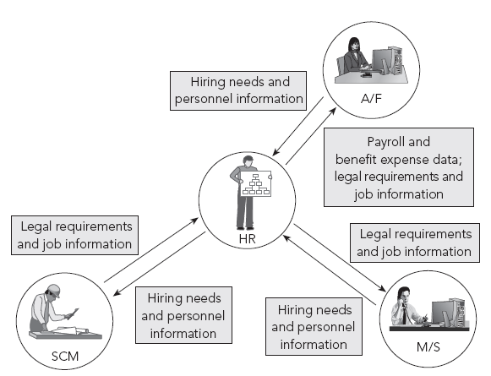
Hubungan Interdepedensi
Human Resources

Slide 13
Reasons for adopting ERP
Integrate financial information.
Integrate customer order information.
Standardize and speed up operations processes.
Reduce inventory.
Standardize Human Resources information .
Common definitions.
Common database.
Update one module, automatically updates others.
ERP systems reflect a specific way of doing business.
Must look at your value chains, rather than functions.

Slide 14
Limitations of ERP
High cost.
Forced change of processes.
Very complex software.
Lack of trained people.
Flexibility of software system upgrades.
Implementation timelines.
Availability of internal technical knowledge and resources.
Education and training.
Implementation strategy and execution.
Resistance to change.

Slide 15
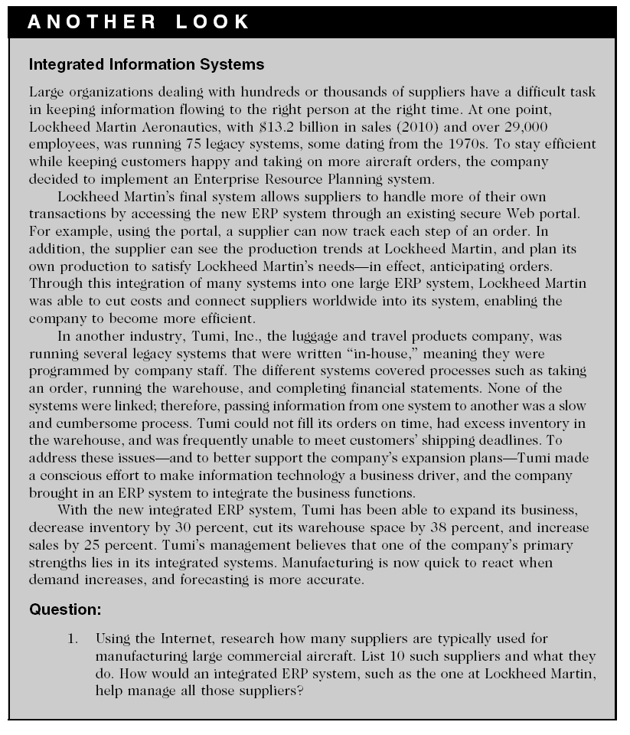

Slide 16
Assume your uncle raises bees for honey on his farm. You help him package the honey and sell it on the Internet. Reproduce Figure 1-1 for this small business example. Add a one-sentence description for each function as it relates to selling this artisan honey online.
Go to the Amazon Web site (http://www.amazon.com), and step through the process of buying an item without actually purchasing the item. Based on this experience, describe the flows of information between Marketing and Sales, Accounting and Finance, and Supply Chain Management at Amazon. How easy is it to buy that item?

