Slide 1
Overview of E-Commerce

Slide 2
Overview E-Commerce
Businesses trading with other businesses and internal processes (Schneider, 2011)
Electronic commerce refers to the buying and selling of information, products and services via computer networks. (Kalakota & Whinston, 1996)
Using electronic commerce, businesses have
  Created new products and services
  Improved promotion, marketing, and delivery of existing offerings

Slide 3
Overview E-Commerce
The incentives for engaging in e-commerce are listed as follows:
Selection and Value
Performance and Service
Look and Feel
Advertising and Incentives
Personal Attention
Community Relationships
Security and Reliability
Notes:
The incentives for engaging in e-commerce are listed as follows:
Selection and Value. Attractive product selections, competitive prices, satisfaction guarantees, and customer support after the sale.
Performance and Service. Fast, easy navigation, shopping, and purchasing, and prompt shipping and delivery.
Look and Feel. Attractive web storefront, website shopping areas, multimedia product catalog pages, and shopping features.
Advertising and Incentives. Targeted web-page advertising and e-mail promotions, discounts and special offers, including advertising at affiliate sites.
Personal Attention. Personal web pages, personalized product recommendations, web advertising, and e-mail notices, and interactive support for all customers.
Community Relationships. Virtual communities of customers, suppliers, company representatives, and others via newsgroups, chat rooms, and links to related sites.
Security and Reliability. Security of customer information and website transactions, trustworthy product information, and reliable order fulfillment.

Slide 4
E-Commerce Technologies

Slide 5
E-COMMERCE TECHNOLOGIES
Internet, intranets, and extranets - network infrastructure or foundation of e-commerce.
Customers - secure information, marketing, transaction, processing, and payment services.
Trading and business partners - exchange information and accomplish secure transactions; including electronic data interchange (EDI), supply chain, financial systems and databases.
Company employees - resources to communicate and collaborate in E-Commerce work activities.
Information system professionals and end users - manage the content and operations of the websites and other E-Commerce resources
Notes:
The Internet, intranets, and extranets are the network infrastructure or foundation of e-commerce.
Customers must be provided with a range of secure information, marketing, transaction, processing, and payment services.
Trading and business partners rely on Internet and extranets to exchange information and accomplish secure transactions; including electronic data interchange (EDI) and other supply chain and financial systems and databases.
Company employees depend on a variety of Internet and intranet resources to communicate and collaborate in support of their EC work activities.
Information system professionals and end users can use a variety of software tools to develop and manage the content and operations of the websites and other EC resources of a company.

Slide 6
E-COMMERCE TECHNOLOGIES
E-Commerce technology basics:
Internet and World Wide Web
Dynamic Content Generation
Web Client/Server Architectures
Advertising on the web
E-mail marketing
Technology-Enabled Customer Relationship Management (CRM)
Branding
Search engine
Domain Names

Slide 7


  Internet and World Wide Web
E-COMMERCE TECHNOLOGIES
Internet
World Wide Web
Notes:
Networks of computers and the Internet that connects them to each other form the basic technological structure that underlies virtually all electronic commerce.
Web is a subset of the computers on the Internet that are connected to one another in a specific way that makes them and their contents easily accessible to each other.
Two important key technological element of Web are hypertext and GUI.

Slide 8
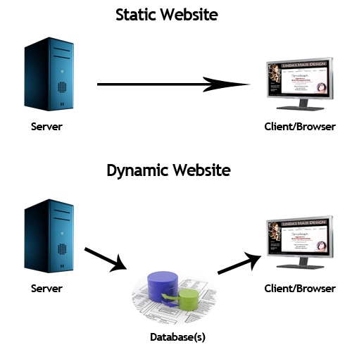
E-COMMERCE TECHNOLOGIES
  Dynamic Content Generation
Dynamic content is non static information constructed in response to a Web client’s request.
Can give user an interactive
experience with the web site.
Dynamic content can be
created using two basic
approach:
  Client-side scripting
  – ASP, PHP, JSP, etc.
  Server-side scripting
  – CGI, etc.

Slide 9
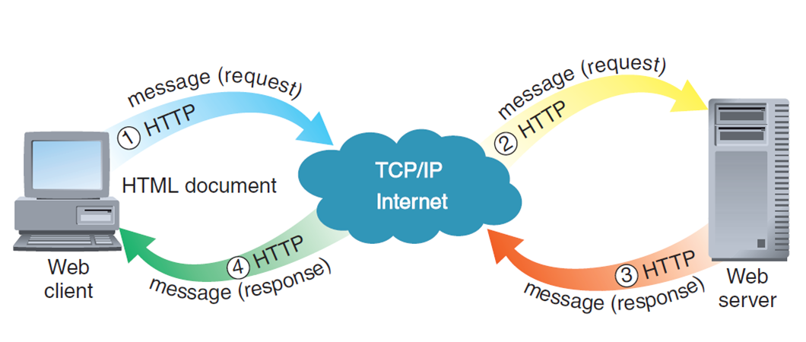
E-COMMERCE TECHNOLOGIES
Web Client/Server Architectures
Message flows in a two-tier client/server network
Notes:
The basic Web client/server model is a two-tier model because it has only one client and one server. All communication take place on the Internet between the client and the server.

Slide 10
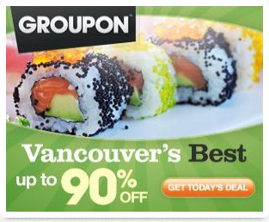
E-COMMERCE TECHNOLOGIES
Advertising on the Web
Advertising is all about communication.
Banner Ads
  Small rectangular object on a Web page that display a stationary or moving graphic and includes hyperlink to the advertiser’s Web site.
  Versatile advertising vehicles
  Serve both informative and persuasive functions
Text Ads
  Short promotional message
  Do not use graphic elements
  Placed along the top or right side of a
  Web page
  Short text ads for products or services
  Very effective

Slide 11

E-COMMERCE TECHNOLOGIES
E-Mail Marketing
E-mail can be powerful element in advertising strategy
Send e-mail messages to customer on new products or sales on existing product
Combine useful content with an advertising e-mail message
Use hyperlink in e-mail messages –
link to the company’s web site

Slide 12
E-COMMERCE TECHNOLOGIES
Technology-Enabled Customer Relationship Management (CRM)
Technology-enabled relationship management is important when promoting and selling on the Web
CRM
Advertising
Promotion & Discounts offered
Distribution Channels
Targeting
Pricing @ Service of Product
New Product Features
Measure customer relationship
Notes:
Seven dimensions of the customer interaction experience
<read slide>

Slide 13
E-COMMERCE TECHNOLOGIES
Branding
A powerful statement of quality, value and other desirable characteristics in one recognizable element
Branded product are easier to advertise and promote
Elements of a brand
Differentiation
Relevance
Perceived value
Notes:
Differentiation
In what significant ways is this product or service unlike its competitors
Relevance
How does this product or service fit into my life?
Perceived value
- Is this product or service good?

Slide 14

E-COMMERCE TECHNOLOGIES
Search Engines
Help people find things on the Web
3 major parts:
  Spider/crawler/robot – to search the Web
  Index/database – to check the stored web page
  Search utility – find matching search terms
Search engine ranking
Search engine positioning
Notes:
Search engine ranking – search engine decide which URLs appear first on searches for a particular search term
Search engine positioning – position the particular URL listed near the top of search engine results. For sites that obtain most of their visitors from search engines, a high ranking that places their URL near the top of the list of links returned by the search engine is extremely important

Slide 15
E-COMMERCE TECHNOLOGIES
Domain Names
Obtain the domain names can be important part of establishing a web presence
Companies often buy more than one domain name
  Yahoo.com & Yahow.com
Buying, selling and leasing domain names

Slide 16
Consumer Behavior & Value

Slide 17
Consumer Behavior
Consumer behavior is the study of when, why, how, and where people do or do not buy a product.
It attempts to understand the buyer decision making process, both individually and in groups.
It studies characteristics of individual consumers such as demographics and behavioral variables in an attempt to understand people's wants.
(source from Wikipedia)

Slide 18
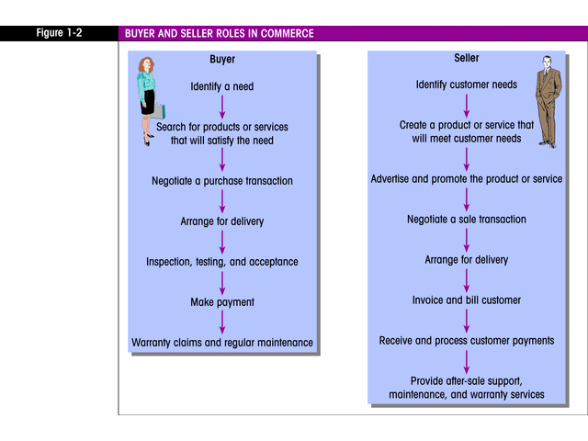
Buyer and Seller Roles in e-Commerce
Make payment
Arrange for Delivery
Invoice and bill customer
Inspection, testing & acceptance
Receive & process customer payments
Arrange for Delivery
Notes:
Now I will continue with the consumer value and behavior parts.
First of all let us look on the roles of buyer and seller in e-commerce.
For buyer, they need to……
Whilst for the seller, they need to…

Slide 19
Consumer Values in E-commerce
Utilitarian Value
Money saving
Time saving
Experiential Value
Entertainment
Larger selection
Excellence Service
Visual
Escape
Interaction
Consumer Value Categories
Consumer Value Components
Source: Lee & Overby, 2004
Notes:
Now we move on to the customer values in e-commerce
Customer value is actually an important predictor of buying behavior and also a significance influence of customer’s purchase decisions.
There are 2 main categories for consumer values.
The first one is Utilitarian value which the components are money saving, time saving, larger selection and excellence service
The second one is the experiential value which comprise of entertainment, visual, escapism, and interaction

Slide 20
Consumer Values : Utilitarian Value
People who believe the most important thing is to do whatever promotes to the highest amount of happiness
Relate to goal-oriented shopping: value is obtained by acquiring products / services in an efficient manner
Positively related to customer preference, attitude, satisfaction, loyalty, behavioral intentions and the amount spent by customers
Notes:
This is the definition of utilitarian value where:

Slide 21


Consumer Values : Utilitarian Value
Money saving
- Economic value dimension
- Product that are offered at right prices given the quality derive value for the consumer
- Value for money
Excellence service
  - Involves quality judgments for the services being offered
  - Quality of product /service
Notes:
These are the components of utilitarian value which is the first one is:
Money saving
Is an economic value dimension and the product that are offered at the right prices given the quality derive value for the customer.
For example: customer would like to buy product or service that is value for money where customers able to get the best price of the product or the service they want by comparing the price from several others merchant or retailers that using the e-commerce platform
The second component is Excellence service where it involves the quality judgment for the services being offered for example the duration of the delivery of product, service after sales, warranty and others.
Besides, the good quality of product / service given by retailers also play an important roles in determining the excellence service in e-commerce

Slide 22

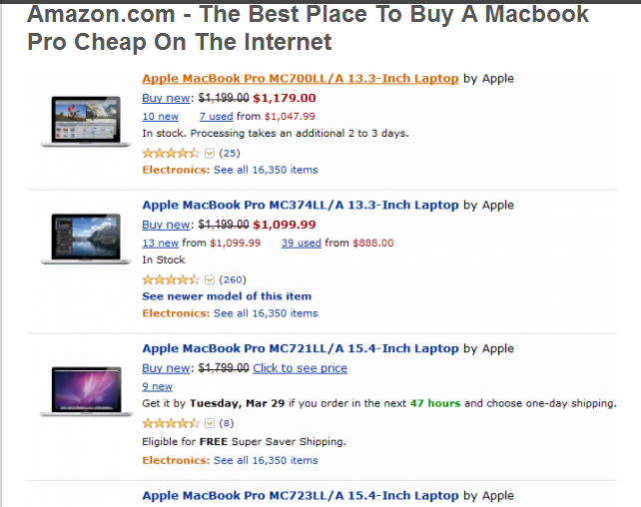
Consumer Values : Utilitarian Value
Time saving
- Importance to consumers who are pressed for time and need to conserve it
Larger selection
- Wide online selection contribute to customer satisfaction in e-commerce
Notes:
For time saving: e-commerce actually offers valuable time saving especially to those who really in hurry and have a very limited time to go for a conventional shopping. By having this e-commerce platform, it actually helps those people in managing and saving their time persistently because customers can shop online at any time they want without any time pressure.
And the last components is larger selection where e-commerce provide wide online selection that contribute to customer satisfaction in e-commerce.
For example, amazon.com where if customers would like to buy a book, this website will give recommendations on the other books that are quite similar to the book that the customers want. Hence, the customer will have more options to choose to buy the products that they want.

Slide 23
Consumer Values : Experiential Value
Refers to the appreciation of an experience : an effective way to meet customers’ need during online shopping session and help effectively to complete their purchase tasks.
Creating unique and memorable experience in business as well as personal life when engage with e-commerce platform
Notes:
The definition for experiential value is it…
Refers to… where it is an effective

Slide 24


Consumer Values : Experiential Value
Entertainment
- Consumer may browse through many different sites just for entertainment and fun
Visual appeal
  - The aesthetic and outlook of the sites may create visual appeal for online shoppers
Notes:
The first components of experiential value is entertainment where consumers may browse through many different sites just for entertainment and fun
And the visual appeal, it shows that the aesthetic and outlook of the sites may create visual appeal for online shoppers and it will make them attracted to browse the website.

Slide 25


Consumer Values : Experiential Value
Escapism
- Refers to the online consumer’s out of routine experience and letting them escape the every day life and worries
Interaction
  - Refers to the value added and benefits gained through interaction with the marketer and other consumers
Notes:
The next component of experiential value is escapism where it refers to the ….
Hence the attractive and persuasive e-commerce website able to give entertainment to those who really need to escape from their daily routine life
The last component is interaction where it refers to…

Slide 26
Influencing Factors of Customer Behavior
Customer’s Decision
Consumer/ Personal Factors
Merchant & Intermediary Factors
Product/ Services Factors
Environmental Factors
E-Commerce Systems
Source: Marek Maurizio, 2011
Notes:
Now we move on to the influencing factors of customer behavior.
These are actually the basic factors of a consumer behavior model that influence customers decision on buying the product / services through e-commerce. There are….

Slide 27

Influencing Factors of Customer Behavior
Environmental Factors
- The environment can influence a buyer decision
- Social variables: influence by friends, internet communities, social networks opinions
- Community / Cultural variables : difference in behavior between countries/ regions
Product / Services Factors
  - Pricing, promotions, quality of the products,
  customer services
Notes:
The first factor is environment factors:
The environment can influence a buyer decision to buy product or services thru e-commerce. Most of the customers prefer to have convenience and accessibility because they can shop on the internet in the comfort of their home environment, and save time and effort.
For social variables, environmental factors usually influence by friends, internet communities, social networks opinions and word of mouths from other customers.
While for the community or cultural variables, the environmental factors depend on the difference in behavior between countries or regions. For example, western country like US or Europe, they have engaged with e-commerce since long time ago however for us in Malaysia, we are still lagging and most of us are not confident in using e-commerce platform.
Now we move on to the product/ services factors. Customers’ decision weather or not to shop online are also influence by the type of product or services offered by the retailers. It consists of the pricing the retailers offers, the promotion for product and services and also customer services especially for warranty and support after sales.

Slide 28

Influencing Factors of Customer Behavior
Merchant & Intermediary Factors
- Online transaction can be affected by the merchant that handle the product
- Reputation, trust, marketing
Consumer / Personal Factors
  - Demographic factors: age, gender, status, ethnic,
  income, education, occupation
  - Individual preference, behavior characteristics
- More experience in online shopping = more online shopping
Notes:
The next factor that influence customer behavior towards online shopping is merchant & intermediary factors.
Normally, in e-commerce, it involved online transaction over the Internet such as payment for the goods or services. Hence it provides challenges to customers in terms of reputation of the retailer, the payment gateway such as paypal and others.
Besides, security and privacy of customer;s data have an impact on customers trust in shopping in the Internet. Hence, merchant or retailers should consider a high level of security and privacy in online shopping experience in order to make their customers trust them and willing to buy through Internet.
The next factor is consumer / personal factors. It involves the demographic factors such as age, gender, status, ethnic, income, education and occupation. Besides, it is also involve individual preference and behavior characteristics towards shopping on the Internet such as ease of use, usefulness, need for interaction and a lot more.
And if the customers have more experience in online shopping, they tend to do more online shopping in the future.

Slide 29
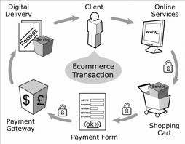
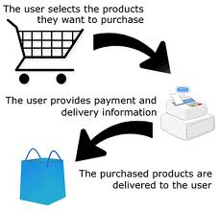

Influencing Factors of Customer Behavior
E-Commerce Systems
  - The platform for online transaction: useful, ease of use, interactive
  - Content element: aesthetics, marketing mix
  - Security, protection, payment mechanism, etc.
  - Consumers are more likely to buy from well designed
  e-commerce system
      Sites with large set of functions
      Functions to prevent possible trouble
Notes:
The last factor is e-commerce systems.
This is actually the platform for online transaction to buy goods or services. Hence it must be very useful, ease of use and interactive. While for the content elements, this e-commerce platform should have aesthetics element and marketing mix such as promotion of products or services.
This e-commerce systems also need to have high security, protection, variable of payment mechanism and others because customers are more likely to buy from a well designed e-commerce systems.

Slide 30
Relationship between technology and customer behavior: Web Experience

Slide 31
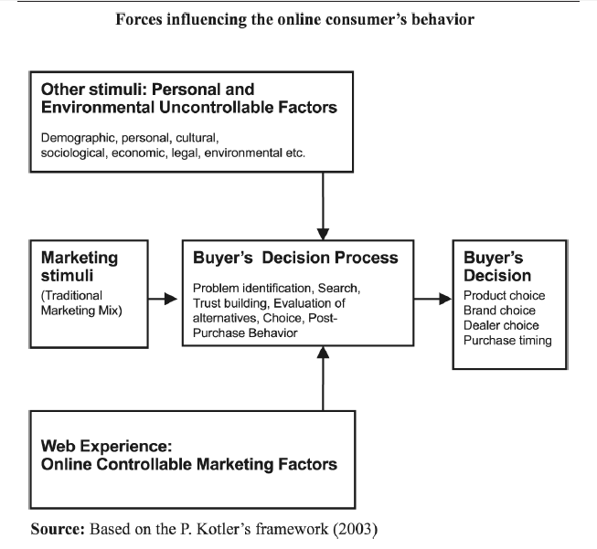
Factors affecting the online consumer’s behavior
Notes:
Customer exposure to the company’s marketing can affect the decision-making by providing inputs for the consumer’s black box where information is
processed before the final consumer’s decision is made (Kotler, 2003).
Online marketers can influence the decision making process of the virtual customers by engaging traditional, physical marketing tools but mainly by creating and delivering the proper online experience, the Web experience.
Web experience is a combination of online functionality, information, emotions, cues, stimuli and products/services, in other words a complex mix of elements going beyond the 4Ps of the traditional marketing mix.

Slide 32
Web experience
Online shopping experience or virtual experience as a crucial e-commerce marketing issues.
Online shopping experience as a process of four stages describing the successive steps of an online transaction - Tamimi et al. (2003).
Consider online customer as someone who has access to information around them.
Online experience is a more complicated issue than the physical shopping experience.
Notes:
So, the online marketer/seller must consider customer experience during buying process ( which somehow can effect their buying decisions )

Slide 33
Definition of Web Experience
“…..consumer’s total impression about the online company (Watchfire Whitepaper Series, 2000) resulting from his/her exposure to a combination of virtual marketing tools “...under the marketer’s direct control, likely to influence the buying behavior of the online consumer” (Constantinides, 2002, p. 60).”
Notes:
The Web experience embraces elements like searching, browsing, finding, selecting, comparing and evaluating information as
well as interacting and transacting with the online firm.
The virtual customer’s total impression and actions are influenced by design, events, emotions, atmosphere and other elements
experienced during interaction with a given Web site, elements meant to induce customer goodwill and affect the final
outcome of the online interaction.

Slide 34
Case study 1: Dieringer Research
Group
Quality of online experience requiring special attention: poorly designed and dysfunctional Web sites are a potential threat not only to the company’s virtual business but also a hazard for their physical activities.
  Changed opinions towards brand ( due to the bad experiences during buying online)
  Opinions changed, switched brands at purchase, whether virtually or physically.
Customers visiting well designed Web sites like J. Crew’s and Bloomingdale’s are ten times more likely to visit the brick-and-mortar stores; visitors of Nieman Marcus.com are 18 times more likely to visit a Nieman Marcus physical store.
Notes:
Synergic effects of the positive Web experience on customers making use of a company’s Web site next to its traditional channels.

Slide 35
Web sites to deliver web experience.
Sites delivering excellent Web experience are designed not only offering the customer’s product needs and expectations but also assisting the customers through the steps of the buying process.
E-commerce infrastructure (O’Keefe and McEachern, 1998) is also of crucial importance.
Web sites must be seen therefore as vital instruments of customer service and persuasion rather than simply as online brochures or catalogues of the company’s products.

Slide 36
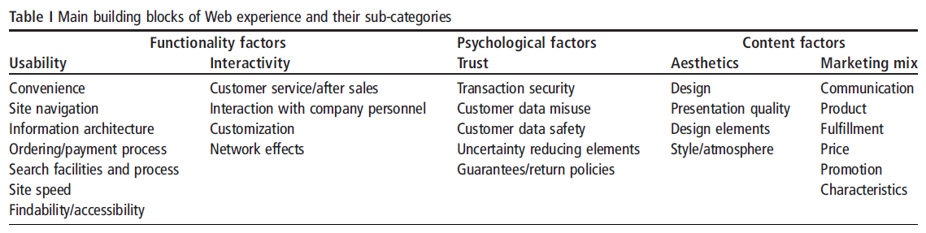
Web experiences elements
Notes:
Web experience elements: the marketing tools and actors under the control of the e-marketer that
can influence or shape the online consumer’s behavior during the virtual interaction
This table shows the complexities online marketers face in their effort to optimize their customers’ Web
experience; creating a successful online presence by means developing a comprehensive and
customer-oriented virtual proposition which is offering broad issues and delivering
the maximum possible effect, the greatest Web experience.

Slide 37
Functionality factors
Factors enhancing the online experience by presenting the virtual client with an good functioning, easy to explore, fast, interactive Web site.
Functionality includes “Usability” and “Interactivity” elements.
Slow, dysfunctional Web pages and poor interactivity prompt most online customers to look for alternatives, since time saving and shopping convenience are important motives to do business online for the majority of Internet users.

Slide 38
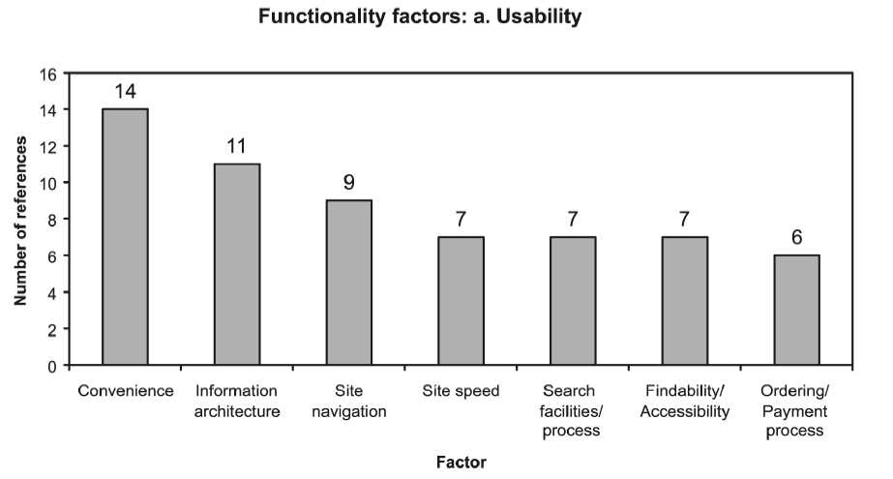
Sources: Efthymios Constantinides (2004)

Slide 39
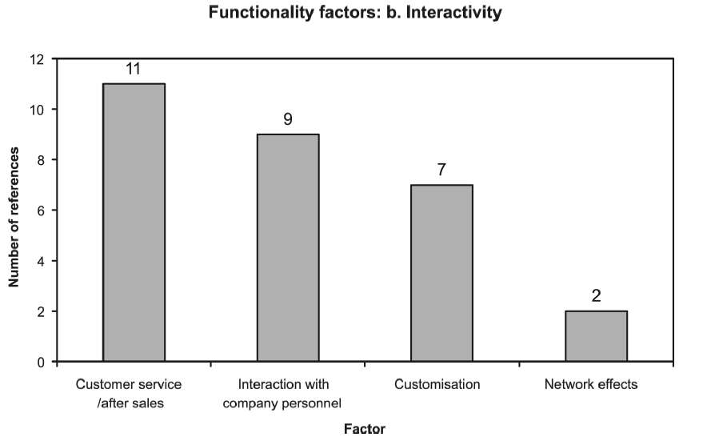
Sources: Efthymios Constantinides (2004)

Slide 40
Psychological factors
Web sites must communicate integrity and credibility in order to persuade customers to stop, explore them and interact online.
Psychological factors are those playing a crucial role in helping online customers unfamiliar with the vendor or unfamiliar with online transactions to overcome fears of fraud and doubts as to the trustworthiness of the Web site and vendor.

Slide 41
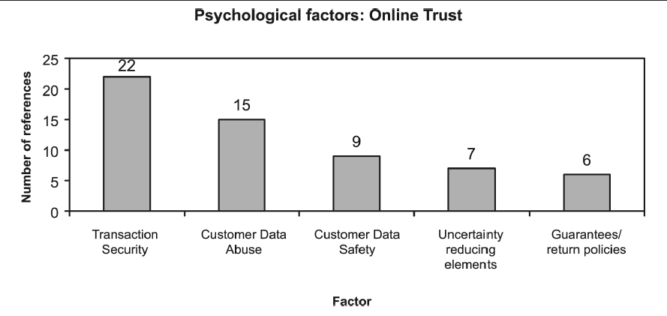
Sources: Efthymios Constantinides (2004)

Slide 42
Content factors
Referring to creative and marketing mix related elements of the Web site. These factors exercise a direct and crucial influence on the Web experience. There are two elements:
Aesthetics embrace the artistic and creative elements of the online presentation, aiming at a pleasing appearance or effect (Merriam-Webster’s Online Dictionary, n.d.).
  These elements communicate the Web site’s atmosphere, something important for attracting online customers by inducing positive and powerful motives for visitors to stop, explore and possibly interact with the site.
Marketing mix’s 4Ps – including fulfillment – are essential contributors to the Web experience

Slide 43
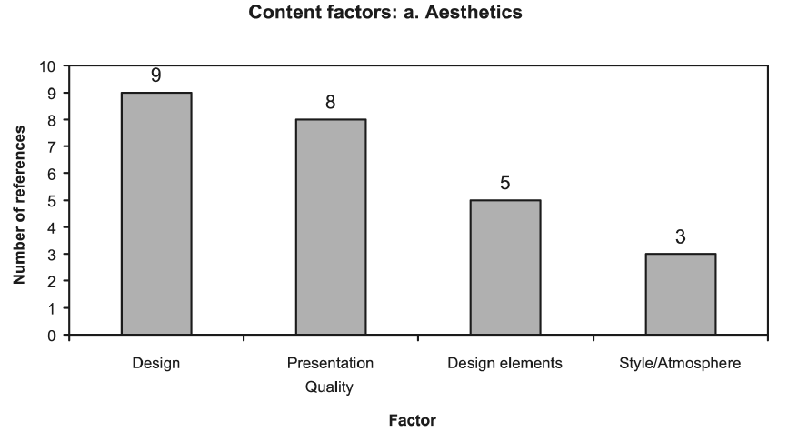
Sources: Efthymios Constantinides (2004)

Slide 44
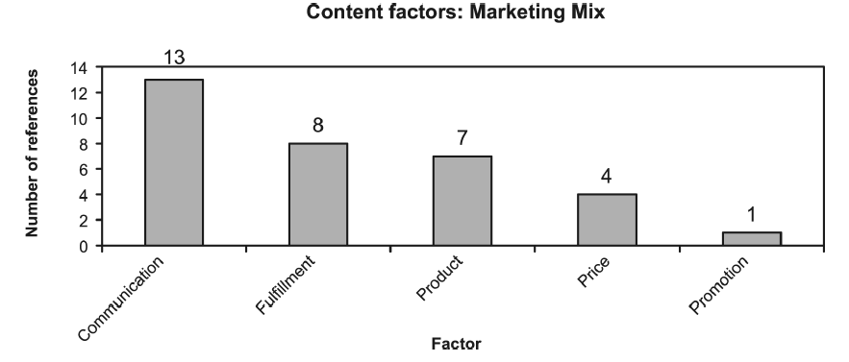
Sources: Efthymios Constantinides (2004)

Slide 45
Web marketing strategy

Slide 46
Web Marketing Strategies
Marketing mix
  Element combination to achieve goals
    Selling and promoting products and services
Marketing strategy
  Marketing mix with elements defined
Four Ps of marketing
  Product
    Physical item or service sold
    Brand: customers’ product perception
Notes:
46
46

Slide 47
Web Marketing Strategies (cont’d.)
Four Ps of marketing (cont’d.)
  Price
    Amount customer pays for product
    Customer value: customer benefits minus total cost
  Promotion
    Any means to spread word about product
  Place (distribution)
    Need to have products or services available in many different locations
    Getting right products to the right places at the best time to sell them
Electronic Commerce, Ninth Edition
Electronic Commerce, Ninth Edition
47
47
Notes:
47
47

Slide 48
Product-Based Marketing Strategies
Web presence must integrate with image and brand
Managers often think in terms of physical objects
  Useful Web site design when customers use product categories
    Web site examples: Home Depot, Staples, Sears
  Not a useful Web site design when customers look to fulfill a specific need
Advice: design Web site to meet individual customer needs
  Offer alternative shopping paths
Electronic Commerce, Ninth Edition
48

Slide 49
Customer-Based Marketing Strategies
Web sites to meet various types of customers’ specific needs
  First step: identify customer groups sharing common characteristics
  Second step: identify subgroups
    Example: Sabre Holdings
Strategy pioneered on B2B sites
B2C sites now adding customer-based marketing elements
  Example: university Web sites
Electronic Commerce, Ninth Edition
49

Slide 50
FIGURE 4-1 Sabre home page
Electronic Commerce, Ninth Edition
50

Slide 51
Communicating with Different
Market Segments
Communications media selection to carry message
  Physical world
    Uses building construction and floor space design
  Online firm
    Communications media selection: critical
    No physical presence
    Customer contact made through image projected through media and Web site
  Online firm challenge
    Obtain customer trust with no physical presence
Electronic Commerce, Ninth Edition
51

Slide 52
Market Segmentation
Divides potential customer pool into segments
  Defined in demographic characteristics terms
Micromarketing
  Practice of targeting very small market segments
  Hampered by cost increases
Three categories to identify market segments
  Geographic segmentation
  Demographic segmentation
  Psychographic segmentation
Television advertisers use all three categories
Electronic Commerce, Ninth Edition
52

Slide 53
FIGURE 4-3 Television advertising messages tailored to program audience
Companies try to:
  Match advertising messages to market segments
  Build sales environment for a product or service
    Corresponds to market segment trying to reach
Electronic Commerce, Ninth Edition
53

Slide 54
Market Segmentation on the Web
Web opportunity
  Present different store environments online
    Juicy Couture site targets young, fashion-conscious buyers
    Talbots site targets older, more established buyers
Limitations of physical retail stores
  Floor and display space
  Must convey one particular message
Web stores
  Separate virtual spaces for different market segments
Electronic Commerce, Ninth Edition
54

Slide 55
Segmentation Using Customer Behavior
Same person
  Needs different combinations of products and services
    Depending on the occasion
Behavioral segmentation
  Creation of separate customer experiences based on their behavior
  Occasion segmentation
    Behavioral segmentation based on things happening at a specific time or occasion
Electronic Commerce, Ninth Edition
55

Slide 56
Segmentation Using Customer Behavior (cont’d.)
Online world single Web site design
  Easier to meet needs of different behavioral modes
  Can include elements appealing to different behavioral segments
Usage-based market segmentation
  Customizing visitor experiences to match the site usage behavior patterns of each visitor or type of visitor
Categories of common patterns of online behavior
  Browsers, buyers, and shoppers
Electronic Commerce, Ninth Edition
56

Slide 57
Segmentation Using Customer Behavior (cont’d.)
Browsers
  Visitors just surfing or browsing
  Web site: must offer something to pique visitors’ interest
  Trigger words
    Prompt visitor to stay and investigate products or services
Have links to site explanations, instructions
Include extra content related to product, service
  Leads to favorable impression (bookmark)
Electronic Commerce, Ninth Edition
57

Slide 58
Segmentation Using Customer Behavior (cont’d.)
Buyers
  Ready to make a purchase right away
  Offer direct route into purchase transaction
Shopping cart
  Part of the Web site
    Keeps track of selected items for purchase
    Automates purchasing process
  Page offers link back into shopping area
Primary goal: get buyer to shopping cart as quickly as possible
Electronic Commerce, Ninth Edition
58

Slide 59
Segmentation Using Customer Behavior (cont’d.)
Shoppers
  Motivated to buy
  Looking for more information before purchase
Offer comparison tools, product reviews, and features lists
People do not retain behavioral categories from one visit to the next
  Even for the same Web site
Electronic Commerce, Ninth Edition
59

Slide 60
Segmentation Using Customer Behavior (cont’d.)
Alternative models
  McKinsey & Company’s six behavior-based categories
    Simplifiers (convenience)
    Surfers (find information, explore new ideas, shop)
    Bargainers (search for good deal)
    Connectors (stay in touch with other people)
    Routiners (return to same sites over and over)
    Sportsters (spend time on sports, entertainment sites)
Must identify groups and formulate ways of generating revenue
Electronic Commerce, Ninth Edition
60

Slide 61
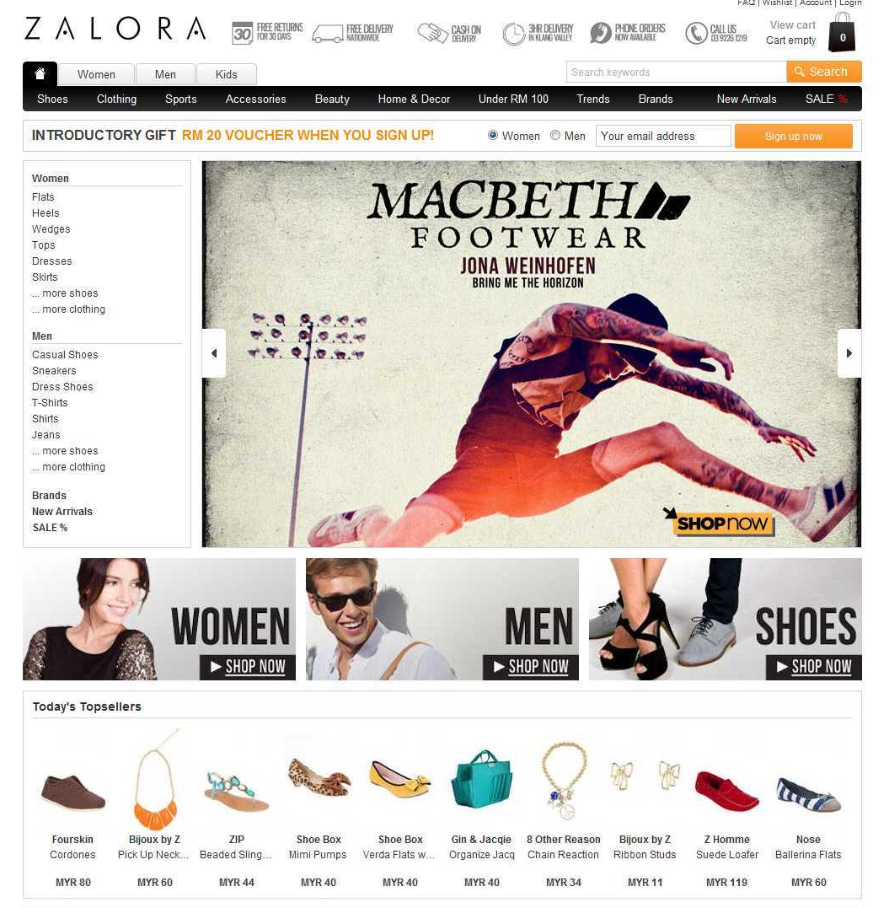
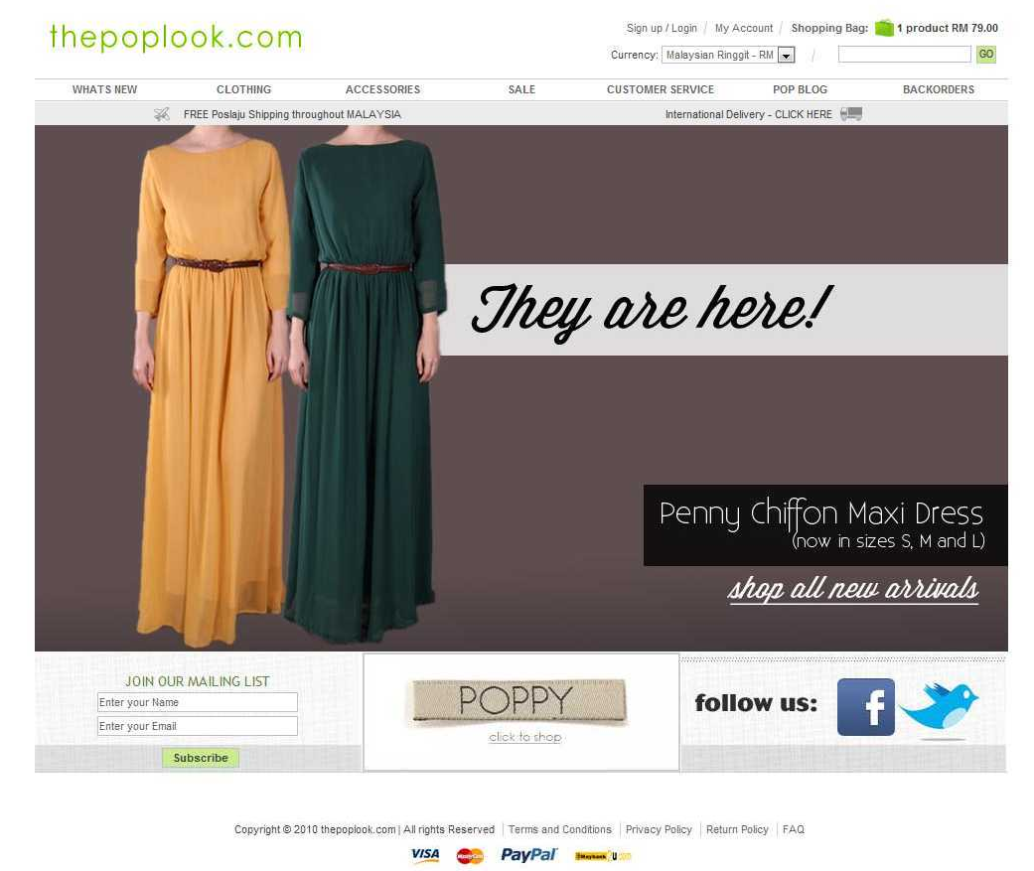
Scenario: comparison of Zalora and The PopLook

Slide 62
Shopping experience | Zalora | The PopLook
Usability | Yes, but too crowded with information | Yes, simple and easy to use.
Payment | Yes, they provide convenience payment method | Yes, they provide convenience payment method
Service & Delivery | Very poor | Good
Useful | Too many product displayed but most of them are sold out and need to restock. | Displayed clearly if the product is not available.
Testimonial | Most customers feel disappointed with the service and delivery provided. | Most customer satisfied with service and delivery provided.

Slide 63
Advantages & Disadvantages of E-Commerce

Slide 64
Advantages of E-Commerce
Advantages
Speed
Cost Savings
No Boundaries
Ease of Networking
Notes:
Speed. The Internet and World Wide Web give businesses opportunities to exchange messages or complete transactions almost instantaneously. With increased speeds of communication, the delivery time is expedited and that makes the whole transaction from start to finish more efficient.
Cost Saving. By using the
No Boundaries. Cyberspace does not know any national boundary. That means you can do business all over the world as easily as you can in your own
neighborhood. Internet, marketing, distribution, personnel, phone, postage and printing costs, among many others, can be reduced.
Ease of Networking. One advantage of the Internet is that is allows people to easily meet, gather data/information and stay in touch with others at a very low cost. Now almost everyone can automatically expose his/her business to the international market.

Slide 65
ADVANTAGES OF E-COMMERCE
Advantages to Customer
Reduced Prices
Global Marketplace
24-Hour Access
More Choices
Quicker Delivery
Faster feedback
Notes:
1.Reduced Prices—Costs of products are reduced since stages along the value chain are decreased. For instance, intermediaries can be eliminated by the company directly selling to the consumer instead of distributing through a retail store.
2. Global Marketplace—Consumers can shop anywhere in the world. Currently, according to the World Trade Organization (WTO) there are no custom duties put on products bought and traded globally electronically. This also provides wide selection of products and services to consumers.
3. 24-Hour Access—Online businesses never sleep as opposed to brick and mortar businesses. E-commerce allows people to carry out businesses without the barriers of time or distance. One can log on to the Internet at any point of time, be it day or night and purchase or sell anything one desires at a single click of the mouse.
4. More Choices—Provides consumers with more choices. For example, before making any purchase, customer can study about all the major brands and
features of any item. It also provides consumers with less expensive products and services by allowing them to shop in many places and conduct quick comparisons.
5. Quicker Delivery—Allows quick delivery of products and services (in some cases) especially with digitized products.
6. Faster feedback

Slide 66
ADVANTAGES OF E-COMMERCE
Advantages to Businesses
Increased Potential Market Share
Low-cost Advertising
Low Barriers to Entries
Strategic Benefit
Notes:
1. Increased Potential Market Share—The Internet enables businesses to have access to international markets thereby increasing their market share. Companies can also achieve greater economies of scale.
2. Low-cost Advertising—Advertising on the Internet costs less than advertising on print or television depending on the intricacies and extent of the advertisement.
3. Low Barriers to Entries—Anyone can start up a company on the Internet. Start-up costs are a lot lower for companies since there is less need for money for capital.
4. Strategic Benefit—The strategic benefit of making a business ‘e-commerce enabled’ is that it helps reduce the delivery time, labour cost and the cost
incurred in the following areas:
• Document preparation
• Error detection and correction
• Reconciliation
• Mail preparation
• Telephone calling
• Data entry
• Overtime
• Supervision expenses

Slide 67
Disadvantages of E-commerce
Hidden Costs
Network Unreliability
The Cost of Staying in Business
Lack of Security
Lack of Privacy
Low Service Levels
Legal Issues
Notes:
1.13.1 Hidden Costs
Although buying on-line is convenient, the cost of this convenience is not always clear at the front end. The online purchases must be shipped and the shipping charges may be considerable. In fact, too many e-commerce companies have developed a reputation of overcharging for
shipping and handling.
1.13.2 Network Unreliability
Internet is a very busy information highway. Although the Internet is designed to overcome the single point of failure problem, there have been several well-publicized incidents of network failures during the past few years. An e-commerce website that cannot serve its customers loses sales, credibility, and even customers. Network reliability problems may be generated by such factors as:
• Equipment failure in the network connection provider or ISP.
• Long response time
• Accidental problems caused by nature
1.13.3 The Cost of Staying in Business
To be profitable, e-businesses must maintain high sales volumes, which in turn means developing and maintaining a big and loyal customer base. Attracting customers and transforming them into repeat buyers is the key to profitability. To survive and remain competitive, businesses must invest heavily in often-costly technology.
1.13.4 Lack of Security
Lack of adequate security for on-line transactions. Securing on-line transaction data during its generation and then safeguarding it after it has been stored in the database are critical issues to be faced. The problem, caused by a coding error in a web page, allowed unauthorized access to stored order and credit card information for thousand of customers,
1.13.5 Lack of Privacy
Ensuring the security of the data is of paramount importance to customers and to the credibility of the business. Customers also worry about the privacy implications of data gathered by organizations of all types and sizes. Because data gathering on the web is so easy, databases routinely contain
information about customer purchasing habits, demographic data, credit information, and so on. In many cases, companies sell customer database information to marketing companies.
1.13.6 Low Service Levels
Low level of customer service that online companies tend to provide. Because the web buying experience is much more impersonal than the traditional one, providing good customer service is critical to the survival of any e-business.
1.13.7 Legal Issues
Legal problems encountered in the e-commerce environment include
• Software and copyright infringements.
• Credit card fraud and stolen identities.
• Business fraud.

Slide 68
Issues in Implementing
E- Commerce

Slide 69
ISSUES IN IMPLEMENTING
E- COMMERCE
Cost
Value
Security
Leveraging existing systems
Interoperability
Notes:
1.5.1 Cost
Electronic commerce requires significant investments in new technologies that can touch many of a company’s core business processes. As with all major business systems, electronic commerce systems require significant investments in hardware, software, staffing, and training.
1.5.2 Value
Businesses want to know that their investments in electronic commerce systems will produce a return. Business objectives such as lead generation, business-process automation, and cost reduction must be met.
1.5.3 Security
The Internet provides universal access, but companies must protect their assets against accidental or malicious misuse. System security, however, must not create prohibitive complexity or reduce flexibility. Customer information also needs to be protected from internal and external misuse.
1.5.4 Leveraging Existing Systems
The Internet represents an alternative and complementary way to do business, but it is imperative that electronic commerce systems integrate existing
systems in a manner that avoids duplicating functionality and maintains usability, performance, and reliability.
1.5.5 Interoperability
When systems from two or more businesses are able to exchange documents without manual intervention, businesses achieve cost reduction, improved performance, and more dynamic value chains. Your company’s vision for electronic commerce should also be to help businesses
establish stronger relationships with customers and industry partners.

Slide 70
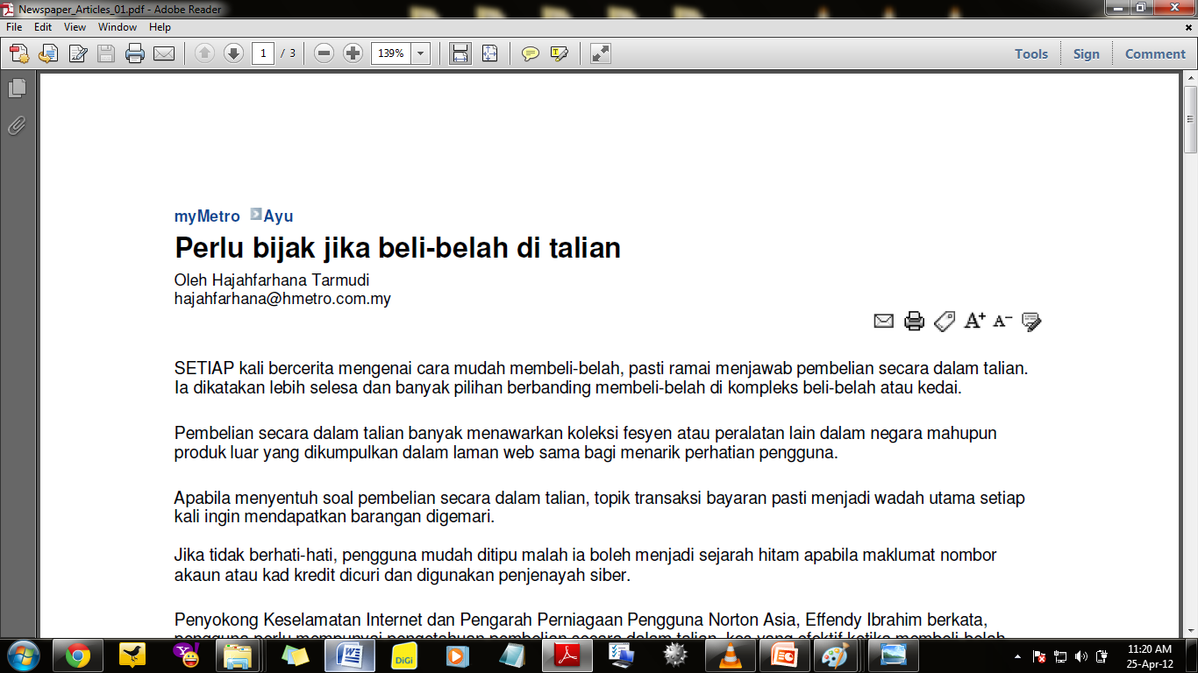
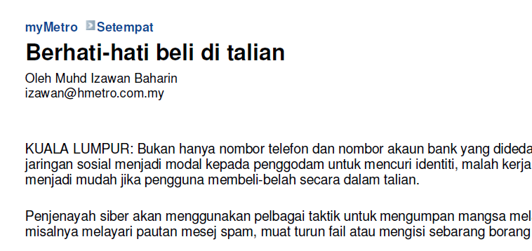
Newspaper
Articles

Slide 71
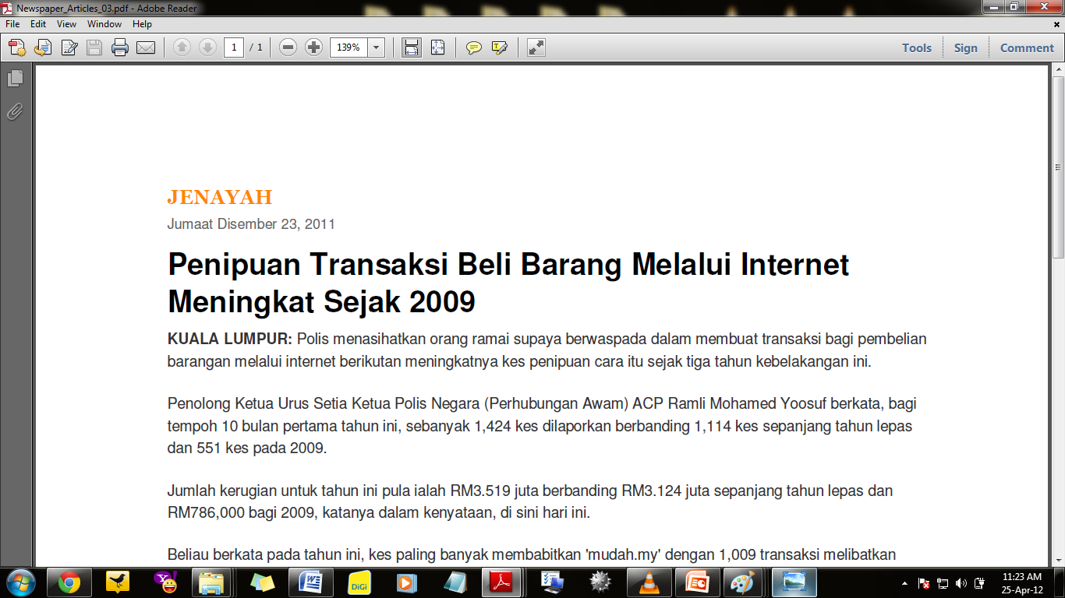
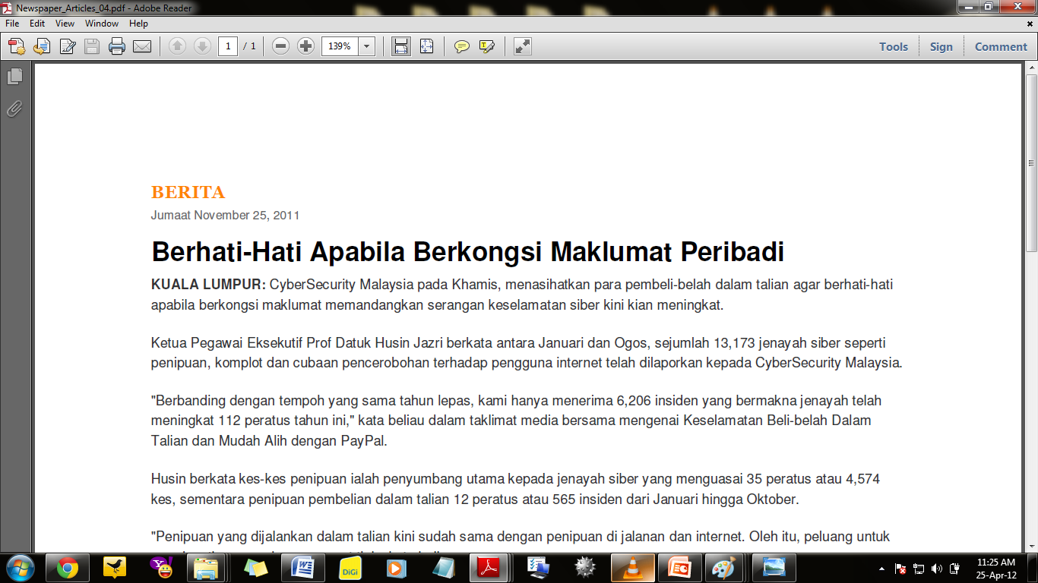
Newspaper
Articles

Slide 72
THANK YOU

