Slide 1
Chap 2 – Internal Audit
Modelling with PAM
Assesment and
Controlling
Dr. Ir. Yeffry Handoko Putra
MAGISTER SISTEM INFORMASI

Slide 2
Definition
Internal auditing is an independent, objective assurance and consulting activity designed to add value and improve an organization’s operations. It helps an organization accomplish its objectives by bringing a systematic, disciplined approach to evaluate and improve the effectiveness of risk management, control, and governance processes (IPPF)
IPPF : International Professional Practices Framework

Slide 3
Who perform internal audit?
performed by employees of the organization (or contractors hired to work on the organization’s behalf) subject to the audits, following plans, procedures, and criteria chosen by the organization
Many of the same standards and sources of guidance influence internal and external IT auditing

Slide 4
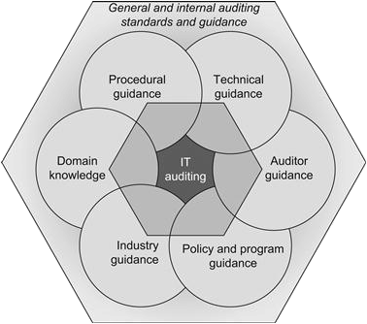
Source of Audit
Audit Program Structure
Procedure and Protocols
Area of Audit Focus
Auditor Practice and Qualification

Slide 5
Independence and objectivity
Independence is the freedom from bias, outside control, or authority that, in an internal auditing context, ensures that the audit program is neither responsible for nor beholden to the parts of the organization it audits and, similarly, that individual auditors do not work for projects, operational functions, or business units that they audit
Objectivity in audit practices connotes more than independence—an objective auditor makes judgments based on evidence, is free from conflicts of interest with the subjects of auditing activities, and is able to act with impartiality

Slide 6
Establishing the IT audit program
The audit program is the formally defined department, business unit, or function within an organization responsible for planning, performing, and reporting the results of all internal audit activities.
The scope of operations for an internal audit program typically comprises all types of audits the organization conducts, including financial and non-IT operational audits as well as audits of IT controls, procedures, environments, and capabilities.

Slide 7
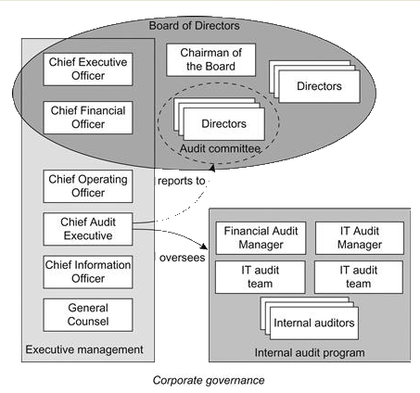
Establishing the IT audit program

Slide 8
Internal Audit Roles and Responsibilities
Role | Responsibilities
CAE (Alternately called Chief Auditor, Director of Audit, Lead Auditor ) | Oversees the internal audit function with the organization Report directly to the audit committee
Audit Committee | Subset of the Board of Directors, typically comprising only independent directors Provides oversight of internal and external auditing Required for public company boards of directors under the Sarbanes-Oxley Act

Slide 9
Internal Audit Roles and Responsibilities
Role | Responsibilities
Management Team | Key members of the management team, such as the CEO, COO and CFO, typically in consultation with the full Board of Directors, approve budgets and resource allocations for the internal audit program
Board of Directors | Considers audit reports and recommendations and makes decision regarding actions to take in response to audit findings

Slide 10
Internal Audit Roles and Responsibilities
Role | Responsibilities
Audit Manager | Responsible for ensuring the proper conduct of specific types of audits (financial, operational, IT) within the audit program Supervises one or more teams of internal auditors
Auditor | Perform audits, working alone or as part of a team depending on the type and scope of audit activities needed Develops and maintains knowledge and subject matter expertise relevant to the types of audits performed Reports to the Audit Manager and /or the CAE

Slide 11
Internal Audit Roles and Responsibilities
Role | Responsibilities
Operational Manager | Ensure access is afforded to auditors when components or processes under the Manager’s responsibility are audited Furnishes or assigns resources as needed to support audit and, as applicable, provide information to auditors
Operation staff | Support of facilitates audits or components or process operated by staff May be observed, interviewed , asked to demonstrate controls, or otherwise provide evidence to auditors

Slide 12
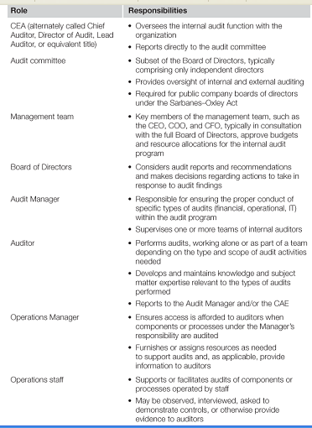
Internal Audit Roles and Responsibilities

Slide 13
Internal audit program charter
The audit program charter describes the purpose of the internal audit program, including external and internal needs the program is intended to address and, in particular, the relationship between the audit program and governance, risk management, compliance, and other enterprise management functions.
No matter where the internal audit program is positioned within the structure of the organization, its existence, purpose, and authority needs to be formally documented and communicated throughout the organization to help ensure that internal auditing activities are viewed in the proper context.
Organizations that do not communicate this type of information about their internal audit programs are likely to encounter misperceptions or fear about internal audits and may find operations personnel hesitant or resistant to cooperate with auditors.

Slide 14
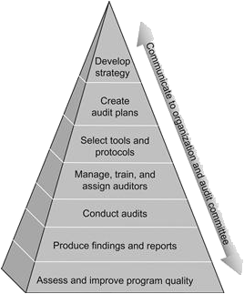
The internal IT audit program’s responsibilities include defining strategic and operational planning, selecting auditing tools, procedures and resources, conducting audits and reporting their results, and ensuring audit program quality.
Internal IT auditing has its own domain-specific principles, practices, assumptions, and vocabulary, all of which may be well understood by personnel working within the audit program but less familiar to others in the organization who interact with auditors.

Slide 15
Benefits of internal IT auditing
supporting corporate IT governance, risk management, and compliance programs;
verifying adherence to organizationally defined policies, procedures, and standards;
satisfying requirements to achieve or maintain process maturity, quality management, or internal control certification;
adding formality to or increasing the rigor of self-assessment processes and activities; and
preparing for or “shadowing” anticipated external audits.

Slide 16
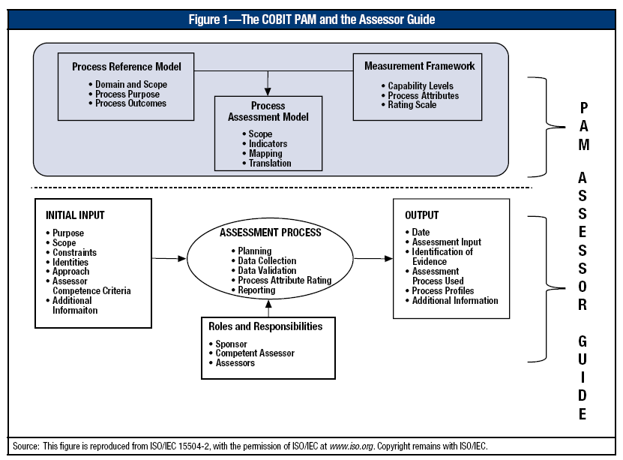
Process Assessment Model –PAM : Audit Process Example (COBIT 5)

Slide 17
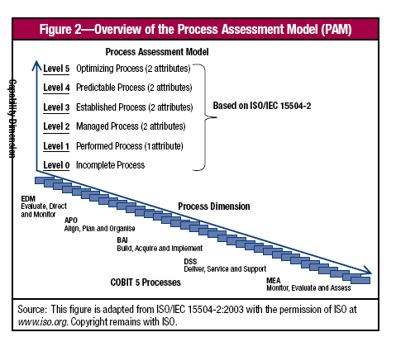

Slide 18
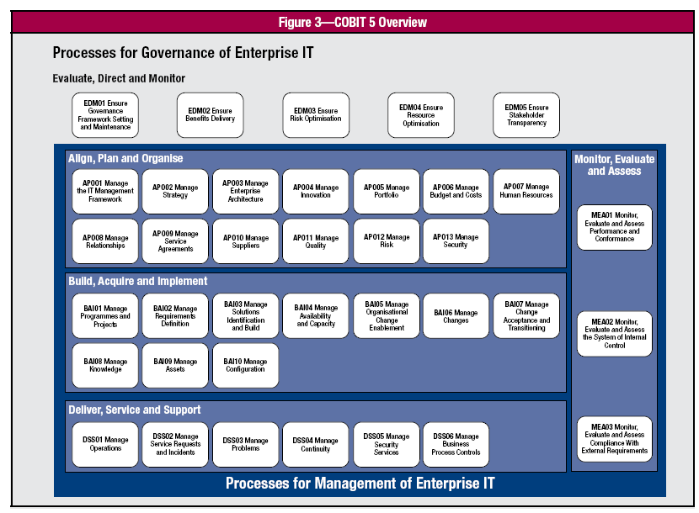
The COBIT 5 process reference model (PRM) is composed of 37 processes describing a life cycle for governance and management of enterprise IT

Slide 19
Terms and Definition in COBIT 5
For the purposes of this document, the terms and definitions given in ISO/IEC 15504-1 apply. Key definitions include:
Attribute indicator—An assessment indicator that supports the judgement of the extent of achievement of a specific process attribute (ISO/IEC 15504:1, 3.16)
Base practice—An activity that, when consistently performed, contributes to achieving a specific process purpose (ISO/IEC 15504:1, 3.17)
Capability dimension—The set of elements in a process assessment model explicitly related to the Measurement Framework for Process Capability (ISO/IEC 15504:1, 3.18)
Capability indicator—An assessment indicator that supports the judgement of the process capability of a specific process (ISO/IEC 15504:1, 3.19)

Slide 20
Terms and Definition in COBIT 5
Generic practice—An activity that, when consistently performed, contributes to the achievement of a specific process attribute (ISO/IEC 15504:1, 3.22)
Performance indicator—An assessment indicator that supports the judgment of the process performance of a specific process (ISO/IEC 15504:1, 3 26)
Note: A performance indicator is an attribute indicator for Process Attribute 1.1 for a specific process. (ISO/IEC 15504:2)
Process assessment model—A model suitable for the purpose of assessing process capability, based on one or more process reference models (ISO/IEC 15504:1, 3.33)
Process attribute—A measurable characteristic of process capability applicable to any process (ISO/IEC 15504:1, 3.31)
Process attribute rating—A judgement of the degree of achievement of the process attribute for the assessed process (ISO/IEC 15504:1, 3.32)

Slide 21
Terms and Definition in COBIT 5
Process capability—A characterization of the ability of a process to meet current or projected business goals (ISO/IEC 15504:1, 3.33)
Process capability level—A point on the six-point ordinal scale (of process capability) that represents the capability of the process, each level building on the capability of the level below (ISO/IEC 15504:1, 3.36)
Process capability level rating—A representation of the achieved process capability level derived from the process attribute ratings for an assessed process (ISO/IEC 15504:1, 3.37)
Process outcome—An observable result of a process (ISO/IEC 15504:1, 3.44)
Note: An outcome is an artefact, a significant change of state or the meeting of specified constraints.

Slide 22
Terms and Definition in COBIT 5
Process purpose—The high-level measurable objectives of performing the process and the likely outcomes of effective implementation of the process (ISO/IEC 15504:1, 3.47)
Process reference model—A model composed of definitions of processes in a life cycle described in terms of process purpose and outcomes, together with an architecture describing the relationships amongst the processes (ISO/IEC 15504:1, 3.48)
Work product—An artefact associated with the execution of a process (ISO/IEC 15504:1, 3.55)

Slide 23
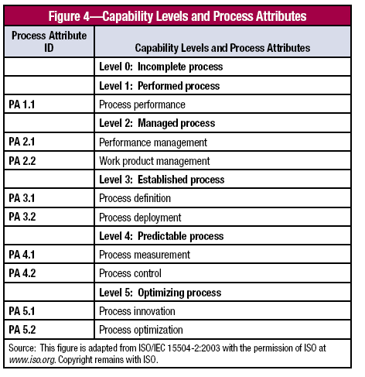
Level 0 Incomplete process—The process is not implemented or fails to achieve its process purpose. At this level, there is little or no evidence of any systematic achievement of the process
purpose.
• Level 1 Performed process (one attribute)—The implemented process achieves its process purpose.
• Level 2 Managed process (two attributes)—The previously described performed process is now implemented in a managed fashion (planned, monitored and adjusted) and its work products
are appropriately established, controlled and maintained.

Slide 24
• Level 3 Established process (two attributes)— The previously described managed process is now implemented using a defined process that is capable of achieving its process outcomes.
• Level 4 Predictable process (two attributes)—The previously described established process now operates within defined limits to achieve its process outcomes.
• Level 5 Optimizing process (two attributes)—The previously described predictable process is continuously
improved to meet relevant current and projected business goals

Slide 25
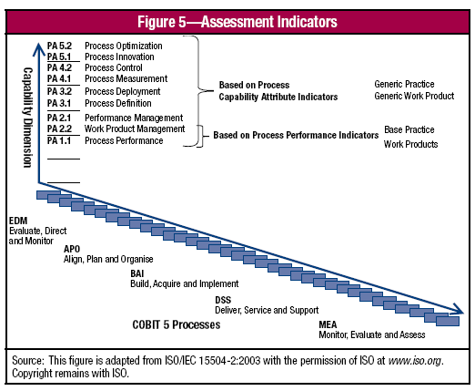

Slide 26
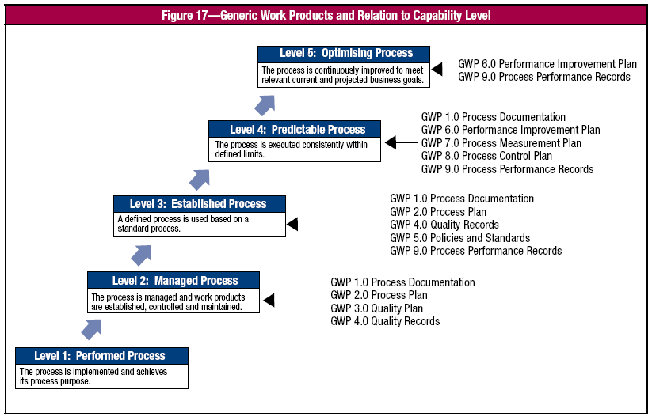

Slide 27
Rating Scale
N—Not achieved. There is little or no evidence of achievement of the defined attribute in the assessed process.
P— Partially achieved. There is some evidence of an approach to, and some achievement of, the defined attribute in the assessed process. Some aspects of achievement of the attribute may be unpredictable.
L— Largely achieved. There is evidence of a systematic approach to, and significant achievement of, the defined attribute in the assessed process. Some weakness related to this attribute may exist in the assessed process.
F— Fully achieved. There is evidence of a complete and systematic approach to, and full achievement of, the defined attribute in the assessed process. No significant weaknesses related to this attribute exist in the assessed process.

Slide 28
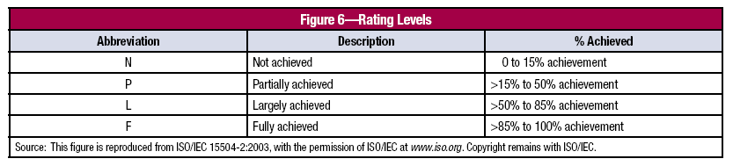
Rating Level

Slide 29
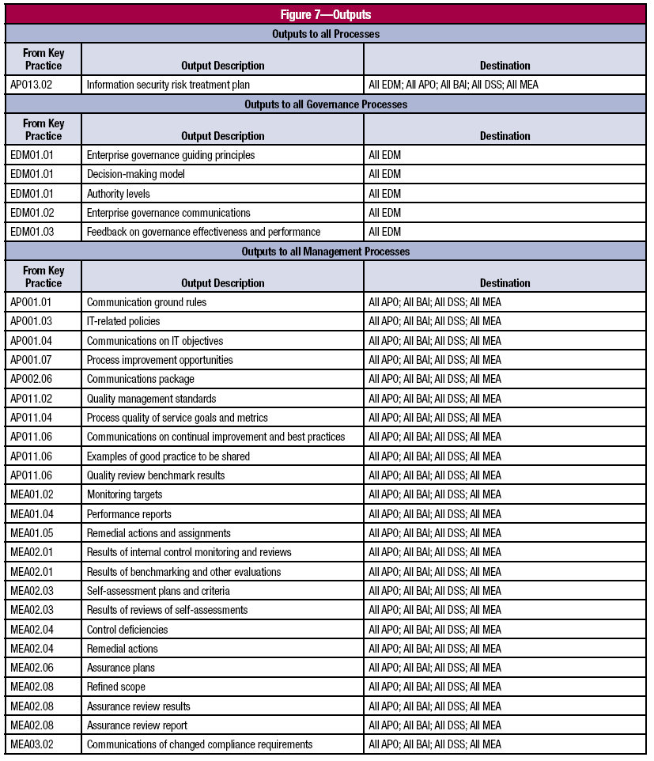
Input and Output

Slide 30
How to fill the input output?
Example for : Deliver, Service and Support (DS)
01 Manage operations.
02 Manage service requests and incidents.
03 Manage problems.
04 Manage continuity.
05 Manage security services.
06 Manage business process controls.

Slide 31
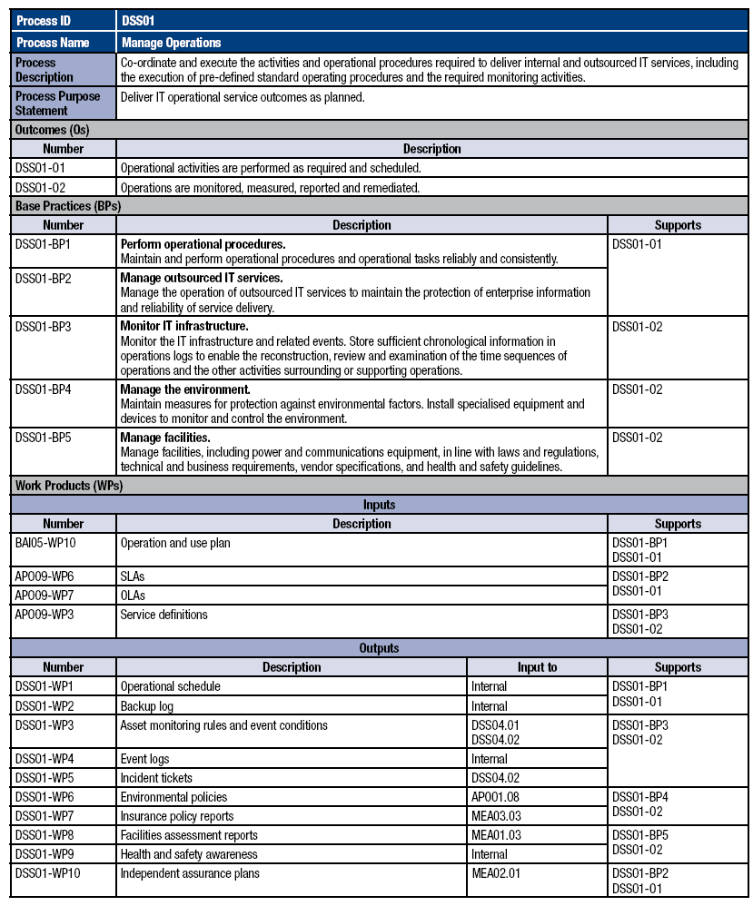

Slide 32
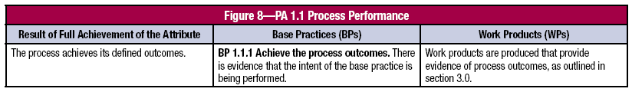
Process Capability Indicators
Level 1—Performed Process
PA 1.1 Process Performance—A measure of the extent to which the process purpose is achieved. Full achievement of this
attribute results in the process achieving its defined outcomes, as shown in fig

Slide 33
Level 2—Managed Process
Process Performance is now implemented in a managed fashion (planned, monitored and adjusted) and its work products are appropriately established, controlled and maintained.
PA 2.1 Performance Management—A measure of the extent to which the performance of the process is managed. As a result of full achievement of this attribute:
a. Objectives for the performance of the process are identified.
b. Performance of the process is planned and monitored.
c. Performance of the process is adjusted to meet plans.
d. Responsibilities and authorities for performing the process are defined, assigned and communicated.
e. Resources and information necessary for performing the process are identified, made available, allocated and used.
f. Interfaces between the involved parties are managed to ensure effective communication and clear assignment of responsibility.

Slide 34
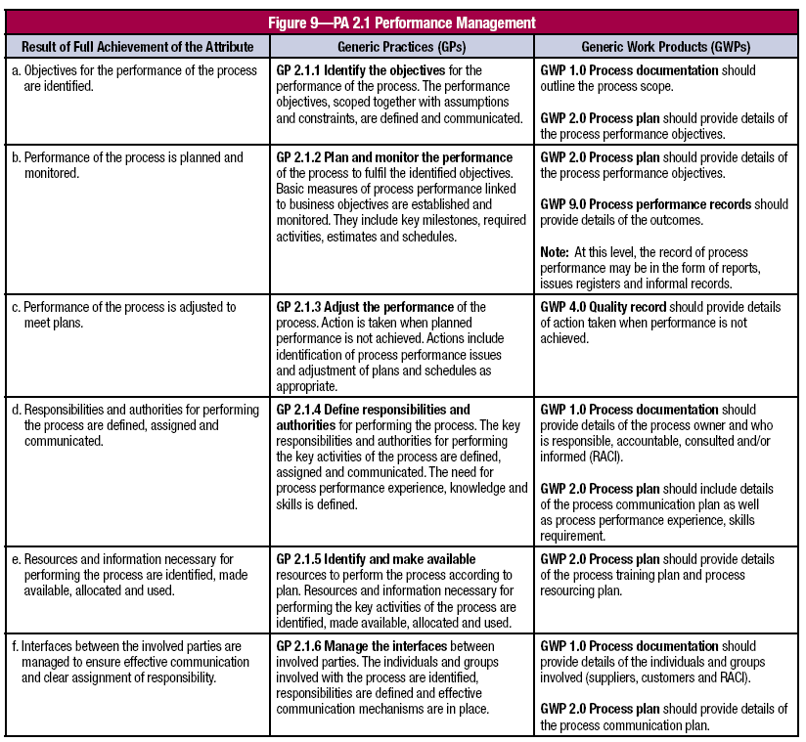

Slide 35
PA 2.2 Work Product Management—A measure of the extent to which the work products produced by the process are appropriately managed. The work products referred to in this clause are those that result from the achievement of the process outcomes. As a result of full achievement of this attribute:
a. Requirements for the work products of the process are defined.
b. Requirements for documentation and control of the work products are defined.
c. Work products are appropriately identified, documented and controlled.
d. Work products are reviewed in accordance with planned arrangements and adjusted as necessary to meet requirements.
Note: Requirements for documentation and control of work products may include requirements for the identification of changes and revision status, approval and re-approval of work products, and the creation of relevant versions of applicable
work products available at points of use.

Slide 36
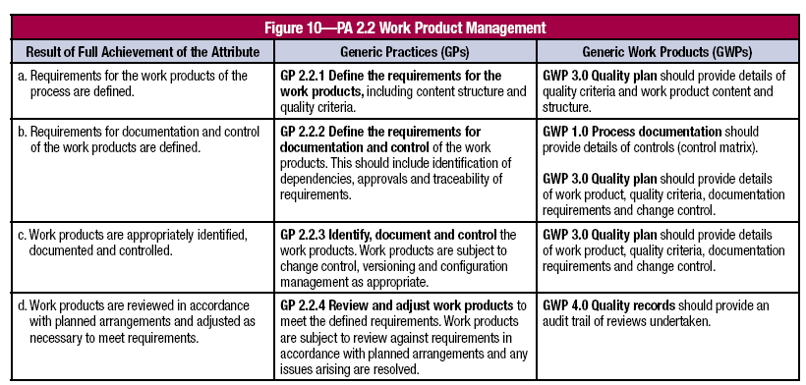

Slide 37
Level 3—Established Process
PA 3.1 Process Definition—A measure of the extent to which a standard process is maintained to support the deployment of the defined process. As a result of full achievement of this attribute:
a. A standard process, including appropriate tailoring guidelines, is defined that describes the fundamental elements that must be incorporated into a defined process.
b. The sequence and interaction of the standard process with other processes are determined.
c. Required competencies and roles for performing a process are identified as part of the standard process.
d. Required infrastructure and work environment for performing a process are identified as part of the standard process.
e. Suitable methods for monitoring the effectiveness and suitability of the process are determined.
Note: A standard process may be used as is when deploying a defined process, in which case tailoring guidelines would
not be necessary.

Slide 38
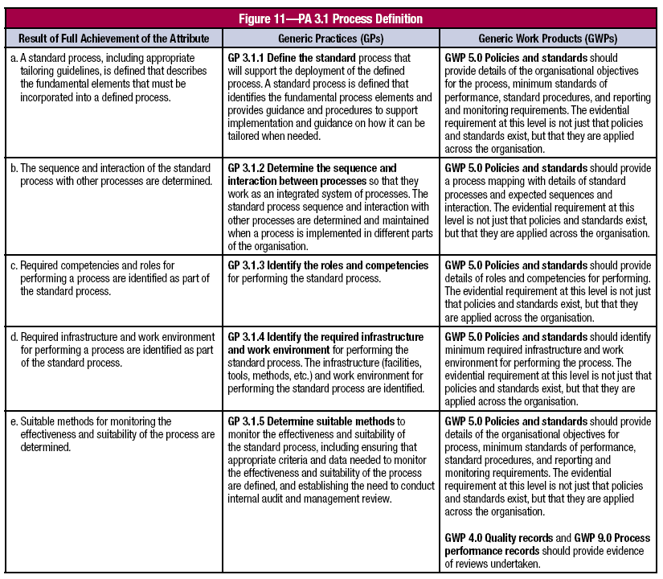

Slide 39
PA 3.2 Process Deployment—A measure of the extent to which the standard process is effectively deployed as a defined process to achieve its process outcomes. As a result of full achievement of this attribute:
a. A defined process is deployed based on an appropriately selected and/or tailored standard process.
b. Required roles, responsibilities and authorities for performing the defined process are assigned and communicated.
c. Personnel performing the defined process are competent on the basis of appropriate education, training and experience.
d. Required resources and information necessary for performing the defined process are made available, allocated and used.
e. Required infrastructure and work environment for performing the defined process are made available, managed and maintained.
f. Appropriate data are collected and analysed as a basis for understanding the behaviour of the process, to demonstrate its suitability and effectiveness, and to evaluate where continuous improvement of the process can be made.
Note: Competency results from a combination of knowledge, skills and personal attributes that are gained through
education, training and experience.

Slide 40
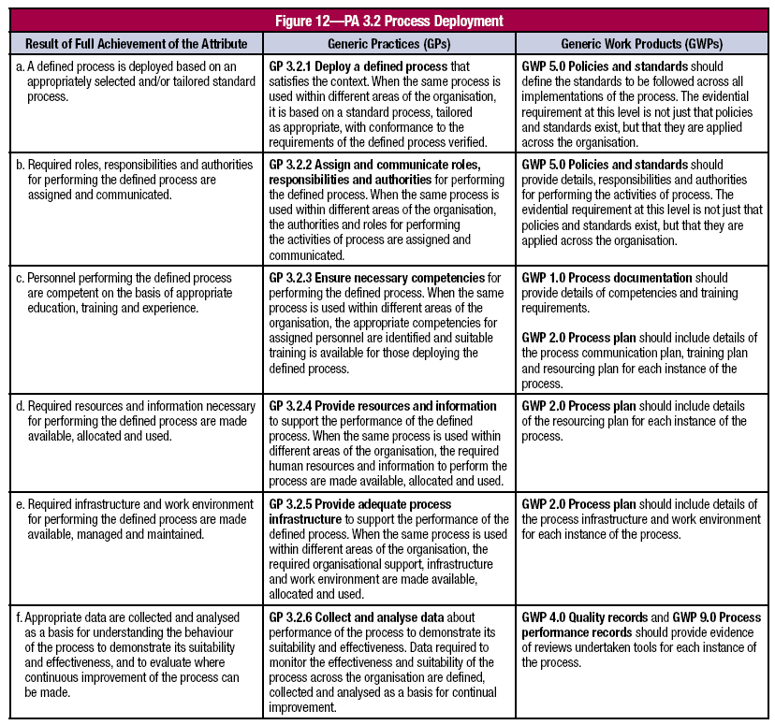

Slide 41
Controlling / implementation assesment result

Slide 42
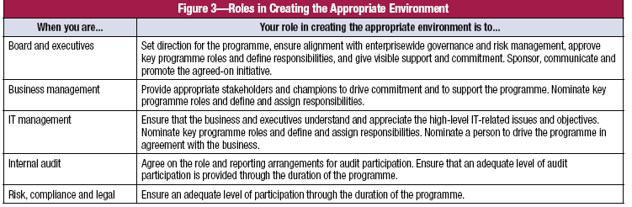
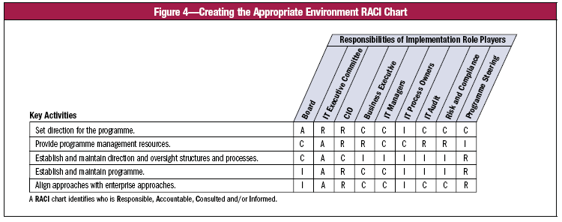

Slide 43
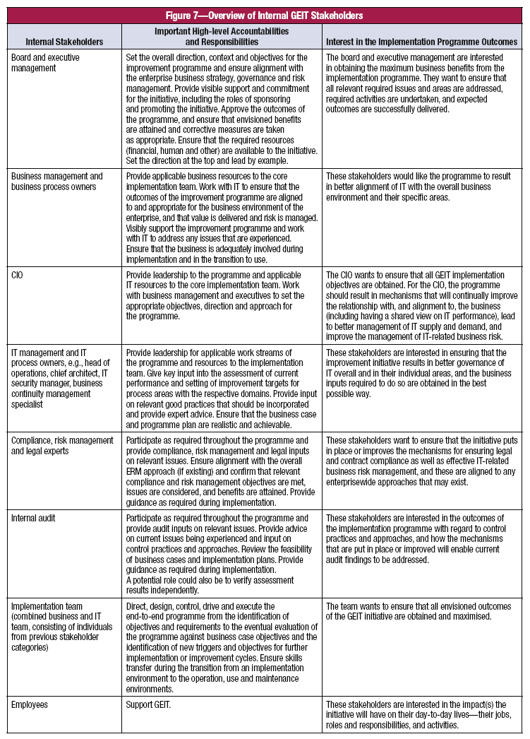
Internal Stakeholders

Slide 44
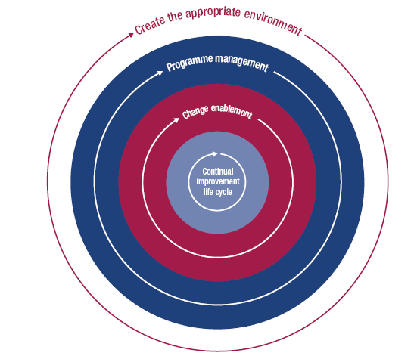
Applying a Continual Improvement Life Cycle Approach

Slide 45
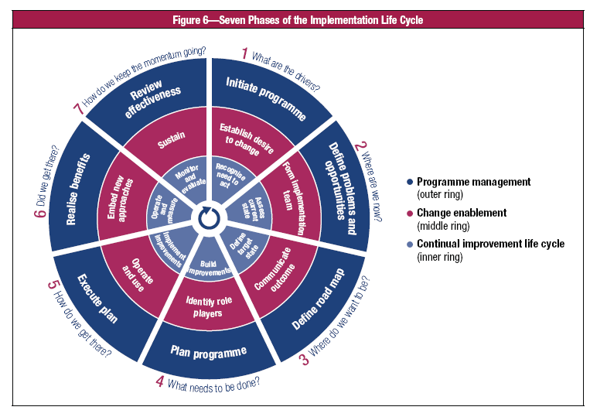

Slide 46
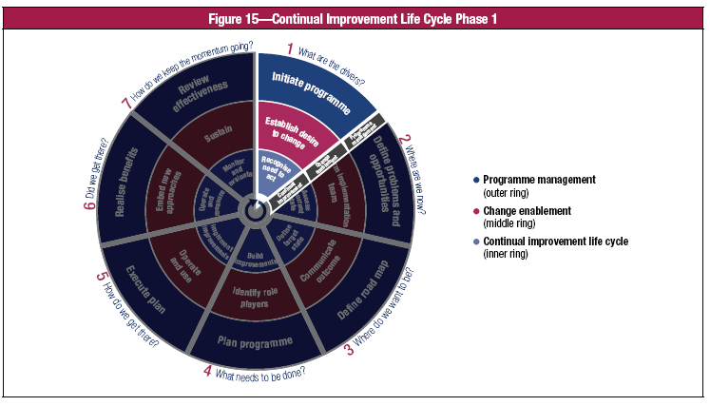
What are the drivers?

Slide 47
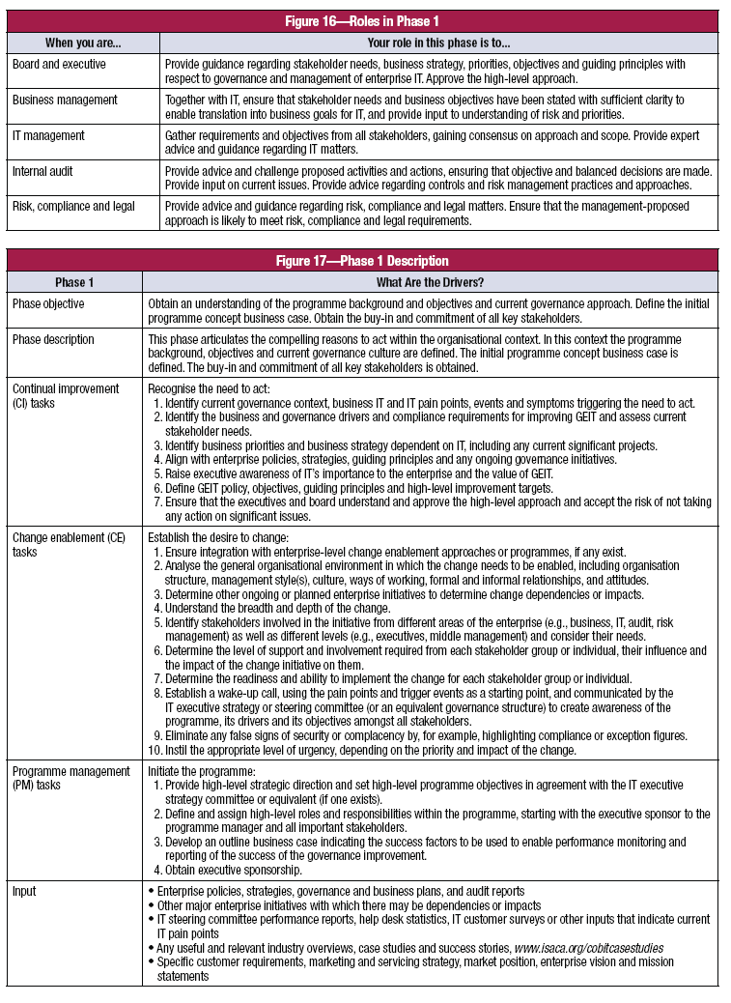

Slide 48
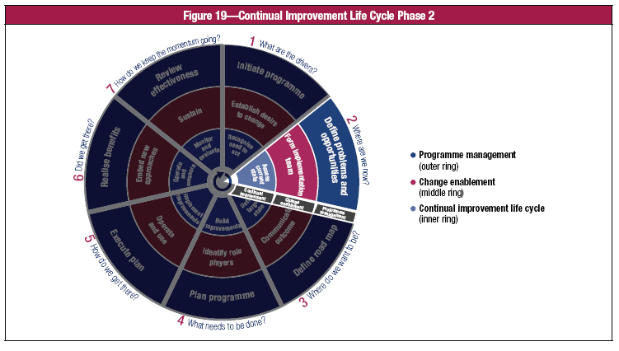
Where are we now?

Slide 49
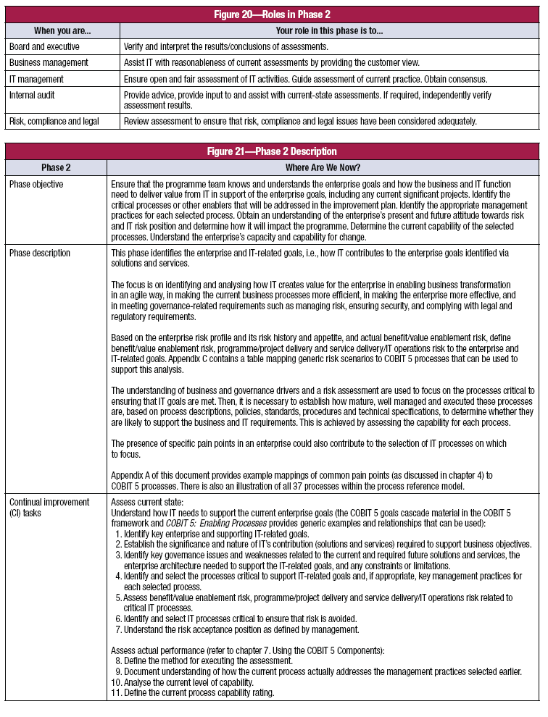

Slide 50
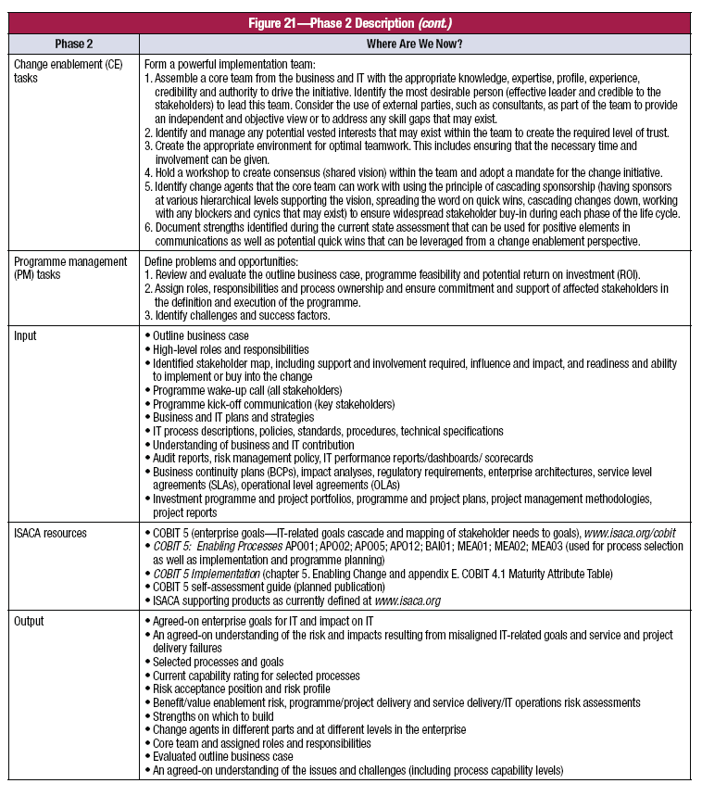

Slide 51
