Slide 1
Chap 3 – External IT Auditor and Regulation PP 82/2012 in Indonesia
Dr. Ir. Yeffry Handoko Putra
MAGISTER SISTEM INFORMASI

Slide 2
External Auditor
Performed by outside auditors and auditing firms
The standards, requirements, or other audit criteria used in external audits are defined outside the organization being audited
Some standards bodies and professional associations further divide external auditing into second-party (by customer or supplier) and third-party audits (by independent organization)

Slide 3
Reasons organizations undergo external IT audits
legal and regulatory compliance
Certification
quality assurance
verification of self-reported
attested information
Organizations undergo both mandatory and voluntary external IT audits

Slide 4
The nature of organization participation
facilitate the work of the external auditors
support the accurate and efficient completion of the audit
Give access to the organization’s facilities, systems, personnel, and documentation and other types of evidence evaluated in the course of the audit
Allocated Resources and assign operation personal

Slide 5
Operational aspects of external audits
Mandatory external IT AUDIT
to satisfy legal requirements
demonstrate regulatory compliance
voluntary external IT AUDIT associated with
Certification
quality assurance
independent validation of internal controls
Processes
Practices

Slide 6
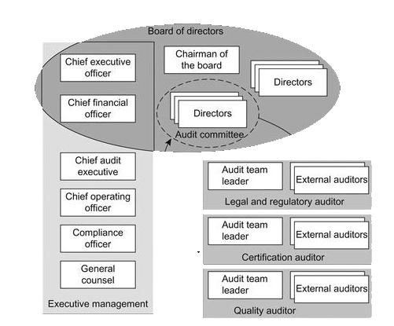
Organizational Responsibility
Organizational responsibility for external audits is typical divided between the independent audit committee of the board of directors and internal management personnel such as an audit executive, directory of quality assurance, or compliance officer
Select
Report to
Select

Slide 7
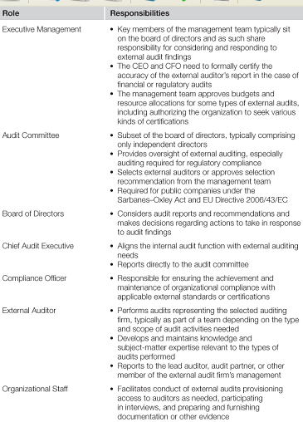
External Audit Roles and Responsibilities

Slide 8
What the external audit role for internal audit?
validate internal audits or highlight discrepancies that indicate areas of improvement for internal processes
substitute for or be incorporated in internal audit reports
serve as a baseline for the organization to assess corrective actions taken to remediate identified weaknesses

Slide 9
Auditor in Indonesia
Financial
Ernst & Young (UK)
Deloitte Touche Tohmatsu (USA)
PricewaterhouseCoopers (UK)
KPMG (Dutch) (KAP Siddharta & Widjaja)
IT and IS
Ikatan Audit Sistem Informasi Indonesia (IASII) http://iasii.or.id
Standar Kompetensi Auditor Teknologi Informasi
Standar Audit Sistem Informasi
CISA Standar as reference
Notes:
The name "KPMG" was chosen when KMG (Klynveld Main Goerdeler) merged with Peat Marwick.
KPMG is one of the largest professional services companies in the world and one of the Big Four auditors, along with Deloitte, EY and PwC. Its global headquarters is located in Amsterdam, the Netherlands.^{[1]}
HeadquartersAmstelveen, Netherlands
https://en.wikipedia.org/wiki/KPMG
KPMG employs 162,000 people^{[3]} and has three lines of services: audit, tax, and advisory. Its tax and advisory services are further divided into various service groups.

Slide 10
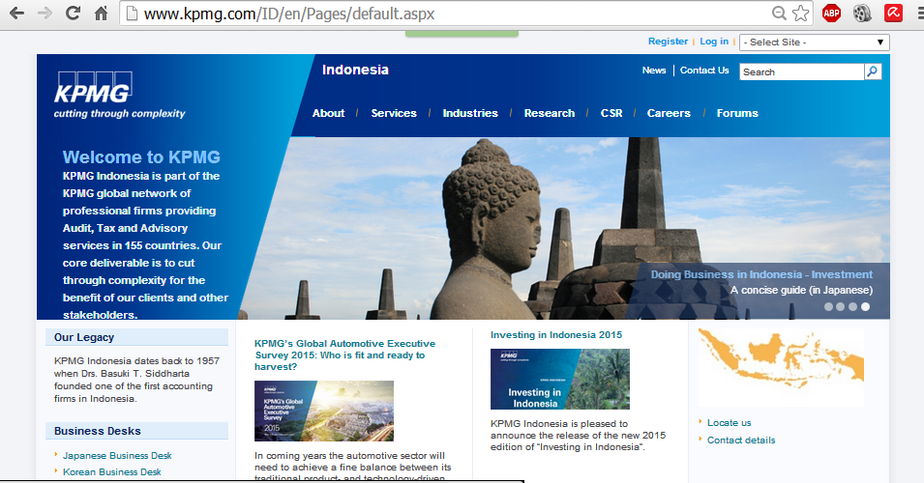

Slide 11
Some of IT Audit Regulation in Indonesia
Peraturan Pemerintah (PP) No. 82 tahun 2012 tentang Penyelenggaraan Sistem dan Transaksi Elektronik (PSTE)

Slide 13
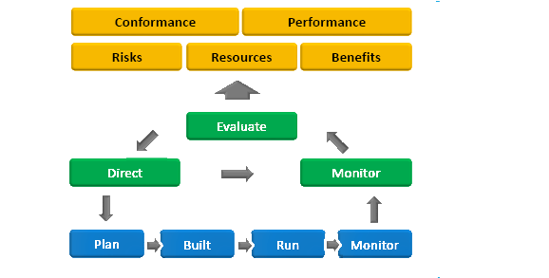
IT Governance, Management, Assurance
Objectives
Assurance
Governance
Management

Slide 14
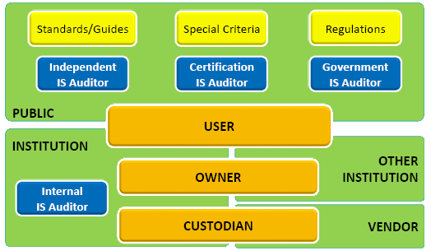
Role Map Owner – User – Custodian – Auditor

Slide 15
Standard – Guides – Ethics
Notes:
CBOK common body of Knowledge

Slide 16
IT Assurance Scope & Objectives

Slide 17
IT Assurance Methodology

Slide 18
Audit SI terkait dengan PP 82/2012
Audit (internal/independent) atas Penyelenggara Sistem Elektronik
Tata Kelola dan Manajemen
Sumber Daya Sistem Elektronik
Layanan/Produk berbasis Sistem Elektronik
Audit (independent) atas Penyelenggara Agen Elektronik
Layanan/Produk berbasis Sistem Elektronik
Audit untuk Sertifikasi Kehandalan/Kelaikan :
Sertifikasi Institusi
Sertifikasi Layanan/Produk

Slide 19
Audit SI terkait dengan PP 82/2012
Audit atas Perangkat Keras
Perangkat Keras yang digunakan oleh Penyelenggara Sistem Elektronik
harus :
memenuhi aspek interkonektivitas dan kompatibilitas dengan sistem yang digunakan;
memperoleh sertifikat kelaikan dari Menteri;
mempunyai layanan dukungan teknis, pemeliharaan, dan purnajual dari penjual atau penyedia;
memiliki referensi pendukung dari pengguna lainnya bahwa Perangkat Keras tersebut berfungsi sesuai dengan spesifikasinya;
memiliki jaminan ketersediaan suku cadang paling sedikit 3 (tiga) tahun;
memiliki jaminan kejelasan tentang kondisi kebaruan; dan
memiliki jaminan bebas dari cacat produk.
Standar teknis Perangkat Keras yang ditetapkan oleh Menteri.

Slide 20
Audit SI terkait dengan PP 82/2012
Audit atas Perangkat Lunak
Perangkat Lunak yang digunakan oleh Penyelenggara Sistem Elektronik untuk pelayanan publik wajib:
terdaftar pada kementerian yang menyelenggarakan urusan pemerintahan di bidang komunikasi dan informatika;
terjamin keamanan dan keandalan operasi sebagaimana mestinya; dan
sesuai dengan ketentuan peraturan perundang-undangan.
Persyaratan Perangkat Lunak yang diatur dalam Peraturan Menteri.
Penyerahan Kode Sumber dan Dokumentasi atas Perangkat Lunak atau melalui pihak ketiga terpercaya penyimpan kode sumber.
Jaminan kerahasiaan kode sumber Perangkat Lunak yang digunakan

Slide 21
advance planning and preparation in external audit

Slide 22
External IT Audit Scope

Slide 23
External Auditor Qualifications for Different Types of Audits

