Slide 1
Knowledge Management in Art Innovation
Dr. Yeffry Handoko Putra

Slide 3
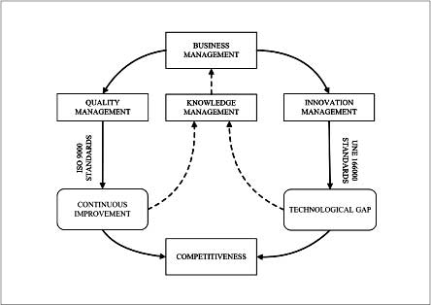

Slide 5
THE KNOWLEDGE MANAGEMENT LANDSCAPE
Data: Flow of captured events or transactions. E.g Complain and Complement in Design
Information: Data organized into categories of understanding
Knowledge: Concepts, experience, and insight that provide a framework for creating, evaluating, and using information. Can be tacit (undocumented) or explicit (documented)
Wisdom: The collective and individual experience of applying knowledge to the solution of problem; knowing when, where, and how to apply knowledge
Notes:
5

Slide 8
The four levels of knowledge

Slide 9
Why We need Knowledge Management
To know the art sensitivity
Align Customer and Designer perspective & need
To record best Critical Success Factor
Time Management
Lean Management
Competition Advantage
To make Standardization (reproduce able)
To make innovation and New Diversification Product
To create Idea Repository and historical benchmark
To distributed to other new comer
INNOVATION

Slide 10
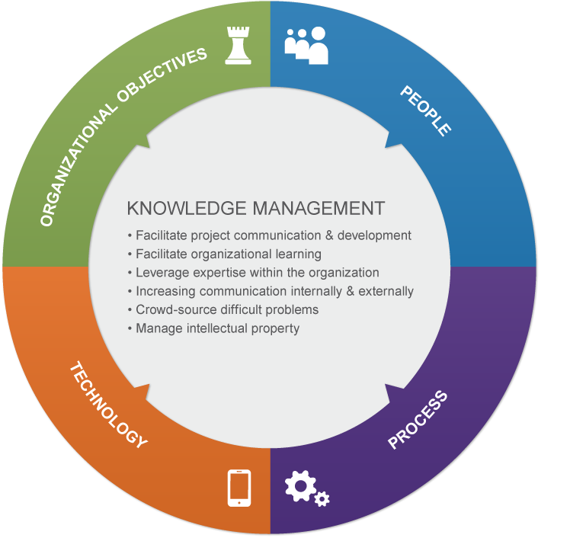

Slide 12
Important Dimensions of Knowledge
Knowledge has Different Forms:
Tacit (unwritten-know how) to be
explicit (formalized-know what). E.g. Tacit:
Knowing how to create : craft, painting
Knowing how to know customer expectation;
Knowledge has a Location:
In the Cognitive event
In the Social Community or Individual Expert
Contextual event (Sticky, situated)
Notes:
12

Slide 13
Knowledge is a Firm Asset:
Intangible asset
Requires organizational resources (people, technology and infrastructure)
Value increases as more people share it
Knowledge is Situational:
Conditional
Contextual
Notes:
13

Slide 14
KM Model

Slide 15
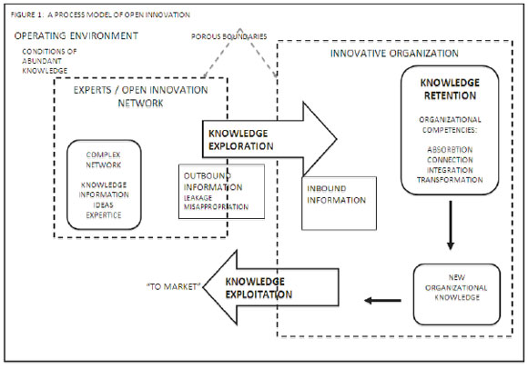

Slide 16
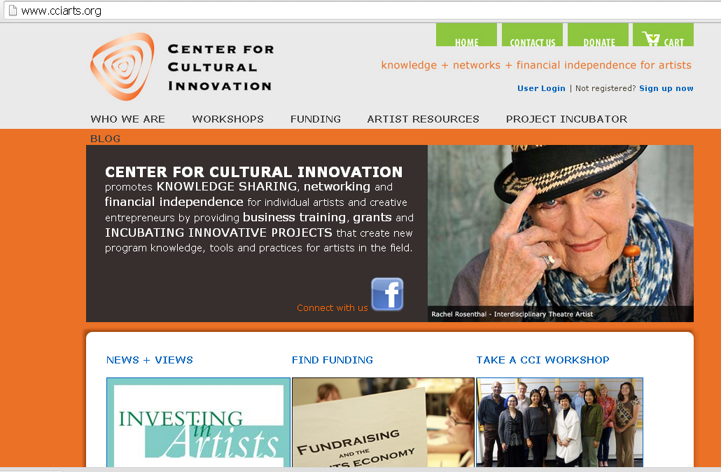

Slide 19
KM as many Discipline

Slide 20
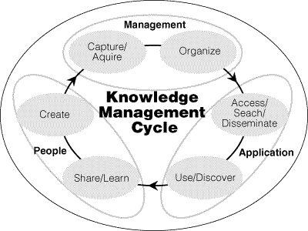

Slide 21
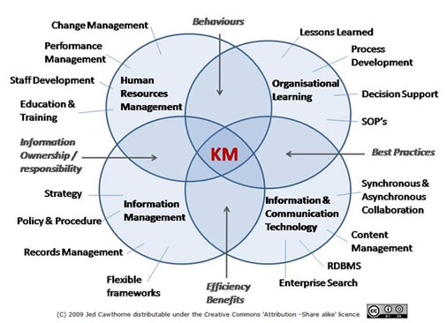

Slide 22
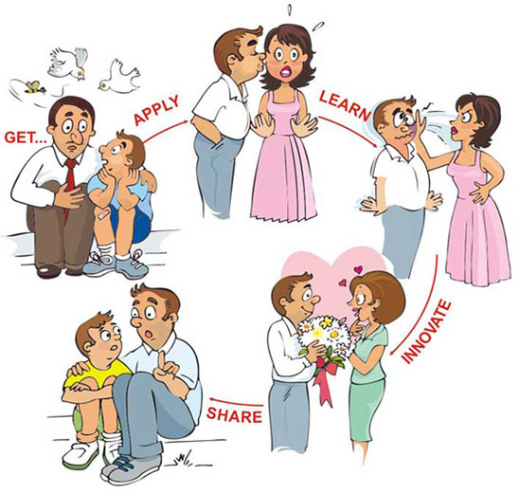

Slide 24
The Knowledge Management Value Chain
Notes:
24

Slide 25
The Knowledge Management Value Chain
Knowledge acquisition
Knowledge storage
Knowledge dissemination
Knowledge application
Building organizational and management capital: collaboration, communities of practice, and office environments
Notes:
25

Slide 26
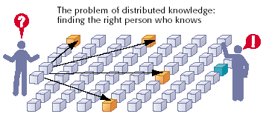
The Problem of Distributed Knowledge
Figure 11-8
Notes:
26

Slide 27
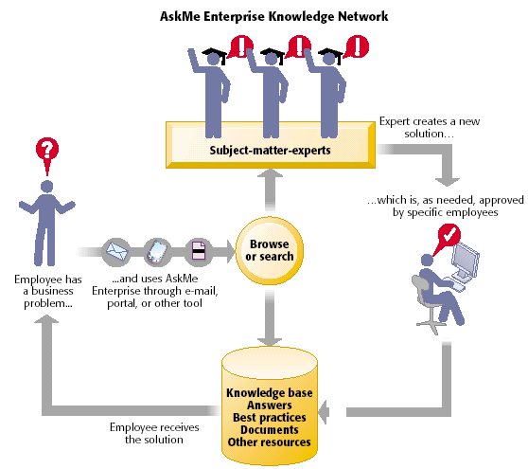
AskMe Enterprise Knowledge Network System
Distributed Knowledge by Email
-Conventional Distribution-
Figure 11-9
Notes:
27

Slide 28
Supporting Technologies: Portals, Collaboration Tools, and Learning Management Systems
Enterprise knowledge portals:
Access to external sources of information
Access to internal knowledge resources
Capabilities for e-mail, chat, discussion groups, videoconferencing
Notes:
28

Slide 29
Learning Management System (LMS):
Provides tools for the management, delivery, tracking, and assessment of various types of employee learning and training
Integrates systems from human resources, accounting, sales in order to identify and quantify business impact of employee learning programs
Notes:
29

Slide 30
Knowledge Workers and Knowledge Work
Knowledge workers: Create knowledge and information for organization
Knowledge workers key roles:
Keeping the organization current in knowledge as it develops in the external world—in technology, science, social thought, and the arts
Notes:
30

Slide 31
Knowledge Workers and Knowledge Work (Continued)
Serving as internal consultants regarding the areas of their knowledge, the changes taking place, and opportunities
Acting as change agents, evaluating, initiating, and promoting change projects
Notes:
31

Slide 32
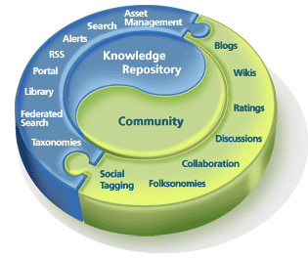
Distributed knowledge
By Social Media
-Actual Distribution-

Slide 33
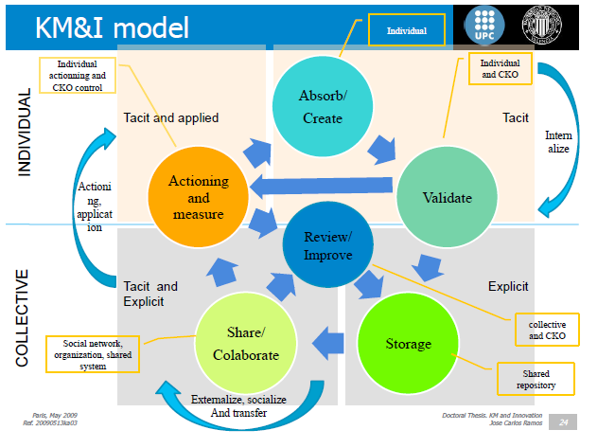

Slide 34
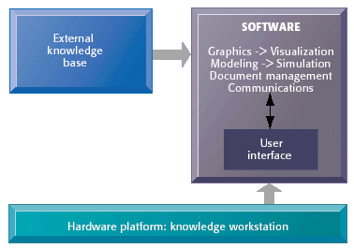
Requirements of Knowledge Work Systems
Figure 11-10
Notes:
34

Slide 35
Examples of Knowledge Work Systems
Computer-Aided Design (CAD):
Information system that automates the creation and revision of industrial and manufacturing designs using sophisticated graphics software
Virtual Reality Systems:
Interactive graphics software and hardware that create computer-generated simulations that emulate real-world activities or photorealistic simulations
Notes:
35

Slide 36
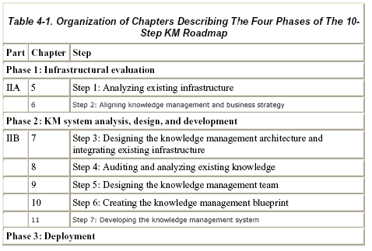
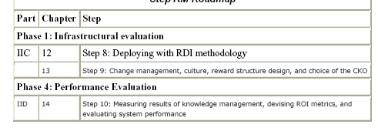
10 Step KM Roadmap

Slide 37
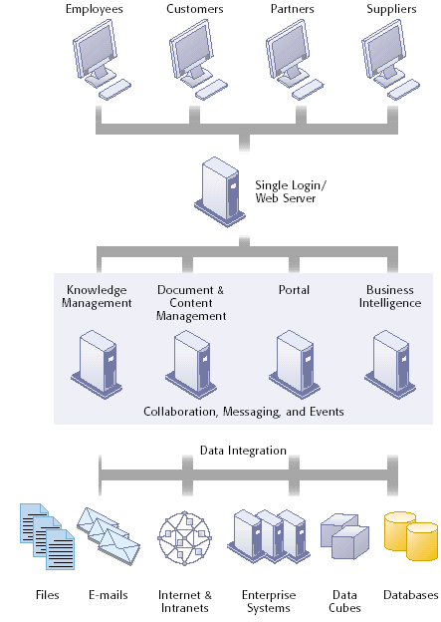
Hummingbird’s Integrated Knowledge Management System
Figure 11-7
Notes:
37

