Slide 1
Definition: Total Quality Management
Total Quality Management (TQ, QM or TQM) and Six Sigma (6σ) are sweeping “culture change” efforts to position a company for greater customer satisfaction, profitability and competitiveness.
TQ may be defined as managing the entire organization so that it excels on all dimensions of products and services that are important to the customer.
We often think of features when we think of the quality of a product or service; TQ is about conformance quality, not features.
Notes:
1980’s Long Range
Encompasses entire organization

Slide 3
Total Quality Is…
Meeting Our Customer’s Requirements
Doing Things Right the First Time; Freedom from Failure (Defects)
Consistency (Reduction in Variation)
Continuous Improvement
Quality in Everything We Do

Slide 4
A Quality Management System Is…
A belief in the employee’s ability to solve problems
A belief that people doing the work are best able to improve it
A belief that everyone is responsible for quality

Slide 5
Elements for Success
Management Support
Mission Statement
Proper Planning
Customer and Bottom Line Focus
Measurement
Empowerment
Teamwork/Effective Meetings
Continuous Process Improvement
Dedicated Resources

Slide 6
The Continuous Improvement Process
Measurement
Empowerment/
Shared Leadership
Customer Satisfaction
Measurement
Business Results
Measurement
Process Improvement/
Problem Solving
Team Management
. . .
Measurement

Slide 7
Modern History of Quality Management
Frederick W. Taylor wrote Principles of Scientific Management in 1911.
Walter A. Shewhart used statistics in quality control and inspection, and showed that productivity improves when variation is reduced (1924); wrote Economic Control of Manufactured Product in 1931.
W. Edwards Deming and Joseph M. Juran, students of Shewhart, went to Japan in 1950; began transformation from “shoddy” to “world class” goods.
In 1960, Dr. K. Ishikawa formalized “quality circles” - the use of small groups to eliminate variation and improve processes.
In the late ‘70’s and early ‘80’s:
Deming returned from Japan to write Out of the Crisis,
and began his famous 4-day seminars in the United States
Phil Crosby wrote Quality is Free
NBC ran “If Japan can do it, why can’t we?”
Motorola began 6 Sigma

Slide 8
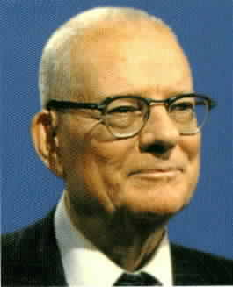
History of Quality Management
Deming’s 14 Points
1. Create constancy of purpose for improvement
2. Adopt a new philosophy
3. Cease dependence on mass inspection
4. Do not award business on price alone
5. Work continually on the system of production and service
6. Institute modern methods of training
7. Institute modern methods of supervision of workers
8. Drive out fear
9. Break down barriers between departments
10. Eliminate slogans, exhortations, and targets for the work force
11. Eliminate numerical quotas
12. Remove barriers preventing pride of workmanship
13. Institute a vigorous program of education and retraining
14. Take action to accomplish the transformation

Slide 9
History of Quality Management
Deming’s Concept of “Profound Knowledge”
Understanding (and appreciation) of Systems
- optimizing sub-systems sub-optimizes the total system
- the majority of defects come from systems, the responsibility of
management (e.g., machines not in good order, defective material, etc.
Knowledge of Statistics (variation, capability, uncertainty in data, etc.)
- to identify where problems are, and point managers and workers
toward solutions
Knowledge of Psychology (Motivation)
- people are afraid of failing and not being recognized,
so they fear how data will be used against them
Theory of Knowledge
- understanding that management in any form is a prediction, and is
based on assumptions

Slide 11
History of Total Quality
According to Dr. Joseph M. Juran (1991):
“On the assembly line at the Ford Motor Company in 1923, most of the workers producing Model T’s were immigrants and could not speak English. Many were also illiterate. Workers learned their trade by modeling the actions of other workers. They were unable to plan, problem-solve, and make decisions. As a result, the Taylor scientific school of management flourished, and MBAs and industrial engineers were invented to do this work. Today, however, the workforce is educated. Workers know what is needed to improve their jobs, and companies that do not tap into this significant source of knowledge will truly be at a competitive disadvantage.”

Slide 12
History of Total Quality
According to Phil Crosby, Quality is . . .
An attitude:
- Zero Defects
- Continuous Improvement
A measurement:
- Price of Conformance, plus
- Price of Nonconformance (defects)

Slide 13
TQ: Transforming an Organization
Notes:
Essential elements to business success include:
Customer Loyalty
Employee Commitment
Operating Efficiency
Some interesting evidence to validate transitioning into a Customer Focused company:
Customer perception of quality in the top 1/5….pretax ROI=32%
Customer perception of quality in the bottom 2/5….pretax ROI=14%
Almost 70% of why customers left companies had nothing to do with product quality
Only 4% of customers complain
65-90% of unhappy customers would never again buy from the company
When people did complain and their problems were resolved quickly, 82% would buy again
It costs five times as much to replace a typical customer as it does to take actions that would have kept the customer in the first place
Only 4% of company problems or barriers to delighting the customer are known to top managers. (9% to managers, 74% to supervisors, 100% baseline employee)
Truth: “Quality offers something to everyone…the customer, the employee, and the business. It stands for what most employees especially believe in…doing a job right the first time, being “the best” at what they do, and having everyone’s ideas treated with respect.”

Slide 15
What is Six Sigma?
A goal of near perfection in meeting customer requirements
A sweeping culture change effort to position a company for greater customer satisfaction, profitability and competitiveness
A comprehensive and flexible system for achieving, sustaining and maximizing business success; uniquely driven by close understanding of customer needs, disciplined use of facts, data, and statistical analysis, and diligent attention to managing, improving and reinventing business processes
(Source:The Six Sigma Way by Pande, Neuman and Cavanagh)

Slide 16
Is 99% Quality Good Enough?
22,000 checks will be deducted from the wrong bank accounts in the next 60 minutes.
20,000 incorrect drug prescriptions will be written in the next 12 months.
12 babies will be given to the wrong parents each day.

Slide 17
Six Sigma Quality
The objective of Six Sigma quality is 3.4 defects per million opportunities!

Slide 18
But is Six Sigma Realistic?
·
IRS – Tax Advice (phone-in)
·
100K
(66810 ppm)
·
·
Restaurant Bills
·
10K
Doctor Prescription Writing
·
Payroll Processing
·
·
Average
Company
·
Order Write-up
Journal Vouchers
Wire Transfers
1K
Air Line Baggage Handling
·
Defects Per Million Opportunities (DPMO)
Purchased Material
Lot Reject Rate
100
(233 ppm)
10
Best in Class
Domestic Airline
Flight Fatality Rate
1
(3.4 ppm)
2
3
4
5
6
(0.43 ppm)
7
SIGMA

Slide 19
Six Sigma Improvement Methods DMAIC vs. DMADV
Define
Measure
Analyze
Continuous Improvement
Reengineering
Improve
Design
Control
Validate

Slide 20
Six Sigma DMAIC Process
Control
Define: Define who your customers are, and what their requirements are for your products and services – Their expectations. Define your team goals, project boundaries, what you will focus on and what you won’t. Define the process you are striving to improve by mapping the process.
Improve
Define
Analyze
Measure

Slide 21
Six Sigma DMAIC Process
Measure: Eliminate guesswork and assumptions about what customers need and expect and how well processes are working. Collect data from many sources to determine speed in responding to customer requests, defect types and how frequently they occur, client feedback on how processes fit their needs, how clients rate us over time, etc. The data collection may suggest Charter revision.
Control
Improve
Define
Analyze
Measure

Slide 22
Six Sigma DMAIC Process
Analyze: Grounded in the context of the customer and competitive environment, analyze is used to organize data and look for process problems and opportunities. This step helps to identify gaps between current and goal performance, prioritize opportunities to improve, identify sources of variation and root causes of problems in the process.
Control
Improve
Define
Analyze
Measure

Slide 23
Six Sigma DMAIC Process
Control
Improve: Generate both obvious and creative solutions to fix and prevent problems. Finding creative solutions by correcting root causes requires innovation, technology and discipline.
Improve
Define
Analyze
Measure

Slide 24
Six Sigma DMAIC Process
Control: Insure that the process improvements, once implemented, will “hold the gains” rather than revert to the same problems again. Various control tools such as statistical process control can be used. Other tools such as procedure documentation helps institutionalize the improvement.
Control
Improve
Define
Analyze
Measure

Slide 25
Six Sigma DMADV Process
Design: Develop detailed design for new process. Determine and evaluate enabling elements. Create control and testing plan for new design. Use tools such as simulation, benchmarking, DOE, Quality Function Deployment (QFD), FMECA analysis, and cost/benefit analysis.
Validate
Design
Define
Analyze
Measure

Slide 26
Six Sigma DMADV Process
Validate
Validate: Test detailed design with a pilot implementation. If successful, develop and execute a full-scale implementation. Tools in this step include: planning tools, flowcharts/other process management techniques, and work documentation.
Design
Define
Analyze
Measure

Slide 27
Quality Function Deployment - QFD
At the conclusion of this class – You will have a thorough understanding of:
What is QFD?
Why it is important?
When it is used?
How it is used?
Understand the function of a QFD Team
Realize the Benefits of QFD
The Voice of The Customer
Organization of information
The House of Quality
QFD Process

Slide 28
History of QFD
Yoji Akao, a Japanese planning specialist, conceptualized QFD in the 1960’s
Dr. Shigeru Mizuno, Professor Emeritus of the Tokyo Institute of Technology is credited with initiated the quality function deployment system

Slide 29
History of QFD
Statistical Quality Control, SQC, was the central quality control activity after WWII.
SQC is an effective method of monitoring process using control charts.
SQC became Total Quality Control, TQC.
QFD was derived from TQC.
Notes:
Control Charts enable the use of objective criteria for distinguishing background variation from events of significance based on statistical techniques.

Slide 30
First Application of QFD
1966, Bridgestone Tire Corp first used a process assurance table.
1972, the process assurance table was retooled by Akao to include QFD process.
1972, Kobe Shipyards (of Mitsubishi Heavy Industry) began a QFD Oil Tanker project.
1978, Kobe Shipyards published their quality chart for the tanker.

Slide 31
QFD in North America
QFD spread rapidly in North America during the 1980’s
The Automobile industry and Manufacturing began heavy use of QFD at this time.
QFD symposiums (North American, Japanese, European, International) were set up to explore research relating to QFD techniques.
The QFD institute was formed in 1994.

Slide 33
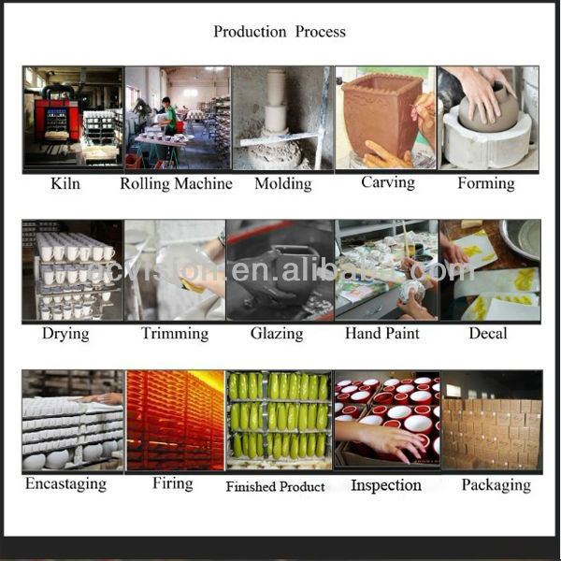

Slide 34
What is Quality Function Deployment?
Quality Function Deployment is a comprehensive quality design method that:
Seeks out spoken and unspoken customer needs from fuzzy Voice of the Customer verbatim;
Uncovers "positive" quality that wows the customer;
Translates these into designs characteristics and deliverable actions; and
Builds and delivers a quality product or service by focusing the various business functions toward achieving a common goal—customer satisfaction.

Slide 35
What is QFD?
Quality Function Deployment, QFD, is a quality technique which evaluates the ideas of key stakeholders to produce a product which better addresses the customers needs.
Customer requirements are gathered into a visual document which is evaluated and remodeled during construction so the important requirements stand out as the end result.

Slide 36
What is QFD?
The link between
Customer
Design Engineer
Competitors
Manufacturing
Provide Insight
Into the whole design & manufacturing operation
From concept to manufacture (cradle to the grave)
Can improve efficiency

Slide 37
Creative Definitions of QFD
A systematic way of documenting and breaking down customer needs into manageable and actionable detail.
A planning methodology that organizes relevant information to facilitate better decision making.
A way of reducing the uncertainty involved in product and process design.
A technique that promotes cross-functional teamwork.
A methodology that gets the right people together, early, to work efficiently and effectively to meet customers’ needs.

Slide 38
Key Thought
Throughout
Quality Function Deployment is a Valuable Decision Support Tool, But it is Not a Decision Maker

Slide 39
WHAT DOES QFD DO?
Better Designs in Half the Time!
CONCEPT
CUSTOMER
“Traditional Timeline”
Plan
Design
Redesign
Manufacture
Benefits
Plan
Design
Redesign
Manufacture
QFD is a Productivity Enhancer
Notes:
The main benefits of QFD are:
Improved Customer Satisfaction
Reduced Development Time
Improved Internal Communications
Better Documentation of Key Issues
Save Money
Some additional benefits are:
Improved morale, organizational harmony
Improved efficiency
Reduction in design changes
Increased competitiveness
High market acceptance
Problems are easier to identify

Slide 40
The QFD Paradigm
QFD provides the opportunity to make sure you have a good product before you try to design and implement it.
It is about planning and problem prevention, not problem solving .
QFD provides a systematic approach to identify which requirements are a priority for whom, when to implement them, and why.

Slide 41
Why is it important?
QFD is very powerful because it incorporates the voice of customer in the design
Resulting in :
A better product design
A satisfied customer
Insight into the design/manufacture operation
Improved problem solving and efficiency in production

Slide 42
When is it used?
Ask these important questions
Why do QFD?
What is the goal?
What should its make-up be?
Is QFD the right tool ?
Is this the right time?
Is this the right place to implement?
What is success?
Who all should be involved?
Notes:
Its important that Organizations ask themselves these types of questions when considering QFD of a new or enhance product. Leadership is also important.

Slide 43
When is QFD Appropriate?
Poor communications and expectations get lost in the complexity of product development.
Lack of structure or logic to the allocation of product development resources.
Lack of efficient and / or effective product / process development teamwork.
Extended development time caused by excessive redesign, problem solving, or putting out fires.

Slide 44
QFD Team
QFD Team
Its function in deployment
Two Types of Teams
New product design
Improving an existing design
Cross functional
Marketing, design, quality, finance and production
Notes:
Management and team member must be committed to the amount of time involved
Priorities need to be defined and communicated to all departments
The scope of the project must be clearly defined as well
And the most important tool of the QFD process is communication

Slide 45
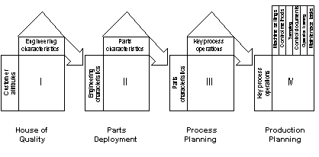
How to use it ?
Comprehensive QFD involves
Four phases:
Notes:
“Quality function deployment is a process of listening to the ‘voice of the customer,’ identifying the customer’s needs, and incorporating those needs in the design and production of goods and services” [Madu, 1999]. This quote emphasizes the role of QFD in the entire production scheme, not just at the beginning. QFD is NOT equal to the House of Quality!
We will, however, focus on the House of Quality since it is most relevant to requirements engineering. But as a take-away message, be remindful of the fact that QFD revises the design and production stages of product and service delivery. Note how the “hows” from one phase become the “whats” of the subsequent phase. Think of these phases as more iterative than waterfall.
The House of Quality (HOQ) – The HOQ is a blueprint for product development [Madu, 1999]. It’s called a “house” because of it’s physical appearance. Note that the HOQ goes by the name “quality chart” outside of North America [Akao, 1997]. Customer requirements, technical requirements, requirements prioritization, design targets, all merge onto the HOQ through a multi-step process. The HOQ is the focus of section 3 in this presentation.

Slide 46
Quality Function Deployment’s
House of Quality
6
Correlation
Matrix
3
Design
Attributes
The House
of Quality
2
1
4
5
Customer
Needs
Relationships
between
Customer Needs
and
Design Attributes
Customer
Perceptions
Importance Rankings
7
Costs/Feasibility
Establishes the Flowdown
Relates WHAT'S & HOW'S
Ranks The Importance
8
Engineering Measures

Slide 47
Key Elements
Informational Elements
The House of Quality
Two Types of Elements in Each House

Slide 48
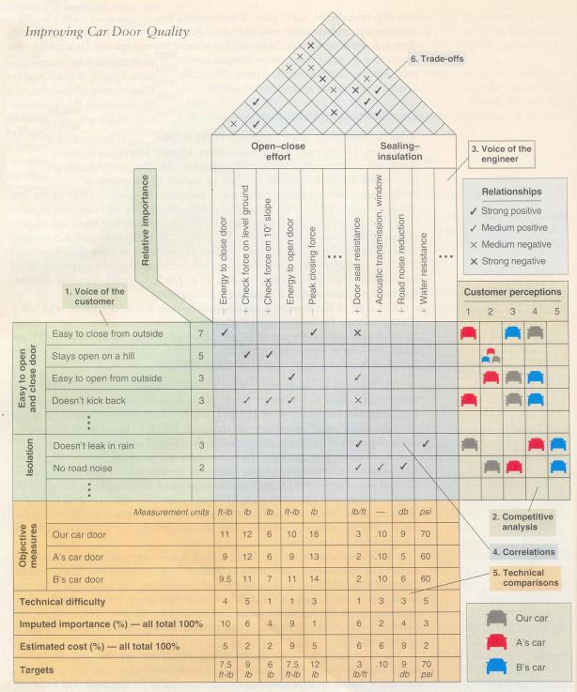

Slide 49
QFD Flowdown
Manufacturing
Environment
Software
Environment
Service
Environment
Customer Wants
Technical Requirements
Part Characteristics
Manufacturing Process
Production Requirements
Customer Wants
Product Functionality
System Characteristics
Design Alternatives
Customer Wants
Service Requirements
Service Processes
Process Controls
⬅Levels Of Granularity
Flowdown Relates The Houses To Each Other

Slide 50
Building the House of Quality
Identify Customer Attributes
Identify Design Attributes / Requirements
Relate the customer attributes to the design attributes.
Conduct an Evaluation of Competing Products.
Evaluate Design Attributes and Develop Targets.
Determine which Design Attributes to Deploy in the Remainder of the Process.

Slide 51
1. Identify Customer Attributes
These are product or service requirements IN THE CUSTOMER’S TERMS.
Market Research;
Surveys;
Focus Groups.
“What does the customer expect from the product?”
“Why does the customer buy the product?”
Salespeople and Technicians can be important sources of information – both in terms of these two questions and in terms of product failure and repair.
OFTEN THESE ARE EXPANDED INTO Secondary and Tertiary Needs / Requirements.

Slide 52
Types of Customer Information and How to Collect it
Notes:
Quality book

Slide 53
What Does The Customer Want
Customer Needs
CTQs
Ys
Key Elements - “What’s”
What’s
Voice of the Customer

Slide 54
How Important the What’s are TO THE CUSTOMER
Customer Ranking of their Needs
Key Elements: Customer Requirements
Customer Importance
Voice of the Customer

Slide 55
2. Identify Design Attributes.
Design Attributes are Expressed in the Language of the Designer / Engineer and Represent the TECHNICAL Characteristics (Attributes) that must be Deployed throughout the DESIGN, MANUFACTURING, and SERVICE PROCESSES.
These must be MEASURABLE since the Output will be Controlled and Compared to Objective Targets.
The ROOF of the HOUSE OF QUALITY shows, symbolically, the Interrelationships between Design Attributes.

Slide 56
How Do You Satisfy the Customer What’s
Product Requirements
Translation For Action
X’s
How’s
Key Elements - “How’s”
What’s
WHAT'S
HOW'S
Satisfing Customer Needs

Slide 57
Correlation Matrix
Impact Of The How’s On Each Other
HOW 1
HOW 2
HOW 3
HOW 4
HOW 5
HOW 6
HOW 7
Strong Positive
Positive
Negative
Strong Negative
Need 1
Need 2
Need 3
Need 4
Need 5
Need 6
Need 7
5
5
3
4
2
4
1
H
L
L
M
65
45
21
36
8
52
4
H
Information – Correlation Matrix
M
M
L
H
3 lbs
12 in.
3 mils
40 psi
3
8 atm
1 mm
L
M
M
L
H
L
M
57 41 48 13 50 6 21
Conflict Resolution

Slide 58
3.Relating Customer & Design Attributes
Symbolically we determine whether there is NO relationship, a WEAK one, MODERATE one, or STRONG relationship between each Customer Attribute and each Design Attribute.
The PURPOSE it to determine whether the final Design Attributes adequately cover Customer Attributes.
LACK of a strong relationship between A customer attribute and any design attribute shows that the attribute is not adequately addressed or that the final product will have difficulty in meeting the expressed customer need.
Similarly, if a design attribute DOES NOT affect any customer attribute, then it may be redundant or the designers may have missed some important customer attribute.

Slide 59
Strength of the Interrelation Between the What’s and the How’s
H Strong 9
M Medium 3
L Weak 1
Transfer Function
Y = f(X)
HOW 1
HOW 2
HOW 3
HOW 4
HOW 5
HOW 6
HOW 7
Key Elements: Relationship
Need 1
Need 2
Need 3
Need 4
Need 5
Need 6
Need 7
5
5
3
4
2
4
1
H
L
L
M
H
Relationships
M
M
L
H
L
M
M
L
H
L
M
Untangling The Web

Slide 60
4. Add Market Evaluation & Key Selling Points
This step includes identifying importance ratings for each customer attribute AND evaluating existing products / services for each of the attributes.
Customer importance ratings represent the areas of greatest interest and highest expectations AS EXPRESSED BY THE CUSTOMER.
Competitive evaluation helps to highlight the absolute strengths and weaknesses in competing products.
This step enables designers to seek opportunities for improvement and links QFD to a company’s strategic vision and allows priorities to be set in the design process.

Slide 61
5. Evaluate Design Attributes of Competitive Products & Set Targets.
This is USUALLY accomplished through in-house testing and then translated into MEASURABLE TERMS.
The evaluations are compared with the competitive evaluation of customer attributes to determine inconsistency between customer evaluations and technical evaluations.
For example, if a competing product is found to best satisfy a customer attribute, but the evaluation of the related design attribute indicates otherwise, then EITHER the measures used are faulty, OR else the product has an image difference that is affecting customer perceptions.
On the basis of customer importance ratings and existing product strengths and weaknesses, TARGETS and DIRECTIONS for each design attribute are set.

Slide 62
HOW 1
HOW 2
HOW 3
HOW 4
HOW 5
HOW 6
HOW 7
HOW 1
HOW 2
HOW 3
HOW 4
HOW 5
HOW 6
HOW 7
Target Values for the How’s
Note the Units
Information: How Much
H
L
L
M
65
45
21
36
8
52
4
Need 1
Need 2
Need 3
Need 4
Need 5
Need 6
Need 7
5
5
3
4
2
4
1
H
M
M
L
H
3 lbs
12 in.
3 mils
40 psi
3
8 atm
1 mm
L
M
M
L
H
L
M
How Much
57 41 48 13 50 6 21
Consistent Comparison

Slide 63
Target Direction
HOW 1
HOW 2
HOW 3
HOW 4
HOW 5
HOW 6
HOW 7
Information On The HOW'S
More Is Better
Less Is Better
Specific Amount
Information: Target Direction
Need 1
Need 2
Need 3
Need 4
Need 5
Need 6
Need 7
5
5
3
4
2
4
1
H
L
L
M
65
45
21
36
8
52
4
H
M
M
L
H
L
M
M
L
H
L
M
57 41 48 13 50 6 21
The Best Direction

Slide 64
6. Select Design Attributes to be Deployed in the Remainder of the Process
This means identifying the design attributes that:
have a strong relationship to customer needs,
have poor competitive performance,
or are strong selling points.
These attributes will need to be DEPLOYED or TRANSLATED into the language of each function in the design and production process so that proper actions and controls are taken to ensure that the voice of the customer is maintained.
Those attributes not identified as critical do not need such rigorous attention.

Slide 65
Which How’s are Key
Where Should The Focus Lie
“CI” = “Customer Importance”
“Strength” is measured on a 9, 3, 1, 0 Scale
HOW 1
HOW 2
HOW 3
HOW 4
HOW 5
HOW 6
HOW 7
5
3
4
2
4
1
45
5
5
15
Key Elements: Technical Importance
Need 1
Need 2
Need 3
Need 4
Need 5
Need 6
Need 7
CI
45
9
9
3
36
2
6
12
4
36
Technical Importance
1
M
TI = Σ_{column}
(CI *Strength)
57 41 48 13 50 6 21
Ranking The HOW'S

Slide 66
HOW 1
HOW 2
HOW 3
HOW 4
HOW 5
HOW 6
HOW 7
Are All The How’s Captured
Is A What Really A How
Key Elements: Completeness
Need 1
Need 2
Need 3
Need 4
Need 5
Need 6
Need 7
H
L
L
M
5
3
4
2
4
1
H
Completeness Criteria
M
M
L
H
L
M
M
L
H
L
M
CC = Σ _{row}
(CI *Strength)
57 41 48 13 50 6 21
Have We Captured the HOW'S

Slide 67
Using the House of Quality
The voice of the customer MUST be carried THROUGHOUT the production process.
Three other “houses of quality” are used to do this and, together with the first, these carry the customer’s voice from its initial expression, through design attributes, on to component attributes, to process operations, and eventually to a quality control and improvement plans.
In Japan, all four are used.
The tendency in the West is to use only the first one or two.

Slide 68
1
Design Attributes
2
Component Attributes
Customer
Attributes
Design
Attributes
3
Process Operations
4
Quality Control Plan
Component
Attributes
The How’s at One Level Become the What’s at the Next Level
Process
Operations

Slide 69
The voice of the customer
Voice of the customer (VOC)
“The efforts to investigate and analyze the customer. With QFD, VOC data is reduce into a set of critical customer needs using techniques such as affinity, diagrams, function analysis, etc, defined and documented in customer needs data dictionary, and prioritized. This VOC effort is also the opportunity to recognize unfulfilled needs that can be provided at minimum, competitive advantage and potentially, a break-through product or true value innovation”

Slide 70
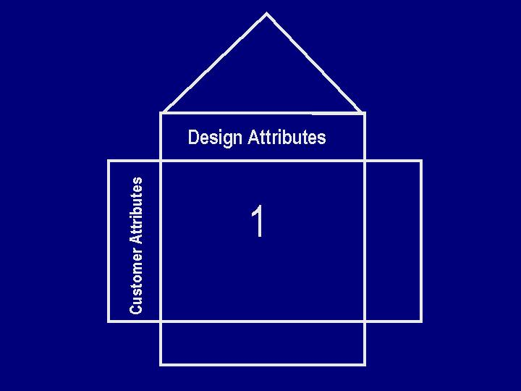
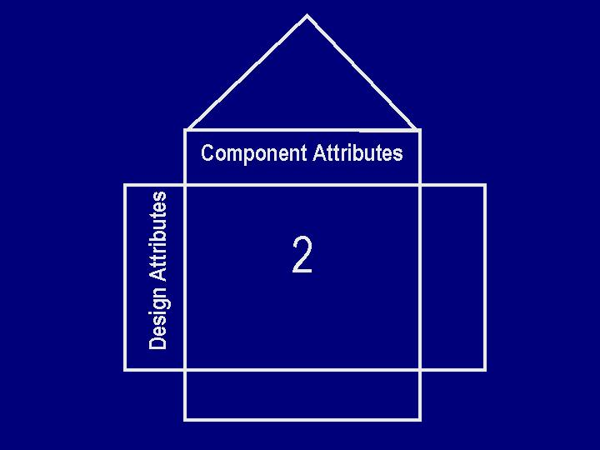
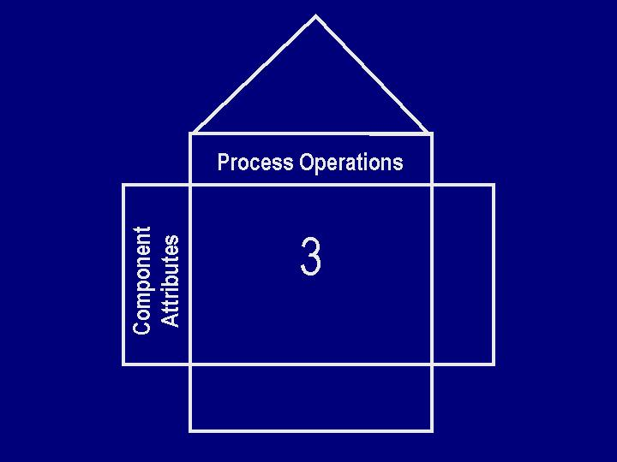
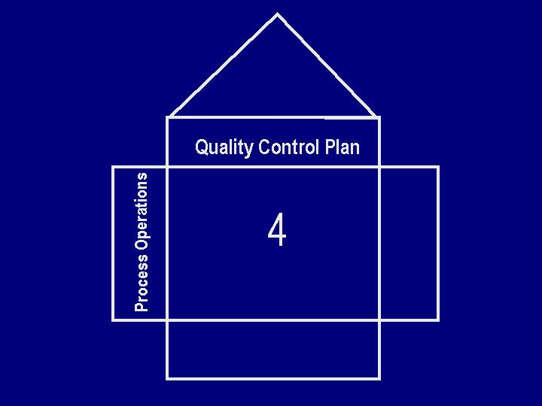
The Cascading Voice of the Customer
NOTES:
“Design Attributes” are also called “Functional Requirements”
“Component Attributes” are also called “Part Characteristics”
“Process Operations” are also called “Manufacturing Processes” and the “Quality Control Plan” refers to “Key Process Variables.
WHATS
Y
Critical to Quality
Characteristics
(CTQs)
The Four Houses of Quality
Key Manufacturing
Processes
X
Key Process Variables

