Slide 1
Chap 5 RF Signal
UNIVERSITAS KOMPUTER INDONESIA
Dr. Yeffry Handoko Putra, M.T

Slide 2
Travelling Electric and Magnetic Waves.

Slide 3
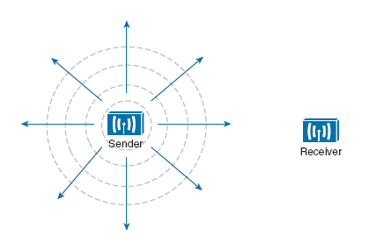
Wave Propagation with an Idealistic Antenna.

Slide 4
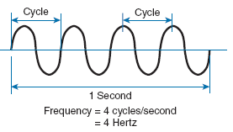
Cycles Within a Wave.

Slide 5
Frequency Unit Names

Slide 6
Continuous Frequency Spectrum.
5.150 to 5.250 GHz
5.250 to 5.350 GHz
5.470 to 5.725 GHz
5.725 to 5.825 GHz
2.4 and 2.5 GHz

Slide 7
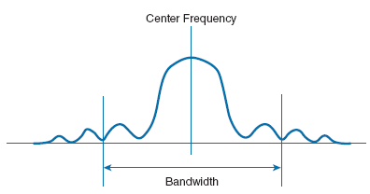
An Example of Channel Spacing in the 2.4-GHz Band.
Signal Bandwidth

Slide 8
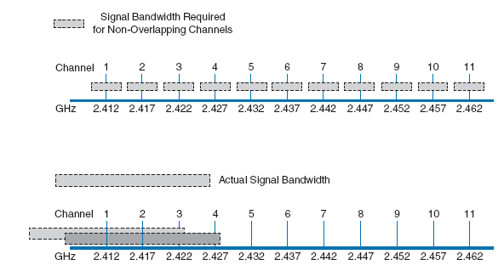
Examples of Channel Spacing and Overlap

Slide 9
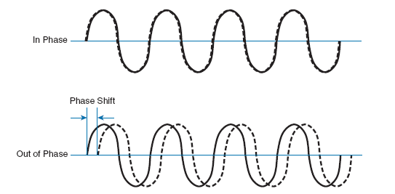
Understanding Phase

Slide 10
Examples of Increasing Frequency and Decreasing Wavelength.

Slide 11
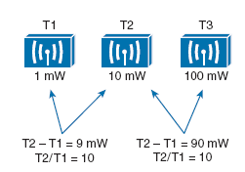
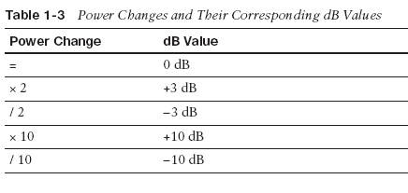
Understanding RF Power and dB
The strength of an RF signal is usually measured by its power, in watts (W). For example,
a typical AM radio station broadcasts at a power of 50,000 W; an FM radio station
might use 16,000 W. In comparison, a wireless LAN transmitter usually has a signal
strength between 0.1 W (100 mW) and 0.001 W (1 mW).
Fact 1 —A value of 0 dB means that the two absolute power values are equal.
Fact 2 —A value of 3 dB means that the power value of interest is double the reference
value; a value of –3 dB means the power value of interest is half the reference.

Slide 12
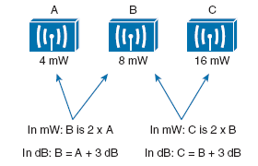

Slide 13
An Example of RF Signal Power Loss.

Slide 14
An Example of RF Signal Power Loss.
Subtracting dB to Represent a Loss in Signal Strength.

Slide 15
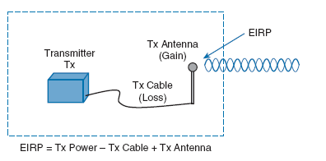
Effective Isotropic Radiated Power (EIRP)
Suppose a transmitter is configured for a power level of 10 dBm (10 mW). A cable with
5-dB loss connects the transmitter to an antenna with an 8-dBi gain. The resulting EIRP
of the system is 10 dBm – 5 dB + 8 dBi, or 13 dBm.
You might notice that the EIRP is made up of decibel-milliwatt (dBm), dB relative to an
isotropic antenna (dBi), and decibel (dB) values

Slide 16
Calculating Received Signal Strength Over the Path of an RF Signal

Slide 17
An Example of Calculating Received Signal Strength
The signal begins at 20 dBm at the transmitter,
has an EIRP value of 22 dBm at the transmitting antenna (20 dBm – 2 dB + 4 dBi), and
arrives at the receiver with a level of –45 dBm.

Slide 18
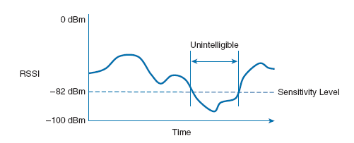
Understanding Power Levels at the Receiver
The noise level, or the average
signal strength of the noise, is called the noise floor

Slide 19
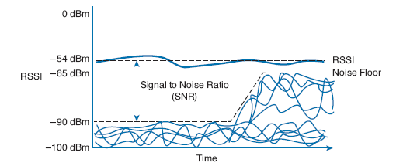
An Example of a Changing Noise Floor and SNR.

Slide 20
Carrying Data Over an RF Signal
Poor Attempts at Sending Data Over an RF Signal

Slide 21
In contrast, wireless LANs must carry data at high bit rates, requiring more bandwidth for modulation. The end result is that the data being sent is spread out across a range of frequencies. This is known as spread spectrum . At the physical layer, wireless LANs can be broken down into the following three spread-spectrum categories, which are discussed
in subsequent sections:

Slide 22
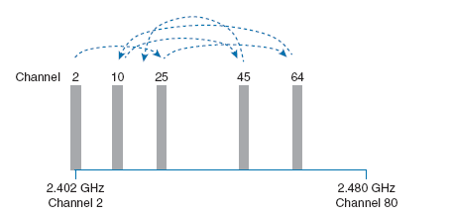
FHSS
An Example FHSS Channel-Hopping Sequence.

Slide 23
DSSS
Example Nonoverlapping Channels Used for DSSS.

Slide 24
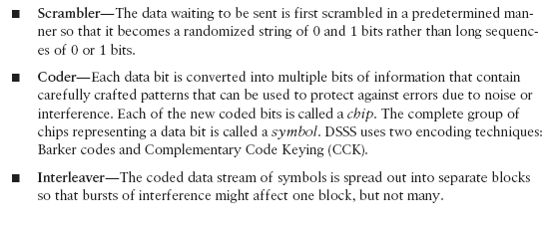
DSSS
DSSS transmits data in a serial stream, where each data bit is prepared for transmission one at a time. It might seem like a simple matter to transmit the data bits in the order that they are stored or presented to the wireless transmitter; however, RF signals are often affected by external factors like noise or interference that can garble the data at the receiver. For that reason, a wireless transmitter performs several functions to make the data stream less susceptible to being degraded along the transmission path:

Slide 25
Functional Blocks Used in a DSSS Transmitter.

Slide 26
1-Mbps Data Rate

Slide 27
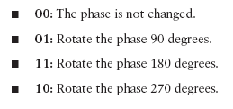
2-Mbps Data Rate
Because DQPSK can modulate data bits in pairs, it is able to transmit twice the data rate
of DBPSK, or 2 Mbps.

Slide 28
Example Phase Changes During DBPSK and DQPSK Modulation.

Slide 29
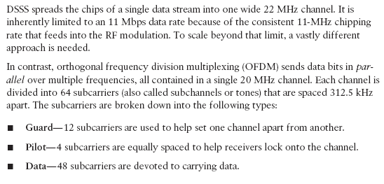
OFDM

Slide 30
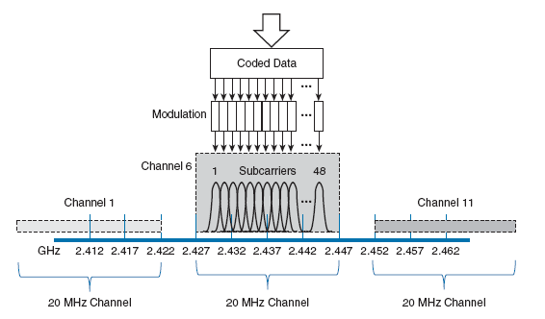
OFDM Operation with 48 Parallel Subcarriers

Slide 31
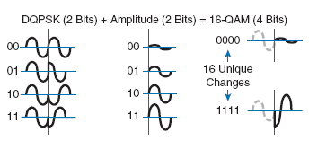
Examples of Phase and Amplitude Changes with 16-QAM.

