Slide 1
Chap 5 Antennas
Wireless and Mobile Communication
Dr. Yeffry Handoko Putra
Department of Computer Engineering

Slide 2
Wireless Communication System
Channel code word
Message Signal
Source
Encoder
Channel
Encoder
Mod-
ulator
Modulated
Transmitted Signal
Source
Wireless Channel
User
Source
Decoder
Channel
Decoder
Demod-
ulator
Received
Signal
Estimate of
Message signal
Estimate of
channel code word

Slide 3
Introduction
An antenna is an electrical conductor or system of conductors
  Transmission - radiates electromagnetic energy into space
  Reception - collects electromagnetic energy from space
In two-way communication, the same antenna can be used for transmission and reception

Slide 4
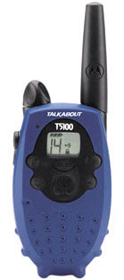
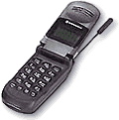
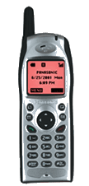
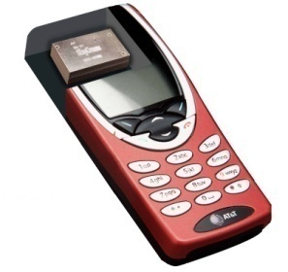
Antenna Evolution
Antennas Have Always Been the Part That Makes a Wireless Device Wireless
Have Traditionally Been External, Connectorized Components
  Misunderstood, considered “black magic”
  Gangly, obtrusive
  Added on at the end of the design
Antennas for Mobile Devices Have Evolved Since Their Introduction
  Whips → Retractables → Stubbies → Embedded

Slide 5








Future of the Wired/Wireless World
Wireless Legend
Black: Multi-Mode
Orange: Single Mode
Auto
GPS
DVD / HDTV
3G
WWN
BT
WPAN
802.11
WLAN
Broadband
Digital Data
(Fiber/FWA)
Mobile Data
Devices
OC3
WAN
3G Mobile
Devices
PC / Server
SODA
Consumer
POS
Digital
Camera
Real-Time
Video
Printer

Slide 6


Wired/Wireless Networks of Today
RCA
GPS
Real-Time
Video
DVD/TV/VCR
Auto
Cable
Ethernet
Broadband
Internet
Service
PCS
Mobile
Network
DSL
Mobile Data
Devices
PC / Server
USB
PCS
Device
Digital
Camera
Printer
Mobile
Devices
Wired
Devices

Slide 7
Antenna Performance
Better Performance is Usually Achieved by Increased S/N in the Wireless Link
  Performance improvements can be realized by higher gain antenna (if beam is properly focused)
    Example: Want horizontal beam for cell phone, zenith beam for GPS
Increased Gain Can be Used in Different Ways
  Better cell coverage area
    Increase cell size / range
    Given all mobiles at max power, then less dropouts
  Less battery power
    Given strong signal area, then reduced Tx Battery
    Especially critical in CDMA networks
  Some combination of above
R1
R2
Increase Cell Coverage
R1
Reduce Dropouts
Reduce Battery Size

Slide 8
Theory of Antenna

Slide 9
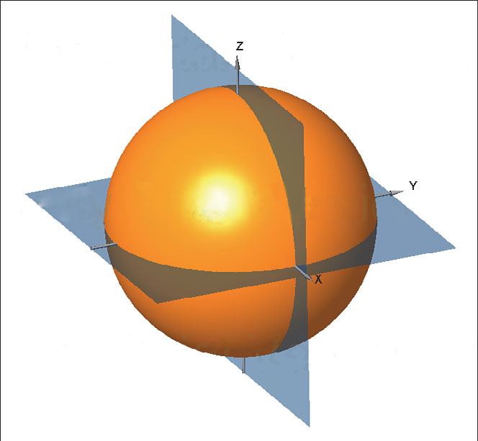
Isotropic Antenna

Slide 10
Radiation Patterns
Radiation pattern
  Graphical representation of radiation properties of an antenna
  Depicted as two-dimensional cross section
Beam width (or half-power beam width)
  Measure of directivity of antenna
  Angle within which power radiated is at least half of that in most preferred direction
Reception pattern
  Receiving antenna’s equivalent to radiation pattern
Omnidirectional vs. directional antenna

Slide 11
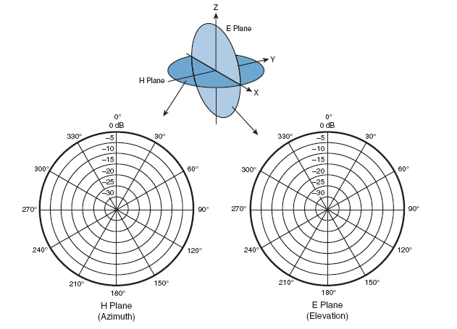
Azimuth (H) Plane and Elevation (E) Plane

Slide 12
Types of Antennas
Isotropic antenna (idealized)
  Radiates power equally in all directions
Dipole antennas
  Half-wave dipole antenna (or Hertz antenna)
  Quarter-wave vertical antenna (or Marconi antenna)
Parabolic Reflective Antenna
  Used for terrestrial microwave and satellite applications
  Larger the diameter, the more tightly directional is the beam

Slide 13
Wireless Device Antenna Choices
Loop
PIFA
Patch
Monopole
MLA

Slide 14
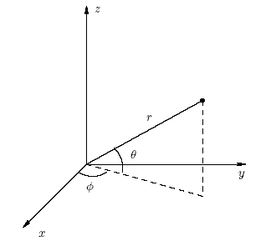
Antenna - Ideal
Isotropics antenna: In free space radiates power equally in all direction. Not realizable physically
H
E
EM fields around a transmitting antenna
, a polar coordinate
d
P_{t}
d
d- distance directly away from the antenna.
φ is the azimuth, or angle in the horizontal plane.
θ is the zenith, or angle above the horizon.
Area
Distance d

Slide 15
Antenna - Real
Not isotropic radiators, but always have directive effects (vertically and/or horizontally)
A well defined radiation pattern measured around an antenna
Patterns are visualised by drawing the set of constant-intensity surfaces

Slide 16
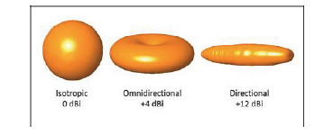
Antenna Gain
Antenna gain
  Power output, in a particular direction, compared to that produced in any direction by a perfect omnidirectional antenna (isotropic antenna)
Expressed in terms of effective area
  Related to physical size and shape of antenna

Slide 17
Antenna Gain
Relationship between antenna gain and effective area
    G = antenna gain
    A_{e} = effective area
    f = carrier frequency
    c = speed of light (≈ 3 x 10⁸ m/s)
    λ = carrier wavelength

Slide 18
Antenna - Ideal - contd.
The power density of an ideal loss-less antenna at a distance d away from the transmitting antenna:
Note: the area is for a
sphere.
W/m²
G_{t} is the transmitting antenna gain
The product P_{t}G_{t} : Equivalent Isotropic Radiation Power
(EIRP)
which is the power fed to a perfect isotropic antenna to
get the same output power of the practical antenna in hand.

Slide 19
Antenna - Ideal - contd.
The strength of the signal is often defined in terms of its Electric Field Intensity E, because it is easier to measure.
P_{a} = E²/R_{m} where R_{m} is the impedance of the medium. For
free space R_{m} = 377 Ohms..
V/m

Slide 20
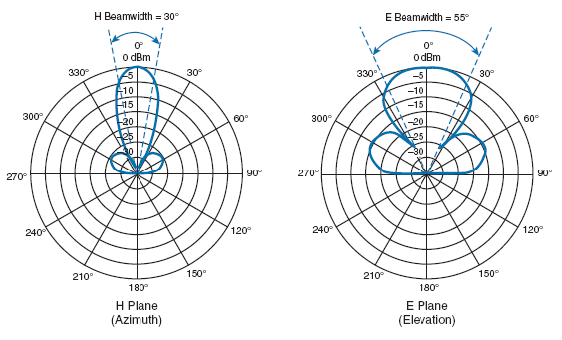
Beam Width
The beamwidth is determined by finding the strongest point on the plot, which is usually somewhere on the outer circle. Next, the plot is followed in either direction until the value decreases by 3 dB, indicating the point where the signal is one-half the strongest
power.

Slide 21
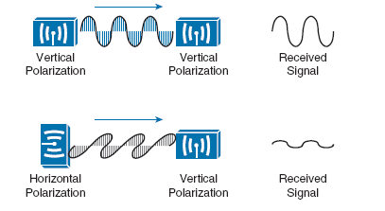
Polarization

Slide 22
Antenna – Real - Simple Dipoles
Not isotropic radiators, e.g., dipoles with lengths λ/4 on car roofs or λ/2 as Hertzian dipole
Example: Radiation pattern of a simple Hertzian dipole
shape of antenna is proportional to the wavelength
λ/4
λ/2
y
y
z
simple
dipole
x
z
x
side view (xy-plane)
side view (yz-plane)
top view (xz-plane)

Slide 23
Antenna – Real - Sdirected and Sectorized
Used for microwave or base stations for mobile phones (e.g., radio coverage of a valley)
y
y
z
Directed
x
z
x
side view (xy-plane)
side view (yz-plane)
top view (xz-plane)
z
z
x
Sectorized
x
top view, 3 sector
top view, 6 sector

Slide 24
Antenna - Ideal - contd.
The receiving antenna is characterized by its effective aperture A_{e}, which describes how well an antenna can pick up power from an incoming electromagnetic wave
The effective aperture A_{e} is related to the gain G_{r} as follows:
  A_{e} = P_{r} / P_{a} => A_{e} = G_{r}λ²/4π
which is the equivalent power absorbing area of the antenna.
G_{r} is the receiving antenna gain and λ = c/f

Slide 25
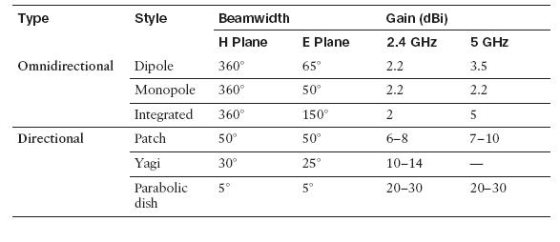
Antenna Type

Slide 26
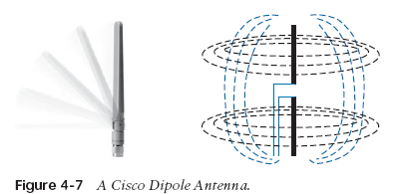
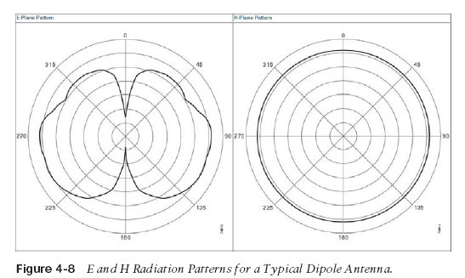
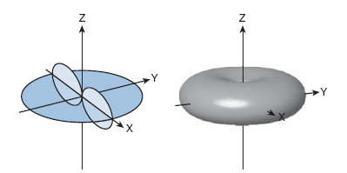
Omni directional Antenna
gain of around +2 to +5 dBi.

Slide 27
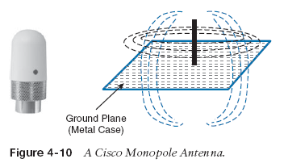
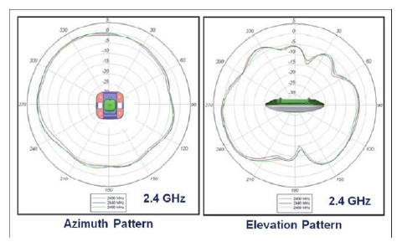


Slide 28
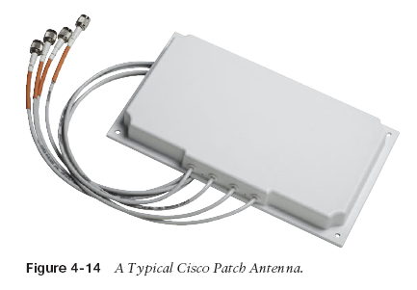
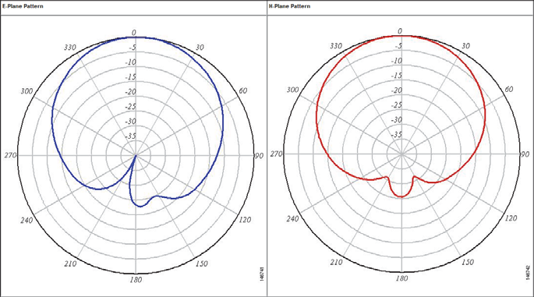
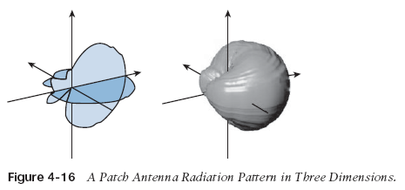
Directional Antennas
mounted on a wall.

Slide 29
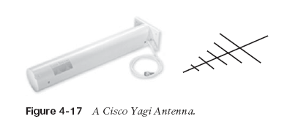
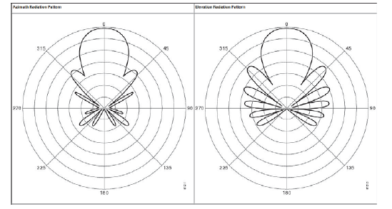
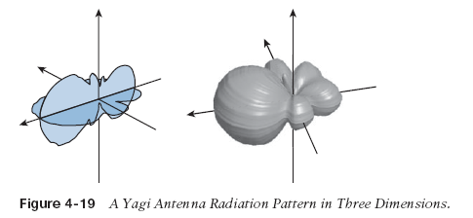
Directional Antennas
gain of about 10-14 dBi in the 2.4-GHz band. Cisco does not offer a 5-GHz Yagi.

Slide 30
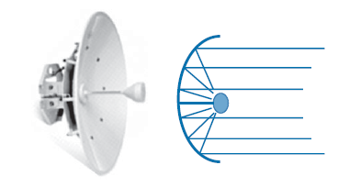
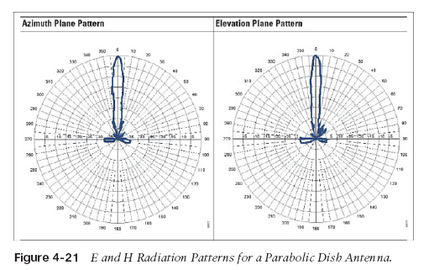
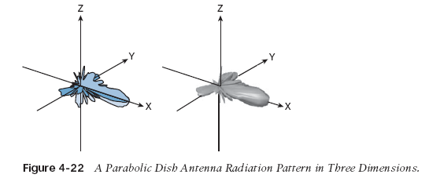
Directional Antennas
antenna a gain of between 20 and 30 dBi—the highest gain of all the wireless LAN antennas.

Slide 31
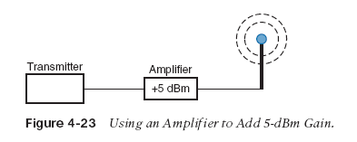
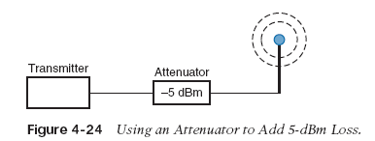
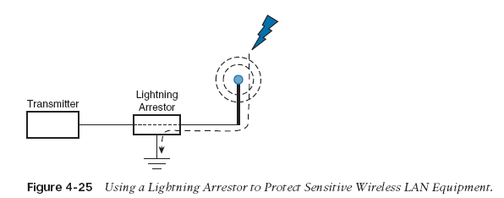
Adding Antenna Accessories

Slide 32
Propagation Modes
Ground-wave propagation
Sky-wave propagation
Line-of-sight propagation
Non line of sight propagation

Slide 33
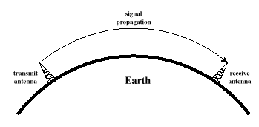
Ground Wave Propagation

Slide 34
Ground Wave Propagation
Follows contour of the earth
Can Propagate considerable distances
Frequencies up to 2 MHz
Example
  AM radio

Slide 35
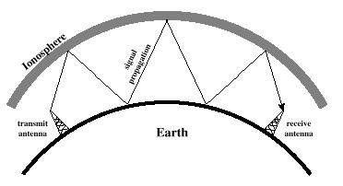
Sky Wave Propagation

Slide 36
Sky Wave Propagation
Signal reflected from ionized layer of atmosphere back down to earth
Signal can travel a number of hops, back and forth between ionosphere and earth’s surface
Reflection effect caused by refraction
Examples
  Amateur radio
  CB radio

Slide 37
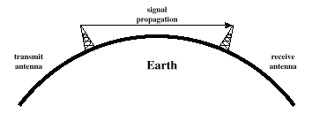
Line-of-Sight Propagation

Slide 38
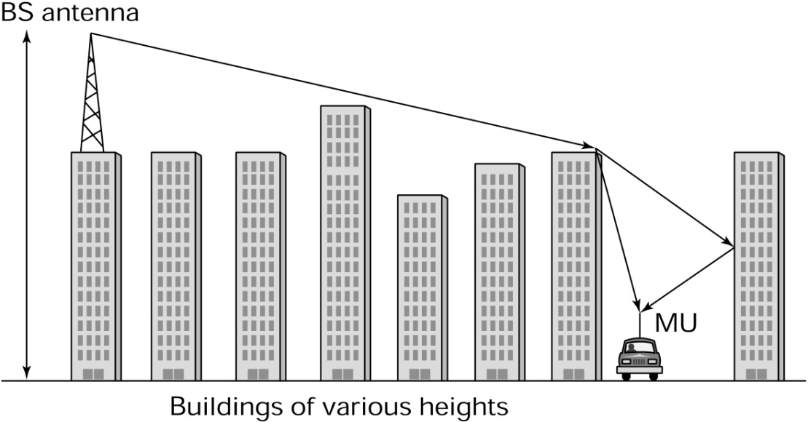
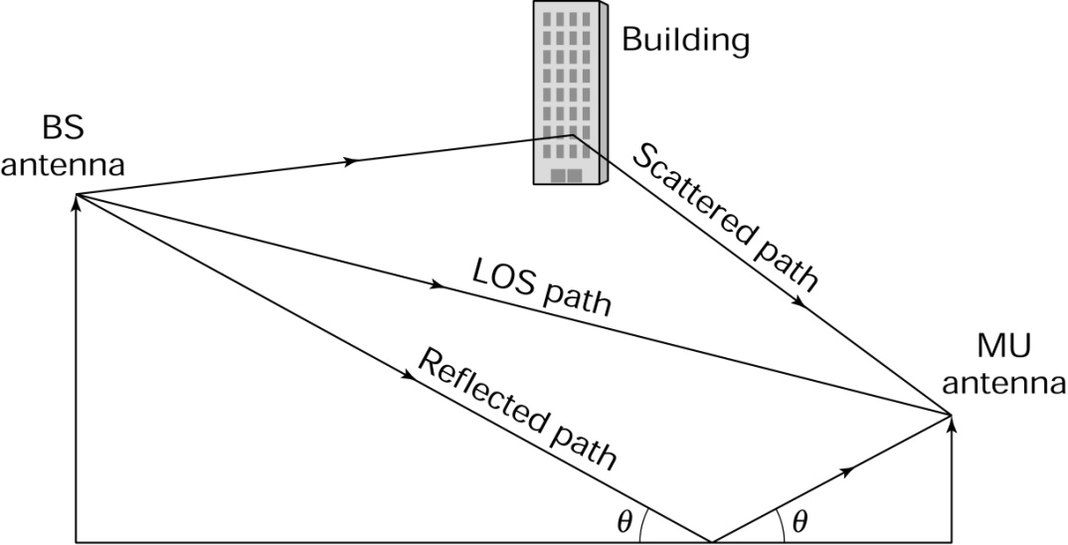
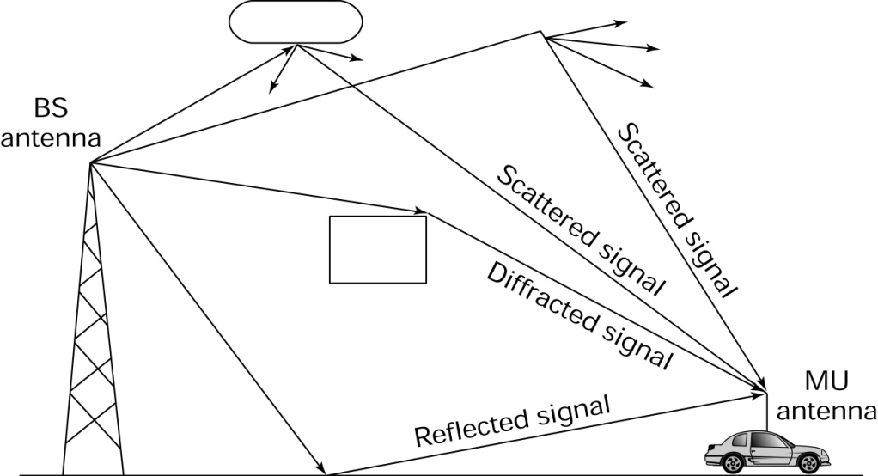
Propagation Non line of sight
Reflection (rough terrain, moving vehicle)
Diffraction (edge of Building)
Scattering (building)
Source: P M Shankar

Slide 39
Line-of-Sight Propagation
Transmitting and receiving antennas must be within line of sight
  Satellite communication – signal above 30 MHz not reflected by ionosphere
  Ground communication – antennas within effective line of site due to refraction
Refraction – bending of microwaves by the atmosphere
  Velocity of electromagnetic wave is a function of the density of the medium
  When wave changes medium, speed changes
  Wave bends at the boundary between mediums

Slide 40
Line-of-Sight Equations
Optical line of sight
Effective, or radio, line of sight
    d = distance between antenna and horizon (km)
    h = antenna height (m)
    K = adjustment factor to account for refraction, rule of thumb K = 4/3

Slide 41
Line-of-Sight Equations
Maximum distance between two antennas for LOS propagation:
    h₁ = height of antenna one
    h₂ = height of antenna two

Slide 42
LOS Wireless Transmission Impairments
Attenuation and attenuation distortion
Free space loss
Noise
Atmospheric absorption
Multipath
Refraction
Thermal noise

Slide 43
Attenuation
Strength of signal falls off with distance over transmission medium
Attenuation factors for unguided media:
  Received signal must have sufficient strength so that circuitry in the receiver can interpret the signal
  Signal must maintain a level sufficiently higher than noise to be received without error
  Attenuation is greater at higher frequencies, causing distortion

Slide 44
Free Space Loss
Free space loss, ideal isotropic antenna
    P_{t} = signal power at transmitting antenna
    P_{r} = signal power at receiving antenna
    λ = carrier wavelength
    d = propagation distance between antennas
    c = speed of light (≈ 3 x 10⁸ m/s)
    where d and λ are in the same units (e.g., meters)

Slide 45
Free Space Loss
Free space loss equation can be recast:

Slide 46
Free Space Loss
Free space loss accounting for gain of antennas
    G_{t} = gain of transmitting antenna
    G_{r} = gain of receiving antenna
    A_{t} = effective area of transmitting antenna
    A_{r} = effective area of receiving antenna

Slide 47
Free Space Loss
Free space loss accounting for gain of other antennas can be recast as

Slide 48
Categories of Noise
Thermal Noise
Intermodulation noise
Crosstalk
Impulse Noise

Slide 49
Thermal Noise
Thermal noise due to agitation of electrons
Present in all electronic devices and transmission media
Cannot be eliminated
Function of temperature
Particularly significant for satellite communication

Slide 50
Thermal Noise
Amount of thermal noise to be found in a bandwidth of 1Hz in any device or conductor is:
    N₀ = noise power density in watts per 1 Hz of bandwidth
    k = Boltzmann's constant = 1.3803 x 10⁻²³ J/K
    T = temperature, in kelvins (absolute temperature)

Slide 51
Thermal Noise
Noise is assumed to be independent of frequency
Thermal noise present in a bandwidth of B Hertz (in watts):
    or, in decibel-watts

Slide 52
Noise Terminology
Intermodulation noise – occurs if signals with different frequencies share the same medium
  Interference caused by a signal produced at a frequency that is the sum or difference of original frequencies
Crosstalk – unwanted coupling between signal paths
Impulse noise – irregular pulses or noise spikes
  Short duration and of relatively high amplitude
  Caused by external electromagnetic disturbances, or faults and flaws in the communications system
  Primary source of error for digital data transmission

Slide 53
Expression E_{b}/N₀
Ratio of signal energy per bit to noise power density per Hertz
The bit error rate for digital data is a function of E_{b}/N₀
  Given a value for E_{b}/N₀ to achieve a desired error rate, parameters of this formula can be selected
  As bit rate R increases, transmitted signal power must increase to maintain required E_{b}/N₀

Slide 54
Other Impairments
Atmospheric absorption – water vapor and oxygen contribute to attenuation
Multipath – obstacles reflect signals so that multiple copies with varying delays are received
Refraction – bending of radio waves as they propagate through the atmosphere

Slide 55
Multipath Propagation
Reflection - occurs when signal encounters a surface that is large relative to the wavelength of the signal
Diffraction - occurs at the edge of an impenetrable body that is large compared to wavelength of radio wave
Scattering – occurs when incoming signal hits an object whose size is in the order of the wavelength of the signal or less

Slide 56
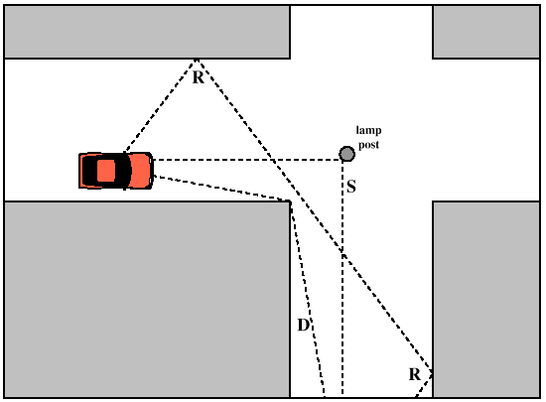

Slide 57
Effects of Multipath Propagation
Multiple copies of a signal may arrive at different phases
  If phases add destructively, the signal level relative to noise declines, making detection more difficult
Intersymbol interference (ISI)
  One or more delayed copies of a pulse may arrive at the same time as the primary pulse for a subsequent bit

Slide 58
Fading
Time variation of received signal power caused by changes in the transmission medium or path(s)
In a fixed environment:
  Changes in atmospheric conditions
In a mobile environment:
  Multipath propagation

Slide 59
Types of Fading
Fast fading
Slow fading
Flat fading
Selective fading
Rayleigh fading
Rician fading

Slide 60
Error Compensation Mechanisms
Forward error correction
Adaptive equalization
Diversity techniques

Slide 61
Forward Error Correction
Transmitter adds error-correcting code to data block
  Code is a function of the data bits
Receiver calculates error-correcting code from incoming data bits
  If calculated code matches incoming code, no error occurred
  If error-correcting codes don’t match, receiver attempts to determine bits in error and correct

Slide 62
Adaptive Equalization
Can be applied to transmissions that carry analog or digital information
  Analog voice or video
  Digital data, digitized voice or video
Used to combat intersymbol interference
Involves gathering dispersed symbol energy back into its original time interval
Techniques
  Lumped analog circuits
  Sophisticated digital signal processing algorithms

Slide 63
Diversity Techniques
Space diversity:
  Use multiple nearby antennas and combine received signals to obtain the desired signal
  Use collocated multiple directional antennas
Frequency diversity:
  Spreading out signal over a larger frequency bandwidth
  Spread spectrum
Time diversity:
  Noise often occurs in bursts
  Spreading the data out over time spreads the errors and hence allows FEC techniques to work well
  TDM
  Interleaving

Slide 64
Signal Encoding Techniques

Slide 65
Reasons for Choosing Encoding Techniques
Digital data, digital signal
  Equipment less complex and expensive than digital-to-analog modulation equipment
Analog data, digital signal
  Permits use of modern digital transmission and switching equipment

Slide 66
Reasons for Choosing Encoding Techniques
Digital data, analog signal
  Some transmission media will only propagate analog signals
  E.g., unguided media
Analog data, analog signal
  Analog data in electrical form can be transmitted easily and cheaply
  Done with voice transmission over voice-grade lines

Slide 67
Signal Encoding Criteria
What determines how successful a receiver will be in interpreting an incoming signal?
  Signal-to-noise ratio
  Data rate
  Bandwidth
An increase in data rate increases bit error rate
An increase in SNR decreases bit error rate
An increase in bandwidth allows an increase in data rate

Slide 68
Comparing Encoding Schemes
Signal spectrum
  With lack of high-frequency components, less bandwidth required
  With no dc component, ac coupling via transformer possible
  Transfer function of a channel is worse near band edges
Clocking
  Ease of determining beginning and end of each bit position

Slide 69
Comparing Encoding Schemes
Signal interference and noise immunity
  Performance in the presence of noise
Cost and complexity
  The higher the signal rate to achieve a given data rate, the greater the cost

Slide 70
Digital Data to Analog Signals
Amplitude-shift keying (ASK)
  Amplitude difference of carrier frequency
Frequency-shift keying (FSK)
  Frequency difference near carrier frequency
Phase-shift keying (PSK)
  Phase of carrier signal shifted

Slide 71
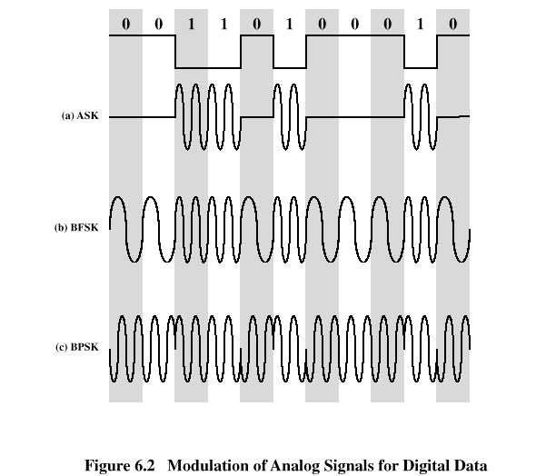

Slide 72
Amplitude-Shift Keying
One binary digit represented by presence of carrier, at constant amplitude
Other binary digit represented by absence of carrier
    where the carrier signal is Acos(2πf_{c}t)

Slide 73
Amplitude-Shift Keying
Susceptible to sudden gain changes
Inefficient modulation technique
On voice-grade lines, used up to 1200 bps
Used to transmit digital data over optical fiber

Slide 74
Binary Frequency-Shift Keying (BFSK)
Two binary digits represented by two different frequencies near the carrier frequency
    where f₁ and f₂ are offset from carrier frequency f_{c} by equal but opposite amounts

Slide 75
Binary Frequency-Shift Keying (BFSK)
Less susceptible to error than ASK
On voice-grade lines, used up to 1200bps
Used for high-frequency (3 to 30 MHz) radio transmission
Can be used at higher frequencies on LANs that use coaxial cable

Slide 76
Multiple Frequency-Shift Keying (MFSK)
More than two frequencies are used
More bandwidth efficient but more susceptible to error
    f _{i} = f _{c} + (2i – 1 – M)f _{d}
    f _{c} = the carrier frequency
    f _{d} = the difference frequency
    M = number of different signal elements = 2 ^{L}
    L = number of bits per signal element

Slide 77
Multiple Frequency-Shift Keying (MFSK)
To match data rate of input bit stream, each output signal element is held for:
  T_{s}=LT seconds
    where T is the bit period (data rate = 1/T)
So, one signal element encodes L bits

Slide 78
Multiple Frequency-Shift Keying (MFSK)
Total bandwidth required
  2Mf_{d}
Minimum frequency separation required 2f_{d}=1/T_{s}
Therefore, modulator requires a bandwidth of
  W_{d}=2^{L}/LT=M/T_{s}

Slide 79
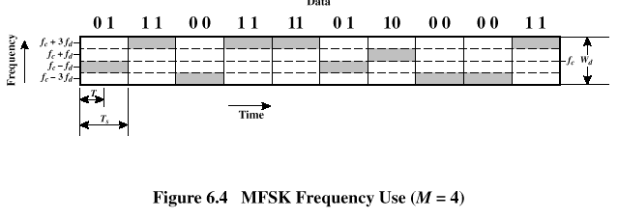
Multiple Frequency-Shift Keying (MFSK)

Slide 80
Phase-Shift Keying (PSK)
Two-level PSK (BPSK)
  Uses two phases to represent binary digits

Slide 81
Phase-Shift Keying (PSK)
Differential PSK (DPSK)
  Phase shift with reference to previous bit
    Binary 0 – signal burst of same phase as previous signal burst
    Binary 1 – signal burst of opposite phase to previous signal burst

Slide 82
Phase-Shift Keying (PSK)
Four-level PSK (QPSK)
  Each element represents more than one bit

Slide 83
Phase-Shift Keying (PSK)
Multilevel PSK
  Using multiple phase angles with each angle having more than one amplitude, multiple signals elements can be achieved
    D = modulation rate, baud
    R = data rate, bps
    M = number of different signal elements = 2^{L}
    L = number of bits per signal element

Slide 84
Performance
Bandwidth of modulated signal (B_{T})
  ASK, PSK B_{T}=(1+r)R
  FSK B_{T}=2DF+(1+r)R
    R = bit rate
    0 < r < 1; related to how signal is filtered
    DF = f₂-f_{c}=f_{c}-f₁

Slide 85
Performance
Bandwidth of modulated signal (B_{T})
  MPSK
  MFSK
    L = number of bits encoded per signal element
    M = number of different signal elements

Slide 86
Quadrature Amplitude Modulation
QAM is a combination of ASK and PSK
  Two different signals sent simultaneously on the same carrier frequency

Slide 87
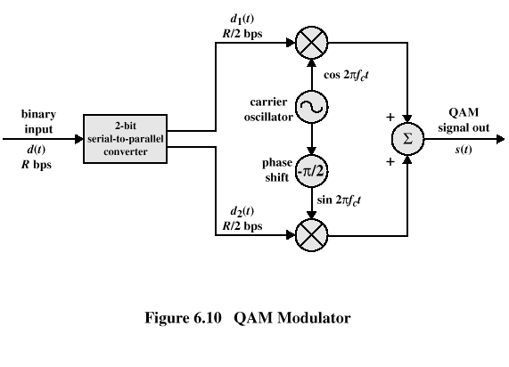
Quadrature Amplitude Modulation

Slide 88
Analog Data to Analog Signal
Modulation of digital signals
  When only analog transmission facilities are available, digital to analog conversion required
Modulation of analog signals
  A higher frequency may be needed for effective transmission
  Modulation permits frequency division multiplexing

Slide 89
Modulation Techniques
Amplitude modulation (AM)
Angle modulation
  Frequency modulation (FM)
  Phase modulation (PM)

Slide 90
Amplitude Modulation
Amplitude Modulation
    cos2πf_{c}t = carrier
    x(t) = input signal
    n_{a} = modulation index (< 1)
      Ratio of amplitude of input signal to carrier
  a.k.a double sideband transmitted carrier (DSBTC)

Slide 91
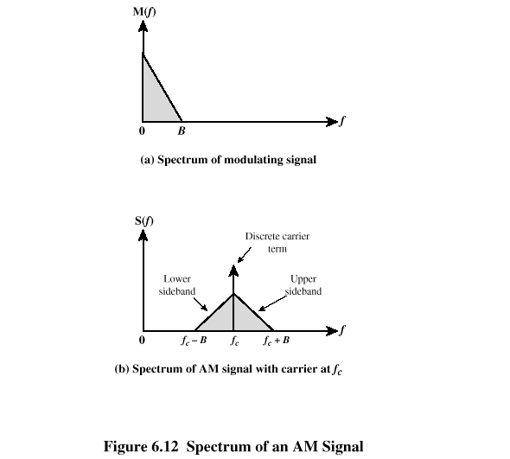

Slide 92
Amplitude Modulation
Transmitted power
    P_{t} = total transmitted power in s(t)
    P_{c} = transmitted power in carrier

Slide 93
Single Sideband (SSB)
Variant of AM is single sideband (SSB)
  Sends only one sideband
  Eliminates other sideband and carrier
Advantages
  Only half the bandwidth is required
  Less power is required
Disadvantages
  Suppressed carrier can’t be used for synchronization purposes

Slide 94
Angle Modulation
Angle modulation
Phase modulation
  Phase is proportional to modulating signal
    n_{p} = phase modulation index

Slide 95
Angle Modulation
Frequency modulation
  Derivative of the phase is proportional to modulating signal
    n_{f} = frequency modulation index

Slide 96
Angle Modulation
Compared to AM, FM and PM result in a signal whose bandwidth:
  is also centered at f_{c}
  but has a magnitude that is much different
Thus, FM and PM require greater bandwidth than AM

Slide 97
Angle Modulation
Carson’s rule
  where
The formula for FM becomes

Slide 98
Analog Data to Digital Signal
Digitization: Often analog data are converted to digital form
Once analog data have been converted to digital signals, the digital data:
  can be transmitted using NRZ-L
  can be encoded as a digital signal using a code other than NRZ-L
  can be converted to an analog signal, using previously discussed techniques

Slide 99
Analog data to digital signal
Pulse code modulation (PCM)
Delta modulation (DM)

Slide 100
Pulse Code Modulation
Based on the sampling theorem
Each analog sample is assigned a binary code
  Analog samples are referred to as pulse amplitude modulation (PAM) samples
The digital signal consists of block of n bits, where each n-bit number is the amplitude of a PCM pulse

Slide 101
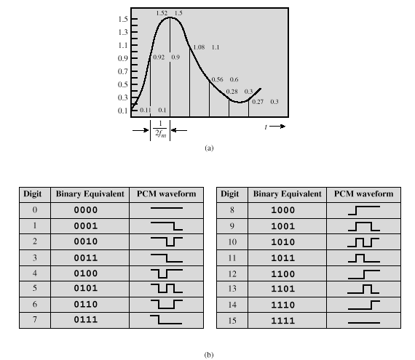

Slide 102
Pulse Code Modulation
By quantizing the PAM pulse, original signal is only approximated
Leads to quantizing noise
Signal-to-noise ratio for quantizing noise
Thus, each additional bit increases SNR by 6 dB, or a factor of 4

Slide 103
Delta Modulation
Analog input is approximated by staircase function
  Moves up or down by one quantization level (δ) at each sampling interval
The bit stream approximates derivative of analog signal (rather than amplitude)
  1 is generated if function goes up
  0 otherwise

Slide 104
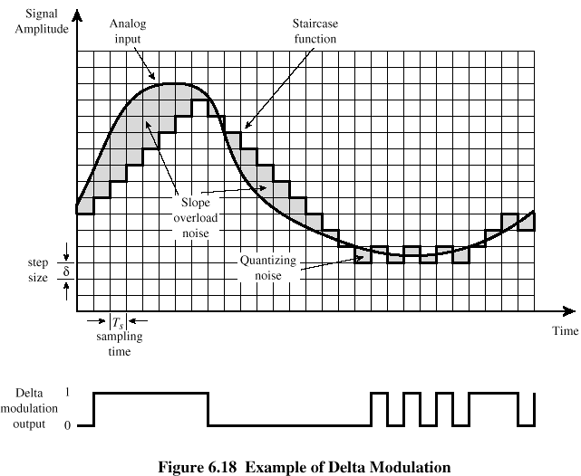
Delta Modulation

Slide 105
Delta Modulation
Two important parameters
  Size of step assigned to each binary digit (δ)
  Sampling rate
Accuracy improved by increasing sampling rate
  However, this increases the data rate
Advantage of DM over PCM is the simplicity of its implementation

