Slide 1
Chap 7 – IT Control
Dr. Ir. Yeffry Handoko Putra
MAGISTER SISTEM INFORMASI

Slide 2
What is IT Control
In a governance or risk management context, controls are any measures such as actions, policies, processes, procedures, practices, devices, or organizational structures—used to manage or mitigate risk.
Controls—especially internal controls—are the primary focus of many types of IT audits

Slide 3
What is IT Control
the controls applicable to an organization’s information technology not only technical controls, but also the administrative controls used by the processes that leverage or support IT and the physical controls associated with people, facilities, equipment, and infrastructure

Slide 4
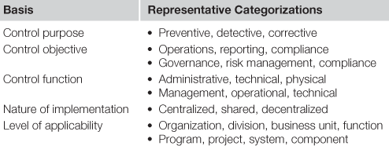
Control Category
Control categorization is primarily intended to introduce consistency in the way controls are referenced and applied in different contexts and for different purposes. There is no single accepted standard for categorizing controls

Slide 5
Example of IT Control
Information Security Management (ISO/IEC 27002) identify :
39 control objectives
100 controls grouped
12 security domains

Slide 6
Organizational controls
are selected and implemented once with applicability across the entire enterprise.
Entity-level controls are important as a focus area for internal and external audits because they provide the foundation for how organizations manage control-supported functions.

Slide 7
Entity-level controls subjected to audit
Entity-level controls include any policies, processes and procedures, standards, or measures specified for organization-wide use.

Slide 8
Entity-level controls subjected to audit
IT governance, policies and procedures, common controls, and personnel oversight—each reflect at least some functions or management activities that are likely to be performed similarly across different business units or operational areas

Slide 9
Entity-level controls subjected to audit
Greater variation may be expected for core IT processes and support functions in organizations with different data centers, facilities, service providers, or types of systems, or in organizations with decentralized management structures

Slide 10
Auditing different IT assets
IT audits require the examination of IT assets as a primary focus in IT-centric auditing or in the context of auditing management functions, business processes, and operational programs and projects supported by IT assets
The questions IT auditors seek to answer also vary so auditors must have applicable technical knowledge about the IT components and technical controls they audit

Slide 11
IT component decomposition
Organizations clearly identifying IT assets and technical controls to be addressed within each type of audit.
Decomposing IT audit subject areas into individual technologies
IT audit plans reflect the IT components it will examine, and the procedures, protocols, standards, or criteria auditors will use

Slide 12
There is no single standard or “best” method to evaluating systems or technical environments

Slide 13
System architecture standards or models as a guide for decomposing IT Component :
seven-layer Open Systems Interconnection model described in ISO/IEC 7498-1
the software architecture design specified in ISO/IEC 12207
software architecture description languages conforming to ISO/IEC/IEEE 42010
Open Distributed Processing ISO/IEC 19501:2005
OSI Layer
Software Life Cycle Process
UML

Slide 14
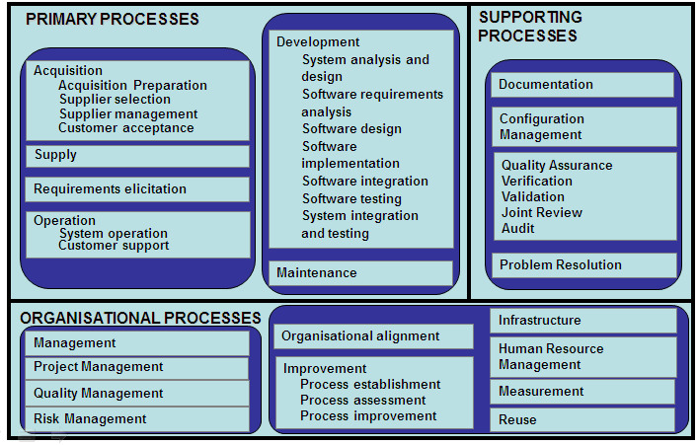
Software Life Cycle Process

Slide 16
To audit a typical n-tier architected system, for example, an auditor using such an approach might separately examine the web server, application server, database, middleware or other integration technology as well as the administrators, support personnel, and end users who access the system

Slide 17
Path Analysis (or critical path analysis, or transaction path analysis)
An alternative approach to auditing systems at the individual component level considers all components, points of integration, and data flows together as the basis for an end-to-end examination

Slide 18
Path Analysis (or critical path analysis, or transaction path analysis)
defines the system scope by tracing the flow of information from initiation by a user or other system through all points of interaction

Slide 20
Any question?

Slide 21
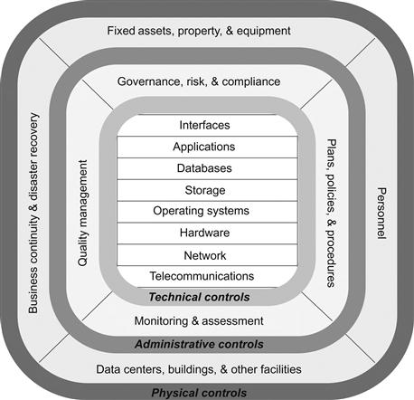
Eight IT Component

Slide 22
Eight IT Component
Systems and applications
The terms system and application are used interchangeably refer to the software and computing capabilities
The audit procedures depends on their architecture
Audit often focus on fully operational or other phases of the system development life cycle
focus on functional and nonfunctional capabilities and controls. Nonfunctional aspects include performance, usability, reliability, and security,

Slide 23
Eight IT Component
Databases
means any collection or repository of information also a specific type of technology that stores and provides access to data
Audit focus on The nature and sensitivity of the data, security or privacy controls, confidentiality, integrity, and availability
Interfaces
Audit focus on confirming that system interconnections are authorized, conform to technical specifications, and satisfy functional and technical requirements

Slide 24
Eight IT Component
Operating systems
Operating system audits confirm the use and appropriate configuration of operating systems on different computing platforms deployed within organizations.
Hardware
Audits focus on consistent and correct configuration and adherence to internal policies and standards
Compared to software, hardware audits also consider the vendors and internal processes used to acquire hardware.

Slide 25
Eight IT Component
Networks
Network audits examine the implementation and configuration of hardware devices, services and protocols running on the network, and security controls such as firewalls and network intrusion detection systems.
Also consider the nature of the communication within the network so that auditors can select appropriate audit procedures to address the use of wireless, satellite, cellular, frame relay, and other network technologies.

Slide 26
Eight IT Component
Storage
Audit procedures storage depend both on the specific types of storage technology and the nature and sensitivity of the data housed in storage environments
may be audited in isolation or in a broader operational context
May include alternate data storage locations or third-party providers of off-site data backup services

Slide 27
Eight IT Component
Virtualized environments
provides an alternative technical approach to delivering infrastructure, platforms and operating systems, servers, software, and systems and applications
employ high-performing hardware and specialized software that enables a single physical server to function as multiple concurrently running instances e.g. Cloud Computing
cloud service Distinctions include on-demand service provisioning, ubiquitous network access, resource pooling, elastic capabilities and services, and metered usage and associated billing and payment models
Available frameworks developed by Cloud Security Alliance and the Federal Risk and Authorization Management Program (FedRAMP)

Slide 28
Auditing procedural controls or processes
auditors may examine process-based or procedural controls in conjunction with the IT assets and components
Influenced by IT framework
COBIT for IT Governance
ITIL or CMMI for IT Service Management
Can be found from IT operation

Slide 29
Relevant Process in IT Audit

Slide 30
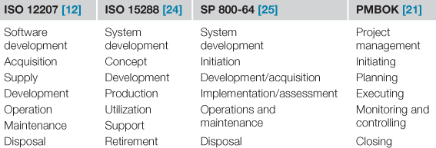
Program and project management

