Slide 1
CHAP 8. DECISION SUPPORT SYSTEM
Dr. Ir. Yeffry Handoko Putra, M.T
E-mail: yeffryhp@unikom.ac.id
Magister of Information System
Universitas Komputer Indonesia

Slide 2
CHAP 8. DECISION SUPPORT SYSTEM
Dr. Ir. Yeffry Handoko Putra, M.T
E-mail: yeffryhp@unikom.ac.id
Magister of Information System
Universitas Komputer Indonesia

Slide 3
Better Decision Making
Management Information Systems (MIS)
Decision-support SYSTEMS(DSS)
Group Decision-support Systems (GDSS)
Executive Support Systems (ESS).

Slide 4
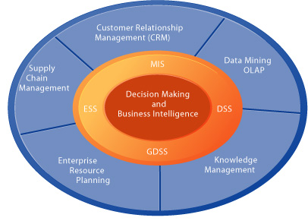
System and Technologies for Business Intelligent
Notes:
Figure 13-1 illustrates the major applications and technologies used for business
intelligence. They include the supply chain management, customer relationship
management, and enterprise systems; systems for knowledge management; and
technologies such as data mining and online analytical processing (OLAP) for obtaining
knowledge and insight from analyzing large quantities of data. These systems work with
specialized systems for management decision making (MIS, DSS, ESS) that focus on the
specific decision needs of managers and employees.

Slide 5
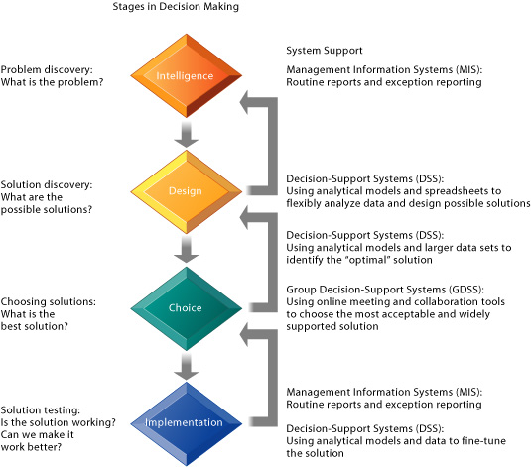

Slide 6
Decision Making in Real World
Information Quality
Accuracy: Do the data represent reality?
Integrity: Are the structure of data and relationships among the entities and attributes
consistent?
Consistency: Are data elements consistently defined?
Completeness: Are all the necessary data present?
Validity: Do data values fall within defined ranges?
Timeliness: Are data available when needed?
Accessibility: Are the data accessible, comprehensible, and usable?

Slide 7
Decision Making in Real World (2)
Management Filter
E.g. Cisco Systems Corporation, was forced to write off as a loss $3.4 billion in excess inventory in 2001
Organizational Inertia
When environments change and businesses need to adopt new business models to survive, strong forces within organizations resist making decisions calling for major change.
Decisions taken by a firm often represent a balancing of the firm’s various interest groups rather than the best solution to the problem.
Notes:
Management Filter
Even with timely, accurate information, some managers make bad
decisions. Managers (like all human beings) absorb information through a series of filters
to make sense of the world around them. Managers have selective attention, focus on
certain kinds of problems and solutions, and have a variety of biases that isolate them
from reality. They filter by turning off information they do not want to hear because it does
not conform to their prior conceptions.
For instance, Cisco Systems Corporation, one of the most advanced users of online
decision-support systems, nevertheless was forced to write off as a loss $3.4 billion in
excess inventory in 2001. Cisco’s managers built inventory in response to the output from
the company’s online sales order entry system, which throughout 1999 and 2000 showed
exceptionally strong orders. Unfortunately, Cisco managers did not pay attention to the
quality of those orders. Customers, perceiving a shortage of routers and other networking
equipment, were placing orders with multiple manufacturers, awarding the business to the
first one who could deliver, and canceling other orders. Cisco’s systems were recording
high levels of order cancellation, but management ignored this “bad news” and
emphasized the “good news”: new orders were piling up (Laudon and Laudon, 2003).
Organizational Inertia Chapter 3 shows that organizations are bureaucracies with
limited capabilities and competencies for acting decisively. When environments change and
businesses need to adopt new business models to survive, strong forces within
organizations resist making decisions calling for major change. Decisions taken by a firm
often represent a balancing of the firm’s various interest groups rather than the best
solution to the problem.
Consider the record label industry. Despite declining sales since 2000 and the
explosion of songs downloaded for free over the Internet, major recording companies did
not move quickly into online music retailing. This required a much leaner business model.
The recording companies resisted selling music over the Internet for years. Until very
recently, nearly all executives and most employees at record label companies continued to
believe that music should be distributed on physical devices (records, tapes, or CDs) and
sold through retail record stores.
Studies of business restructuring find that firms tend to ignore poor performance
until threatened by outside takeovers, and they systematically blame poor performance on
external forces beyond their control such as economic conditions (the economy), foreign
competition, and rising prices, rather than blaming senior or middle management for poor
business judgment (John, Lang, Netter, et. al., 1992).

Slide 8
Trends in Decision Support and Business Intelligence
Detailed enterprise-wide data
Enterprise systems create an explosion in firmwide, current, and relatively accurate information, supplying end users at their desktops with powerful analytic tools for analyzing and visualizing data.
Broadening decision rights and responsibilities
As information becomes more widespread throughout the corporation, it is possible to reduce levels of hierarchy and grant more decision-making authority to lower-level employees.
Intranets and portals
Intranet technologies create global, company-wide networks that ease the flow of information across divisions and regions and delivery of near real-time data to management and employee desktops
Notes:
The rise of client/server computing, the Internet, and Web technologies has made
a major impact on systems that support decision making. Many decision-support
applications are now delivered over corporate intranets. We see six major trends:
l Detailed enterprise-wide data. Enterprise systems create an explosion in
firmwide, current, and relatively accurate information, supplying end users at
their desktops with powerful analytic tools for analyzing and visualizing data.
l Broadening decision rights and responsibilities. As information becomes
more widespread throughout the corporation, it is possible to reduce levels of
hierarchy and grant more decision-making authority to lower-level employees.
l Intranets and portals. Intranet technologies create global, company-wide
networks that ease the flow of information across divisions and regions and
delivery of near real-time data to management and employee desktops.
l Personalization and customization of information. Web portal technologies
provide great flexibility in determining what data each employee and manager
sees on his or her desktop. Personalization of decision information can speed up
decision making by enabling users to filter out irrelevant information.
l Extranets and collaborative commerce. Internet and Web technologies
permit suppliers and logistics partners to access firm enterprise data and
decision-support tools and work collaboratively with the firm.
l Team support tools. Web-based collaboration and meeting tools enable
project teams, task forces, and small groups to meet online using corporate
intranets or extranets. These new collaboration tools borrow from earlier GDSS
and are used for both brainstorming and decision sessions.

Slide 9
Trends in Decision Support and Business Intelligence
Personalization and customization of information
Web portal technologies provide great flexibility in determining what data each employee and manager sees on his or her desktop. Personalization of decision information can speed up decision making by enabling users to filter out irrelevant information.
Extranets and collaborative commerce.
Team support tools.
Notes:
The rise of client/server computing, the Internet, and Web technologies has made
a major impact on systems that support decision making. Many decision-support
applications are now delivered over corporate intranets. We see six major trends:
l Detailed enterprise-wide data. Enterprise systems create an explosion in
firmwide, current, and relatively accurate information, supplying end users at
their desktops with powerful analytic tools for analyzing and visualizing data.
l Broadening decision rights and responsibilities. As information becomes
more widespread throughout the corporation, it is possible to reduce levels of
hierarchy and grant more decision-making authority to lower-level employees.
l Intranets and portals. Intranet technologies create global, company-wide
networks that ease the flow of information across divisions and regions and
delivery of near real-time data to management and employee desktops.
l Personalization and customization of information. Web portal technologies
provide great flexibility in determining what data each employee and manager
sees on his or her desktop. Personalization of decision information can speed up
decision making by enabling users to filter out irrelevant information.
l Extranets and collaborative commerce. Internet and Web technologies
permit suppliers and logistics partners to access firm enterprise data and
decision-support tools and work collaboratively with the firm.
l Team support tools. Web-based collaboration and meeting tools enable
project teams, task forces, and small groups to meet online using corporate
intranets or extranets. These new collaboration tools borrow from earlier GDSS
and are used for both brainstorming and decision sessions.

Slide 10
Jenis DSS (Dhar and Stein, 1997).
Model-driven DSS
primarily standalone systems isolated from major corporate information systems that used some type of model to perform “what-if ” and other kinds of analyses.
Data driven DSS
These systems analyze large pools of data found in major corporate systems. They support decision making by enabling users to extract useful information that was previously buried in large quantities of data. Often data from transaction processing systems are collected in data warehouses for this purpose. Online analytical processing (OLAP) and data mining can then be used to analyze the data.
Notes:
Today, there are two basic types of decision-support systems, model driven and
data driven (Dhar and Stein, 1997). Model-driven DSS were primarily standalone systems
isolated from major corporate information systems that used some type of model to
perform “what-if ” and other kinds of analyses. Their analysis capabilities were based on a
strong theory or model combined with a good user interface that made the model easy to
use. The voyage-estimating DSS described in Chapter 2 and DaimlerChrysler’s
Transportation Efficiency Support System described in the chapter-opening case are
examples of model-driven DSS.
The second type of DSS is a data-driven DSS. These systems analyze large pools of
file:///H|/ch13/chpt13-2fulltext.htm (2 of 18)09/02/2006 8:45:28 PM
Chapter 13
data found in major corporate systems. They support decision making by enabling users to
extract useful information that was previously buried in large quantities of data. Often data
from transaction processing systems are collected in data warehouses for this purpose.
Online analytical processing (OLAP) and data mining can then be used to analyze the data.
Companies are starting to build data-driven DSS to mine customer data gathered from
their Web sites as well as data from enterprise systems.
Traditional database queries answer such questions as, “How many units of product
number 403 were shipped in November 2004?” OLAP, or multidimensional analysis,
supports much more complex requests for information, such as, “Compare sales of product
403 relative to plan by quarter and sales region for the past two years.” We describe OLAP
and multidimensional data analysis in Chapter 7. With OLAP and query-oriented data
analysis, users need to have a good idea about the information for which they are looking.

Slide 11
Data Mining
Providing insights into corporate data that cannot be obtained with OLAP by finding hidden patterns and relationships in large databases and inferring rules from them to predict future behavior. The patterns and rules then can be used to guide decision making and forecast the effect of those decisions. The types of information that can be obtained from data mining include :
Associations
In sequences,
Classification
Clustering
forecasting
Notes:
Data
mining provides insights into corporate data that cannot be obtained with OLAP by finding
hidden patterns and relationships in large databases and inferring rules from them to
predict future behavior. The patterns and rules then can be used to guide decision making
and forecast the effect of those decisions. The types of information that can be obtained
from data mining include associations, sequences, classifications, clusters, and forecasts: Associations are occurrences linked to a single event. For instance, a study of
supermarket purchasing patterns might reveal that when corn chips are
purchased, a cola drink is purchased 65 percent of the time, but when there is a
promotion, cola is purchased 85 percent of the time. With this information,
managers can make better decisions because they have learned the profitability
of a promotion.
l In sequences, events are linked over time.We might find, for example, that if a
house is purchased, a new refrigerator will be purchased within two weeks 65
percent of the time, and an oven will be bought within one month of the home
purchase 45 percent of the time.
l Classification recognizes patterns that describe the group to which an item
belongs by examining existing items that have been classified and by inferring a
set of rules. For example, businesses such as credit card or telephone
companies worry about the loss of steady customers. Classification can help
discover the characteristics of customers who are likely to leave and can provide
a model to help managers predict who they are so that they can devise special
campaigns to retain such customers.
l Clustering works in a manner similar to classification when no groups have yet
been defined. A data-mining tool can discover different groupings within data,
such as finding affinity groups for bank cards or partitioning a database into
groups of customers based on demographics and types of personal investments.
l Although these applications involve predictions, forecasting uses predictions in a
different way. It uses a series of existing values to forecast what other values
will be. For example, forecasting might find patterns in data to help managers

Slide 12
Data Mining
Associations
occurrences linked to a single event. For instance, a study of supermarket purchasing patterns might reveal that when corn chips are purchased, a cola drink is purchased 65 percent of the time, but when there is a promotion, cola is purchased 85 percent of the time. With this information, managers can make better decisions because they have learned the profitability of a promotion.
In sequences
events are linked over time.We might find, for example, that if a house is purchased, a new refrigerator will be purchased within two weeks 65 percent of the time, and an oven will be bought within one month of the home purchase 45 percent of the time.
Classification
recognizes patterns that describe the group to which an item belongs by examining existing items that have been classified and by inferring a set of rules. For example, businesses such as credit card or telephone companies worry about the loss of steady customers. can devise special campaigns to retain Classification can help discover the characteristics of customers who are likely to leave and can provide a model to help managers predict who they are so that they such customers.
Notes:
Data
mining provides insights into corporate data that cannot be obtained with OLAP by finding
hidden patterns and relationships in large databases and inferring rules from them to
predict future behavior. The patterns and rules then can be used to guide decision making
and forecast the effect of those decisions. The types of information that can be obtained
from data mining include associations, sequences, classifications, clusters, and forecasts: Associations are occurrences linked to a single event. For instance, a study of
supermarket purchasing patterns might reveal that when corn chips are
purchased, a cola drink is purchased 65 percent of the time, but when there is a
promotion, cola is purchased 85 percent of the time. With this information,
managers can make better decisions because they have learned the profitability
of a promotion.
l In sequences, events are linked over time.We might find, for example, that if a
house is purchased, a new refrigerator will be purchased within two weeks 65
percent of the time, and an oven will be bought within one month of the home
purchase 45 percent of the time.
l Classification recognizes patterns that describe the group to which an item
belongs by examining existing items that have been classified and by inferring a
set of rules. For example, businesses such as credit card or telephone
companies worry about the loss of steady customers. Classification can help
discover the characteristics of customers who are likely to leave and can provide
a model to help managers predict who they are so that they can devise special
campaigns to retain such customers.
l Clustering works in a manner similar to classification when no groups have yet
been defined. A data-mining tool can discover different groupings within data,
such as finding affinity groups for bank cards or partitioning a database into
groups of customers based on demographics and types of personal investments.
l Although these applications involve predictions, forecasting uses predictions in a
different way. It uses a series of existing values to forecast what other values
will be. For example, forecasting might find patterns in data to help managers

Slide 13
Data Mining
Clustering
works in a manner similar to classification when no groups have yet been defined. A data-mining tool can discover different groupings within data, such as finding affinity groups for bank cards or partitioning a database into groups of customers based on demographics and types of personal investments.
forecasting
uses predictions in a different way. It uses a series of existing values to forecast what other values will be. For example, forecasting might find patterns in data to help managers
Notes:
Data
mining provides insights into corporate data that cannot be obtained with OLAP by finding
hidden patterns and relationships in large databases and inferring rules from them to
predict future behavior. The patterns and rules then can be used to guide decision making
and forecast the effect of those decisions. The types of information that can be obtained
from data mining include associations, sequences, classifications, clusters, and forecasts: Associations are occurrences linked to a single event. For instance, a study of
supermarket purchasing patterns might reveal that when corn chips are
purchased, a cola drink is purchased 65 percent of the time, but when there is a
promotion, cola is purchased 85 percent of the time. With this information,
managers can make better decisions because they have learned the profitability
of a promotion.
l In sequences, events are linked over time.We might find, for example, that if a
house is purchased, a new refrigerator will be purchased within two weeks 65
percent of the time, and an oven will be bought within one month of the home
purchase 45 percent of the time.
l Classification recognizes patterns that describe the group to which an item
belongs by examining existing items that have been classified and by inferring a
set of rules. For example, businesses such as credit card or telephone
companies worry about the loss of steady customers. Classification can help
discover the characteristics of customers who are likely to leave and can provide
a model to help managers predict who they are so that they can devise special
campaigns to retain such customers.
l Clustering works in a manner similar to classification when no groups have yet
been defined. A data-mining tool can discover different groupings within data,
such as finding affinity groups for bank cards or partitioning a database into
groups of customers based on demographics and types of personal investments.
l Although these applications involve predictions, forecasting uses predictions in a
different way. It uses a series of existing values to forecast what other values
will be. For example, forecasting might find patterns in data to help managers

Slide 14
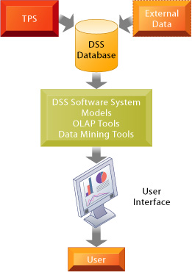
Komponen DSS
Notes:
They include a database of data used for
query and analysis; a software system with models, data mining, and other analytical
tools; and a user interface. FIGURE 13-4 Overview of a decision-support system
The main components of the DSS are the DSS database, the DSS software system, and the user interface.
The DSS database may be a small database residing on a PC or a massive data warehouse. and milk.
The DSS database is a collection of current or historical data from a number of
applications or groups. It may be a small database residing on a PC that contains a subset
of corporate data that has been downloaded and possibly combined with external data.
Alternatively, the DSS database may be a massive data warehouse that is continuously
updated by major corporate TPS (including enterprise systems and data generated byWeb
site transactions). The data in DSS databases are generally extracts or copies of
production databases so that using the DSS does not interfere with critical operational
systems.
The DSS software system contains the software tools that are used for data
analysis. It may contain various OLAP tools, data-mining tools, or a collection of
mathematical and analytical models that easily can be made accessible to the DSS user. A
model is an abstract representation that illustrates the components or relationships of a
phenomenon. A model can be a physical model (such as a model airplane), a mathematical
model (such as an equation), or a verbal model (such as a description of a procedure for
writing an order). Each decision-support system is built for a specific set of purposes and Perhaps the most common models are libraries of statistical models. Such libraries
usually contain the full range of expected statistical functions, including means, medians,
deviations, and scatter plots. The software has the ability to project future outcomes by
analyzing a series of data. Statistical modeling software can be used to help establish
relationships, such as relating product sales to differences in age, income, or other factors
between communities. Optimization models, often using linear programming, determine
optimal resource allocation to maximize or minimize specified variables, such as cost or
time. A classic use of optimization models is to determine the proper mix of products
within a given market to maximize profits.
Forecasting models often are used to forecast sales. The user of this type of model
might supply a range of historical data to project future conditions and the sales that might
result from those conditions. The decision maker could vary those future conditions
(entering, for example, a rise in raw materials costs or the entry of a new, low-priced
competitor in the market) to determine how new conditions might affect sales. Companies
often use this software to predict the actions of competitors. Model libraries exist for
specific functions, such as financial and risk analysis models.
Among the most widely used models are sensitivity analysis models that ask “whatif
” questions repeatedly to determine the impact on outcomes of changes in one or more
factors. “What-if” analysis—working forward from known or assumed conditions—allows
the user to vary certain values to test results to better predict outcomes if changes occur
in those values. What happens if we raise the price by 5 percent or increase the
advertising budget by $100,000? What happens if we keep the price and advertising
budget the same? Desktop spreadsheet software, such as Microsoft Excel or Lotus 1-2-3, is
often used for this purpose (see Figure 13-5). Backward sensitivity analysis software is
used for goal seeking: If I want to sell 1 million product units next year, how much must I
reduce the price of the product?

Slide 15
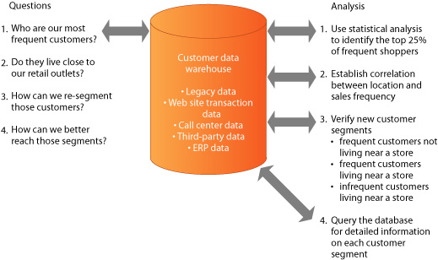
A DSS for customer analysis and segmentation
Notes:
FIGURE 13-6 A DSS for customer analysis and segmentation
This DSS enables companies to segment their customer database with a high level of precision where it can
be used to drive a marketing campaign. Based on the results of data mining, a firm can develop specific
marketing campaigns for each customer segment. For example, it could target frequent customers living
near a store with coupons for products of interest and with rewards for frequent shoppers

Slide 16
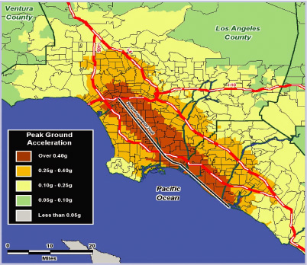
DATA VISUALIZATION AND GEOGRAPHIC INFORMATION SYSTEMS
Notes:
DATA VISUALIZATION AND GEOGRAPHIC INFORMATION SYSTEMS
Data from information systems can be made easier for users to digest and act on by using
graphics, charts, tables, maps, digital images, three-dimensional presentations,
animations, and other data visualization technologies. By presenting data in graphical
form, data visualization tools help users see patterns and relationships in large amounts of
data that would be difficult to discern if the data were presented as traditional lists of text.
Some data visualization tools are interactive, enabling users to manipulate data and see
the graphical displays change in response to the changes they make.
Geographic information systems (GIS) are a special category of DSS that use data
visualization technology to analyze and display data for planning and decision making in
the form of digitized maps. The software can assemble, store, manipulate, and display
geographically referenced information, tying data to points, lines, and areas on a map. GIS
have modeling capabilities, enabling managers to change data and automatically revise
business scenarios to find better solutions.
GIS can thus be used to support decisions that require knowledge about the
geographic distribution of people or other resources in scientific research, resource
management, and development planning. For example, GIS might be used to help state
and local governments calculate emergency response times to natural disasters, retail
chains identify profitable new store locations, or banks identify the best locations for
installing new branches or automatic teller machine (ATM) terminals. GIS tools have
become affordable even for small businesses, and some can be used on the Web. HAZUS-MH Multi-Hazard risk assessment and loss estimation software for the Federal Emergency
Management Agency (FEMA) maps and displays hazard data so that governments at all levels can plan for
natural disaster response and recovery. Illustrated here is a map for earthquake planning displaying ground
acceleration relative to the Newport-Inglewood fault in southern California. The GIS environment allows
users to create geographic presentations, helping companies visualize and understand their hazard risks
and solutions.
The Window on Management shows how GIS are being used in Sweden to help
plan the assignment of home health aides that assist elderly people. Planners of elderly
home care must deal with a complex set of variables that include multiple tasks, many
different caregivers and clients, and limited time frames for both care giving and travel.
This particular problem lends itself to geographic information system software because the
locations of both elderly clients and home caregivers must be considered when planning
daily schedules.

Slide 17
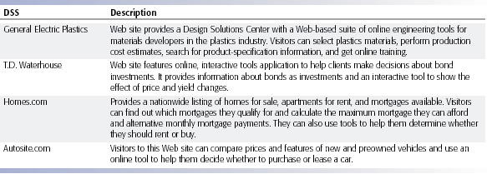
Web-Based Customer Decision-Support Systems

Slide 18
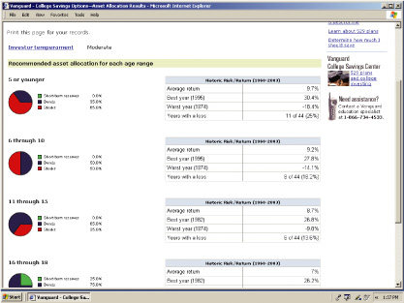
Web-Based Customer Decision-Support Systems

Slide 19
GROUP DECISION-SUPPORT SYSTEMS
Notes:
What Is a GDSS?
A group decision-support system (GDSS) is an interactive computer-based
system used to facilitate the solution of unstructured problems by a set of
decision makers working together as a group (DeSanctis and Gallupe, 1987).
Groupware and Web-based tools for videoconferencing and electronic meetings
described earlier in this text can support some group decision processes, but
their focus is primarily on communication. GDSS, however, provide tools and
technologies geared explicitly toward group decision making and were
developed in response to a growing concern over the quality and effectiveness
of meetings. The underlying problems in group decision making have been the
explosion of decision-maker meetings, the growing length of those meetings,
and the increased number of attendees. Estimates on the amount of a
manager’s time spent in meetings range from 35 to 70 percent.

Slide 20
GROUP DECISION-SUPPORT SYSTEMS
What Is a GDSS?
interactive computer-based system used to facilitate the solution of unstructured problems by a set of decision makers working together as a group (DeSanctis and Gallupe, 1987).
Groupware and Web-based tools for videoconferencing and electronic meetings described earlier in this text can support some group decision processes, but their focus is primarily on communication.
provide tools and technologies geared explicitly toward group decision making and were developed in response to a growing concern over the quality and effectiveness of meetings.
The underlying problems in group decision making have been the explosion of decision-maker meetings, the growing length of those meetings, and the increased number of attendees. Estimates on the amount of a manager’s time spent in meetings range from 35 to 70 percent.
Notes:
What Is a GDSS?
A group decision-support system (GDSS) is an interactive computer-based
system used to facilitate the solution of unstructured problems by a set of
decision makers working together as a group (DeSanctis and Gallupe, 1987).
Groupware and Web-based tools for videoconferencing and electronic meetings
described earlier in this text can support some group decision processes, but
their focus is primarily on communication. GDSS, however, provide tools and
technologies geared explicitly toward group decision making and were
developed in response to a growing concern over the quality and effectiveness
of meetings. The underlying problems in group decision making have been the
explosion of decision-maker meetings, the growing length of those meetings,
and the increased number of attendees. Estimates on the amount of a
manager’s time spent in meetings range from 35 to 70 percent.

Slide 21
`

Slide 22
COMPONENTS OF GDSS
Electronic questionnaires
Electronic brainstorming tools
Idea organizers
Questionnaire tools
Tools for voting or setting priorities
Stakeholder identification and analysis tools
Policy formation tools
Group dictionaries
Notes:
Electronic brainstorming tools enable individuals, simultaneously and
anonymously, to contribute ideas on the topics of the meeting.
l Idea organizers facilitate the organized integration and synthesis of
ideas generated during brainstorming.
l Questionnaire tools support the facilitators and group leaders as they
gather information before and during the process of setting priorities.
l Tools for voting or setting priorities make available a range of
methods from simple voting, to ranking in order, to a range of
weighted techniques for setting priorities or voting.
l Stakeholder identification and analysis tools use structured
approaches to evaluate the impact of an emerging proposal on the
organization and to identify stakeholders and evaluate the potential
impact of those stakeholders on the proposed project.
l Policy formation tools provide structured support for developing
agreement on the wording of policy statements.
l Group dictionaries document group agreement on definitions of
words and terms central to the project.

Slide 23
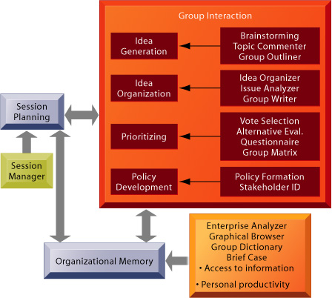
Group system tools
Notes:
FIGURE 13-7 Group system tools
The sequence of activities and collaborative support tools used in an electronic meeting system
facilitate communication among attendees and generate a full record of the meeting.
Sources: From Nunamaker et al., “Electronic Meeting Systems to Support Group Work,”
Communications of the ACM, July 1991. Reprinted by permission.

