Slide 1

SUPPLY CHAIN MANAGEMENT
Pertemuan ke-6
SISTEM INFORMASI ENTERPRISE
Program Studi Teknik Informatika
Universitas Komputer Indonesia

Slide 2

What is a Supply Chain?
The network of external suppliers, internal processes, and external distributors, and the links connecting them, that deliver a finished product or service to the customer.
The system of suppliers, manufacturers, transportation, distributors, and vendors that exists to transform raw materials to final products and supply those products to customers.
RNL - 2014

Slide 3
Defining SCM
SCM is :
The process of effectively managing the components of an extended value chain--from suppliers, through manufacturing and distribution chain, and to the consumers.
The coordination of all supply activities of an organization from its suppliers and partners to its customers.
The integration of the activities that procure materials and services, transform them into intermediate goods and the final product, and deliver them to customers.
The integration of business processes from end user through original suppliers, that provide products, services, and information that add value for customers.
RNL - 2014

Slide 4
SCM
The management of all activities and processes related to both upstream vendors and downstream customers in the value chain
Tracking and managing demand, inventory, and delivery
Procurement and vendor relationship management
Technology enabled
Upstream supply chain ; Transactions between an organization and its suppliers and intermediaries, equivalent to buy-side e-commerce.
Downstream supply chain ; Transactions between an organization and its customers and intermediaries, equivalent to sell-side e-commerce.
RNL - 2014

Slide 5
The Goal of SCM
Supply chain management is concerned with the efficient integration of suppliers, factories, warehouses and stores so that merchandise is produced and distributed:
  In the right quantities
  To the right locations
  At the right time
In order to
  Minimize total system cost
  Satisfy customer service requirements
RNL - 2014

Slide 6
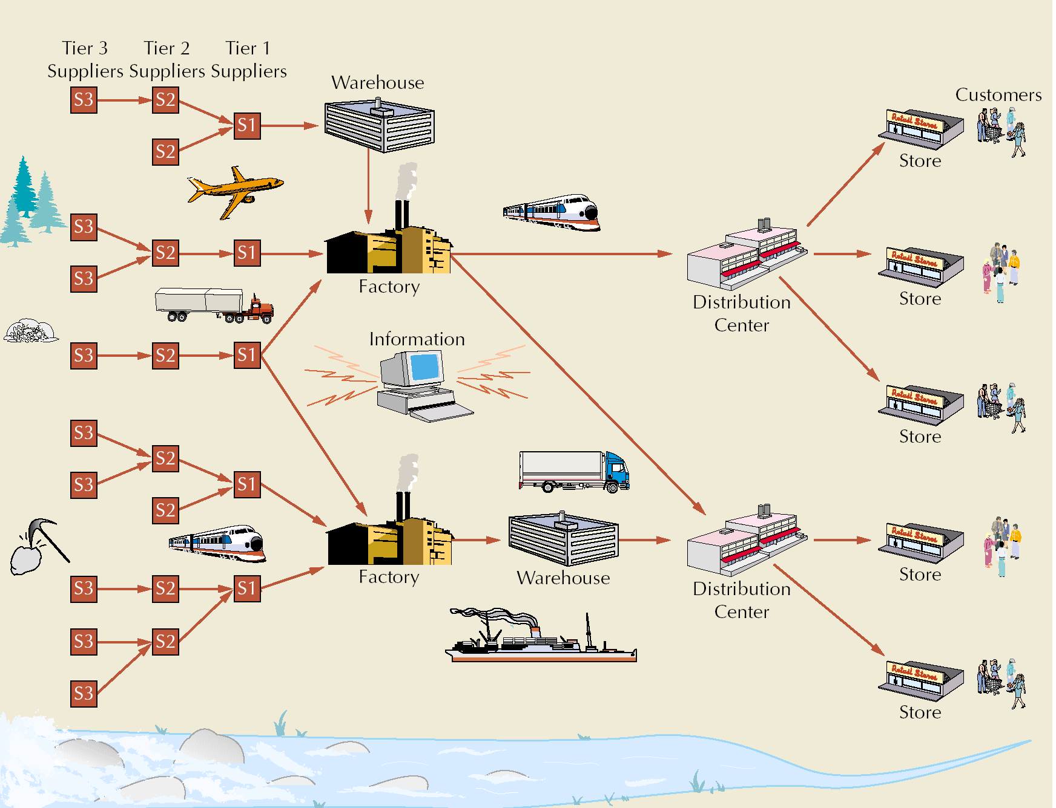
Supply Chain
Supplier
Manufacturer
Distributor
Retailer
Customers

Slide 7
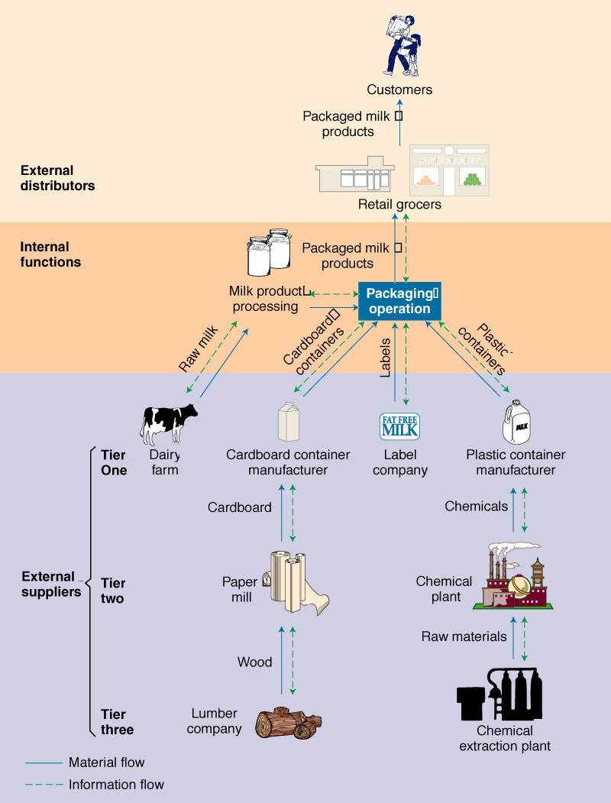
Ex : Dairy Products Supply Chain
RNL - 2014

Slide 8
Flows in a Supply Chain
Cash
Products and Services
Information
N-Tier Suppliers Suppliers Manufacturers Distributors Retailers
Supply Side Internal Demand Side
Demand
Supply
RNL - 2014

Slide 9
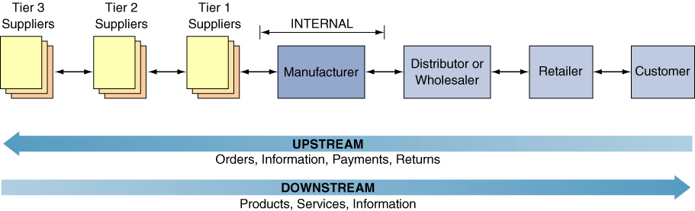
Approaches to SCM
In Push systems, work release is based on downstream demand forecasts
  Keeps inventory to meet actual demand
  Acts proactively
In Pull systems, work release is based on actual demand or the actual status of the downstream customers
  May cause long delivery lead times
  Acts reactively
RNL - 2014

Slide 10
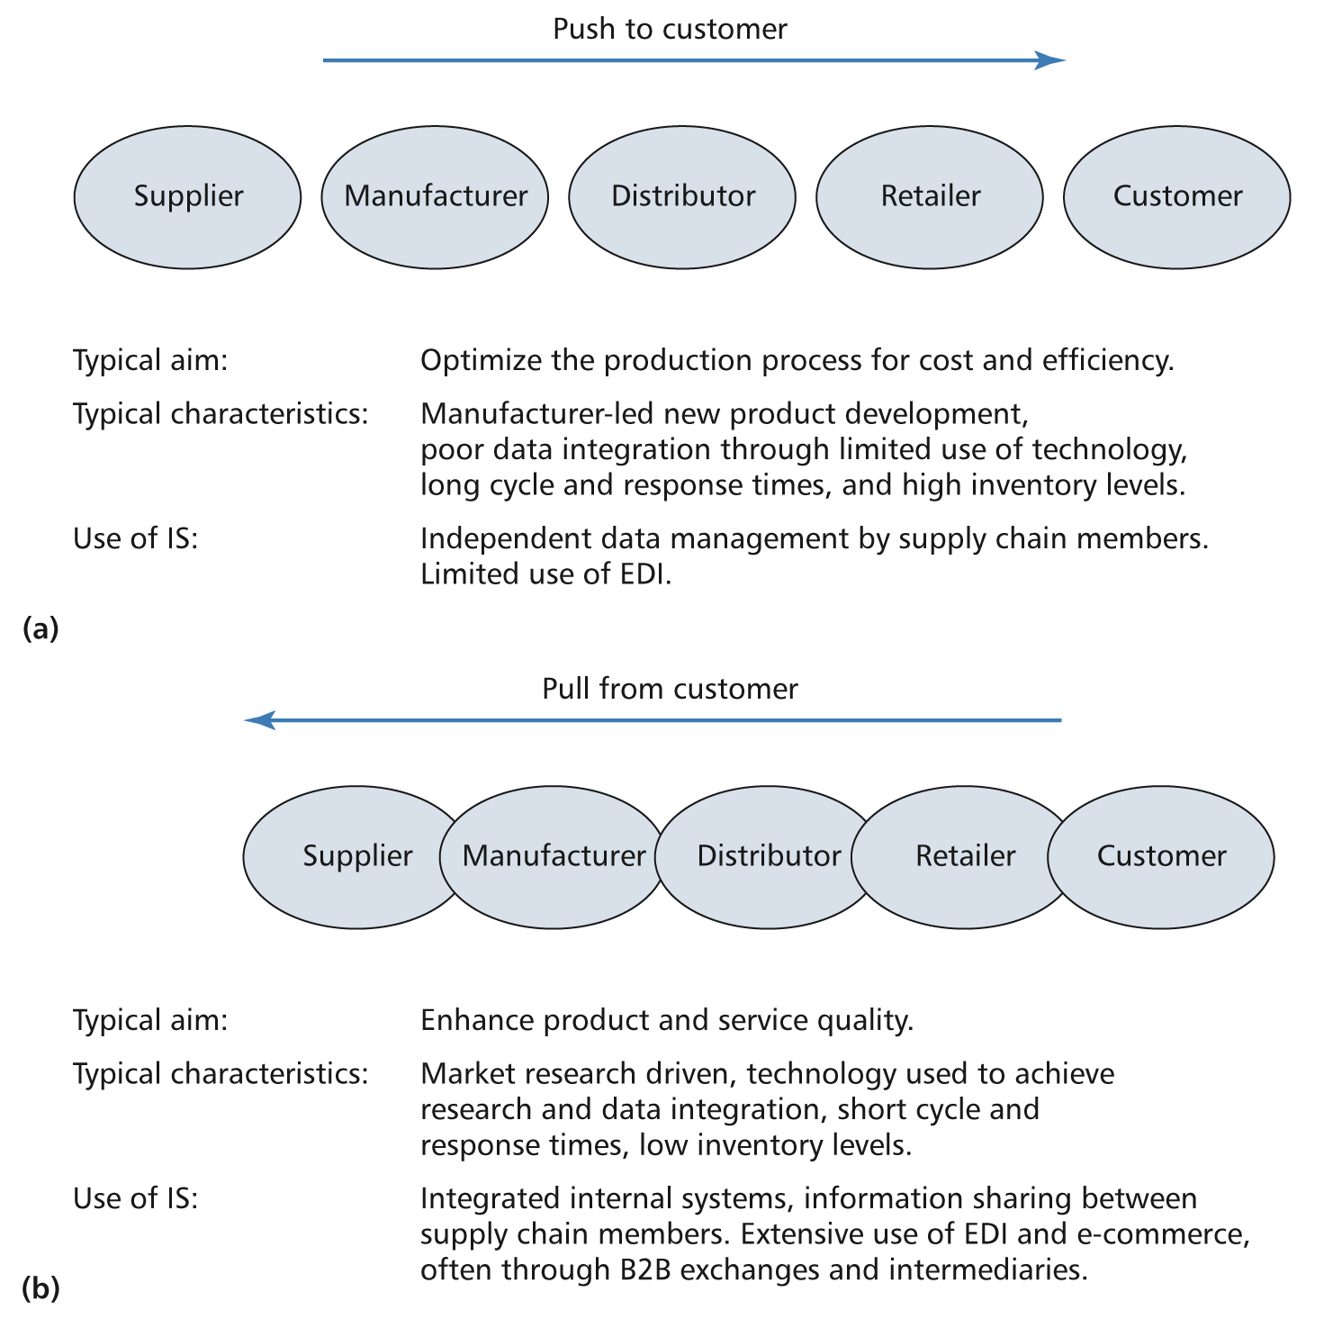
Push Approach to SCM
RNL - 2014

Slide 11
Pull Approach to SCM
RNL - 2014

Slide 12
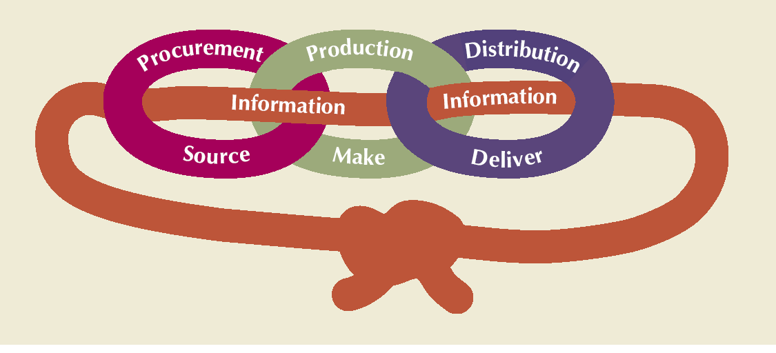
Supply Chain Processes
RNL - 2014

