Slide 1

ENTERPRISE RESOURCE PLANNING
Pertemuan ke-9
SISTEM INFORMASI ENTERPRISE
Program Studi Teknik Informatika
Universitas Komputer Indonesia

Slide 2

Introduction
ERP – integrates all departments and functions throughout an organization into a single IT system so that employees can make enterprisewide decisions by viewing enterprisewide information on all business operations.
ERP – Integration of financial, manufacturing and human resources on a single computer system.
Enterprise resource planning (ERP) is a term used to refer to a system that links individual applications (for example, accounting and manufacturing applications) into a single application that integrates the data and business processes of the entire business.
RNL - 2014

Slide 3
Traditional Information System with Closed Database Architecture
Business Enterprise
Products
Materials
Order Entry
System
Manufacturing
and
Distribution
System
Procurement
System
Customer
Supplier
Orders
Purchases
Customer
Sales
Account Rec
Production
Scheduling
Shipping
Vendor
Accts Pay
Inventory
Customer Database
Manufacturing Database
Procurement Database

Slide 4
ERP System
Business Enterprise
Data Warehouse
Legacy
Systems
ERP System
On-Line Analytical Processing
(OLAP)
Bolt-On Applications
(Industry Specific Functions)
Customers
Suppliers
Core Functions [On-Line Transaction Processing (OLTP)]
Sales
&
Distribution
Business
Planning
Shop Floor
Control
Logistics
Operational Database
Customers, Production,
Vendor, Inventory, etc.

Slide 5
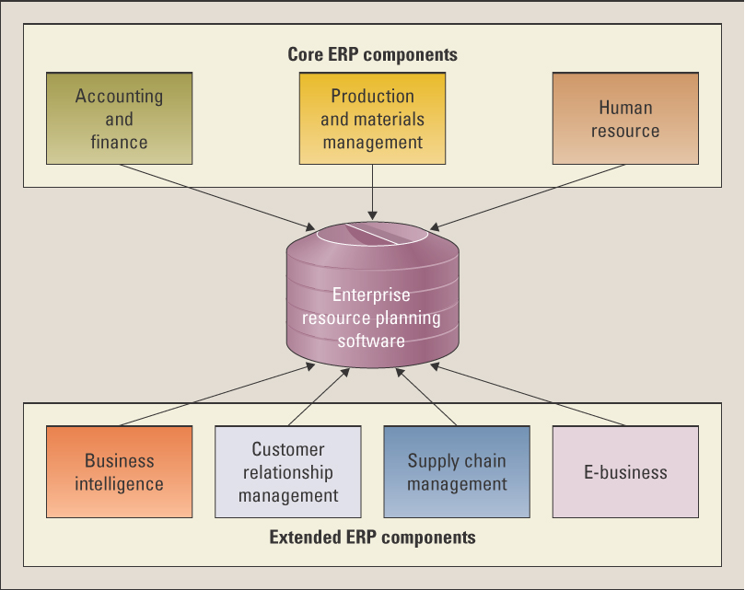

Slide 6
Modules of ERP
Financial modules: These modules support the accounting and finance functions.
Manufacturing and logistics modules: These modules consist of a group of applications for planning production, taking orders and delivering products to the customer.
Human resource modules: These modules handle personnel related tasks for corporate managers and individual employees.
RNL - 2014

Slide 7
Accounting and Finance Components
Manage accounting data and financial processes within the enterprise with functions such as general ledger, accounts payable, accounts receivable, budgeting, and asset management.
RNL - 2014

Slide 8
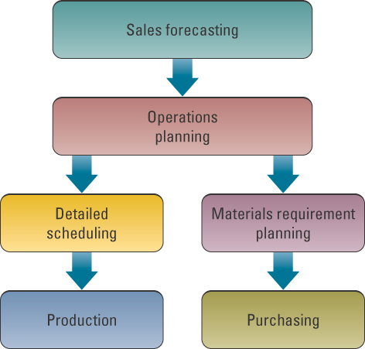
Production and Materials Management Components
handle the various aspects of production planning and execution such as demand forecasting, production scheduling, job cost accounting, and quality control
RNL - 2014

Slide 9
Human Resource Components
Track employee information including payroll, benefits, compensation, performance assessment, and assumes compliance with the legal requirements of multiple jurisdictions and tax authorities
RNL - 2014

Slide 10
Extended ERP Components
Business intelligence - information that people use to support their decision-making efforts
CRM - involves managing all aspects of a customer’s relationship with an organization to increase customer loyalty and retention and an organization’s profitability
SCM - involves the management of information flows between and among stages in a supply chain to maximize total supply chain effectiveness and profitability
E-business - means conducting business on the Internet, not only buying and selling, but also serving customers and collaborating with business partners
RNL - 2014

Slide 11
E-Business Components
E-logistics – manages the transportation and storage of goods.
E-procurement – the business-to-business (B2B) purchase and sale of supplies and services over the Internet.
RNL - 2014

Slide 12
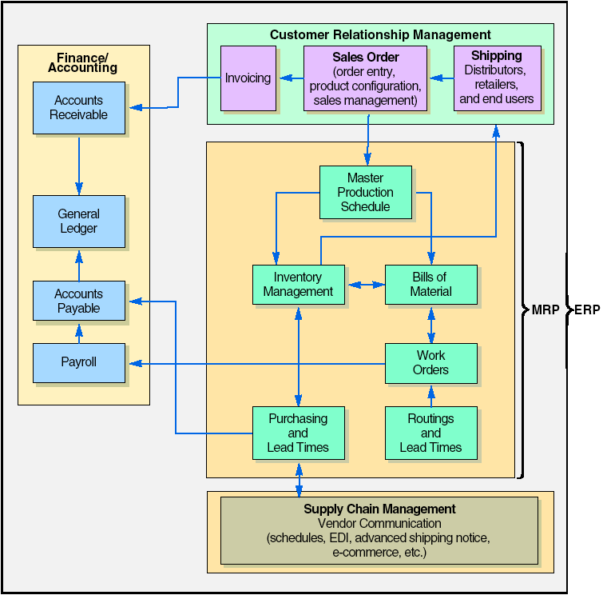
ERP – CRM – SCM - MRP
RNL - 2014

Slide 13
SAP’s ERP Modules
Cash to Cash
Covers all financial related activity:
Accounts receivable GL Cash management
Accounts payable Treasury Asset management
Promote to Deliver
Covers front-end
customer-oriented
activities:
Marketing
Quote and order
processing
Transportation
Documentation and
labeling
After sales service
Warranty &
guarantees
Design to Manufacture
Covers internal production activities:
Design Shop floor
engineering reporting
Production Contract/project
engineering management
Plant Subcontractor
maintenance management
Procure to Pay
Covers sourcing
activities:
Vendor sourcing
Purchase
requisitioning
Purchase ordering
Purchase contracts
Inbound logistics
Supplier invoicing/
matching
Supplier payment/
settlement
Supplier
performance
Recruit to Hire
Covers all HR & Payroll oriented
activity:
Time and attendance Payroll
Travel and expenses
Dock to Dispatch
Covers internal inventory management:
Warehousing Forecasting Physical inventory
Distribution planning Replenishment planning Material handling
RNL - 2014

