Slide 1
DATA MINING
LECTURE 8
Clustering Validation
Minimum Description Length
Information Theory
Co-Clustering

Slide 2
CLUSTERING VALIDITY

Slide 3
Cluster Validity
How do we evaluate the “goodness” of the resulting clusters?
But “clustering lies in the eye of the beholder”!
Then why do we want to evaluate them?
  To avoid finding patterns in noise
  To compare clustering algorithms
  To compare two clusterings
  To compare two clusters

Slide 4
Clusters found in Random Data
Random Points
DBSCAN
K-means
Complete Link

Slide 5
Different Aspects of Cluster Validation
Determining the clustering tendency of a set of data, i.e., distinguishing whether non-random structure actually exists in the data.
Comparing the results of a cluster analysis to externally known results, e.g., to externally given class labels.
Evaluating how well the results of a cluster analysis fit the data without reference to external information.
  - Use only the data
Comparing the results of two different sets of cluster analyses to determine which is better.
Determining the ‘correct’ number of clusters.
For 2, 3, and 4, we can further distinguish whether we want to evaluate the entire clustering or just individual clusters.

Slide 6
Measures of Cluster Validity
Numerical measures that are applied to judge various aspects of cluster validity, are classified into the following three types.
  External Index: Used to measure the extent to which cluster labels match externally supplied class labels.
    E.g., entropy, precision, recall
  Internal Index: Used to measure the goodness of a clustering structure without reference to external information.
    E.g., Sum of Squared Error (SSE)
  Relative Index: Used to compare two different clusterings or clusters.
    Often an external or internal index is used for this function, e.g., SSE or entropy
Sometimes these are referred to as criteria instead of indices
  However, sometimes criterion is the general strategy and index is the numerical measure that implements the criterion.

Slide 7
Measuring Cluster Validity Via Correlation
Two matrices
  Similarity or Distance Matrix
    One row and one column for each data point
    An entry is the similarity or distance of the associated pair of points
  “Incidence” Matrix
    One row and one column for each data point
    An entry is 1 if the associated pair of points belong to the same cluster
    An entry is 0 if the associated pair of points belongs to different clusters
Compute the correlation between the two matrices
  Since the matrices are symmetric, only the correlation between
  n(n-1) / 2 entries needs to be calculated.
High correlation (positive for similarity, negative for distance) indicates that points that belong to the same cluster are close to each other.
Not a good measure for some density or contiguity based clusters.

Slide 8
Measuring Cluster Validity Via Correlation
Correlation of incidence and proximity matrices for the K-means clusterings of the following two data sets.
Corr = -0.9235
Corr = -0.5810

Slide 9
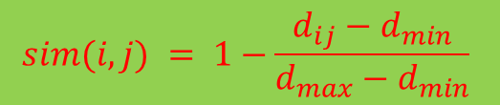
Using Similarity Matrix for Cluster Validation
Order the similarity matrix with respect to cluster labels and inspect visually.
$$sim(i,j) = 1−\frac{d_{ij}−d_{min}}{d_{max}−d_{min}}$$

Slide 10
Using Similarity Matrix for Cluster Validation
Clusters in random data are not so crisp
DBSCAN

Slide 11
Using Similarity Matrix for Cluster Validation
Clusters in random data are not so crisp
K-means

Slide 12
Using Similarity Matrix for Cluster Validation
Clusters in random data are not so crisp
Complete Link

Slide 13
Using Similarity Matrix for Cluster Validation
DBSCAN

Slide 14
Internal Measures: SSE
Internal Index: Used to measure the goodness of a clustering structure without reference to external information
  Example: SSE
SSE is good for comparing two clusterings or two clusters (average SSE).
Can also be used to estimate the number of clusters

Slide 15
Estimating the “right” number of clusters
Typical approach: find a “knee” in an internal measure curve.
Question: why not the k that minimizes the SSE?
  Forward reference: minimize a measure, but with a “simple” clustering
Desirable property: the clustering algorithm does not require the number of clusters to be specified (e.g., DBSCAN)

Slide 16
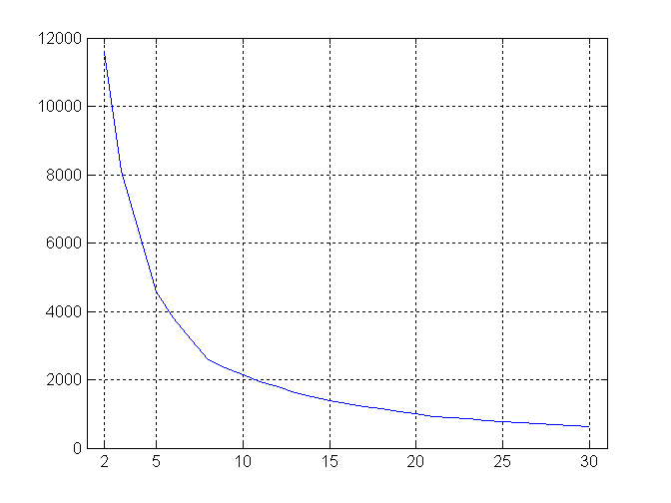
Internal Measures: SSE
SSE curve for a more complicated data set
SSE of clusters found using K-means

Slide 17
Internal Measures: Cohesion and Separation
Cluster Cohesion: Measures how closely related are objects in a cluster
Cluster Separation: Measure how distinct or well-separated a cluster is from other clusters
Example: Squared Error
  Cohesion is measured by the within cluster sum of squares (SSE)
  Separation is measured by the between cluster sum of squares
      Where m_{i} is the size of cluster i

Slide 18
Internal Measures: Cohesion and Separation
A proximity graph based approach can also be used for cohesion and separation.
  Cluster cohesion is the sum of the weight of all links within a cluster.
  Cluster separation is the sum of the weights between nodes in the cluster and nodes outside the cluster.
cohesion
separation

Slide 19
Internal measures – caveats
Internal measures have the problem that the clustering algorithm did not set out to optimize this measure, so it is will not necessarily do well with respect to the measure.
An internal measure can also be used as an objective function for clustering

Slide 20
Framework for Cluster Validity
Need a framework to interpret any measure.
  For example, if our measure of evaluation has the value, 10, is that good, fair, or poor?
Statistics provide a framework for cluster validity
  The more “non-random” a clustering result is, the more likely it represents valid structure in the data
  Can compare the values of an index that result from random data or clusterings to those of a clustering result.
    If the value of the index is unlikely, then the cluster results are valid
For comparing the results of two different sets of cluster analyses, a framework is less necessary.
  However, there is the question of whether the difference between two index values is significant

Slide 21
Statistical Framework for SSE
Example
  Compare SSE of 0.005 against three clusters in random data
  Histogram of SSE for three clusters in 500 random data sets of 100 random points distributed in the range 0.2 – 0.8 for x and y
    Value 0.005 is very unlikely

Slide 22
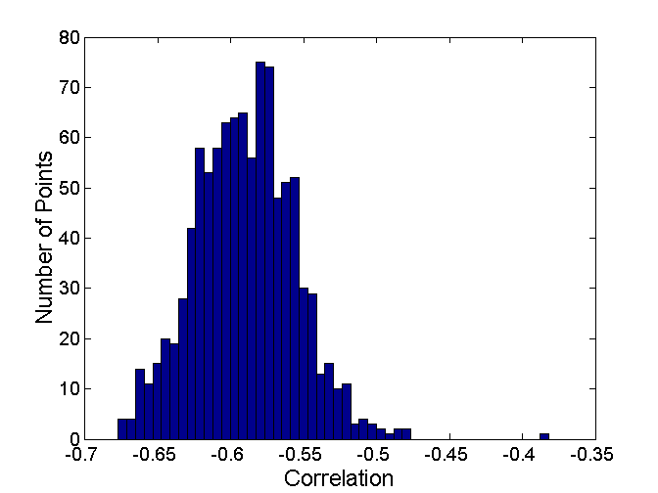
Statistical Framework for Correlation
Correlation of incidence and proximity matrices for the K-means clusterings of the following two data sets.
Corr = -0.9235
Corr = -0.5810

Slide 23
Empirical p-value
If we have a measurement v (e.g., the SSE value)
..and we have N measurements on random datasets
…the empirical p-value is the fraction of measurements in the random data that have value less or equal than value v (or greater or equal if we want to maximize)
  i.e., the value in the random dataset is at least as good as that in the real data
We usually require that p-value ≤ 0.05
Hard question: what is the right notion of a random dataset?

Slide 24
External Measures for Clustering Validity
Assume that the data is labeled with some class labels
  E.g., documents are classified into topics, people classified according to their income, senators classified as republican or democrat.
In this case we want the clusters to be homogeneous with respect to classes
  Each cluster should contain elements of mostly one class
  Also each class should ideally be assigned to a single cluster
This does not always make sense
  Clustering is not the same as classification
But this is what people use most of the time

Slide 25
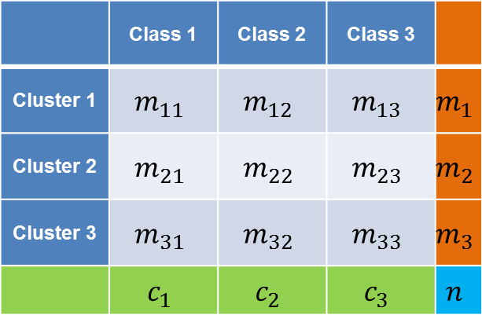
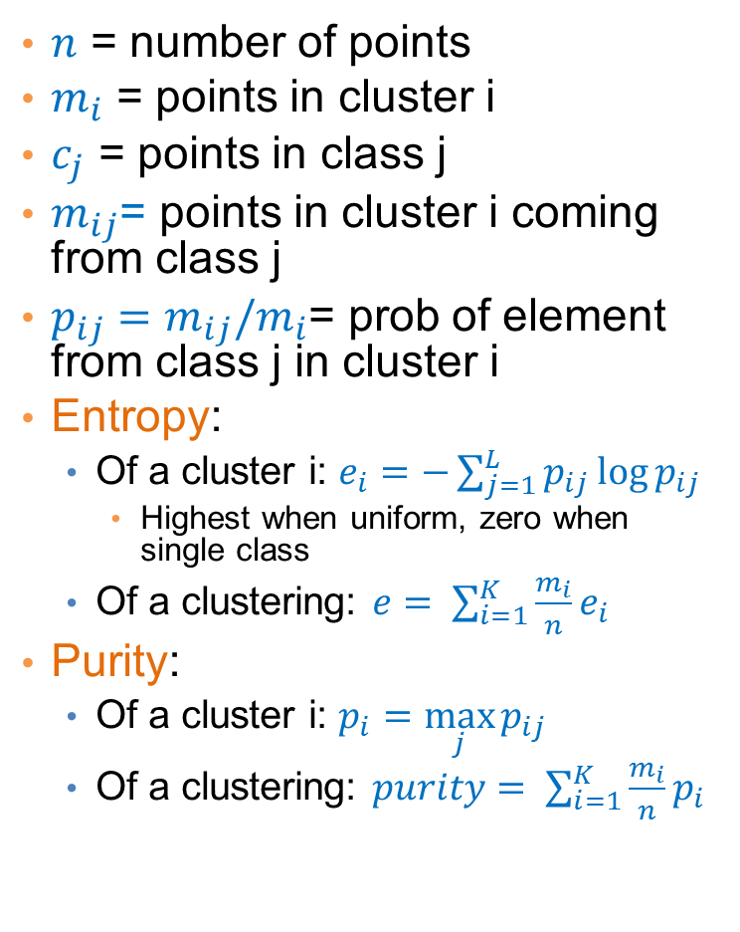
Measures
$n$ = number of points
$m_{i}$ = points in cluster i
$c_{j}$ = points in class j
$m_{ij}$= points in cluster i coming from class j
$p_{ij}=m_{ij}/m_{i}$= prob of element from class j in cluster i
Entropy:
  Of a cluster i: $e_{i}=−\sum_{j=1}^{L}{p_{ij}\log{p_{ij}}}$
    Highest when uniform, zero when single class
  Of a clustering: $e= \sum_{i=1}^{K}{\frac{m_{i}}{n}e_{i}}$
Purity:
  Of a cluster i: $p_{i}=\max_{j}{p_{ij}}$
  Of a clustering: $purity= \sum_{i=1}^{K}{\frac{m_{i}}{n}p_{i}}$
 | Class 1 | Class 2 | Class 3
Cluster 1 | $$m_{11}$$ | $$m_{12}$$ | $$m_{13}$$ | $$m_{1}$$
Cluster 2 | $$m_{21}$$ | $$m_{22}$$ | $$m_{23}$$ | $$m_{2}$$
Cluster 3 | $$m_{31}$$ | $$m_{32}$$ | $$m_{33}$$ | $$m_{3}$$
 | $$c_{1}$$ | $$c_{2}$$ | $$c_{3}$$ | $$n$$

Slide 26
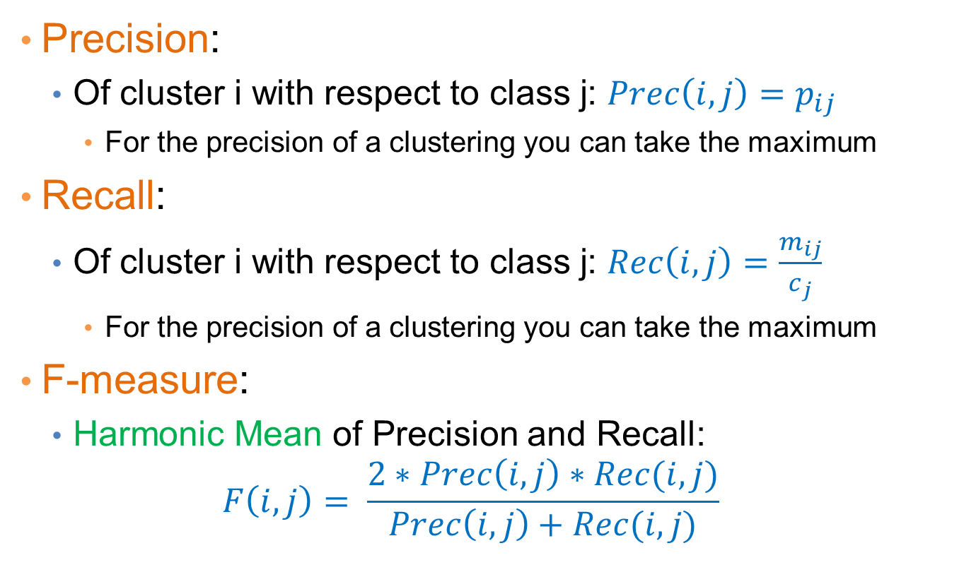
Measures
Precision:
  Of cluster i with respect to class j: $Prec\left(i,j\right)=p_{ij}$
    For the precision of a clustering you can take the maximum
Recall:
  Of cluster i with respect to class j: $Rec\left(i,j\right)=\frac{m_{ij}}{c_{j}}$
    For the precision of a clustering you can take the maximum
F-measure:
  Harmonic Mean of Precision and Recall:
  $$F\left(i,j\right)= \frac{2∗Prec\left(i,j\right)∗Rec(i,j)}{Prec\left(i,j\right)+Rec(i,j)}$$

Slide 27
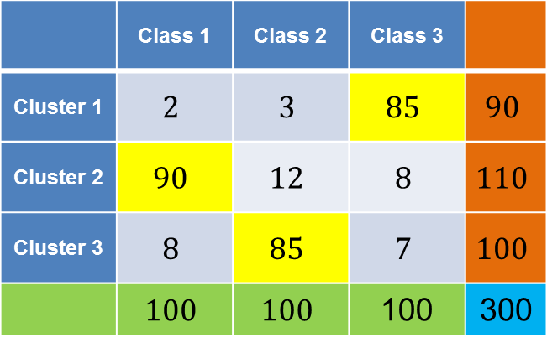
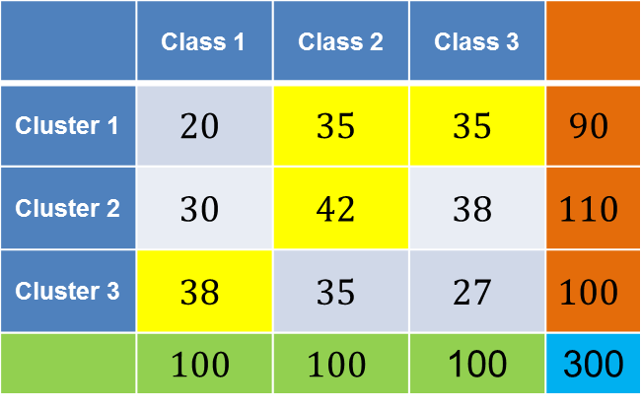
Good and bad clustering
 | Class 1 | Class 2 | Class 3
Cluster 1 | $$2$$ | $$3$$ | $$85$$ | $$90$$
Cluster 2 | $$90$$ | $$12$$ | $$8$$ | $$110$$
Cluster 3 | $$8$$ | $$85$$ | $$7$$ | $$100$$
 | $$100$$ | $$100$$ | 100 | 300
 | Class 1 | Class 2 | Class 3
Cluster 1 | $$20$$ | $$35$$ | $$35$$ | $$90$$
Cluster 2 | $$30$$ | $$42$$ | $$38$$ | $$110$$
Cluster 3 | $$38$$ | $$35$$ | $$27$$ | $$100$$
 | $$100$$ | $$100$$ | 100 | 300
Purity: (0.94, 0.81, 0.85) – overall 0.86
Precision: (0.94, 0.81, 0.85)
Recall: (0.85, 0.9, 0.85)
Purity: (0.38, 0.38, 0.38) – overall 0.38
Precision: (0.38, 0.38, 0.38)
Recall: (0.35, 0.42, 0.38)

Slide 28
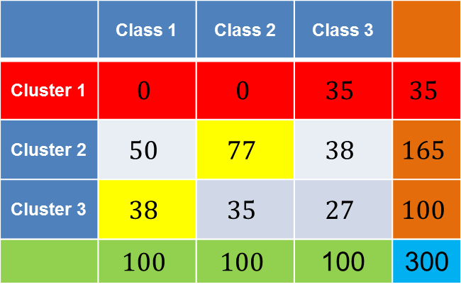
Another bad clustering
 | Class 1 | Class 2 | Class 3
Cluster 1 | $$0$$ | $$0$$ | $$35$$ | $$35$$
Cluster 2 | $$50$$ | $$77$$ | $$38$$ | $$165$$
Cluster 3 | $$38$$ | $$35$$ | $$27$$ | $$100$$
 | $$100$$ | $$100$$ | 100 | 300
Cluster 1:
  Purity: 1
  Precision: 1
  Recall: 0.35

Slide 29
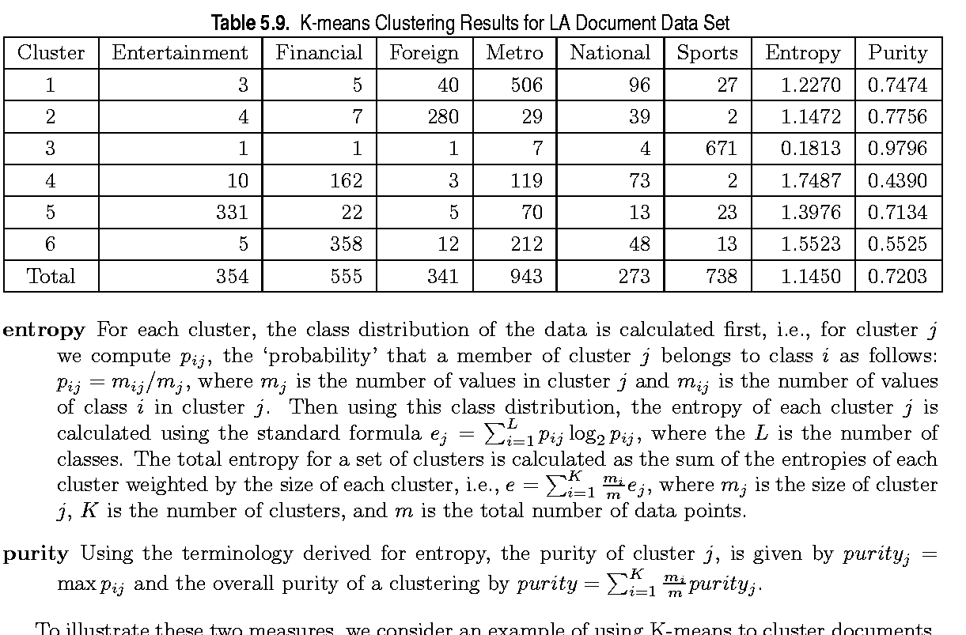
External Measures of Cluster Validity: Entropy and Purity

Slide 30
Final Comment on Cluster Validity
“The validation of clustering structures is the most difficult and frustrating part of cluster analysis.
Without a strong effort in this direction, cluster analysis will remain a black art accessible only to those true believers who have experience and great courage.”
Algorithms for Clustering Data, Jain and Dubes

Slide 31
MINIMUM DESCRIPTION LENGTH

Slide 32
Occam’s razor
Most data mining tasks can be described as creating a model for the data
  E.g., the EM algorithm models the data as a mixture of Gaussians, the K-means models the data as a set of centroids.
What is the right model?
Occam’s razor: All other things being equal, the simplest model is the best.
  A good principle for life as well

Slide 33
Occam's Razor and MDL
What is a simple model?
Minimum Description Length Principle: Every model provides a (lossless) encoding of our data. The model that gives the shortest encoding (best compression) of the data is the best.
  Related: Kolmogorov complexity. Find the shortest program that produces the data (uncomputable).
  MDL restricts the family of models considered
  Encoding cost: cost of party A to transmit to party B the data.

Slide 34
Minimum Description Length (MDL)
The description length consists of two terms
  The cost of describing the model (model cost)
  The cost of describing the data given the model (data cost).
  L(D) = L(M) + L(D|M)
There is a tradeoff between the two costs
  Very complex models describe the data in a lot of detail but are expensive to describe the model
  Very simple models are cheap to describe but it is expensive to describe the data given the model
This is generic idea for finding the right model
  We use MDL as a blanket name.

Slide 35
Example
Regression: find a polynomial for describing a set of values
  Model complexity (model cost): polynomial coefficients
  Goodness of fit (data cost): difference between real value and the polynomial value
Minimum model cost
High data cost
High model cost
Minimum data cost
Low model cost
Low data cost
MDL avoids overfitting automatically!
Source: Grunwald et al. (2005) Tutorial on MDL.

Slide 36
Example
Suppose you want to describe a set of integer numbers
  Cost of describing a single number is proportional to the value of the number x (e.g., logx).
  How can we get an efficient description?
Cluster integers into two clusters and describe the cluster by the centroid and the points by their distance from the centroid
  Model cost: cost of the centroids
  Data cost: cost of cluster membership and distance from centroid
What are the two extreme cases?

Slide 37
MDL and Data Mining
Why does the shorter encoding make sense?
  Shorter encoding implies regularities in the data
  Regularities in the data imply patterns
  Patterns are interesting
Example
00001000010000100001000010000100001000010001000010000100001
Short description length, just repeat 12 times 00001
0100111001010011011010100001110101111011011010101110010011100
Random sequence, no patterns, no compression

Slide 38
Is everything about compression?
Jürgen Schmidhuber: A theory about creativity, art and fun
  Interesting Art corresponds to a novel pattern that we cannot compress well, yet it is not too random so we can learn it
  Good Humor corresponds to an input that does not compress well because it is out of place and surprising
  Scientific discovery corresponds to a significant compression event
    E.g., a law that can explain all falling apples.
Fun lecture:
  Compression Progress: The Algorithmic Principle Behind Curiosity and Creativity

Slide 39
Issues with MDL
What is the right model family?
  This determines the kind of solutions that we can have
    E.g., polynomials
    Clusterings
What is the encoding cost?
  Determines the function that we optimize
  Information theory

Slide 40
INFORMATION THEORY
A short introduction

Slide 41
Encoding
Consider the following sequence
AAABBBAAACCCABACAABBAACCABAC
Suppose you wanted to encode it in binary form, how would you do it?
50% A
25% B
25% C
A → 0
B → 10
C → 11
A is 50% of the sequence
We should give it a shorter representation
This is actually provably the best encoding!

Slide 42
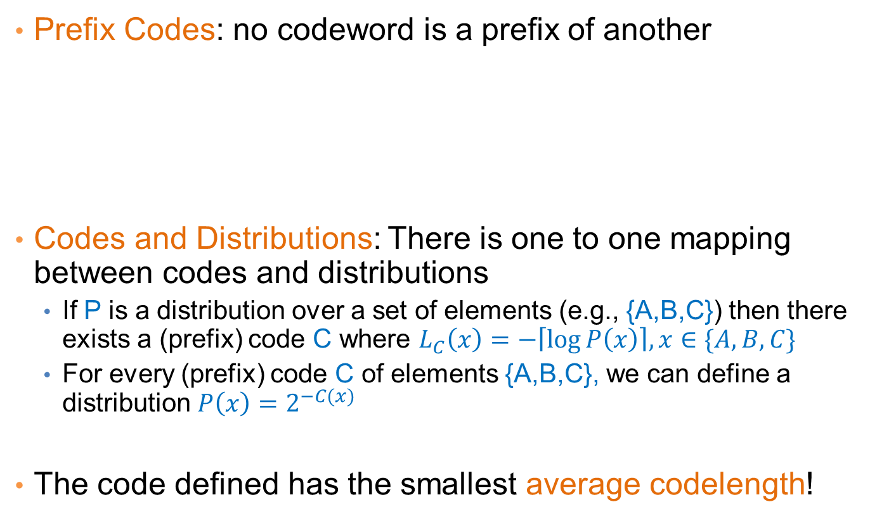
Encoding
Prefix Codes: no codeword is a prefix of another
Codes and Distributions: There is one to one mapping between codes and distributions
  If P is a distribution over a set of elements (e.g., {A,B,C}) then there exists a (prefix) code C where $L_{C}\left(x\right)=−\left\lceil \log{P\left(x\right)}\right\rceil , x∈\{A,B,C\}$
  For every (prefix) code C of elements {A,B,C}, we can define a distribution $P\left(x\right)=2^{−C(x)}$
The code defined has the smallest average codelength!
A → 0
B → 10
C → 11
Uniquely directly decodable
For every code we can find a prefix code of equal length

Slide 43
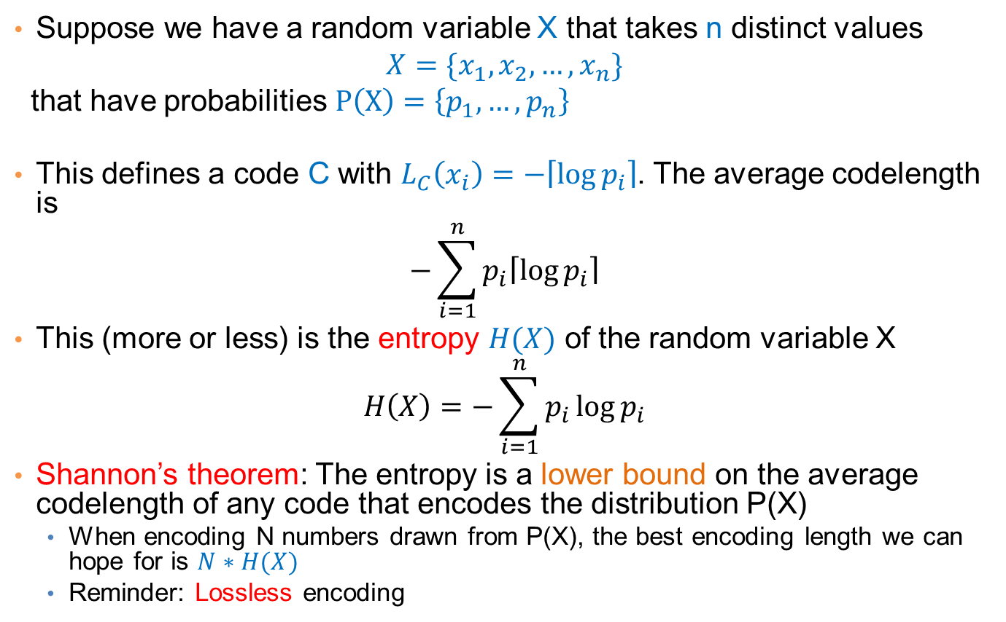
Entropy
Suppose we have a random variable X that takes n distinct values
$$X=\{x_{1},x_{2},…, x_{n}\}$$
that have probabilities $P\left(X\right)=\left\{p_{1},…, p_{n}\right\}$
This defines a code C with $L_{C}\left(x_{i}\right)=−\left\lceil \log{p_{i}}\right\rceil$. The average codelength is
$$−\sum_{i=1}^{n}{p_{i}\left\lceil \log{p_{i}}\right\rceil }$$
This (more or less) is the entropy $H(X)$ of the random variable X
$$H\left(X\right)=−\sum_{i=1}^{n}{p_{i}\log{p_{i}}}$$
Shannon’s theorem: The entropy is a lower bound on the average codelength of any code that encodes the distribution P(X)
  When encoding N numbers drawn from P(X), the best encoding length we can hope for is $N∗H(X)$
  Reminder: Lossless encoding

Slide 44
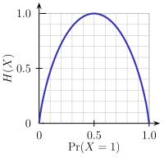
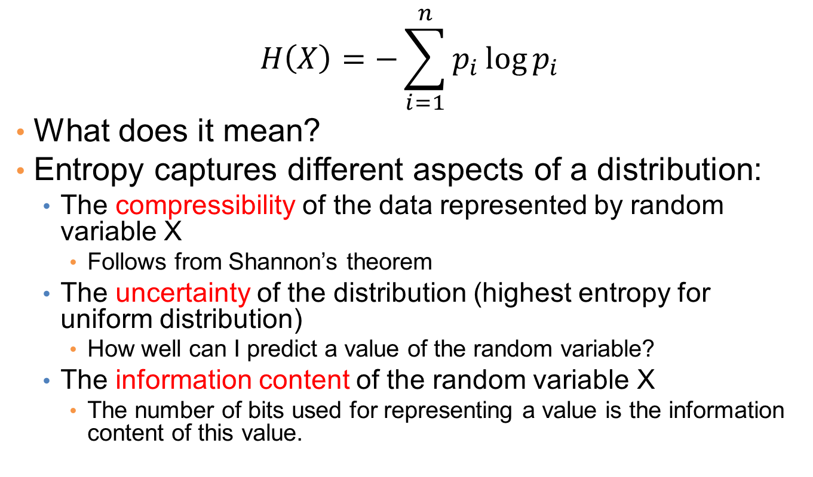
Entropy
$$H\left(X\right)=−\sum_{i=1}^{n}{p_{i}\log{p_{i}}}$$
What does it mean?
Entropy captures different aspects of a distribution:
  The compressibility of the data represented by random variable X
    Follows from Shannon’s theorem
  The uncertainty of the distribution (highest entropy for uniform distribution)
    How well can I predict a value of the random variable?
  The information content of the random variable X
    The number of bits used for representing a value is the information content of this value.

Slide 45
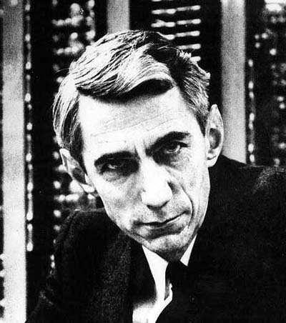
Claude Shannon
Father of Information Theory
Envisioned the idea of communication of information with 0/1 bits
Introduced the word “bit”
The word entropy was suggested by Von Neumann
  Similarity to physics, but also
  “nobody really knows what entropy really is, so in any conversation you will have an advantage”

Slide 46
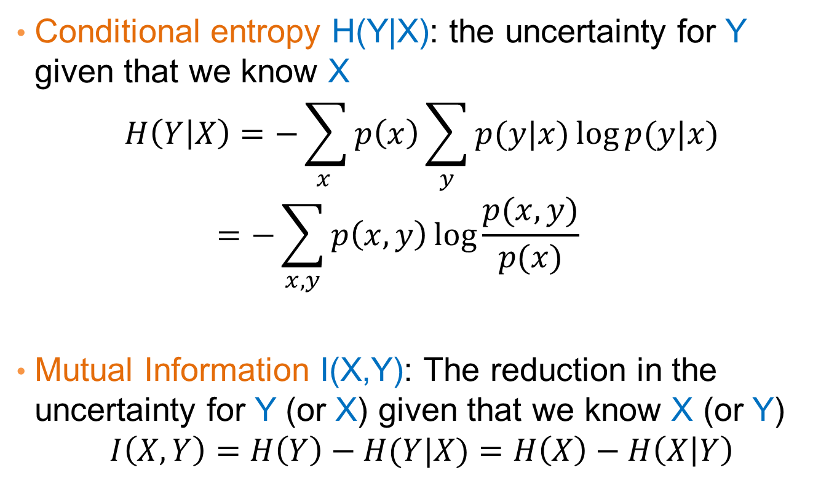
Some information theoretic measures
Conditional entropy H(Y|X): the uncertainty for Y given that we know X
$$H\left(Y | X\right)=−\sum_{x }{p\left(x\right)\sum_{y}{p(y|x)\log{p(y|x)}}}=−\sum_{x,y}{p\left(x,y\right)\log{\frac{p(x,y)}{p(x)}}}$$
Mutual Information I(X,Y): The reduction in the uncertainty for Y (or X) given that we know X (or Y)
$$I\left(X,Y\right)=H\left(Y\right)−H(Y|X)=H\left(X\right)−H\left(X | Y\right)$$

Slide 47
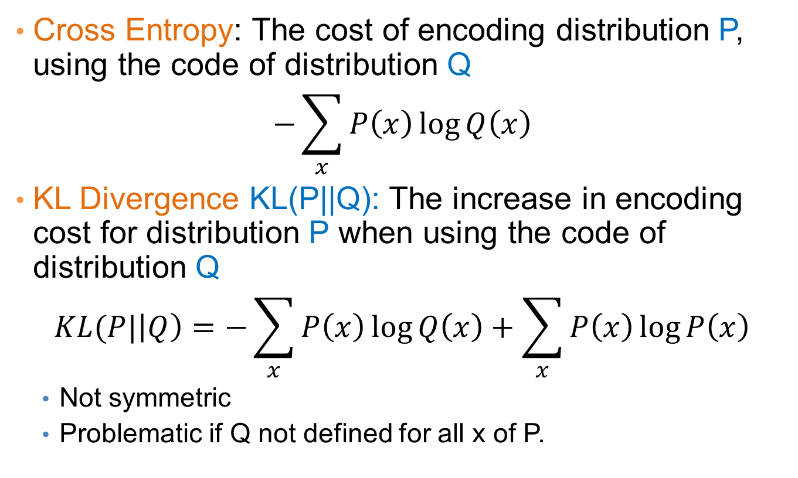
Some information theoretic measures
Cross Entropy: The cost of encoding distribution P, using the code of distribution Q
$$−\sum_{x}{P\left(x\right)\log{Q\left(x\right)}}$$
KL Divergence KL(P||Q): The increase in encoding cost for distribution P when using the code of distribution Q
$$KL(P|\left|Q\right)=−\sum_{x}{P\left(x\right)\log{Q\left(x\right)}}+\sum_{x}{P\left(x\right)\log{P\left(x\right)}}$$
  Not symmetric
  Problematic if Q not defined for all x of P.

Slide 48
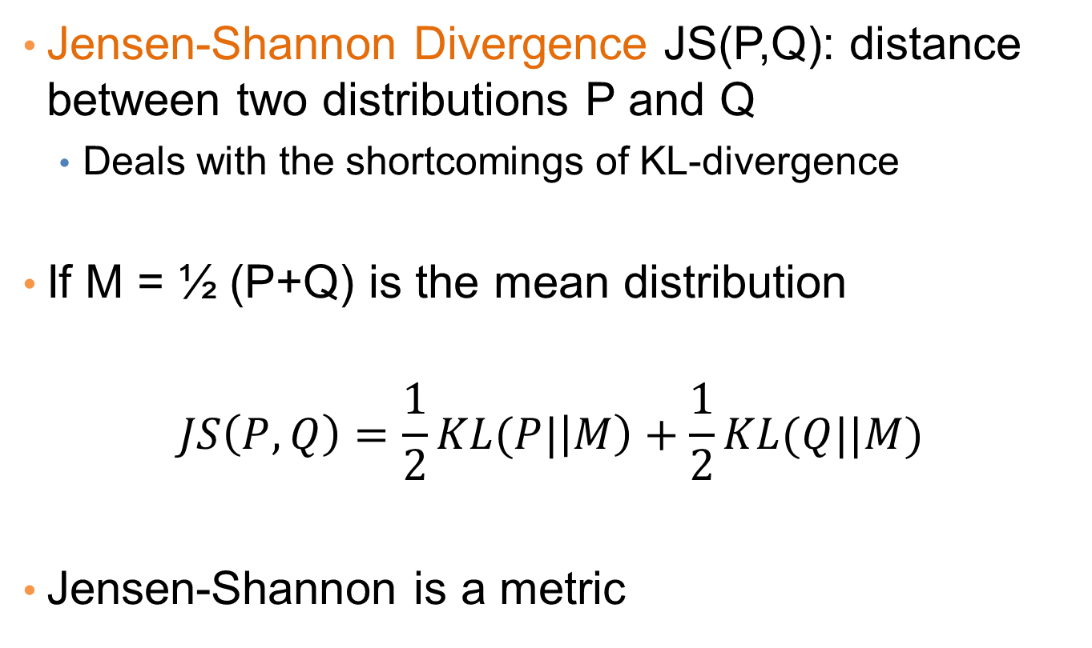
Some information theoretic measures
Jensen-Shannon Divergence JS(P,Q): distance between two distributions P and Q
  Deals with the shortcomings of KL-divergence
If M = ½ (P+Q) is the mean distribution
$$JS\left(P,Q\right)=\frac{1}{2}KL(P|\left|M\right)+\frac{1}{2}KL(Q||M)$$
Jensen-Shannon is a metric

Slide 49
Using MDL for
Co-CLUSTERING
(CROSS-ASSOCIATIONS)
Thanks to Spiros Papadimitriou.

Slide 50

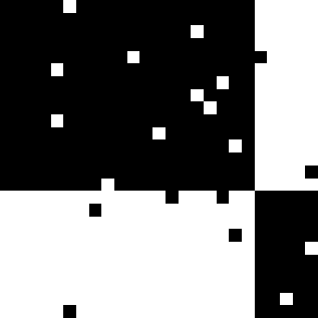
Co-clustering
Simultaneous grouping of rows and columns of a matrix into homogeneous groups
Students buying books
5
5
97%
3%
10
10
Customers
54%
Customer groups
15
15
20
20
3%
96%
25
25
5
10
15
20
25
5
10
15
20
25
Product groups
Products
CEOs buying BMWs

Slide 51
Co-clustering
Step 1: How to define a “good” partitioning?
Intuition and formalization
Step 2: How to find it?

Slide 52
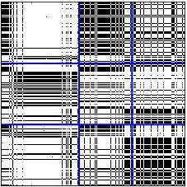
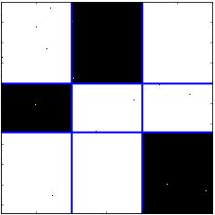
Co-clustering
Intuition
Why is this better?
Row groups
Row groups
versus
Column groups
Column groups
Good Clustering
Similar nodes are grouped together
As few groups as necessary
A few, homogeneous blocks
Good Compression
implies

Slide 53
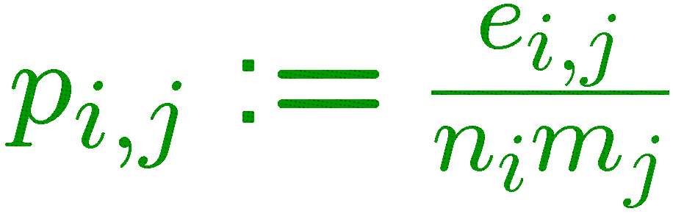
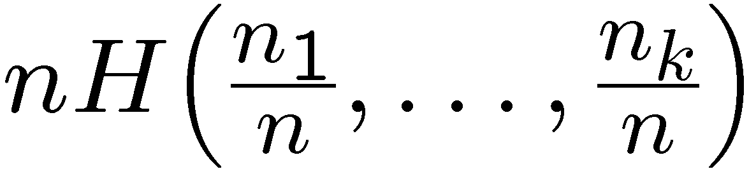
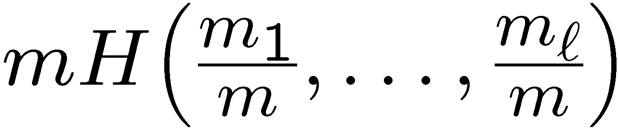
Co-clustering
MDL formalization—Cost objective
ℓ = 3 col. groups
m₁
m₂
m₃
density of ones
n₁
n₁m₂ H(p_{1,2}) bits for (1,2)
p_{1,1}
p_{1,2}
p_{1,3}
block size
entropy
∑_{i,j} n_{i}m_{j} H(p_{i,j})
bits total
k = 3 row groups
n₂
p_{2,1}
p_{2,2}
p_{2,3}
data cost
+
model cost
n₃
p_{3,1}
p_{3,2}
p_{3,3}
+
row-partition
description
col-partition
description
+
log*k + log*ℓ
+
∑_{i,j}
⎡log n_{i}m_{j}⎤
n × m matrix
transmit
#partitions
transmit
#ones e_{i,j}

Slide 54
Co-clustering
MDL formalization—Cost objective
✗
✗
one row group
one col group
n row groups
m col groups
high
low
code cost
(block contents)
+
low
high
description cost
(block structure)

Slide 55
Co-clustering
MDL formalization—Cost objective
✓
k = 3 row groups
ℓ = 3 col groups
low
code cost
(block contents)
+
low
description cost
(block structure)

Slide 56
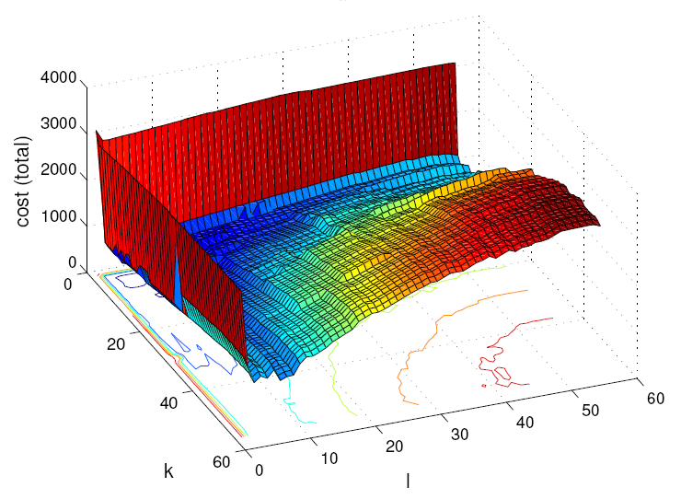
Co-clustering
MDL formalization—Cost objective
Cost vs. number of groups
one row group
one col group
total bit cost
n row groups
m col groups
k
ℓ
k = 3 row groups
ℓ = 3 col groups

Slide 57
Co-clustering
Step 1: How to define a “good” partitioning?
Intuition and formalization
Step 2: How to find it?

Slide 58
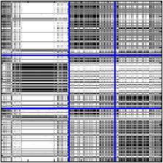
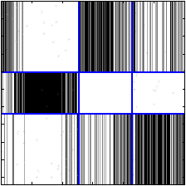
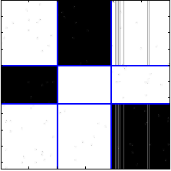
Search for solution
Overview: assignments w/ fixed number of groups (shuffles)
original groups
row shuffle
column shuffle
row shuffle
reassign all rows,
holding column
assignments fixed
reassign all columns,
holding row
assignments fixed
No cost improvement:
Discard

Slide 59
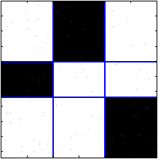
Search for solution
Overview: assignments w/ fixed number of groups (shuffles)
Final shuffle result
row shuffle
column shuffle
column shuffle
column shuffle
row shuffle
No cost improvement:
Discard

Slide 60
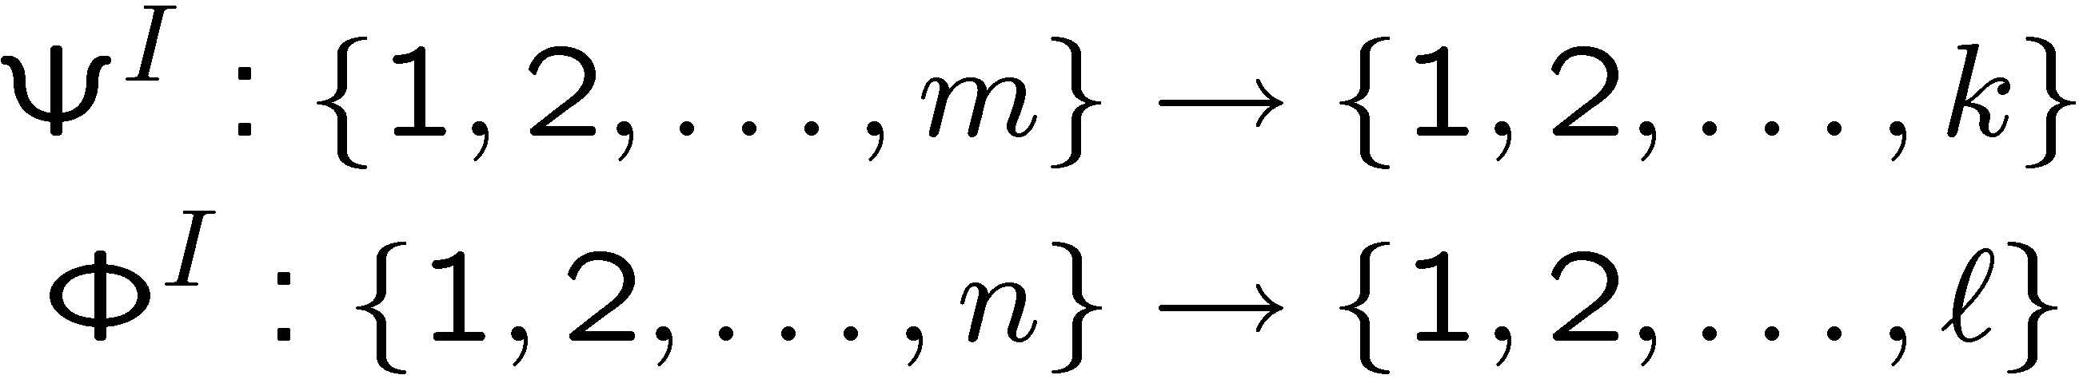
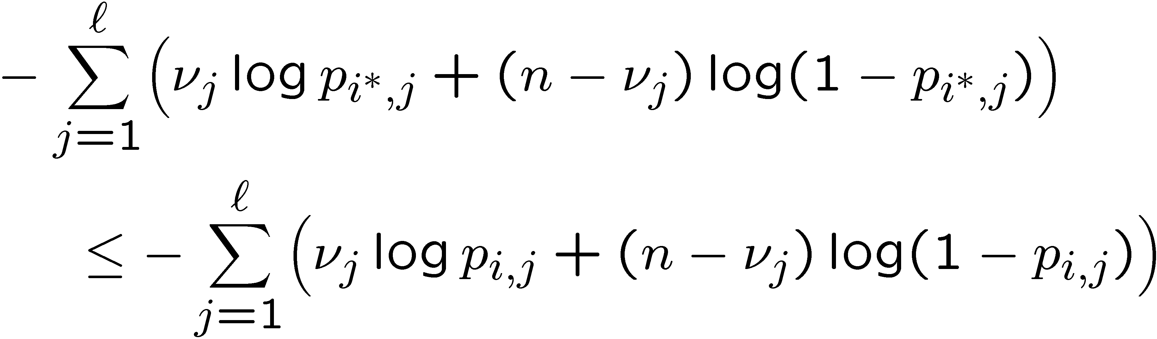
Search for solution
Shuffles
Let
denote row and col. partitions at the I-th iteration
Fix Φ^{I} and for every row x:
  Splice into ℓ parts, one for each column group
  Let ν_{j}, for j = 1,…,ℓ, be the number of ones in each part
  Assign row x to the row group i¤ ≡ Ψ^{I+1}(x) such that, for all i = 1,…,k,
Similarity (“KL-divergences”)
of row fragments
to blocks of a row group
p_{1,1}
p_{1,2}
p_{1,3}
p_{2,1}
p_{2,2}
p_{2,3}
Assign to second row-group
p_{3,1}
p_{3,2}
p_{3,3}

Slide 61
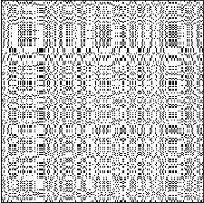
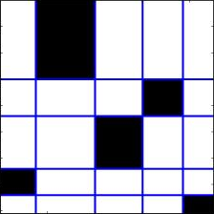
Search for solution
Overview: number of groups k and ℓ (splits & shuffles)
k = 5, ℓ = 5

Slide 62
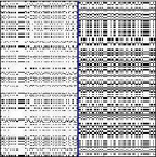
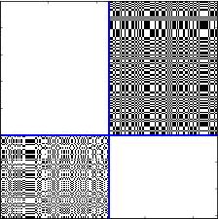
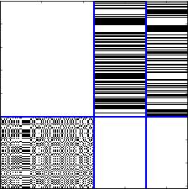
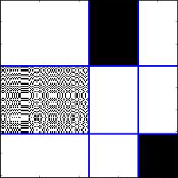
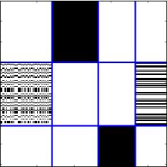
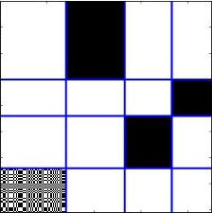
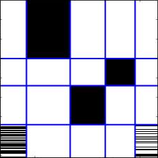
Search for solution
Overview: number of groups k and ℓ (splits & shuffles)
k = 1, ℓ = 1
shuffle
shuffle
col. split
row split
row split
No cost improvement:
Discard
k = 5, ℓ = 6
k = 6, ℓ = 5
k = 5, ℓ = 5
shuffle
shuffle
shuffle
shuffle
shuffle
shuffle
shuffle
col. split
row split
col. split
row split
col. split
row split
col. split
k=1, ℓ=2
k=2, ℓ=2
k=2, ℓ=3
k=3, ℓ=3
k=3, ℓ=4
k=4, ℓ=4
k=4, ℓ=5
Split:
Increase k or ℓ
Shuffle:
Rearrange rows or cols

Slide 63
Search for solution
Overview: number of groups k and ℓ (splits & shuffles)
k = 1, ℓ = 1
k = 5, ℓ = 5
k = 5, ℓ = 5
Final result
k=1, ℓ=2
k=2, ℓ=2
k=2, ℓ=3
k=3, ℓ=3
k=3, ℓ=4
k=4, ℓ=4
k=4, ℓ=5
Split:
Increase k or ℓ
Shuffle:
Rearrange rows or cols

Slide 64
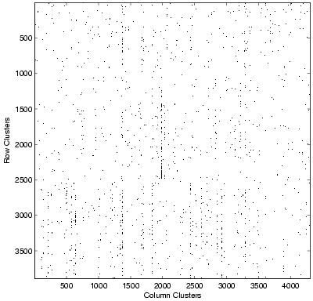
Co-clustering
CLASSIC
CLASSIC corpus
3,893 documents
4,303 words
176,347 “dots” (edges)
Combination of 3 sources:
MEDLINE (medical)
CISI (info. retrieval)
CRANFIELD (aerodynamics)
Documents
Words

Slide 65
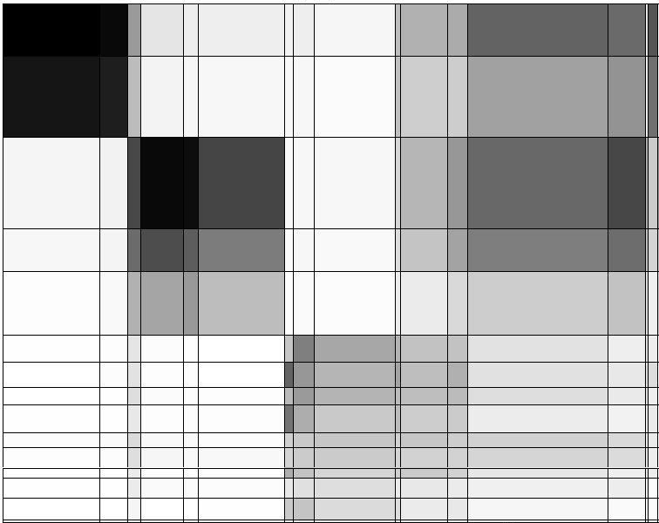
Graph co-clustering
CLASSIC
Documents
Words
“CLASSIC” graph of documents & words:
k = 15, ℓ = 19

Slide 66
Co-clustering
CLASSIC
insipidus, alveolar, aortic, death, prognosis, intravenous
blood, disease, clinical, cell, tissue, patient
paint, examination, fall, raise, leave, based
MEDLINE
(medical)
CISI
(Information Retrieval)
CRANFIELD (aerodynamics)
providing, studying, records, development, students, rules
abstract, notation, works, construct, bibliographies
shape, nasa, leading, assumed, thin
“CLASSIC” graph of documents & words:
k = 15, ℓ = 19

Slide 67
Co-clustering
CLASSIC
Document cluster # | Document class |  |  | Precision
 | CRANFIELD | CISI | MEDLINE
1 | 0 | 1 | 390 | 0.997
2 | 0 | 0 | 610 | 1.000
3 | 2 | 676 | 9 | 0.984
4 | 1 | 317 | 6 | 0.978
5 | 3 | 452 | 16 | 0.960
6 | 207 | 0 | 0 | 1.000
7 | 188 | 0 | 0 | 1.000
8 | 131 | 0 | 0 | 1.000
9 | 209 | 0 | 0 | 1.000
10 | 107 | 2 | 0 | 0.982
11 | 152 | 3 | 2 | 0.968
12 | 74 | 0 | 0 | 1.000
13 | 139 | 9 | 0 | 0.939
14 | 163 | 0 | 0 | 1.000
15 | 24 | 0 | 0 | 1.000
Recall | 0.996 | 0.990 | 0.968
0.999
0.975
0.94-1.00
0.987
0.97-0.99

