Slide 1
Unit Testing, Integration Testing and System Testing
Testing and System Implementation

Slide 2
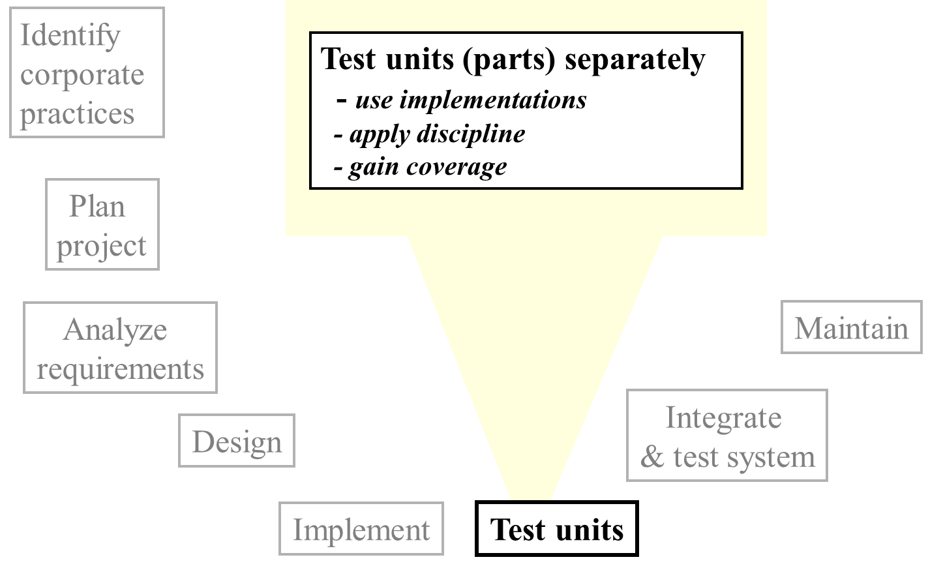
Software Engineering Roadmap

Slide 3
Testing: the Big Picture
3.
System tests
2. Integration tests
Module combination
1.
Unit
tests
Module
Function

Slide 4
What Is Unit Testing?
In computer programming, unit testing is a method by which individual units of source code are tested to determine if they are fit for use.
A unit is the smallest testable part of an application. In procedural programming a unit may be an individual function or procedure. In object-oriented programming a unit is usually a method. Unit tests are created by programmers or occasionally by white box testers.

Slide 5
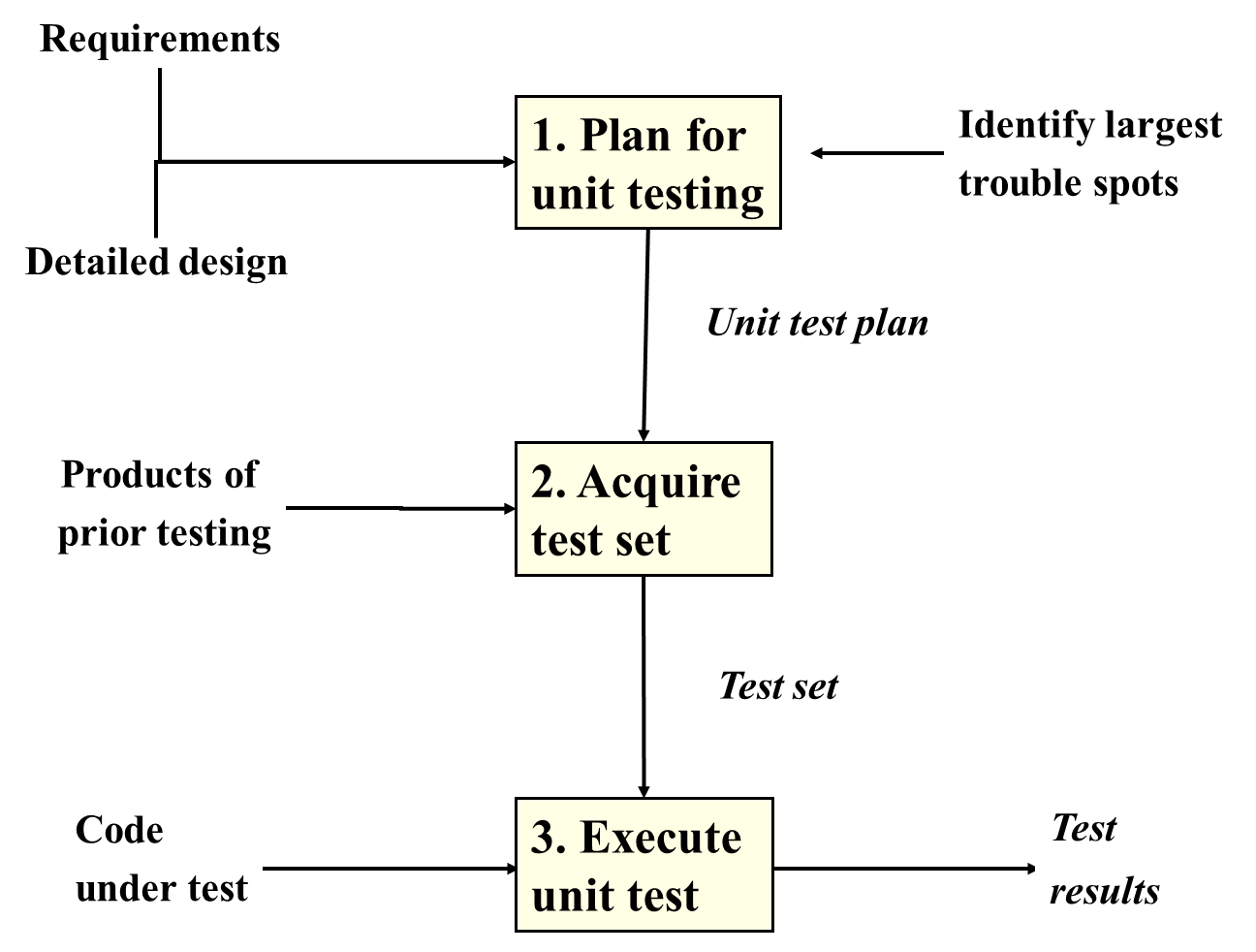
Roadmap for unit testing

Slide 6
Plan for Unit Testing
1. Decide on the philosophy for unit testing
individual engineer responsible (common)?
reviewed by others?
designed & performed by others?
2. Decide what / where / how to document
individual’s personal document set (common)?
how / when to incorporate into other types of testing?
incorporate in formal documents?
use tools / test utilities?
3. Determine extent of unit testing (i.e., in advance).
do not just “test until time expires”
prioritize, so that important tests definitely performed
4. Decide how and where to get the test input
5. Estimate the resources required
use historical data if available
6. Arrange to track time, defect count, type & source

Slide 7
One way to ...
Perform Method Testing 1/2
1. Verify operation at normal parameter values
(a black box test based on the unit’s requirements)
2. Verify operation at limit parameter values
(black box)
3. Verify operation outside parameter values
(black box)
4. Ensure that all instructions execute
(statement coverage)
5. Check all paths, including both sides of all branches
(decision coverage)
6. Check the use of all called objects
7. Verify the handling of all data structures
8. Verify the handling of all files

Slide 8
One way to ...
Perform Method Testing 2/2
9. Check normal termination of all loops
(part of a correctness proof)
10. Check abnormal termination of all loops
11. Check normal termination of all recursions
12. Check abnormal termination of all recursions
13. Verify the handling of all error conditions
14. Check timing and synchronization
15. Verify all hardware dependencies

Slide 9
Relating Tests to Requirements & Design
(1) D-Requirements
3.2.EC.1.2 Qualities of Encounter characters
Every game character has the same set of qualities. Each quality shall be a non-negative floating point number with at least one decimal of precision. . . .
(2) Design GameCharacter Requirements
An abstract class with attribute name ...
. . . .

Slide 10
Relating Tests to Requirements & Design
(1) D-Requirements
3.2.EC.1.2 Qualities of Encounter characters
Every game character has the same set of qualities. Each quality shall be a non-negative floating point number with at least one decimal of precision. . . .
(2) Design GameCharacter Requirements
An abstract class with attribute name ...
Test this class ...
... against this requirement
Characters
GameCharacter
Test this method ...
Encounter Characters
... against this requirement
EncounterCharacter
adjustQuality()

Slide 11
Unit test
Applied to ...
Concentration
Stamina
Results in a zero value?
1. Within range
No:
Test 1.1
Test 1.1.1
etc.
Yes:
Test 1.2
Partitioning of Range for Unit Testing 1 of 2
Test 1.2.1
etc.

Slide 12
Unit test
Applied to ...
Concentration
Stamina
Results in a zero value?
2. Outside range
No:
Test 2.1
Test 2.1.1
etc.
Yes:
Test 2.2
Partitioning of Range for Unit Testing 2 of 2
Test 2.2.1
etc.

Slide 13
Why do we do integration testing?
Unit tests only test the unit in isolation
Many failures result from faults in the interaction of subsystems
Often many Off-the-shelf components are used that cannot be unit tested
Without integration testing the system test will be very time consuming
Failures that are not discovered in integration testing will be discovered after the system is deployed and can be very expensive.

Slide 14
Integration testing Strategy
The entire system is viewed as a collection of subsystems (sets of classes) determined during the system and object design.
The order in which the subsystems are selected for testing and integration determines the testing strategy
Big bang integration (Nonincremental)
Bottom up integration
Top down integration
Sandwich testing
Variations of the above

Slide 15
Stubs and drivers
Driver
Driver:
A component, that calls the TestedUnit
Controls the test cases
Stub:
A component, the TestedUnit depends on
Partial implementation
Returns fake values.
Tested
Unit
Stub

Slide 16
Example : three Layer call hierarchy
A
Layer I
B
C
D
Layer II
E
F
G
Layer III

Slide 17
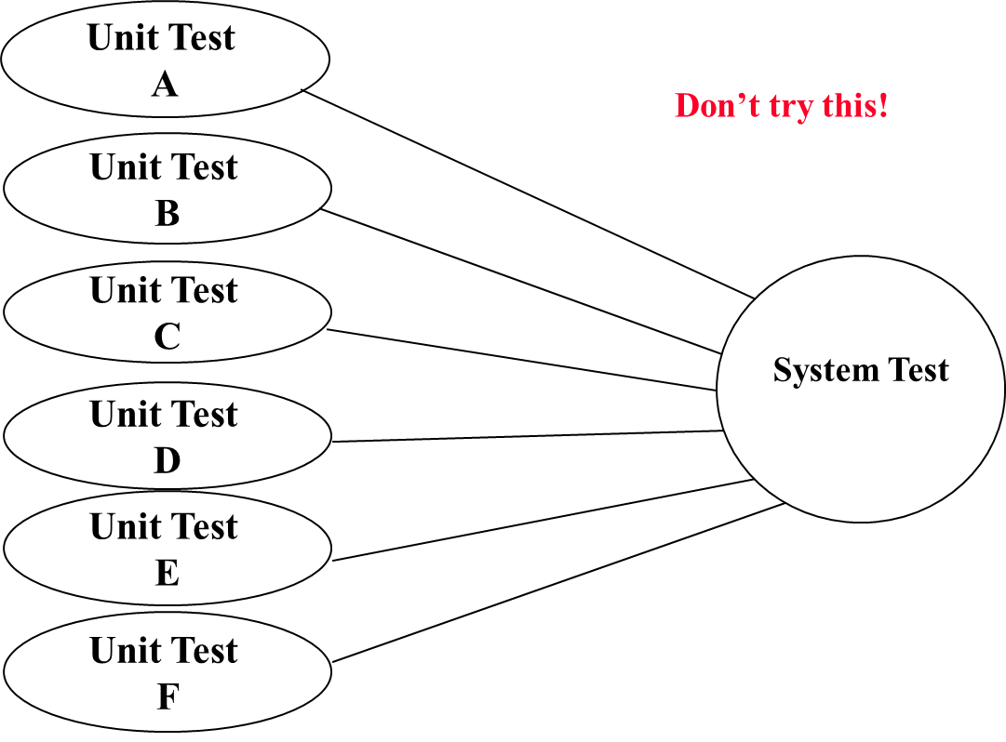
Integration Testing: Big-Bang Approach

Slide 18
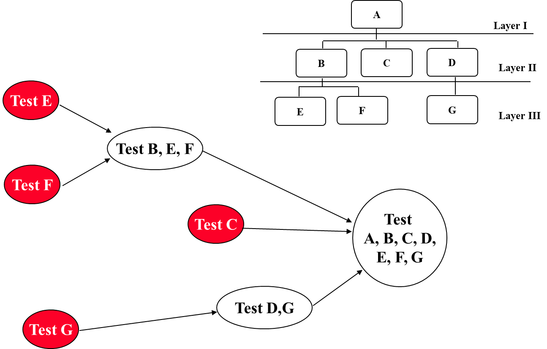
Bottom-up Integration

Slide 19
Pros and Cons of bottom up integration testing
Bad for functionally decomposed systems:
Tests the most important subsystem (UI) last
Useful for integrating the following systems
Object-oriented systems
real-time systems
systems with strict performance requirements

Slide 20
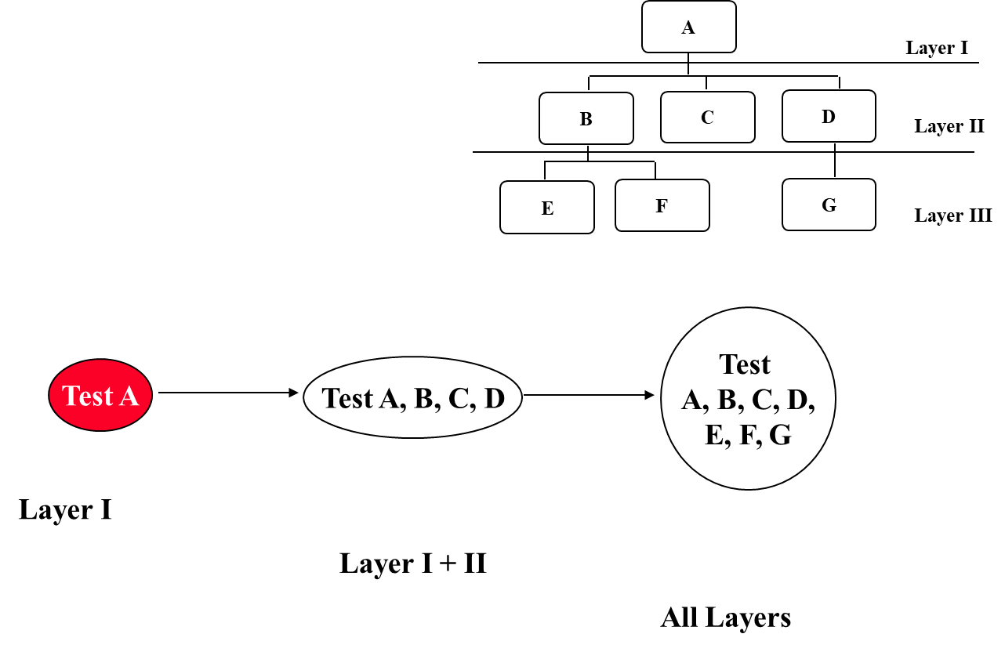
Top-down Integration Testing

Slide 21
Pros and Cons of top-down integration testing
Test cases can be defined in terms of the functionality of the system (functional requirements)
Writing stubs can be difficult: Stubs must allow all possible conditions to be tested.
Possibly a very large number of stubs may be required, especially if the lowest level of the system contains many methods.
One solution to avoid too many stubs: Modified top-down testing strategy
Test each layer of the system decomposition individually before merging the layers
Disadvantage of modified top-down testing: Both, stubs and drivers are needed

Slide 22
Sandwich Testing Strategy
Combines top-down strategy with bottom-up strategy
The system is view as having three layers
A target layer in the middle
A layer above the target
A layer below the target
Testing converges at the target layer
How do you select the target layer if there are more than 3 layers?
Heuristic: Try to minimize the number of stubs and drivers

Slide 23
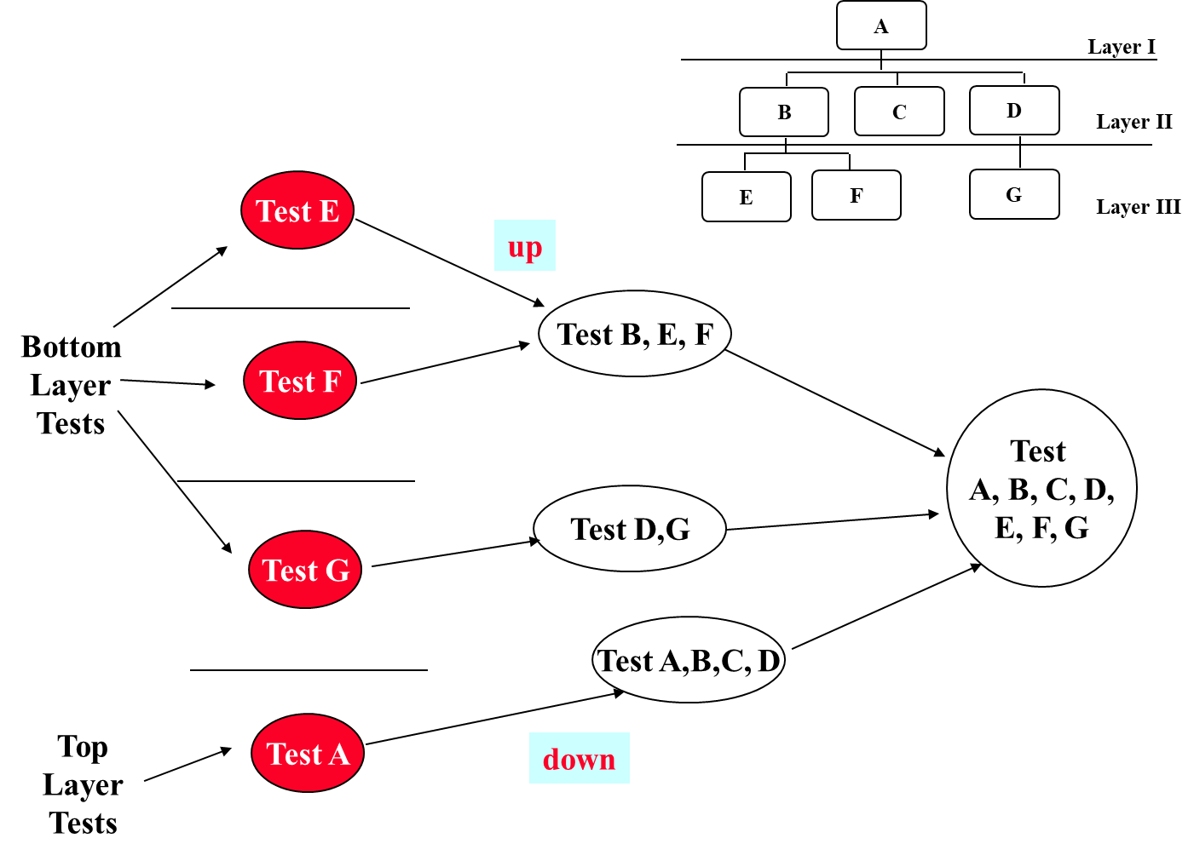
Sandwich Testing Strategy

Slide 24
Pros and Cons of Sandwich Testing
Top and Bottom Layer Tests can be done in parallel
Does not test the individual subsystems thoroughly before integration
Solution: Modified sandwich testing strategy

Slide 25
Modified Sandwich Testing Strategy
Test in parallel:
Middle layer with drivers and stubs
Top layer with stubs
Bottom layer with drivers
Test in parallel:
Top layer accessing middle layer (top layer replaces drivers)
Bottom accessed by middle layer (bottom layer replaces stubs)

Slide 26
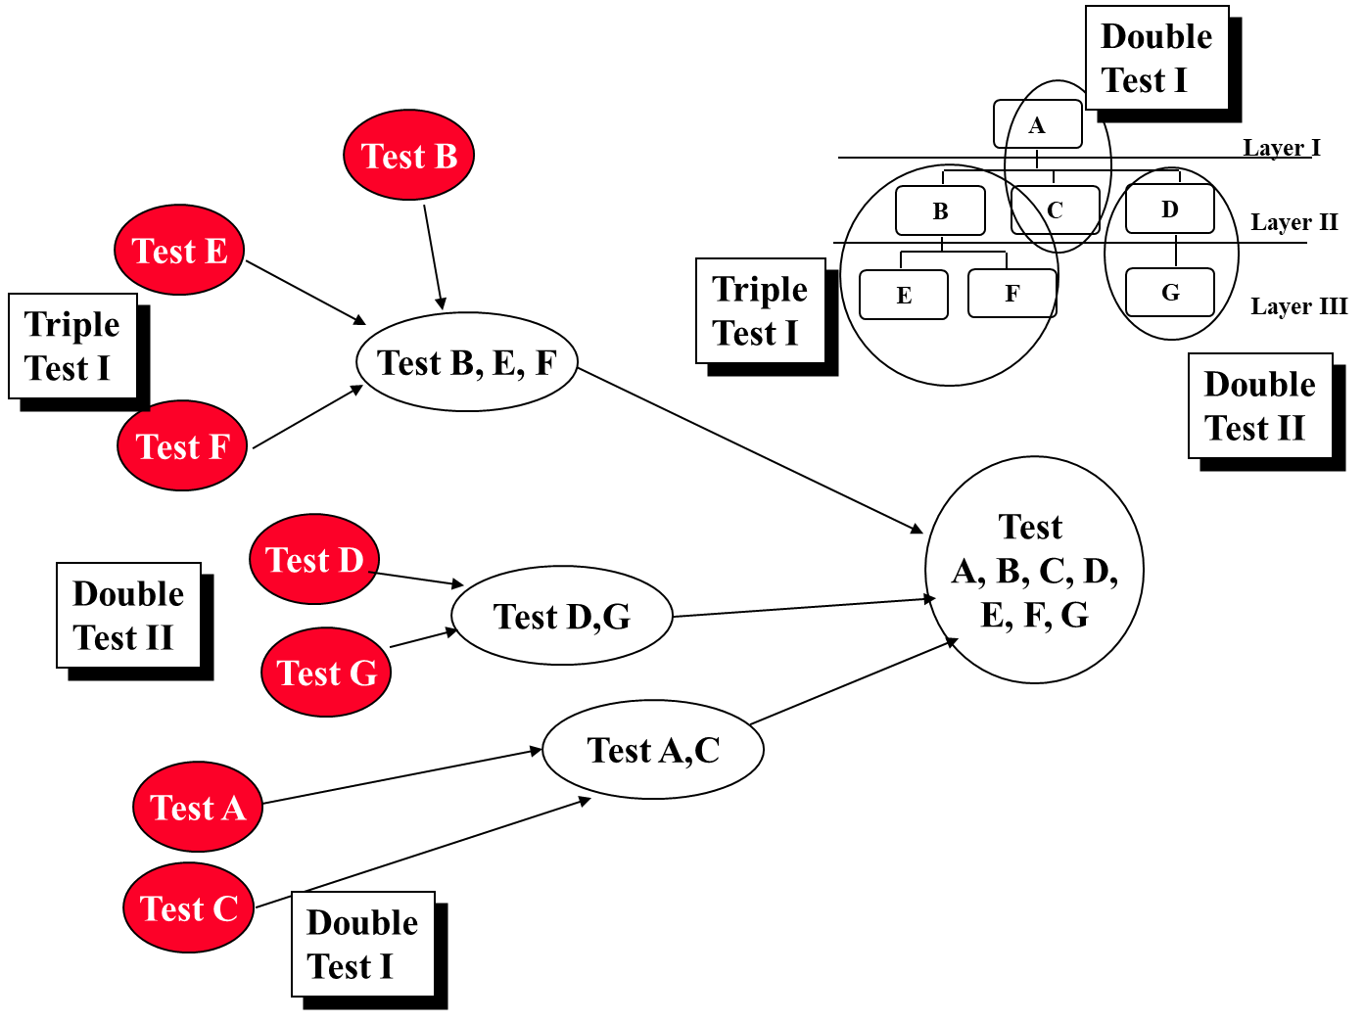
Modified Sandwich Testing Strategy

Slide 27
Steps in Integration-Testing
1. Based on the integration strategy, select a component to be tested. Unit test all the classes in the component.
2. Put selected component together; do any preliminary fix-up necessary to make the integration test operational (drivers, stubs)
3. Do functional testing: Define test cases that exercise all uses cases with the selected component
4. Do structural testing: Define test cases that exercise the selected component
5. Execute performance tests
6. Keep records of the test cases and testing activities.
7. Repeat steps 1 to 7 until the full system is tested.
The primary goal of integration testing is to identify errors in the (current) component configuration.

Slide 28
Which Integration Strategy should you use?
...Top-level components are usually important and cannot be neglected up to the end of testing
Detection of design errors postponed until end of testing
Top down approach
Test cases can be defined in terms of functions examined
Need to maintain correctness of test stubs
Writing stubs can be difficult
Factors to consider
Amount of test harness (stubs &drivers)
Location of critical parts in the system
Availability of hardware
Availability of components
Scheduling concerns
Bottom up approach
good for object oriented design methodologies
Test driver interfaces must match component interfaces
...

Slide 29
System Testing
Functional Testing
Structure Testing
Performance Testing
Acceptance Testing
Installation Testing
Impact of requirements on system testing:
The more explicit the requirements, the easier they are to test.
Quality of use cases determines the ease of functional testing
Quality of subsystem decomposition determines the ease of structure testing
Quality of nonfunctional requirements and constraints determines the ease of performance tests

Slide 30
Structure Testing
Essentially the same as white box testing.
Goal: Cover all paths in the system design
Exercise all input and output parameters of each component.
Exercise all components and all calls (each component is called at least once and every component is called by all possible callers.)
Use conditional and iteration testing as in unit testing.

Slide 31
Functional Testing
Essentially the same as black box testing
Goal: Test functionality of system
Test cases are designed from the requirements analysis document (better: user manual) and centered around requirements and key functions (use cases)
The system is treated as black box.
Unit test cases can be reused, but in end user oriented new test cases have to be developed as well.

Slide 32
Performance Testing
Stress Testing
Stress limits of system (maximum # of users, peak demands, extended operation)
Volume testing
Test what happens if large amounts of data are handled
Configuration testing
Test the various software and hardware configurations
Compatibility test
Test backward compatibility with existing systems
Security testing
Try to violate security requirements
Timing testing
Evaluate response times and time to perform a function
Environmental test
Test tolerances for heat, humidity, motion, portability
Quality testing
Test reliability, maintain- ability & availability of the system
Recovery testing
Tests system’s response to presence of errors or loss of data.
Human factors testing
Tests user interface with user

Slide 33
Test Cases for Performance Testing
Push the (integrated) system to its limits.
Goal: Try to break the subsystem
Test how the system behaves when overloaded.
Can bottlenecks be identified? (First candidates for redesign in the next iteration
Try unusual orders of execution
Call a receive() before send()
Check the system’s response to large volumes of data
If the system is supposed to handle 1000 items, try it with 1001 items.
What is the amount of time spent in different use cases?
Are typical cases executed in a timely fashion?

Slide 34
Acceptance Testing
Goal: Demonstrate system is ready for operational use
Choice of tests is made by client/sponsor
Many tests can be taken from integration testing
Acceptance test is performed by the client, not by the developer.
Majority of all bugs in software is typically found by the client after the system is in use, not by the developers or testers. Therefore two kinds of additional tests:
Alpha test:
Sponsor uses the software at the developer’s site.
Software used in a controlled setting, with the developer always ready to fix bugs.
Beta test:
Conducted at sponsor’s site (developer is not present)
Software gets a realistic workout in target environ- ment
Potential customer might get discouraged

Slide 35
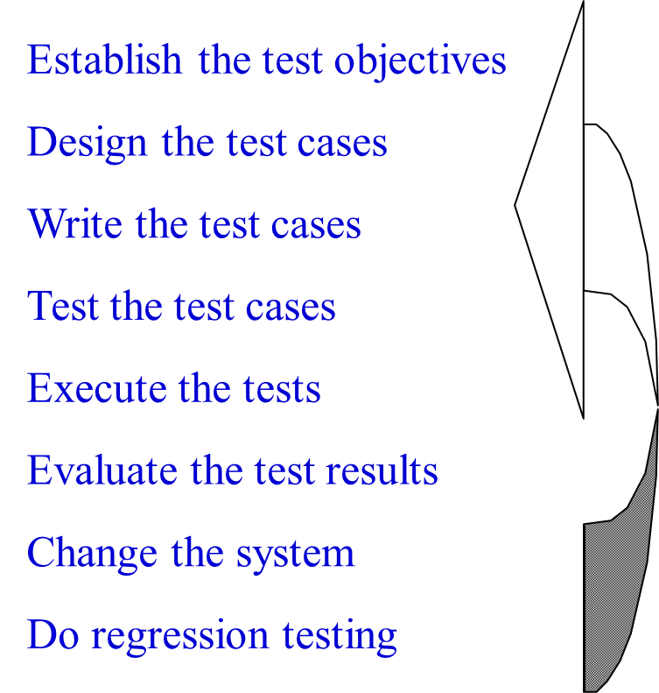
Testing Life Cycle

Slide 36
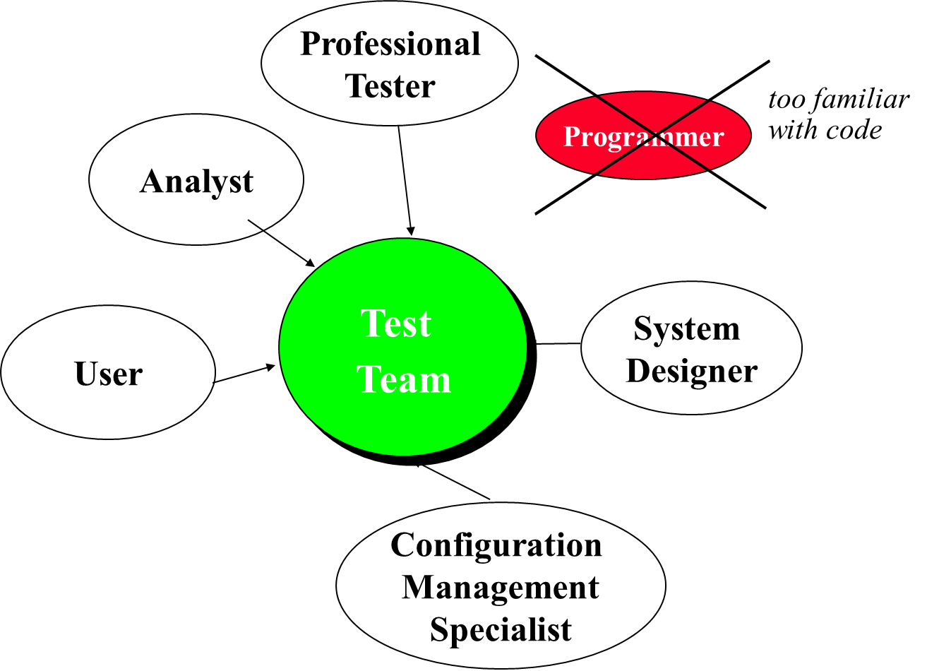
Test Team

