Slide 1
Project scheduling
Precedence diagram method
Project Management
Magister Sistem Informasi
Universitas Komputer Indonesia
references:
Larson, e.w., Gray C.F., 2011, 5tH ed.;
Pinto, j.k. 2010, 2ND. ED.

Slide 2
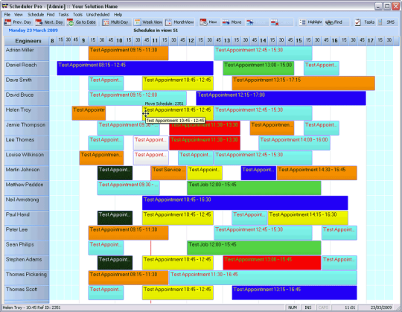
PRECEDENCE DIAGRAM METHOD
The Precedence Diagram Method is a tool for scheduling activities in a project plan. It is a method of constructing a project schedule network diagram that uses boxes, referred to as nodes, to represent activities and connects them with arrows that show the dependencies.
Critical Tasks, noncritical tasks, and slack time
Shows the relationship of the tasks to each other
Allows for what-if, worst-case, best-case and most likely scenario
Key elements include determining predecessors and defining attributes such as
early start date
late start date
early finish date
late finish date
Duration
WBS reference

Slide 3
PRECEDENCE DIAGRAM METHOD
Extension of AON Network
Allows concurrent activities to overlap
Restraints not required to model logical relationships
Schedule logic is easier and quicker to develop
Easier to modify
Better represents work flow in continuous operations

Slide 4
Types of Task Relationship
FS – Finish to Start
Finish
Start
SS – Start to Start
Start
Start
FF – Finish to Finish
Finish
Finish
SF – Start to Finish
Start
Finish

Slide 5
Leads & Lags
Activity Lead – Lag
Lag = time that a following activity is delayed from the start of the previous activity
Lead = time that an activity precedes the start or finish of the next activity

Slide 6
Leads & Lags
Normal
Finish - Start
Finish – Start
Modified by a Lead
Finish – Start
Modified by a Lag
Lead and Lag are used to Modify Relationships
Lead and Lag Can be used with any Relationship Type (FS, FF, SS)

Slide 7
Remodeling an Appliance
Activity |  | Duration | Predecessors
A | Conduct competitive analysis | 3 | -
B | Review field sales report | 2 | -
C | Conduct tech capabilities assessment | 5 | -
D | Identify relevant specification | 2 | A,B,C
E | Conduct telephone survey | 3 | D
F | Identify relevant specification improvements | 3 | E
G | Interface with marketing staff | 1 | F
H | Develop engineering specifications | 5 | G
I | Check and debug designs | 4 | H
J | Develop testing protocol | 3 | G
K | Identify critical performance level | 2 | J
L | Assess and modify product components | 6 | I, K
M | Conduct capabilities assessment | 12 | L
N | Identify selection criteria | 3 | M
O | Develop RFQ | 4 | M
P | Develop production master schedule | 5 | N, O
Q | Liaise with sales staff | 1 | P
R | Prepare product launch | 3 | Q

Slide 8
QUESTION
Develop Gantt chart and create a complete activity network diagram.
Identify the critical path.

Slide 9
Critical Path and Activity Slack Case
J. Wold, project manager of Print Software, Inc. Wants you to prepare a project network; compute the early, late, and slack activity times; determine the planned project duration; and identify the critical path. His assistant has collected the following information for the Color Printer Drivers Software Project.

Slide 10
Project Network Case (Continued)
ID | Description | Predecessor | Time
A | External specifications | None | 8
B | Review design features | A | 2
C | Document new features | A | 3
D | Write software | A | 60
E | Program and test | B | 60
F | Edit and publish notes | C | 2
G | Review manual | D | 2
H | Alpha site | E,F | 20
I | Print manual | G | 10
J | Beta site | H,I | 10
K | Manufacture | J | 12
L | Release and ship | K | 3

Slide 11
Greendale Stadium Case
The G&E Company is preparing a bid to build the new 47,000 seat baseball stadium. The construction must start July 1, 2017, and be completed in time for the start of the 2019 season. A penalty clause $100,000 per day of delay beyond March 20, 2019, is written into the contract.
Ben Keith, the president of the company, expressed optimism of obtaining the contract and revealed that company could net as much as $2 million on the project. He also said if they are successful, the prospects for future projects are quite good since there is projected a renaissance in building classic ball parks with modern luxury boxes.
Assignment: Given the information provided in the next table, construct a network schedule for the stadium project and answer the following questions:
1. Will the project be able to be completed by the March deadline? How long will it take?
2. What is the critical path for the project?
3. Based on the schedule would you recommend that G&E pursue this contract? Why? Include a one-page Gant chart for the stadium schedule.

Slide 12
ID | Activity | Duration (days) | Predecessor(s)
1 | Baseball Stadium
2 | Clear stadium site | 70 | -
3 | Demolish building | 30 | 2
4 | Set up construction site | 70 | 3
5 | Drive support piling | 120 | 2
6 | Pour lower concrete bowl | 120 | 5
7 | Pour main concourse | 120 | 3,6
8 | Install playing field | 90 | 3,6
9 | Construct upper steel bowl | 120 | 3,6
10 | Install seats | 140 | 7,9
11 | Build luxury boxes | 90 | 7,9
12 | Install jumbotron | 30 | 7,9
13 | Stadium infrastructure | 120 | 7,9
14 | Construct steel canopy | 75 | 10
15 | Light installation | 30 | 14
16 | Build roof supports | 90 | 6
17 | Construct roof | 180 | 16
18 | Install roof tracks | 90 | 16
19 | Install roof | 90 | 17,18
20 | Inspection | 20 | 8,11,13,15,19

Slide 13
EMR Project Case
No | Activities | Duration | Predecessor
1 | Electronic Medical Reference Project
2 | Architectural Decision | 5 days
3 | Specification
4 | Internal Specification | 12 days | 2
5 | External Specification | 7 days | 2
6 | Feature Specification | 10 days | 2
7 | Design Phase
8 | Voice Recognition | 10 days | 4SS+7 and 5
9 | Case | 4 days | 4 and 5FS+1
10 | Screen | 2 days | 4,5
11 | Database | 25 days | 6
12 | Microphone-soundcard | 5 days | 6 and 11FF-4
13 | Digital Devices | 7 days | 6
14 | Computer I/O | 5 days | 6
15 | Review Design | 5 days | 8,9,10,11,12,13,14

Slide 14
TERIMA KASIH

