Slide 1
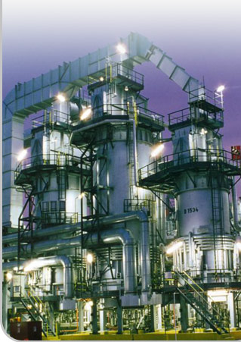
STRATEGIC MANAGEMENT DR. HERMAN S. MBA
ENVIRONMENTAL SCANNING &
INDUSTRY ANALYSIS
Magister Management Program
Universitas Komputer Indonesia

Slide 3
SCANNING THE NATURAL ENVIRONMENT
Resources
Wildlife
Climate
Environmental Sustainability

Slide 4
SCANNING THE SOCIETAL ENVIRONMENT
ECONOMIC | TECHNOLOGY | POLITICAL-LEGAL | SOCIOCULTURAL
GDP trends | Total Govornment spending for R&D | Antitrust regulation | Lifestyle changes
Interest rates | Tot Industry spending for R&D | Environmental protection laws | Career expectations
Money supply | Focus of technologies effort | Global warming legislation | Consumer activism
Inflation rate | Patent protection | Immigration laws | Rate of family formation
Unemployment level | New products | Tax laws | Growth rate of pop
Wage/price control | New dev in tech transfer fr lab to mrkt | Special incentives | Regional shift in population
Devaluation/ revaluation | Productivity improve | Foreign trade regulation | Life expectancies
Energy alternatives | Internet availability | Laws on hiring & promotion | Birhrate
Energy availability & cost | Telcom infrastructure | Stability of government | Health care

Slide 5
TECHNOLOGY IMPACT ON INDUSTRY
Portable information devices & electronic networking
Alternative energy sources
Precission farming
Virtual personal assistants
Genetically altered organisms
Smart, mobile robots

Slide 6
SOCIOCULTURAL TRENDS
Increasing environmental awareness
Growing health consciousness
Expanding senior market
Declining mass market
Changing pace and location of life
Changing household composition
Increasing diversity of workforce & market

Slide 7
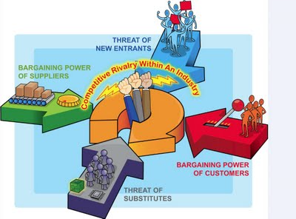
FORCES DRIVING INDUSTRY COMPETITION

Slide 8
THREAT OF NEW ENTRANTS
NEW ENTRANTS BARRIER TO ENTRY:
Economic of scale
Product differentiation
Capital requirement
Switching cost
Access to distribution channel
Government policy

Slide 9
RIVALRY AMONG EXISTING FIRMS
Number of competitors
Rate of industry growth
Product or service characteristics
Amount of fixed costs
Capacity
High of exit barriers
Diversity of rivals.

Slide 10
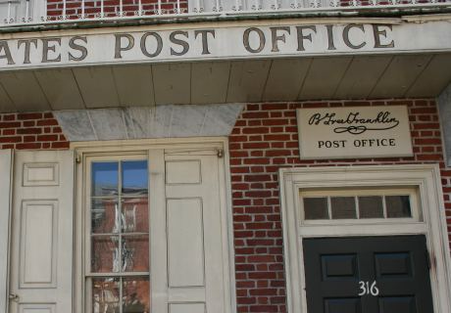
THREAT OF SUBSTITUTE PRODUCT

Slide 11
BARGAINING POWER OF BUYER

Slide 12
BARGAINING POWER OF SUPPLIER

Slide 13
RELATIVE POWER OF OTHER STAKEHOLDER

Slide 14
SYSTHESIS OF EXTERNAL FACTOR
List opportunity & threats (8-10) in column 1.
Weight each factor from 1.0 (most important) to 0.0 (not important) in column 2.
Rate each factor from 5 (outstanding) to 1 (poor) in column 3, based on company’s response to that factor.
Multiply each factor’s weight times its rating to obtain each factor’s weighted score in column 4.
Use column 5 (comments) for rationale used for each factor.
Add the individual weighted scores to obtain the total weighted score for the company in column 4. This tells how well the company is responding to the factors in its external environment.

Slide 15
EFAS TABLE (EXAMPLE)
External factors (1) | Weight (2) | Rating (3) | Weighted Score (4) | Comments
Opportunities
Economic integration of european community
Demographic favor quality appliances
Economic development of asia
Opening of eastern europe
Trend to superstore
Threats
Increasing government regulation
Strong U.S. competition
Whirlpool & electrolux strong globally
New product advances
Japanese appliance companies
TOTAL SCORES

