Slide 1
Tone, mood, atmosphere
Group 2
63718020 Dinan Fuzianti
63718010 Melva pangestu
63718007 Rima MARDIYANI
63719004 MUHAMMAD LUTHFI NURJAYA

Slide 2
Atmosphere
is the emotional tone pervading a section or the whole of a literary work, which fosters in the reader expectations as to the course of events, whether happy or (more commonly) terrifying or disastrous (Abrams, M. H )
- the arrangement or representation of natural and artificial things, not as the stand on their on, but in their association with characters’ actions, thought, feelings, and expereiences. (Ribó, I.)

Slide 3
Mood
The alternative terms frequently used for atmosphere (Abrams, M. H)

Slide 4
Tone
- Tone as the expression of literary speaker’s “attitude to his listener”. (Abrams, M. H)
- Tone was defined as the content and form, or manner, in which the story is told (Dwyer, R., & Davis, I.)

Slide 5
Chapter 5 : Nick invite Diasy to have a tea and they both visited Gatsby’s place
Chapter 6 : Tom & Daisy came to Gatsby Party. Gatsby want Daisy to come back to him.
Chapter 7 : Nick & Jordan come to Tom & Daisy’s place to have a lunch and Gatsby pursued Daisy
to tell tom that she didn’t love him but gone wrong and Daisy freak out untill she nabrak Myrtle
Chapter 8 : Gatsby wait for Daisy’s call but he found dead at his pool
Chapter 9 : Nick call every Gatsby’s closest person to come to Gatsby furneral

Slide 6
How to Identify?

Slide 7
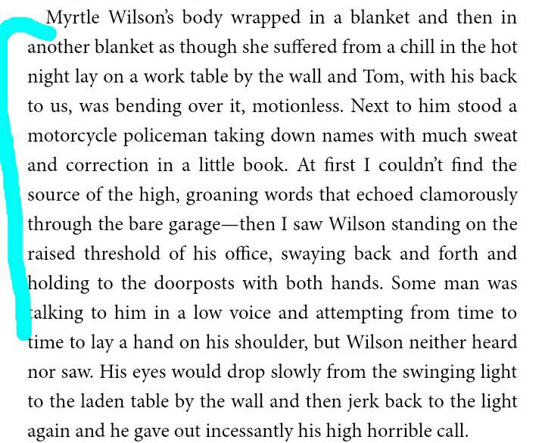
Atmosphere To identify Atmosphere, usually the narrator have a third person speaker to describe the situation. it would describe the place situation or the surrounder so the reader can feel it.
From the passage, Nick described the situation where Myrtle dead and her dead body wrapped in a blanket as it surrounded by people. Wilson, the husband of Myrtle seat in his office look so frustated.
Atmosphere : Gripping

Slide 8
Tone the tone could be formal and informal. it can be identified by the attitude that author want to deliver. Tone can be seen from the dialogue of a character that show the exact emotion.
In the first passage, Tom was declining the idea about Daisy who didn't love him, from the way he talked it can be seen that he was filled with emotion. The tone in this moment are furious and jealous.
Meanwhile in the second passage shown the conversation between Nick and Gatsby. The tone of this can be seen from Gatsby’s who is flustered

Slide 9
Mood Mood are related with atmosphere and tone. But the mood defined as the emotion that the readers can feel. It can be identified by the description, monologue and dialouge from two characters.
From the passage, when Daisy and Gatsby came to a place and there are just the two of them. As the readers we could feel the romantic and affection from both of them.

Slide 10
Relation between Atmosphere, Tone & Mood.
Atmosphere
Tone
Mood

Slide 11
Reference
Ribó, I. (2019). Prose Fiction: An Introduction to the Semiotics of Narrative.
Dwyer, R., & Davis, I. (Eds.). (2016). Narrative research in practice: Stories from the field. Springer.
Abrams, M. H., & Harpham, G. (2011). A glossary of literary terms. Cengage Learning.

Slide 12
Thank You

