Slide 1
Note-Taking for Consecutive Interpreting

Slide 2
Katharine Allen (51st ATA Conference, Denver)
  Importance of developing note-taking skills in community interpreting
    not interrupting speakers all the time for short consecutive interpretation.
  Community interpreting training programs are teaching would-be interpreters to interrupt people all the time
    Sometimes the medical provider is giving a long explanation to the patient about his/her condition and their plans for patient recovery → lose track when interrupted.
Importance of note-taking

Slide 3
In court,
  Many interpreters are now using digital recorders in the long consecutive mode
    Then providing simultaneous interpretation
However, recorders sometimes fail (technical problems, etc)
Importance of note-taking

Slide 4
But, long consecutive interpreting with note-taking may not be the best model all the time
  the distance between the original speech and the interpreted rendition is too long
    paralinguistic elements (nonverbal communication, intonation, emotional outbursts, etc) are lost.
  Maybe in these emotionally charged settings, the simultaneous mode would be the best format
Note-taking?

Slide 5
7 principles
  Noting the idea, not the word
  Abbreviation
    Unless a word is short (4-5 letters), interpreters should use an unambiguous abbreviated form
  Links
  Negation
    OK = agree;
then “disagree” =
Emphasis
Verticality – top to bottom
Shift
OK
Jean-François Rozan (1956)

Slide 6
54, prices
but no = income
so pop^{on}
“Over the course of 1954, prices rose, although not to the same extent as income, thus the population’s net income increased.”
Notes

Slide 7
Macro
  Looking at the bigger picture
  Structure, framework, the way the speech is built up
Micro-level
Words, expressions
Note-taking for consecutive interpreting
  Skeleton structure of the speech.
  Visual representation of your analysis of the source speech.
Andrew Gillies (2005)

Slide 8
Exercise
Measuring the demand for treatment of substance use disorders is vital for monitoring changes in the pattern of drug use in the community and in planning a responsive treatment system.
This survey has been developed in the framework of the UNODC-WHO Programme on Drug Dependence Treatment and Care.¹

Slide 9
Different tasks
  Phase 1: listening and analysis, note-taking, short-term memory operations, coordination of these tasks
  Phase 2: note-reading, remembering, production
Difficulties:
  If you’re thinking too much about how to note something, you will listen less well.
  If your notes are unclear or illegible your production will suffer because you’ll put too much effort into reading them.
Note-taking

Slide 10
Dissecting the speech
  Analyzing its structure, progression
  Analyzing the communicative function of different parts of the speech
  Recognizing the main ideas and secondary ones
  Spotting the links between them
Note-taking

Slide 11
To summarize:
  Function and structure of the speech’s parts.
  Not the content!
Mini Summaries

Slide 12
Way of organizing information on a piece of paper
Organic chart
Words and drawings are connected to one-another on the page in various ways
  Lines
  Position on the page relative to one another
How the mind associates and recalls information
Mind Maps

Slide 13
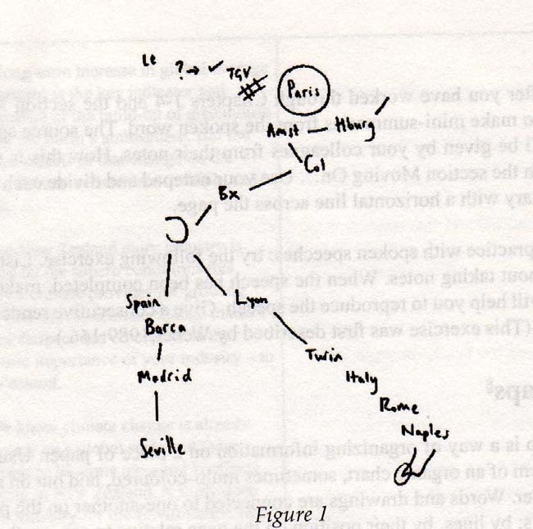
In the long term the idea is to develop a European high-speed railway network with Paris at its centre. A line to the north will reach Brussels, where it can branch out to the east to Cologne, or continue further north to Amsterdam and later even Hamburg. To the south-east the line through Lyon will Enter Italy through Turin and reach through Rome and Naples right down to the toe of Italy. In the south-west a link up with Spain via Barcelona and then to Madrid will make it possible to extend the network down to Seville.
Mind Maps

Slide 14
“Who did what to whom?”
The sentence
  Basic unit of communication
    Subject
    Verb
    Object
SOV

Slide 15
“Who does what to whom (or to what)?”
S
V
O
O
We…
…took stock of…
relations…
…and the situation
For the purposes of note‐taking in consecutive interpreting an idea is….
SVO
SVO

Slide 16

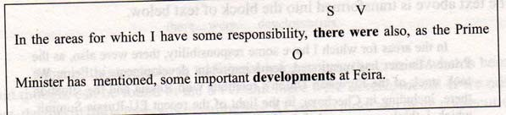
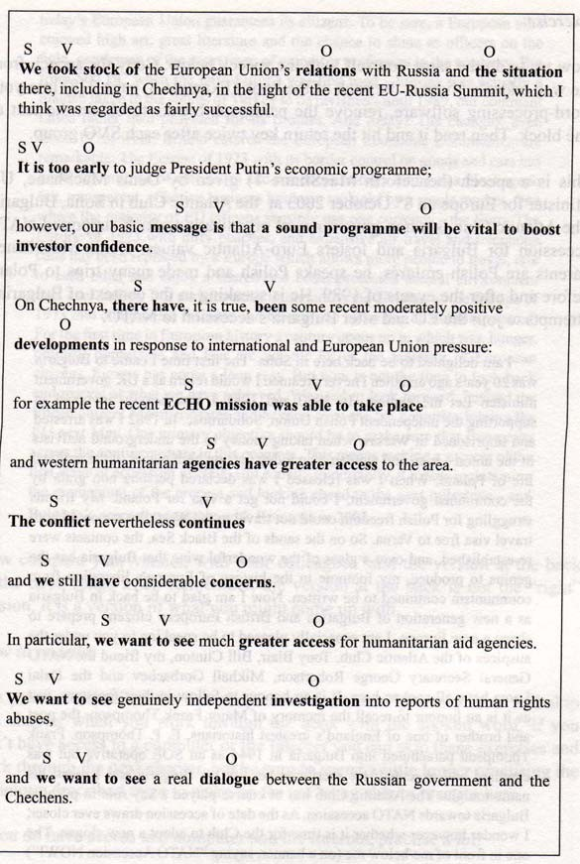

Slide 17
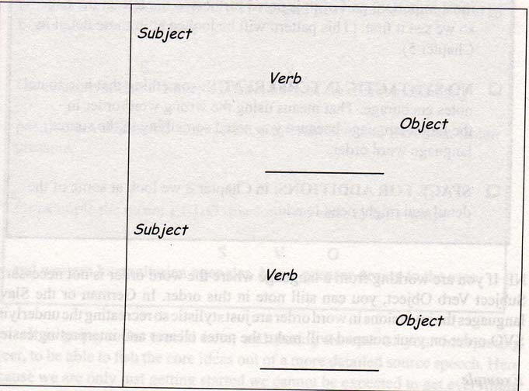
On each page
  Two or three sections
    Subject, verb and object
    Diagonally across the page.
    Don’t squeeze more than this onto a page
      Will be harder to read back
SVO

Slide 18
Easier to read back
  Less writing on a page, so ideas stand out
Visible structure
  Visible at a glance, which is not possible if we note horizontally as we write normally.
Eyes move from left to right
  Like a typewriter, always coming back to the left at the end of each idea
The beginning of each idea
  Is noted furthest to the left, so we see it first
No syntactic interference
  Something that horizontal notes encourage. That means using the wrong word order in the target language because you noted something in the source language order
Space for additions
SVO Diagonally

Slide 19
There
were
developments
we
took stock
relations
+ situations
It
is
too early
SVO Diagonally

Slide 20
Links
  Signal the way the speaker wants to listener to relate what is about to be said to what has been said before
Speech
Ideas
Links between them
Links

Slide 21
The economy is struggling. The Central Bank has left interest rates unchanged.
The economy is struggling. However, the Central Bank has left interest rates unchanged.
The economy is struggling. Consequently, the Central Bank has left interest rates unchanged.
  Different messages
    Bring ideas into relations with one another
    Provide more information about the situation
Links

Slide 22
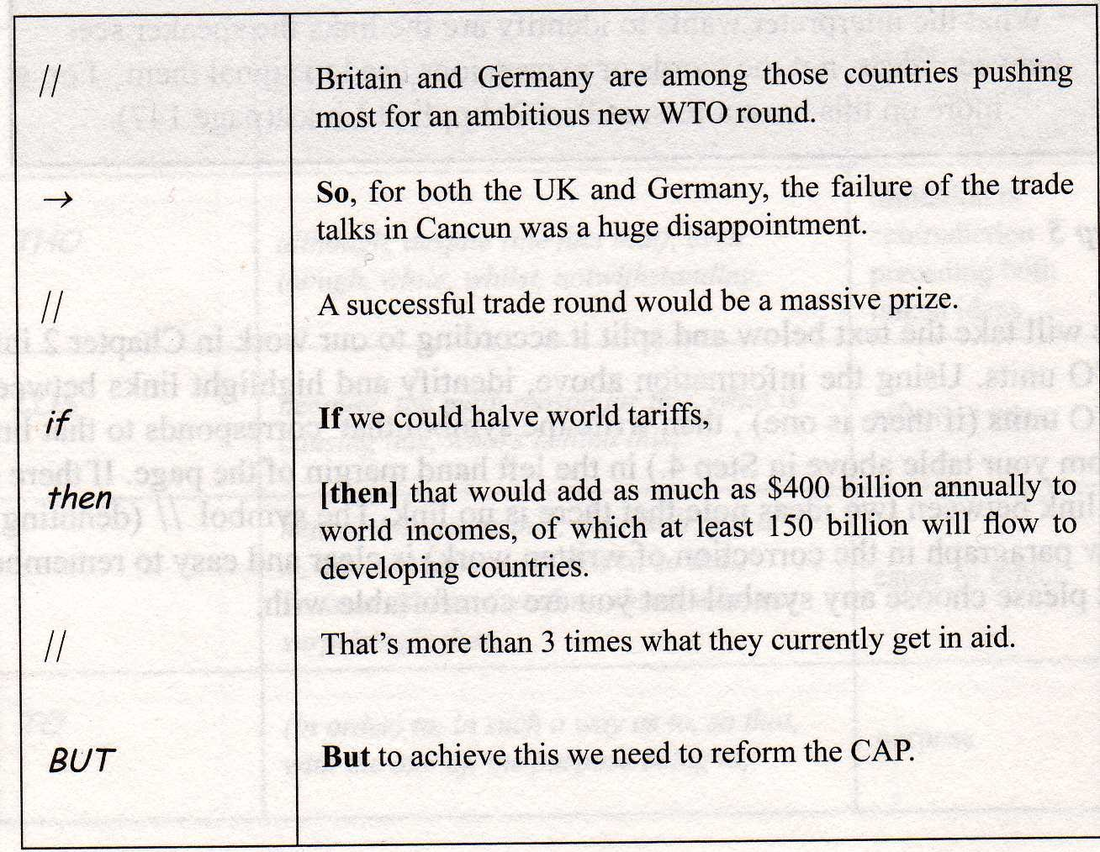
Links

Slide 23
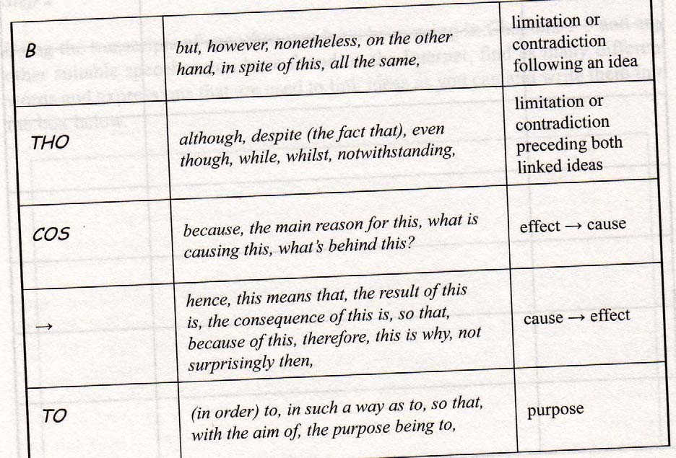
Links

Slide 24
It’s not uncommon for speakers to have the same subject doing many different things.
By noting the verbs parallel to one another on the page
  Clearly see they have the same subject
Parallel Values

Slide 25
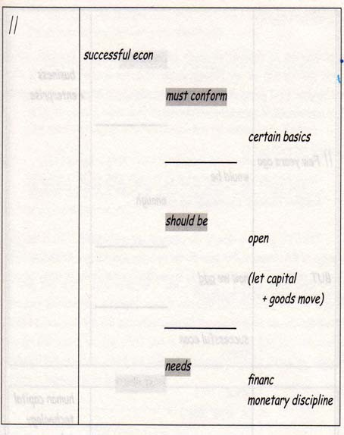
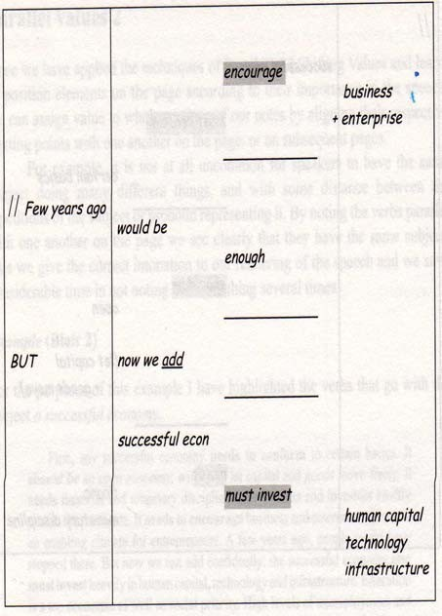
First, any successful economy needs to conform to certain basics. It should be an open economy, willing to let capital and goods move freely. It needs financial and monetary discipline - the markets and investors swiftly punish the profligate. It needs to encourage business and enterprise - to create an enabling climate for entrepreneurs. A few years ago, people might have stopped there. But now we can add confidently: the successful economy also must invest heavily in human capital, technology and infrastructure. Education is a top economic as well as social priority. High levels of unemployment and social exclusion do not just disfigure society, they waste the national resource of human talent.
Parallel Values

Slide 26
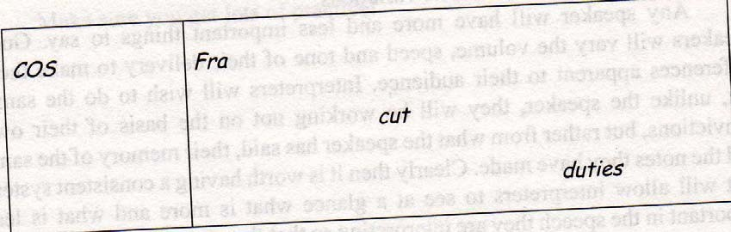
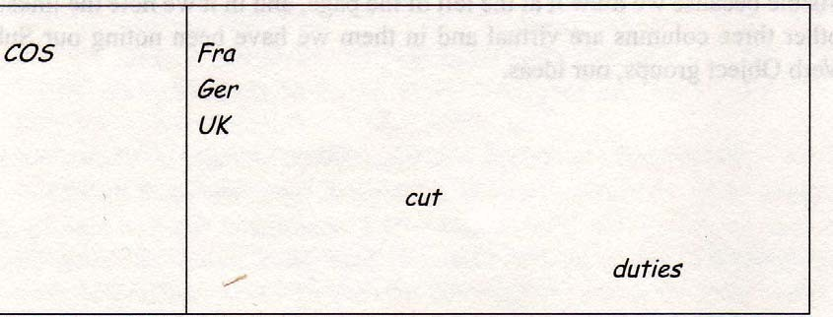
Because the French government has cut customs duties.
Because the French, German and British governments have cut customs duties.
Parallel Values

Slide 27
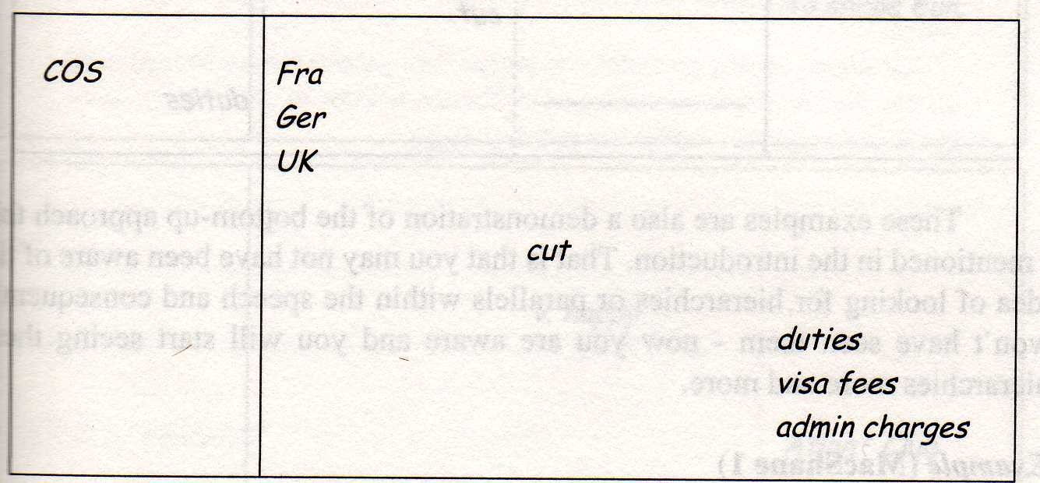
Because the French, German and British governments have cut customs duties, visa fees and administrative charges.
Parallel Values

Slide 28
By positioning an element vertically below another
  In brackets
  Clearly identify
    One belongs to the other
    Is subordinate to it within the clause or SVO group
  We can adjust our intonation appropriately
Brackets

Slide 29
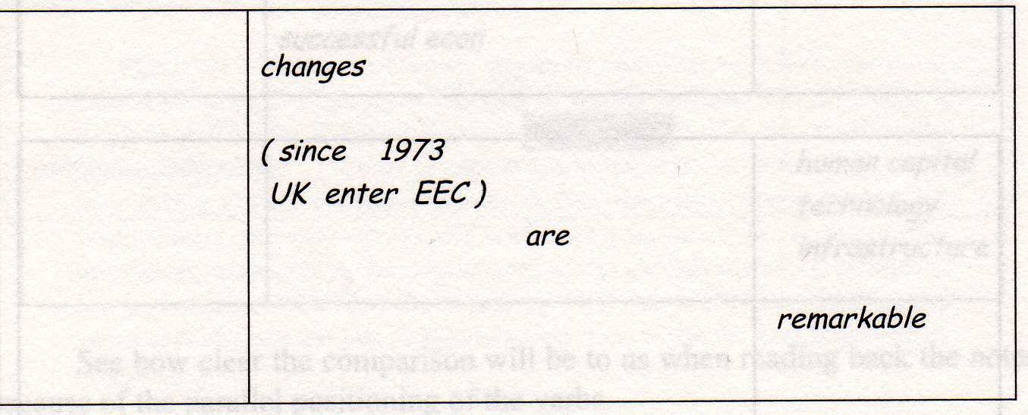
And today? The changes, even since 1973, when Britain entered the European Economic Community, are remarkable:
Brackets

Slide 30
First thing students interpreters ask about
Knowing a reasonable number of useful symbols can make our lives easier
  But unimportant when compared to all of what we have read before
  If you don’t have a consistent and meaningful note-taking system
    No symbol is going to help you
Symbols

Slide 31
Not only a picture
  Short word
  Pair of letters
  Single letter
    The important thing is what it represents
      Concepts not words
  Concepts not words
    They’re not one-to-one translations so they help us avoid source language interference when we interpret
Symbols

Slide 32
Clear and unambiguous
Quick and simple to draw
  More than 3 strokes of the pen is probably two slow.
Prepared in advance
  DON’T IMPROVISE MID SPEECH
Consistent
  If E is energy, make sure it stays energy always and find yourself another symbol for environment and economy.
Organic
  Starting point for many other symbols
Must mean something to you
  Don’t blindly copy symbols you see if they don’t create associations for you
Symbols

Slide 33
The symbol of the square commonly denotes “country, nation, land, state”
  al national (adjective
  ally nationally
  ze to nationalize
  tn nationalization
  o national (noun), citizen
Symbols - Organic

Slide 34
←
↗
↘
↔
→
Return, come back, reverse, regress Rise, increase, grow, climb, etc
Fall, decline, slide, slip, drop, shrink Exchange, relations
Lead to, consequence of, therefore
Symbols – The Arrow

Slide 35
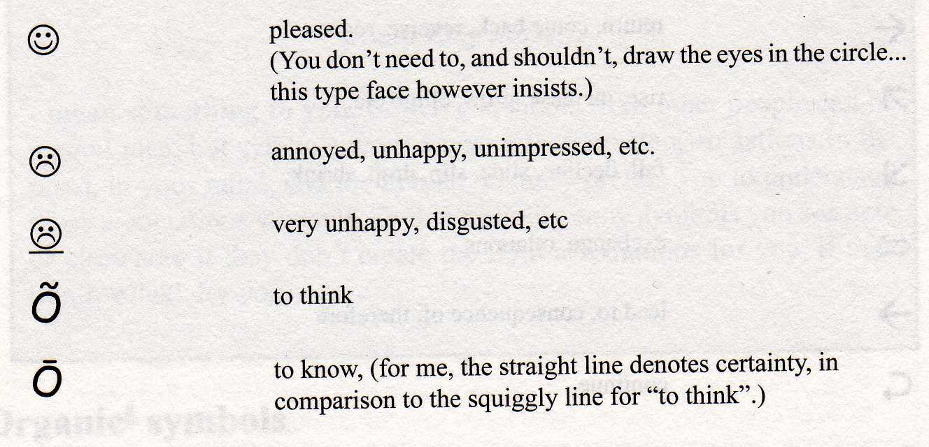
Symbols - People

Slide 36
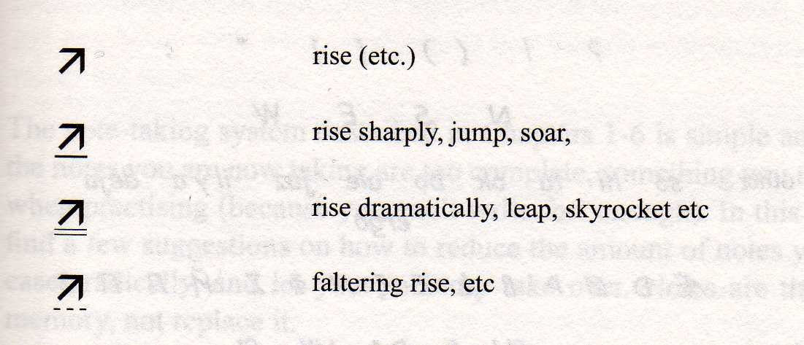
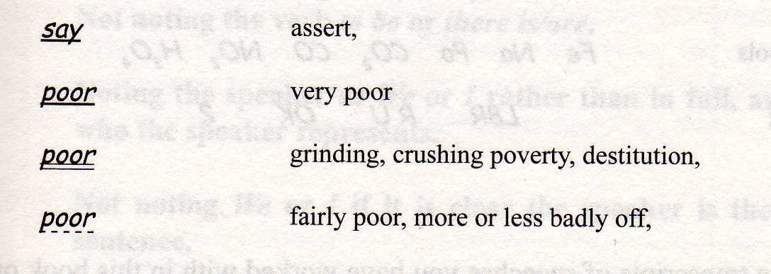
Symbols - Underlining

Slide 37
Math | = | + | > < % /
Science | E | µ | t
Music | #
Text messages | L8R R U OK? 2 |  |  |  |  | etc.
Keyboard | % & @ ¶ ™
Punctuation marks | ? ! ( ) " :
Vehicle registrations | D DA UK CH F
Short words in other
languages: | so hi ta ok / deja / ergo etc |  |  |  |  | / pero
Currencies | $ | Y L |  | €
Periodic table | Fe | Na |  | Po | Ag | CO2 | CO | NO2 | H3SO4
Where to find symbols?

Slide 38
Skills
  Fluency
  Natural intonation
  Engaging your audience
  Using your notes correctly
“Read” might be misleading
  Interpreters do not read their notes in the usual sense of the word.
  You’re constantly reading ahead of your notes
Reproduction/ Delivery

Slide 39
Good speakers vary
  Volume
  Speed
  Tone of delivery
Interpreters will want to do the same
  Based on
    What the speaker said
    Memory
    Notes taken
Reproduction/ Delivery

Slide 40
Rozan, Jean-François. Note-taking in Consecutive Interpreting. Trans. Andrew Gillies. Tertium. Poland, 2004.
Gillies, Andrew. Note-Taking for Consecutive Interpreting: A Short Course. St. Jerome. 2005
http://interpreters.free.fr/
References

