Slide 1
Analysis on Popular Literature
Twilight Novel Series

Slide 2
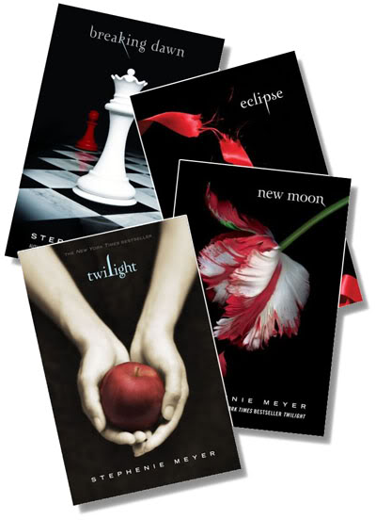
The Popularity
Published from 2005-2008
Sold over 120 million copies worldwide
38 different languages translation around the globe.[
Over 235 weeks on the New York Times Best Seller list for Children's Series Books.
The four Twilight books have consecutively set records as the biggest selling novels of 2008 on the USA Today Best-Selling Books list

Slide 3
Why

Slide 4
Theme
Vampire
Love

Slide 5
Character
A perfect figure of vampire
A beautiful, weak, lovely girl

Slide 6
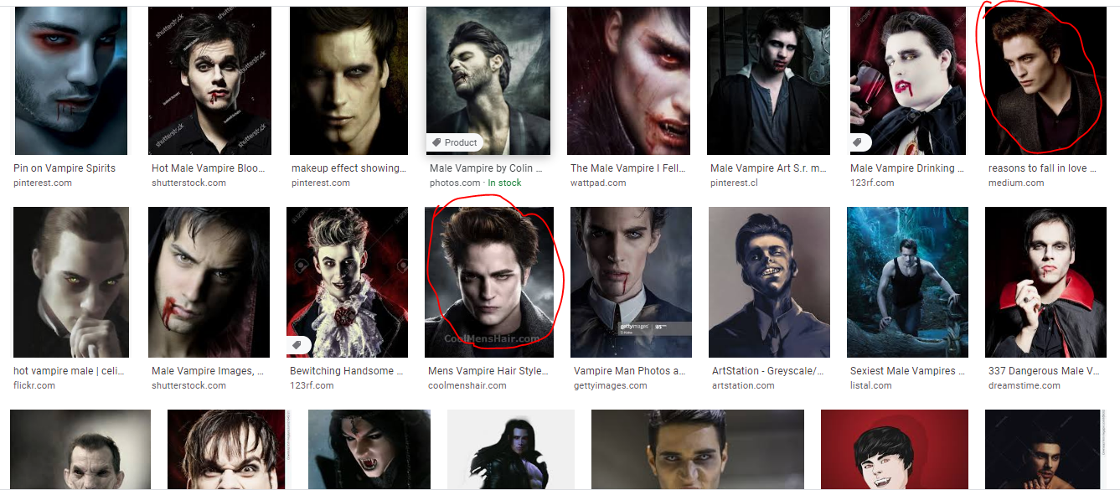

Slide 7
Plot

Slide 8
Setting

Slide 9
Convention?
Invention?

