Slide 1
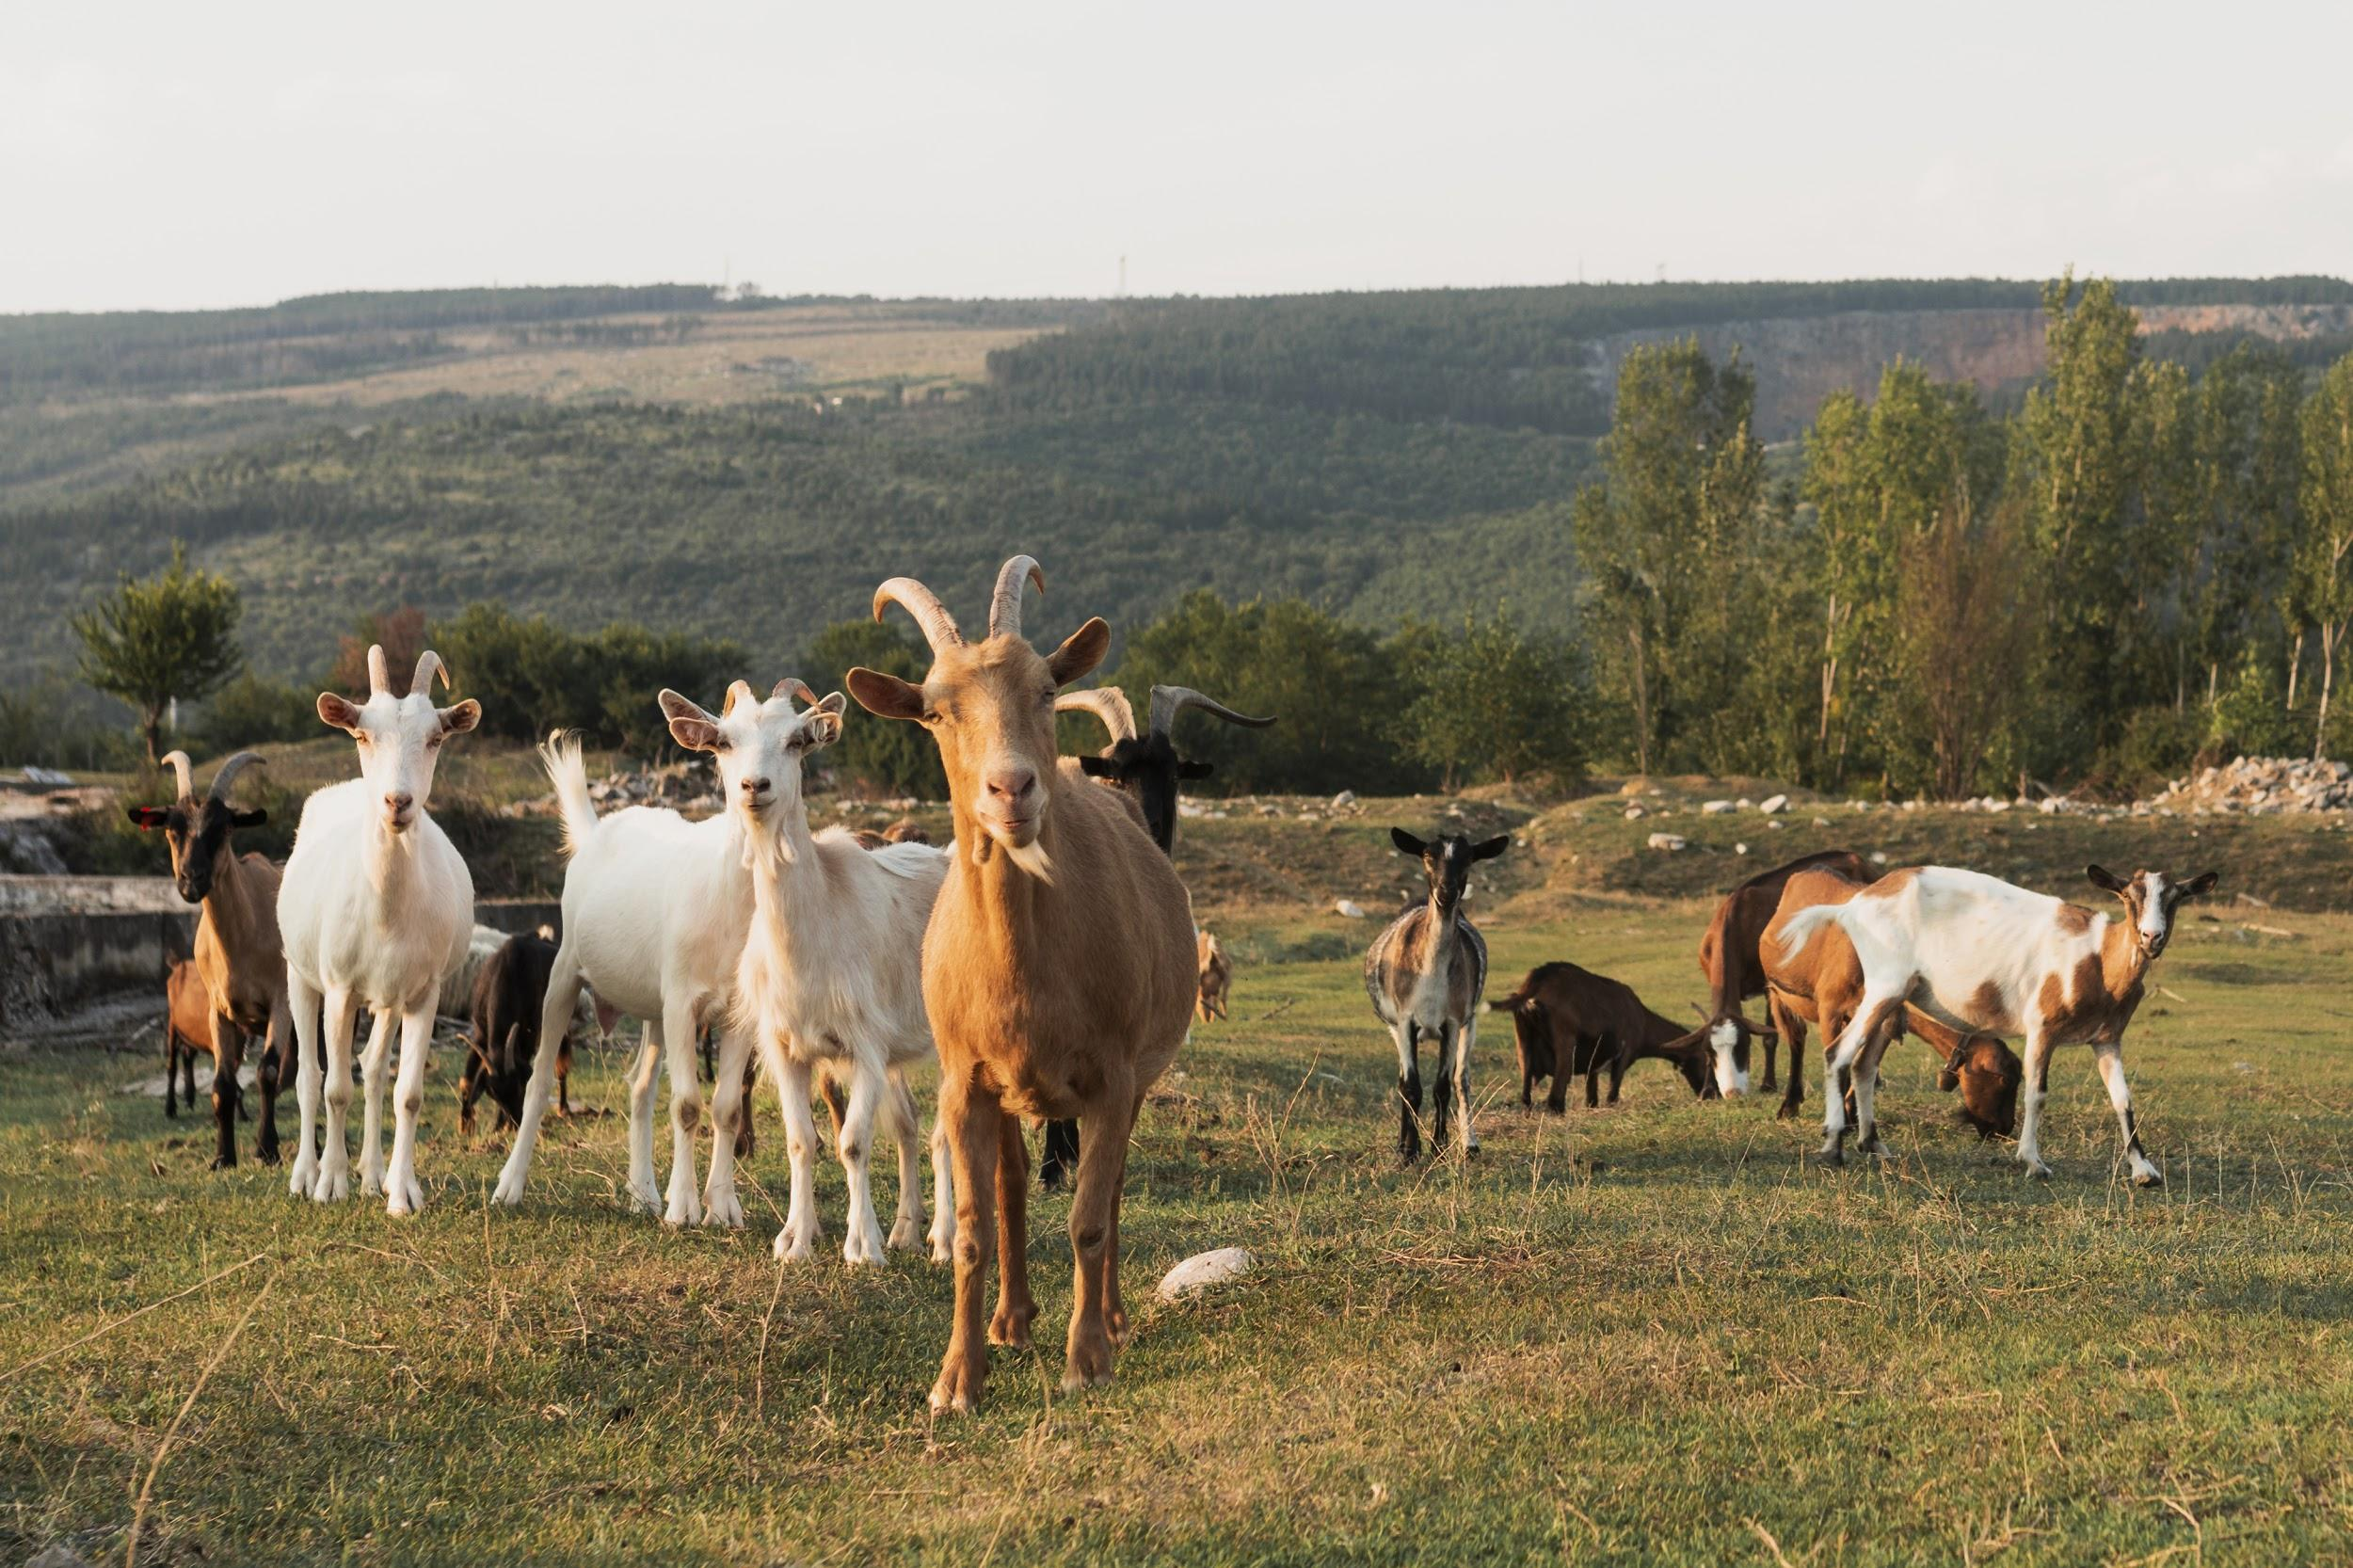
Animal Farm
Created by:
63718029 Nurin Fadhila Fasya
63718027 Vina Siti Sri Nofia
63717710 Saleha Aryani
63718039 Husnun Habibah

Slide 2
01
02
ANIMAL FARM OVERVIEW
Allegory and Satire
TABLE OF CONTENTS
03
04
Class Struggle
Class Struggle in Animal Farm
Synopsis, Animalism
Soviet Communism, Stalin
Definition, Bourgeois, Proletaria.

Slide 3
Animal Farm
OVERVIEW
Animal Farm is a novel written by George Orwell. The story is about livestock who wants to be free from their farmer. The Animal rebel and kick out the farmer, then their start to manage and organize the farm by themselves.

Slide 4
Animalism
Animalism
Animalism is ideology that are made by the pigs, and agreed by others animal there. Animalism is a concept that Animals are Equal.

Slide 5
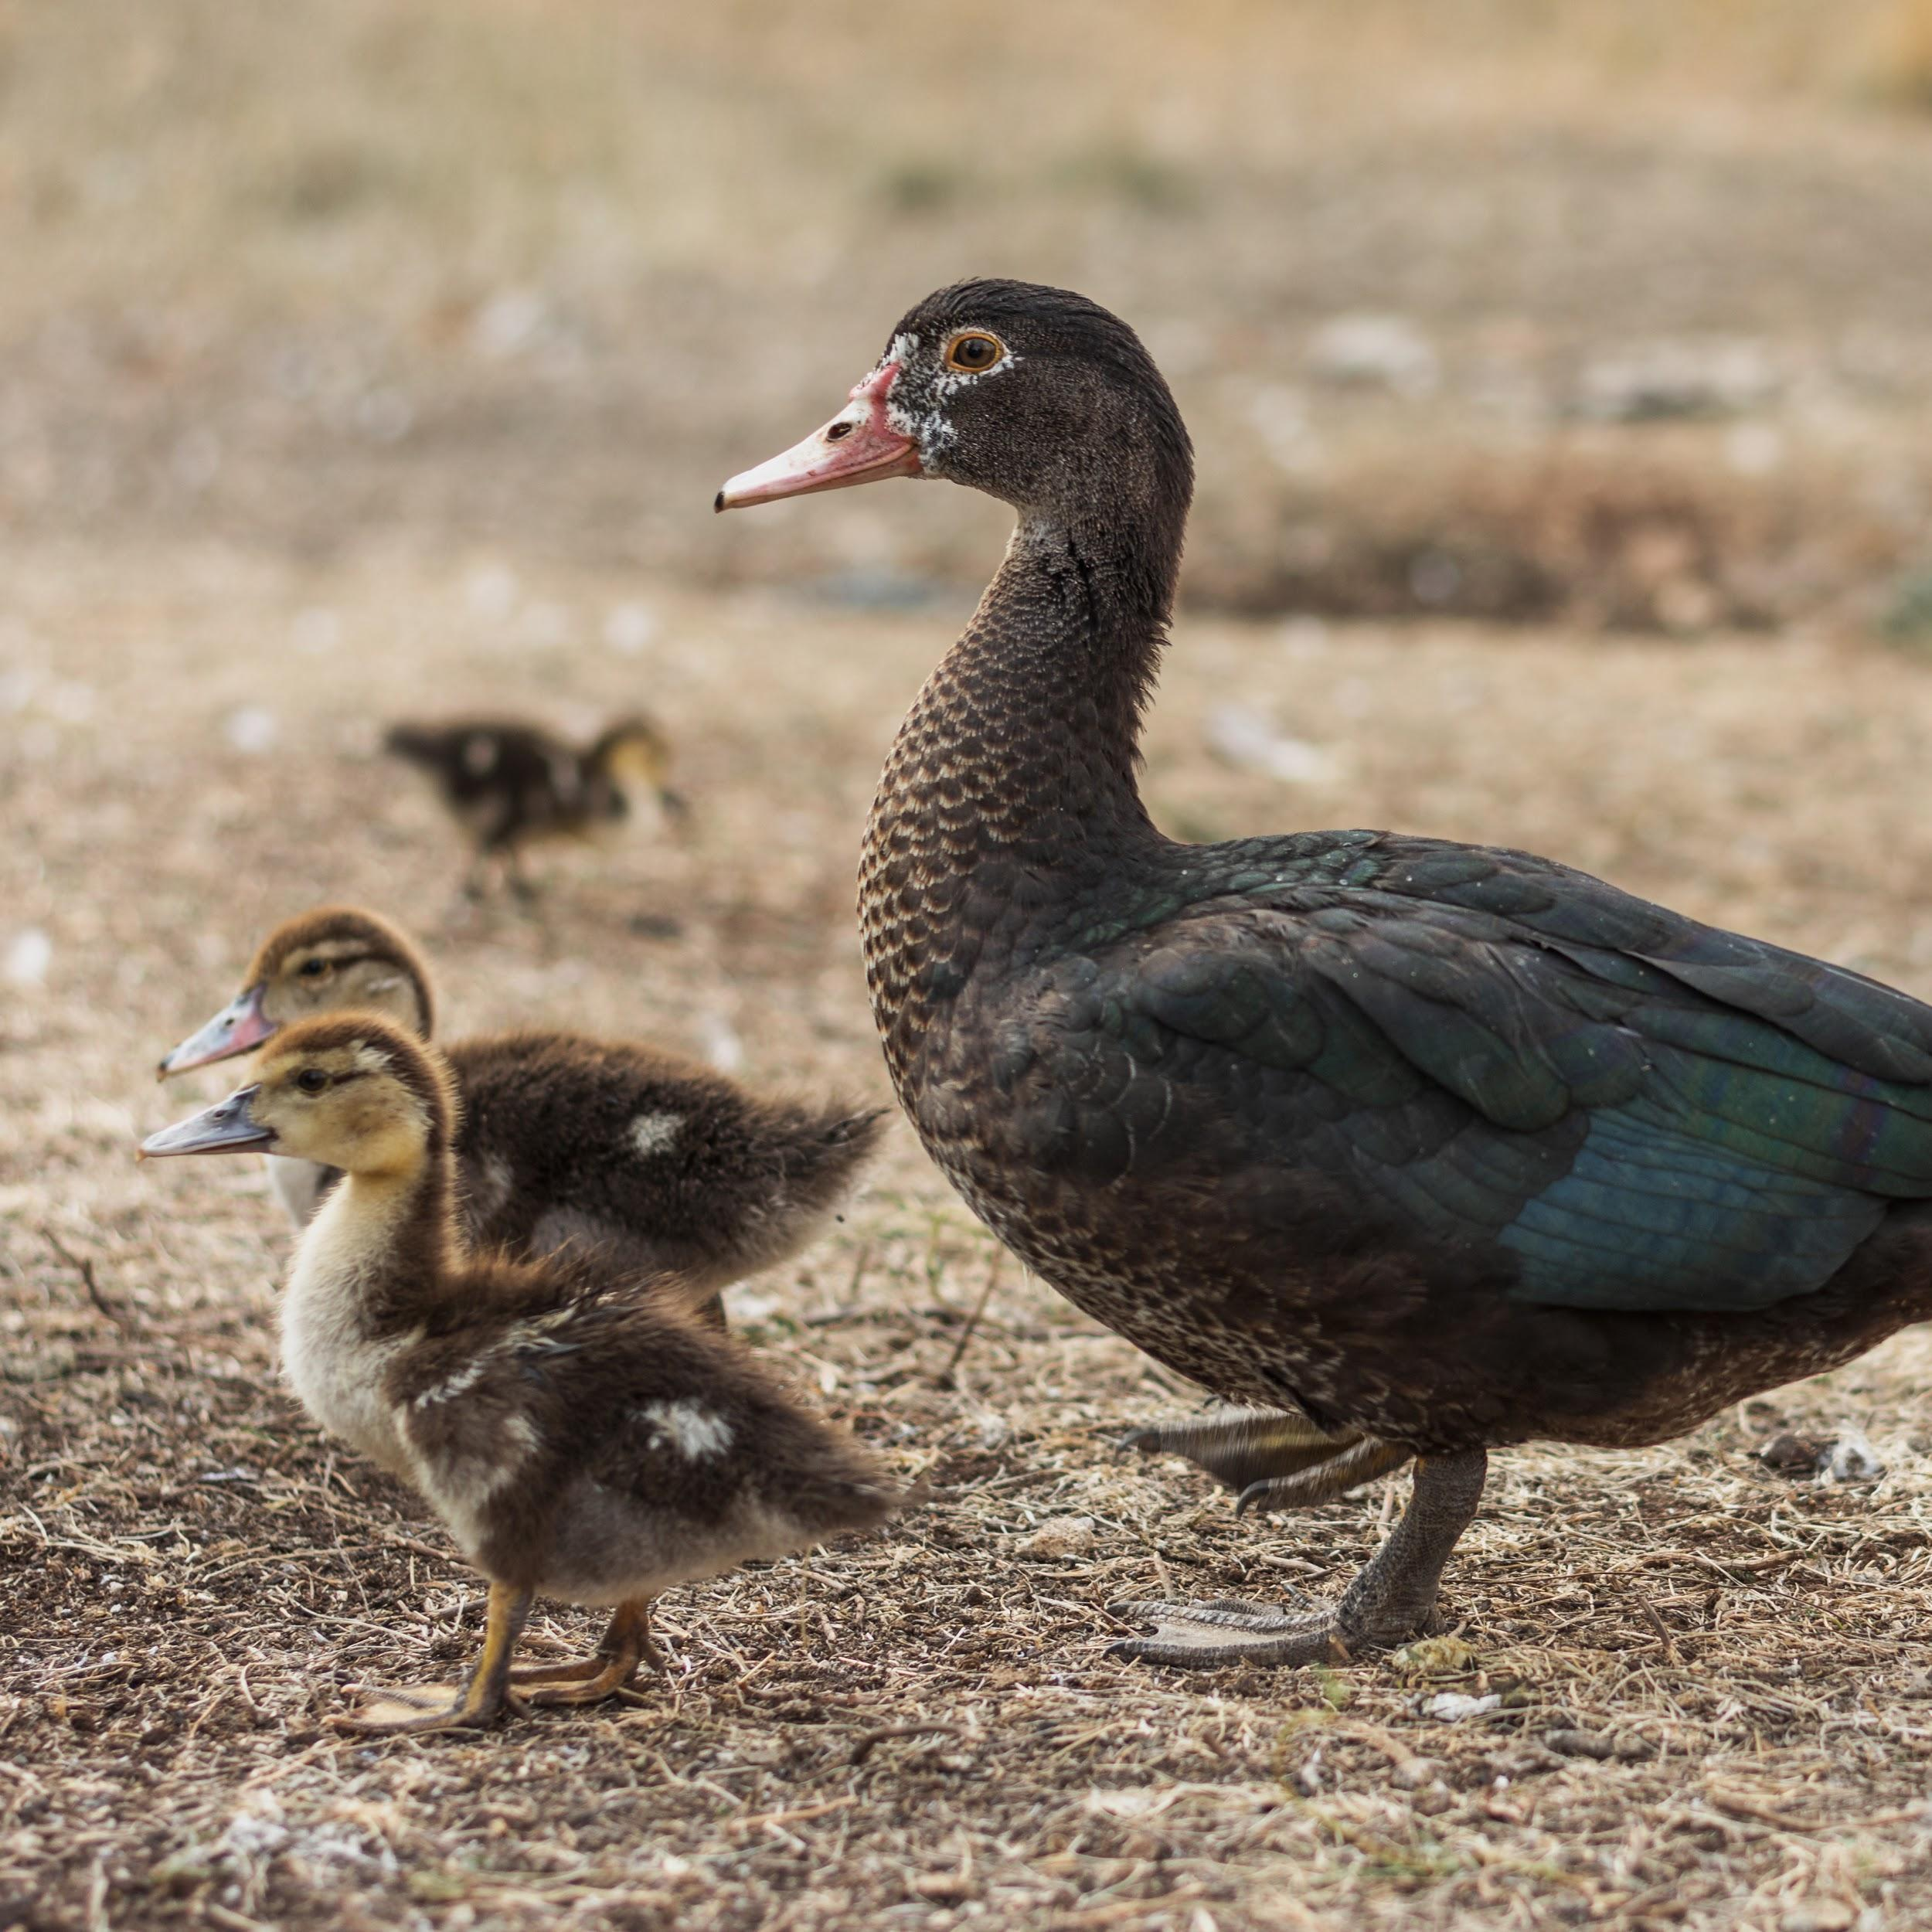
02
Satire
Animal Farm is a Parody of political practice of Uni Soviet

Slide 6
Deadly Satire of Soviet Communism
A parody of socialist ideals by the soviet regime

Slide 7
Stalinism
George orwell is satirize Stalinism (Socialism, totalitarian, Collectivities of Agriculture, Cult of Personality)

Slide 8
03
Marxism
Marxism is doctrine developed by Karl Marx

Slide 9
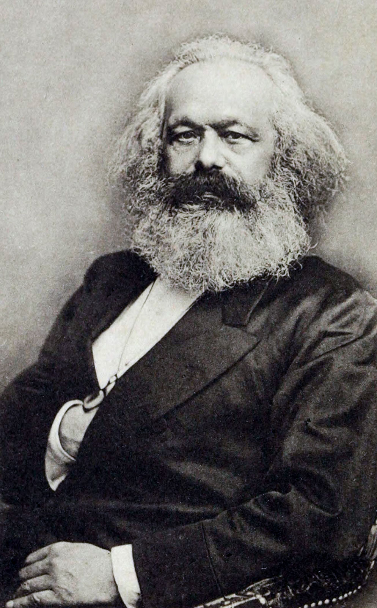
KARL MARX (1818-1883)
In their Communist Manifesto, Marx and Engels write that the history of all hitherto existing society is the history of class struggles (1967:79).
CLASS STRUGGLE

Slide 10
THE BOURGEOISIE
THE PROLETARIA
In their Communist Manifesto, Karl Marx and Friedrich Engels explain that bourgeois is a synonym of capitalist because both are the owners of the means of social production and the employers of wage labor (1967:79).
According to Marx (1967), a proletariat designates the class of wage workers who were engaged in industrial production and whose chief source of income was derived from the sale of their labor power.
CLASS STRUGGLE

Slide 11
PRODUCT AND WORK
THEORY OF CLASS STRUGGLE BY KARL MARX
HUMAN IS SOCIAL ANIMAL
1
Marx believed that “production,” or work, was the thing that gave life material meaning.
2
we are by nature social animals. We work together, we collaborate, we are more efficient when we share resources.

Slide 12
02
Class Struggle in Animal Farm
“Four legs good, two legs BETTER! Four legs good, two legs BETTER! Four legs good, two legs BETTER!”

Slide 13
Pig as Bourjouis
Other Animals as Proletaria

Slide 14
RESOURCES
Marx, Karl and Friedrich Engels. The Communist Manifesto. London: Penguin Classic, 1967. Print.
David T. McLellan www.britannica.com/Marxism

