Slide 1
REPORT
VB 2010

Slide 2
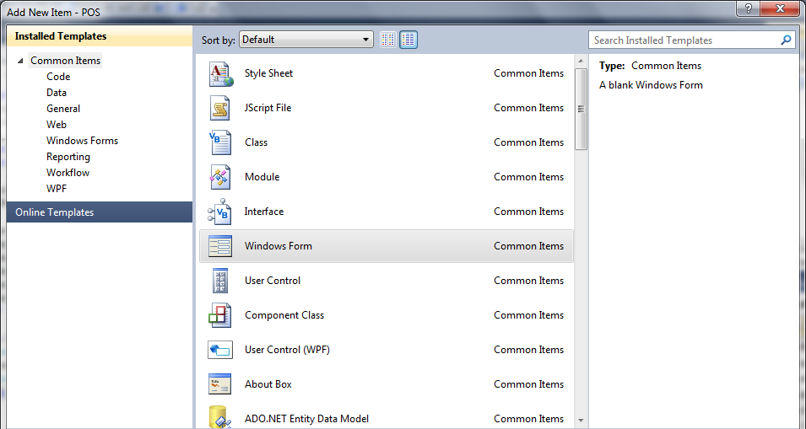
Reporting
Tambah form baru dengan nama frmLapJual.vb

Slide 3
Reporting
Tambah item baru Project > Add New Item,
Pilih Reporting > Report Wizard.
Beri nama RptJual.rdlc

Slide 4
Reporting

Slide 5
Reporting
Klik Next

Slide 6
Reporting

Slide 7
Reporting – Click and Drag
Klik itemnya, tahan dan
pindahkan ke Group
Klik Next

Slide 8
Reporting

Slide 9
Reporting
Uncheck semua pilihan
dan klik Next

Slide 10
Reporting
Pilihlah styles report yang anda suka
Dan klik Finish

Slide 11
Reporting – design results

Slide 12
Reporting
Tambahkan ReportViewer Control ke form FrmLapJual

Slide 13
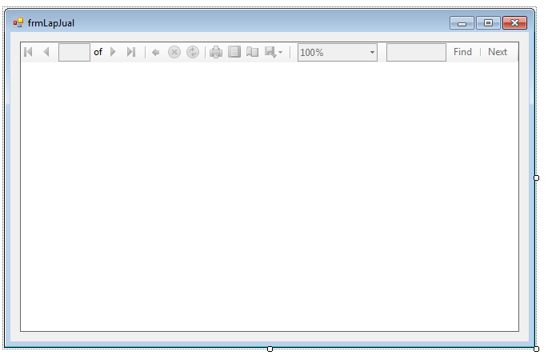
Reporting
Desain seperti tampilan berikut:

Slide 14
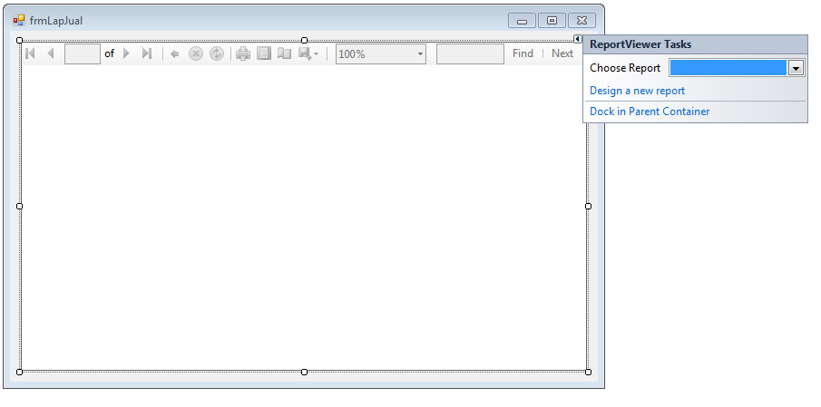
Reporting
Pilihlah report yang tadi anda buat sebelumnya (RptLapJual.rdlc).
Tekan F5

Slide 15
Reporting – Adding total
Click this

Slide 16
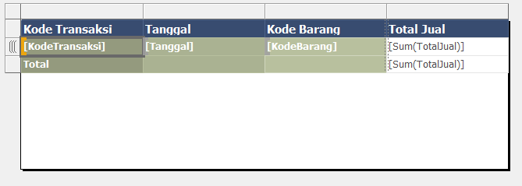
Reporting – Adding total

Slide 17
Reporting – Adding Page Heading
Click this

Slide 18
Reporting – Adding Page Heading
Click this
Klik dan pindahkan
ke area bawah

Slide 19
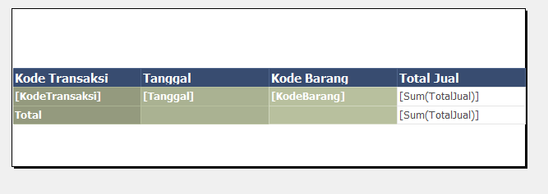
Reporting – Adding Page Heading

Slide 20
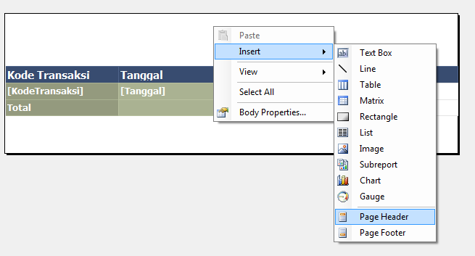
Reporting – Adding Page Heading
Right Click

Slide 21
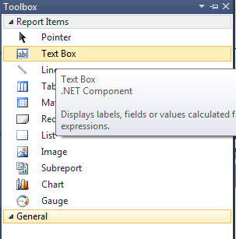
Reporting – Adding Page Heading
Tambahkan Textbox yang terdapat di toolbox ke dalam area page Header.

Slide 22
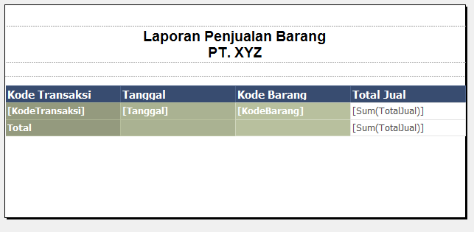
Reporting – Adding Page Heading
Desainlah seperti gambar berikut :

Slide 23
Next WEEK : .....?

